Slide 1
Community Wealth Building

Slide 2
Content
What is Community Wealth Building?
Anchor institutions
Plural ownership of the economy
Making financial power work for local places
Fair employment and just labour markets
Progressive procurement of goods and services
Socially just use of land and property
Challenges
Community Wealth Building works
It’s already happening in Scotland
Further opportunities

Slide 3
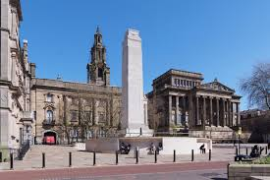
“Community wealth building is about creating a fairer, more socially just economy. It is practical action, framed by progressive concepts.”
Notes:
Community wealth building is an intentional reorganisation of the local economy in order to tackle the inequalities and disadvantages that experienced in communities across the UK. Through this approach, based on the relative power of local ‘anchor institutions’ local economies are reorganised, so that wealth is not extracted but broadly held and income is recirculated.
Community wealth building is about creating a fairer, more socially just economy. It recognises the failure of ‘trickle down economics’ to redistribute wealth. Instead of solely relying on redistributing some growth ‘after the fact’ of its creation, community wealth building seeks to restructure the composition of the economy itself, so that the production of wealth is focussed on community benefit by ensuring it is widely held, shared and democratised.
It is an approach developed in Cleveland Ohio which, in the UK, has been most notable adopted in Preston. Its ideas are being applied by a growing number of businesses, public and social sector organisations across the UK who are now driving a shift in economic development thinking.
The link takes you to a short video setting out simply what community wealth building is.

Slide 4
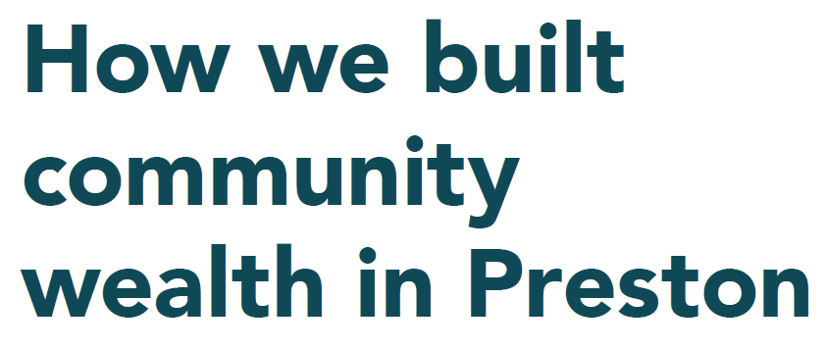
Community Wealth Building in the UK
Notes:
Ted Howard is a social entrepreneur and author from Cleveland, Ohio. He and his organisation “The Democracy Collaborative” he helped set up worker co-operatives to supply local institutions – such as hospitals, councils and universities – in order to keep profit localised. Redirecting local spending for community wealth through the use of worker co-operatives has now become known as “the Cleveland model”.
Preston Council believed they could also benefit from these ideas and has worked with the Centre for Local Economic Strategies (CLES), with input from the Democracy Collaborative over the last eight years.
CLES is a UK organisation looking to support the delivery of social justice through local economies. They are the ‘go to’ organisation for community wealth building information guidance and support.
Preston is recognised as one of the most improved localities in the UK and now more and more local areas are taking an interest in the approach.

Slide 5
Community Wealth Building in Scotland
Scottish Government
Scotland’s Centre for Regional Economic Growth (SCRIG)
Scottish Local Authorities Economic Development (SLAED)
Ayrshire Growth Deal
Notes:
The Scottish Government has made their policy position on Inclusive Growth clear and the First Minister had made her intentions around a wellbeing economy known.
Community wealth building is an approach that can support the delivery of these policy areas.
SLAED has convened a short-life working group to promote the approach amongst Local Authority Economic Development colleagues and has produced supporting materials (including this presentation).
Scotland’s Centre for Regional Economic Growth have supported an information session with a range of partners.
North Ayrshire council is developing a CWB approach and this has been augmented by the Ayrshire Growth Deal which has provided a £3M CWB fund for the Regional Economic Partnership to co-design an Ayrshire-wide approach with the Scottish Government. Recent analysis and action work by North Ayrshire Council, helped by CLES has heralded the start a programme of work, which seeks to influence not only the anchor organisations of North Ayrshire, but also the wider Ayrshire Growth Deal.

Slide 6
Video: What is Community
Wealth Building?
Notes:
Short video from CLES introducing the concept

Slide 7
Anchor Institutions
Large commercial, public and social sector organisations
Significant stake in a local place
Exert sizable influence to generate social value
Notes:
The community wealth building approach is built around the relative power of anchor organisations.
The term ‘anchor institutions’ is used to refer to organisations which have an important presence in a place, usually by virtue of being large scale employers, the largest purchasers of goods and services in the locality, overseeing large areas of land having relatively fixed assets.
The actions of anchor institutions are key to the delivery of the approach. These are large commercial, public and social sector organisations which have a significant stake in a place. Anchors can exert sizable influence by adopting these strategies to impact upon economic, social, and environmental priorities, generating what is commonly referred to as social value.
Examples include local authorities, NHS trusts and boards, universities, trade unions, large local businesses, housing associations and the combined activities of the community and voluntary sector.

Slide 8
What is Community Wealth Building?
Community wealth building makes wealth socially helpful by ensuring it is broadly held, owned and distributed
It delivers national and international benefits, including
Productivity benefits
Social benefits
Environmental benefits
Can work anywhere, but crucial in areas where the economy has been hollowed out through years of under investment
Whole systems approach to economic development geared to challenges of austerity, financialisation and automation
Notes:
Productivity benefits – contributing to national prosperity
Social benefits – bringing economic activity where it can produce the highest social return
Environmental benefits from shortening supply chains.
Financialisation is a process where the financial sector grows both in scale and complexity, becoming more important as a share of national output. Financialisation means lending and investing in financial assets for example in providing a wider range of ways in which households can take on more debt.

Slide 9
What is Community Wealth Building?
Notes:
Once anchor institutions have identified a desire, preferably in collaboration with local partners, the approach offer 5 pillars against which they can review existing practice then identify and prioritise local action.
Some areas focus on developing under one or two pillars, others might seek to deliver action against all five. It is for the local anchors to agree local action.
Some pillars have ideas which will be familiar and local authorities may already be delivering related actions.

Slide 10
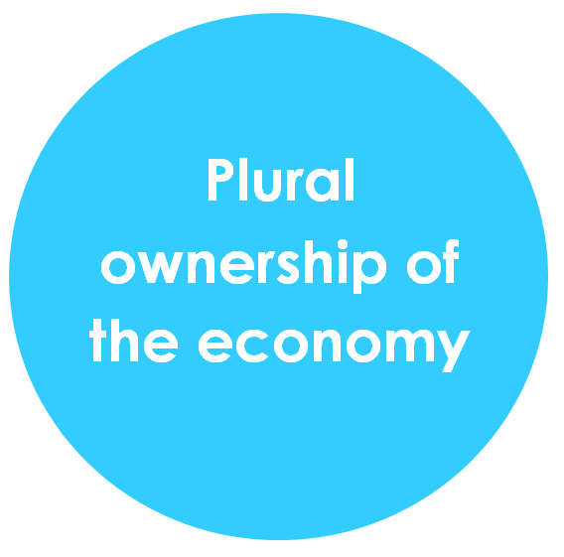
OWNERSHIP
OECD figures suggest that the UK has amongst the highest levels of income inequality in the European Union.
Financial wealth is held by a small minority - 44% of the UK’s wealth is owned by just 10% of its population, five times the total wealth held by the poorest half.
More than a fifth of the population live on an income below the poverty line, despite the majority of these households being in work
In response, community wealth building seeks to promote locally owned and socially minded enterprises. It also seeks to democratise the economy with greater local authority insourcing and development of municipal enterprise.
Notes:
Locally owned or socially minded enterprises are more likely to employ, buy and invest locally, thereby contributing to local economic and social development. In these instances, therefore, there is a higher propensity for wealth to be generative rather than extracted.

Slide 11
Public sector insourcing – report by the Association for Public Service Excellence (APSE), insourcing on the increase, increasingly viewed as a pragmatic means to address service improvement, service efficiency and to recalibrate local services to local needs.
Municipal enterprise – In Wrexham, the local authority has implemented a renewable energy scheme, which will rec=dcuce the amount of CO2 emitted by 3,000 tonnes a year and generate up to £1m a year in surplus income for the next 25 years.
Worker ownership – Preston City Council has led international innovation on the democratisation of the economy, working with UCLAN, local people and organisations to develop a healthy co-operative sector.
Community ownership – Granby 4 Streets is a community land trust which provides affordable ownership and rental property for residents in Toxteth, South Liverpool.

Slide 12
LOCAL INVESTMENT
The UK banking sector is orientated towards global markets rather than local investment and economic development
There has been stagnation of lending to small businesses and the closing of many local branches, reducing the connection between lenders, their local communities and personal banking services
Access to credit is needed for small businesses to operate
Community wealth building seeks to increase flows of investment within local economies. It does this by harnessing the wealth that exists locally - to channel investment to local communities while still delivering a steady and reasonable financial return for investors

Slide 13
Making financial power work for local places examples of practice
The use of local pension funds to support local investment priorities - Preston City Council has already taken steps to ensure that its large public pension investments are utilised for social good, using this money to fund housing development in the city centre. In 2017, Islington Council set about reducing its pension fund’s exposure to carbon. It is also investigating how it might support social impact investment, specifically social housing.
Support for local credit unions and the provision of loans to community groups – local government in particular is able to support credit unions in the form of grants or guarantees as well as depositing funds with credit unions that would otherwise be invested with banks.

Slide 14
FAIR EMPLOYMENT
Continuing stagnation of real wages, the erosion of job security, the rise of zero-hour contracts and job loss driven by automation, mean that the reality of employment for many in the UK is increasingly precarious
Many people working in full time jobs are unable to make ends meet. In 2018, the Joseph Rowntree Foundation calculated that the number of workers in poverty was 4 million, meaning that about one in eight people are now classed as working poor
Community wealth building not only aims to improve employment opportunities but wider employment terms and conditions and worker rights - for example, by promoting recruitment from lower income areas, inclusive employment practices, committing employers to paying the Living Wage and by building progression routes for employees.
Notes:
Often the biggest employers in a place, the approach anchor institutions take to employment can have a defining effect on the prospects and incomes of local people. Working with human resource departments within anchor institutions to stimulate the local economy through progressive employment and local labour market activities has proved a powerful tool. Instances of this are occurring across the local government, health and higher education sectors.

Slide 15
Fair employment and just labour markets examples of practice
The real Living Wage - many anchor institutions are now real Living Wage employers, paying a minimum of £9 per hour in the UK and £10.55 per hour in London.
Inclusive employment programmes - numerous anchor institutions have adopted inclusive employment programmes to attract those furthest from the labour market into employment. Leeds Teaching Hospital NHS Trust, run a programme with other local partners to build the confidence of the long term unemployed. They also have a particular focus on promoting careers to young people in the local area, have established a number of health career ambassadors and have a cohort of staff who go into schools in areas of high deprivation

Slide 16
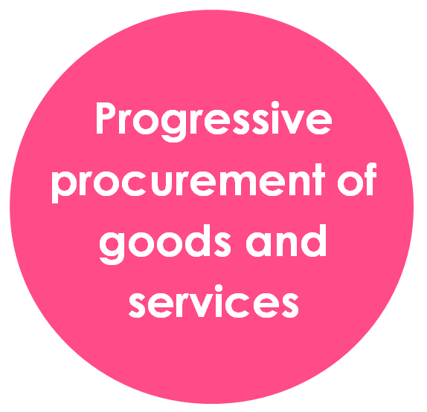
PROCUREMENT
When it comes to how money is spent and how services are commissioned by anchor institutions, cost is often the dominant determining factor in who gets the contract. Social value tends to be a weaker consideration.
Community wealth building promotes the progressive procurement of goods and services, as this spending power can be a means through which greater economic, social and environmental benefits can be achieved.
Notes:
By adapting their procurement processes and decision making, anchor institutions can create dense local supply chains and ecosystems of local enterprises, SMEs, employee owned businesses, social enterprises, cooperatives and other forms of community ownership. This is important because these types of businesses are more likely to support local employment and have a greater tendency to recirculate wealth and surplus locally and help to reduce carbon footprint.

Slide 17
Local spending - Preston’s efforts to localise social value impact has brought millions of pounds back into the local economy. The recirculation of over £200m being spent with local suppliers as a result of the changes in procurement behaviour across anchor institutions has had a positive multiplier effect on local jobs, wellbeing, health, and economic growth.
Social value frameworks - the adoption of a robust social value framework by Manchester City Council, who consistently use 20% social value weighting in their tendering process, has produced significant social and economic impacts. These include creating jobs for the long term unemployed and persons with learning disabilities, as well as support for the third and community sector.

Slide 18
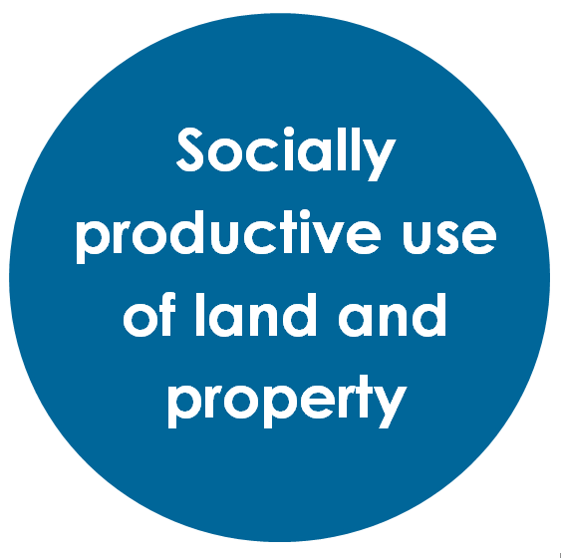
ASSETS
How land and property assets are owned and managed are key features of any local economy. Land ownership matters because it is an expression of economic and political power
The current state of landownership is a major driver of inequality, as a few private owners benefit from speculation on property markets whilst the majority suffer the consequences of unaffordable house prices
In the past anchors would act to ensure that publicly owned land secured benefits for the local community, for example municipal town halls and local parks
In recent decades over 2 million hectares of public land has been sold off to private interests
Through a community wealth building approach, assets are owned and managed in ways which ensure that they generate wealth for local citizens, as opposed to being enclosed by private interests.
Notes:
These trends have been exacerbated by conditions of austerity, with local authorities especially under pressure to sell off land and property assets rather than investing in their social, economic, and environmental value for the local community.
The goal here is not simply for a local authority or anchor institution to ‘own more land’, but instead to ensure that the land they do own is run by and for the people. This can be understood through the concept of ‘the commons’- the idea that the land held by public institutions is owned by all of us, together. To achieve this, public land owners should develop governance and management structures where communities can take direct control of common assets.
By advancing a ‘commons’ approach to public land and assets, anchors can ensure that our shared buildings, parks, and other land holdings help to create good local economies, ensure sensible environmental stewardship, and advance social justice.

Slide 19
Community asset transfers – as part of developing the relationship with the community, the transfer of management/and or ownership of land or buildings from public bodies to the 3rd sector is becoming more and more prevalent. It is an approach that Wigan have utilised extensively as part of the Wigan Deal, which has led to numerous former Council-owned buildings being transferred to community organisations to provide services such as sporting facilities, allotments and libraries.
Using land to support the local community – this is an approach that is currently being utilised by University Hospitals Birmingham NHS Foundation Trust who regularly allow local community groups and charities to make use of their buildings and facilities for free, giving over their conference centre to let local charities run annual conferences for example. They also run a local farmers market on their land which is specifically targeted at micro enterprise within a 30-mile radius
Socially just use of land and property examples of practice

Slide 20
Challenges
The continued dominance of our current economic model
Policy obstacles
A lack of strong drivers to encourage community wealth building
Notes:
The continued dominance of our current economic model – even inclusive growth is limited as a conceptual and practical frame – CLES argues that it is about ‘after the fact’ economic development centred around the fruits of growth – no matter how extractive the ownership of production may be. Inclusive growth is strong on competitiveness and inward investment, but weak on tackling inequality and poverty. It perpetuates a focus on growth, GDP and other traditional measurements of economic success. CLES calls for an inclusive economy approach – an approach to economic development focussed on social goals, environmental sustainability and economic prosperity for all.
Policy obstacles include commercialisation across local government, health and higher education – commissioning has been reduce to competitive tendering, with a focus on ‘value for money’ and driving down costs. This is a barrier to using supply chains as a means of rooting wealth within local communities. Centralised procurement systems don’t appear to include social value considerations.
A lack of strong drivers to encourage community wealth building - in England the Social value Act 2012 has become a tick box exercise in many organisations.

Slide 21
Community wealth building…
…works – the success in Preston presents a proof of concept. By modelling methods of economic development which are founded on harnessing the collective power of public institutions rather than relying on inward corporate investment, Preston has demonstrated that reliance on external investment is no longer the only way
…is the work of many hands – it succeeds when it is a shared endeavour involving many individuals across many organisations
…must be unique to place – creating a bespoke local approach, based on an assessment of local need to identify the unique local circumstances, and working in ways that are most appropriate for local conditions
…is about public service – collaboration across anchor institutions in a locality to produce positive outcomes

Slide 22
Community wealth building…
…means a diversity of suppliers – progressive procurement work can increase competition, allowing a plurality of providers, including but not limited to local suppliers, to compete and bid. It demands a careful balancing of geographical, social, environmental and other factors.
…tells a story that people want to hear – interest in the ‘Preston Model’ demonstrates a demand for innovative new ideas
…is not a ‘model’ it is an inspiration – it should never be a one size fits all policy prescription
…is both a policy approach and a way of working – it is relatively easy for an anchor institution to adopt the five principles of community wealth building as an economic policy, but to animate that policy with other anchor organisations within a place and then to affect a change in business operations takes focus, effort and time

Slide 23
It’s already happening in Scotland
Councils as employers, contributing to fair employment and just labour markets - Councils are major employers employing 10%+ of the resident employment base in 1/3rd of councils
Councils as procurers, contributing to the progressive procurement of goods and services - Councils spend a substantial part of their procurement budget within their localities. Local spend as a share of total procurement spend varies significantly across councils depending on their local circumstances, the Procurement Reform (Scotland) Act 2014 creates opportunities to develop progressive procurement
Councils as asset managers, contributing to socially productive use of land and property - Some 40,000 assets are managed by Scotland’s local authorities, including a wide range of land, buildings and infrastructure, there is evidence of a general direction of travel towards a corporate asset management approach linked to social and economic outcomes, at all levels from strategic to local.

Slide 24
It’s already happening in Scotland
North Ayrshire Council are Scotland’s first Community Wealth Building Council.
They have established a CWB Commission and published their Community Wealth Building Strategy
The Ayrshire Growth Deal Heads of Terms includes a £3million CWB Fund
Notes:
Tied into the Ayrshire Growth Deal and all projects should follow the principles of CWB
CLES have carried out a diagnostic for NAC and there are a range of recommendations
Work with anchors in the CPP to explore procurement spend.
Deeper market engagement before commissioning.
Push anchors to review workforce policy and planning.
Develop business citizenship through a charter or pledge.
Use council and other anchor assets to develop a ‘deep town approach’ within a locality.
There is representation from, and engagement with, Community Planning Partners

Slide 25
Other councils and City Deals
Tay Cities Growth Deal
Western Isles
Clackmannanshire
One of Glasgow City Regional authorities
South of Scotland Enterprise
Notes:
CLES/Scottish Government working with these areas to pilot approaches to CWB. Clacks are developing wellbeing economy approach.
Western Isles as a distinct economy.
Tay Cities to explore how growth deals can take a CWB approach.

Slide 26
Further opportunities
Positive targeting of recruitment / work experience, etc within disadvantaged areas / groups through local government and community planning partners
Whilst there is little growth demand in LG employment, replacement demand and future workforce planning provides an opportunity for tackling poverty via recruiting from disadvantaged areas
Better Economic Development - Procurement collaboration
More strategic / collaborative / aspirational / imaginative approaches to Community Benefits
Targeted local procurement alongside supplier development programmes
Data improvements to measure local procurement
Notes:
There are further examples of potential activity in the report which went to the SLAED Executive Group in September 2019 which can be accessed on the SLAED Khub.

Slide 27
Further opportunities
Asset management could help with holistically developing the place agenda
More explicit linkage could be made of assets with economic development priorities – e.g. encouraging footfall that promotes commercial sustainability in declining town centres
There are opportunities to evolve the asset portfolio to ensure accessibility for disadvantaged populations via physical location and/or transport links
Co-location opportunities across CPPs could help with the management of assets and access to those assets
Community asset transfer can be further developed to promote community ownership and further local wealth building
Co-ordination and cross departmental working between procurement, asset management and economic development teams is required to maximise opportunities in regard to community wealth building.

Slide 28
Useful links
www.cles.org.uk
SLAED Khub

