Slide 1

Place, Place-Based Approach​es and the Shaping Places for Wellbeing Approach
Masterclass
Irene Beautyman
Place and Wellbeing Partnership Lead
Improvement Service & Public Health Scotland

Slide 2
Place, place-based approaches and the Shaping Places for Wellbeing approach
✔️What we mean by place and why it matters
✔️What taking a place-based approach means
✔️Shaping Places for Wellbeing Programme

Slide 3
We have evaluated the link between the activities we have delivered and the outcomes we want to achieve. These are the causes of change.
Change is more likely when people:
Have a foundational and mutual understanding of 'place', and the relationship to health and inequality.
Understand the aims and offer of the Shaping Places for Wellbeing Programme and our place-based approach.
Believe the Shaping Places for Wellbeing approach will add value to their current work.
Hold realistic expectations about the Programme’s place-based approach and systems change.

Slide 4
Who?
Public Health Scotland
v
v
NHS Boards
Impacts on strategic decision-making
Improvement Service
Health and social Care Partnerships
Strategic decision-making impacts on a place
v
Local Authorities
Third Sector
Impacts on a place
Communities
Other statutory Authorities
Private sector
Scottish Government

Slide 5
Place
✔️What we mean by place and why it matters
✔️What taking a place-based approach means
✔️Shaping Places for Wellbeing Programme

Slide 6

What’s happening to Scottish people?
The number of people dying early is increasing.
Levels of ill health are forecast to increase by 21% over next 20 years
People are spending more of their life in ill health.
The gap in life expectancy between the poorest and the wealthiest is growing.

Slide 7
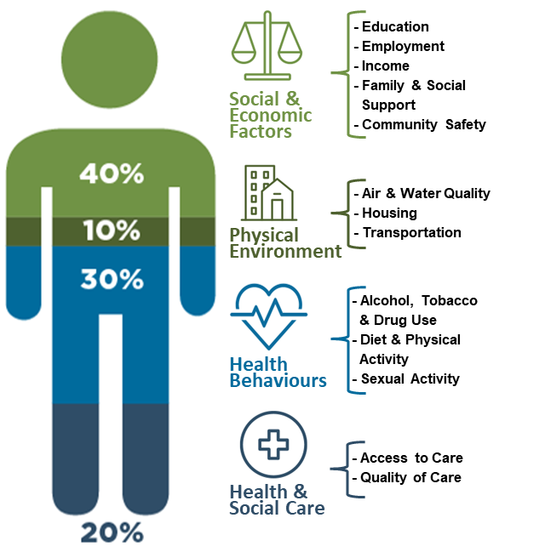
How can we stop this happening to Scottish people?​​
20%

Slide 8
How can we stop this happening to Scottish people?​​
20%

Slide 9

Leave no-one behind
The state of health and health inequalities in Scotland
We do not need another grand strategy.
We need practical collaboration, up and downstream, to sweat the considerable assets we already have – public, third and private sectors, collaborating with communities. Each of us has our part to play.
Joined up, long term use of resources
Coherence across policy streams
Cross sector work and with communities
Adopt successes at scale

Slide 10
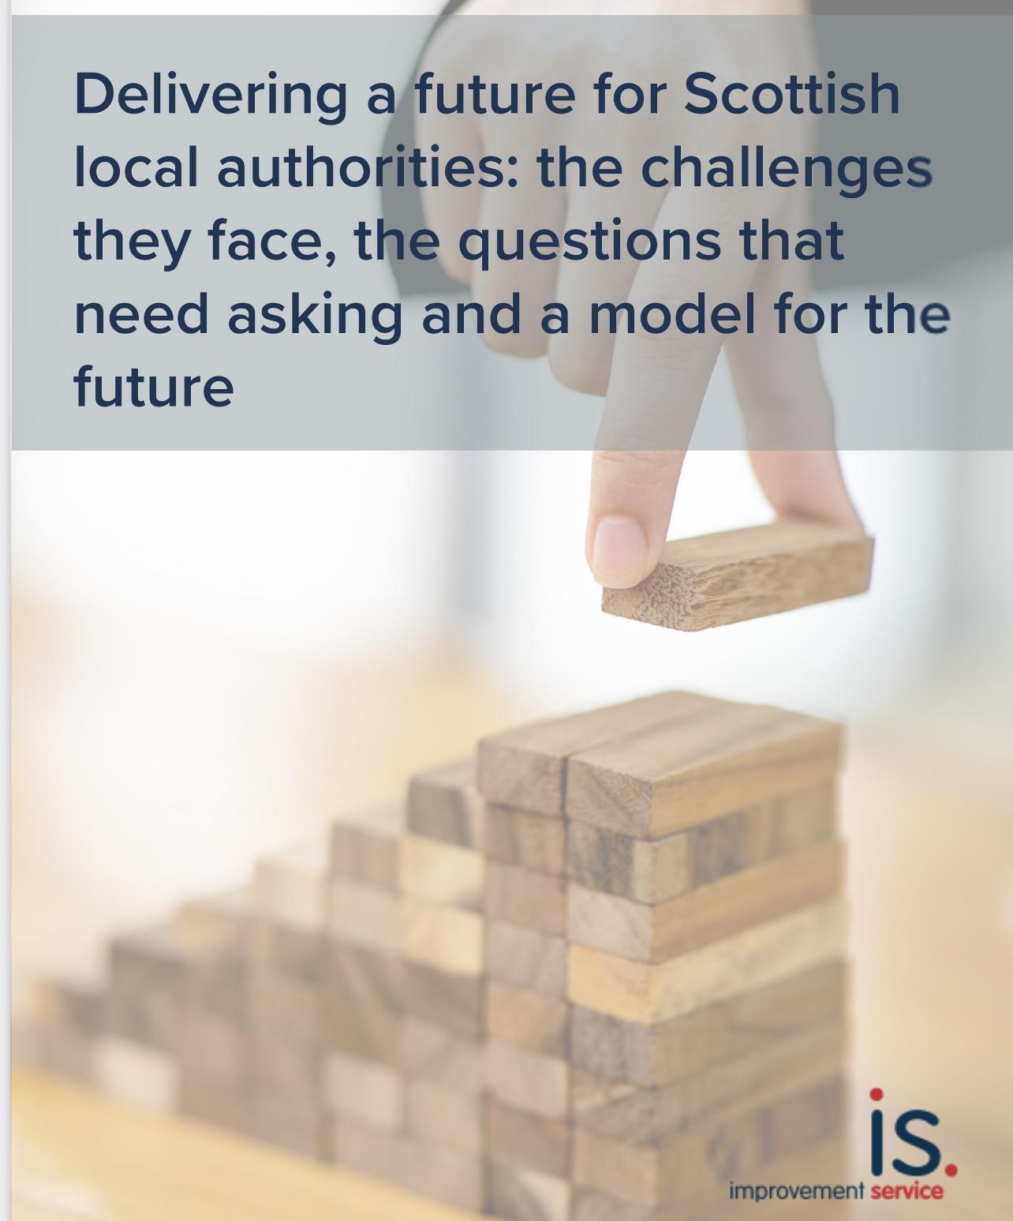
Delivering a future for Scottish local authorities
Unlock community action
Six core anchors that underpin the role of the local government sector of the future:
Partnerships and outcomes
Local and central government relationships
Understand people's needs
Data informed decisions
Intensive support on inequalities

Slide 11






National Planning Framework 4 NEW outcomes are
Meeting the housing needs of people living in Scotland including, in particular, the housing needs for older people and disabled people,
Improving the health and wellbeing of people living in Scotland,
Increasing the population of rural areas of Scotland,
Improving equality and eliminating discrimination,
Meeting any targets relating to the reduction of emissions of greenhouse gases, within the meaning of the Climate Change (Scotland) Act 2009, contained in or set by virtue of that Act, and
Securing positive effects for biodiversity

Slide 12
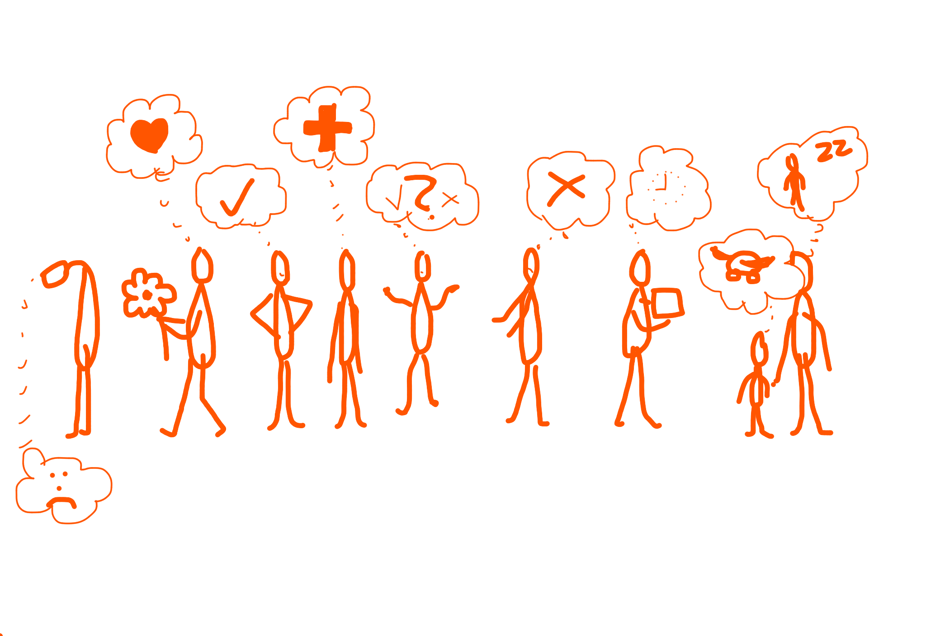
The purpose of the planning system is to manage the development and use of land in the long-term public interest

Slide 13
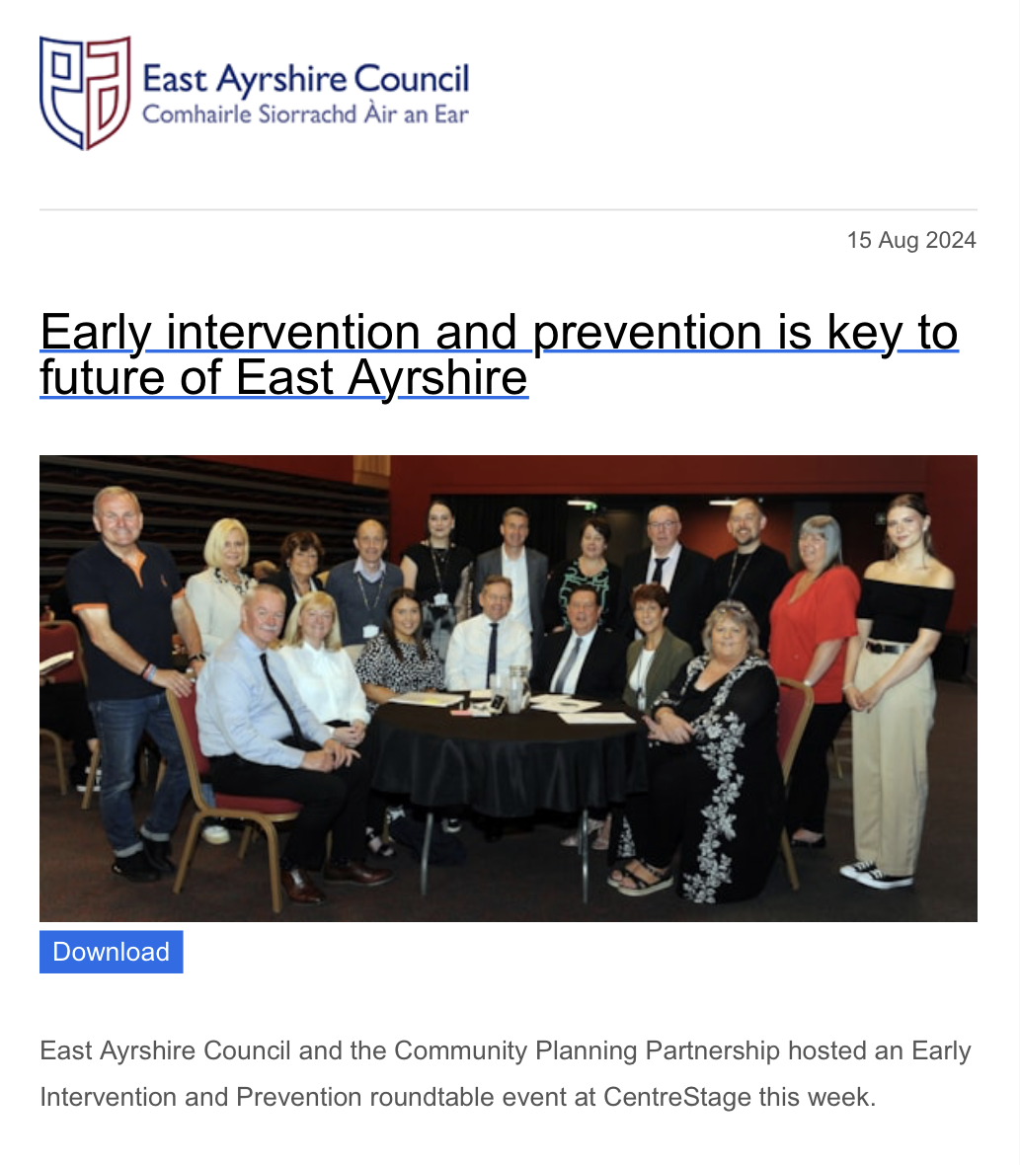
Why take a place-based approach?

Slide 14
Why take a place-based approach?
Prevention
Leader of the Council, Councillor Douglas Reid
“thinking differently about public services to help reduce demand and tackle the significant challenges we face, which includes our ageing population and increasing demand for services at a time of reduced funding and budget cuts.”

Slide 15
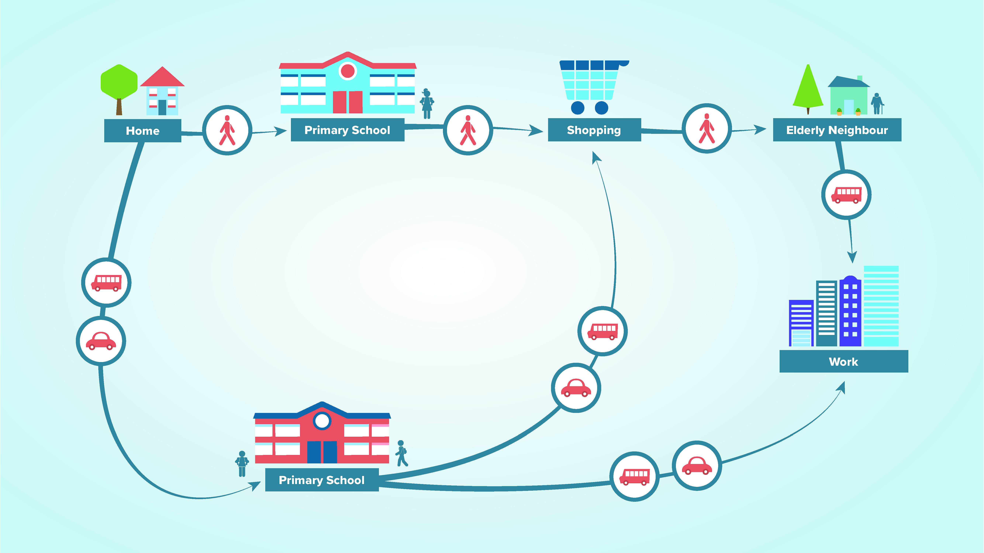
New Primary School Location
How do the decisions made about the places we live and work bring benefits for health and wellbeing, for the climate, and for reducing inequalities?

Slide 16
Local school enables and enhances:
Two care roles AND work
Age in place
Complex journeys with less stress
Physical activity, mental health and cognitive skills
Community cohesion
Local business viability
20% reduction in car kilometres by 2030
Air quality
Connections for the half of deprived households with no car
Not needing a car can reduce in-work poverty

Slide 17
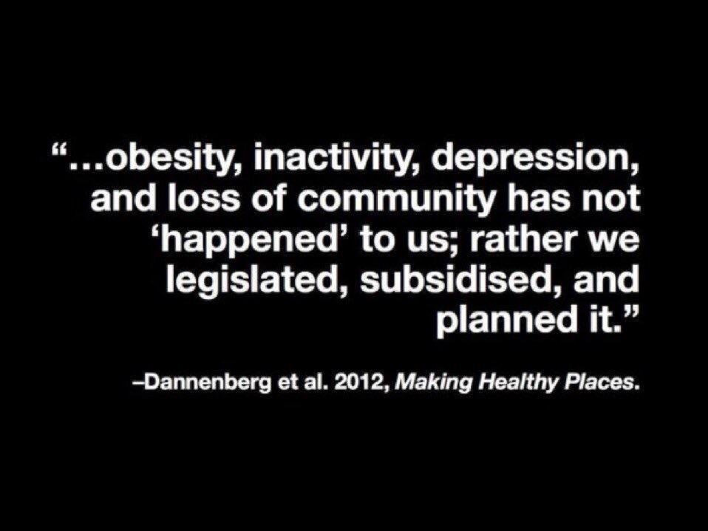

Slide 18


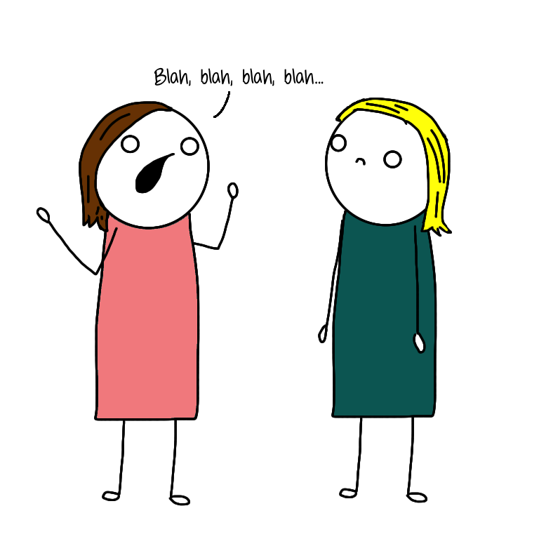

We ALL create places that have a positive or negative impact on wellbeing and inequality

Slide 19
Place-based approaches
✔️What we mean by place and why it matters
✔️What taking a place-based approach means
✔️Shaping Places for Wellbeing Programme

Slide 20



Key parts to a place-based approach
PEOPLE
What they are experiencing
PLACE
ALL the features that have a positive impact
DECISIONS
How they impact people and place

Slide 21


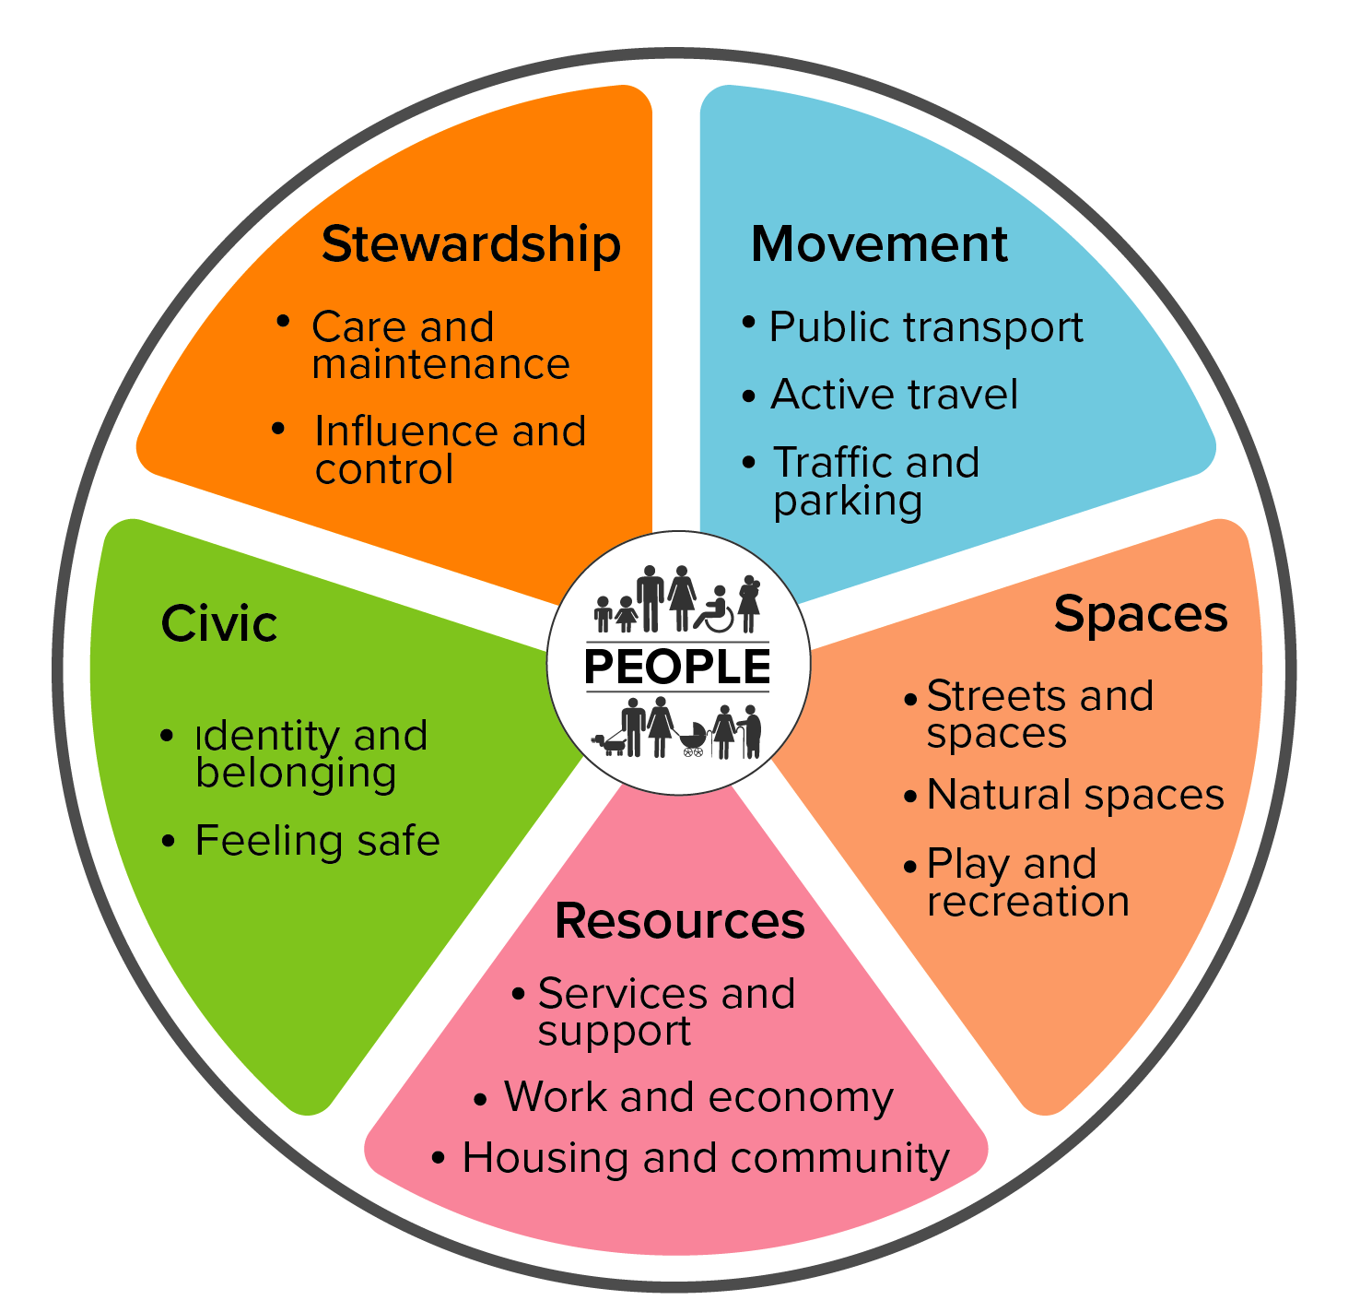
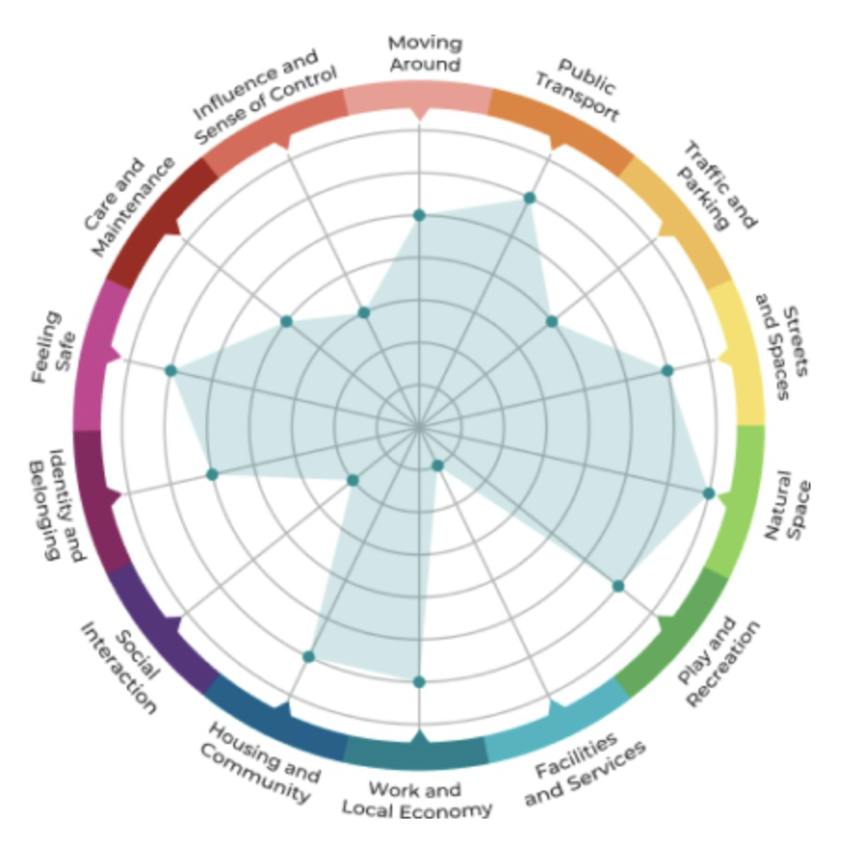
Take a place-based approach
PEOPLE
Inequality they are experiencing
Inequality data
Quantitative
Qualitative
PLACE
All the features that have a positive impact
Place and Wellbeing Outcomes
DECISIONS
How they impact people and place
Place & Wellbeing Assessments
Briefing Papers
Leadership & governance

Slide 22




Place and Wellbeing Collaborative
Improvement Service
Public Health Scotland
Directors of Public Health
COSLA
Heads of Planning Scotland
Health Improvement Managers
'A shared ambition to improve the places where we live, work and relax in.'

Slide 23
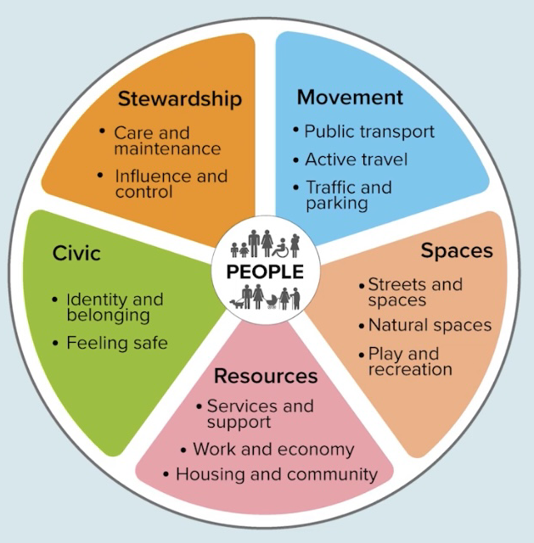
The evidenced and preventative features every place needs to enable:
Place and Wellbeing Outcomes
wellbeing of people
equality
net-zero emissions and sustainability.
TRIPLE WIN!
Notes:
https://www.improvementservice.org.uk/products-and-services/consultancy-and-support/planning-for-place-programme/place-and-wellbeing-outcomes
Intro to the Place and Wellbeing Outcomes

Slide 24
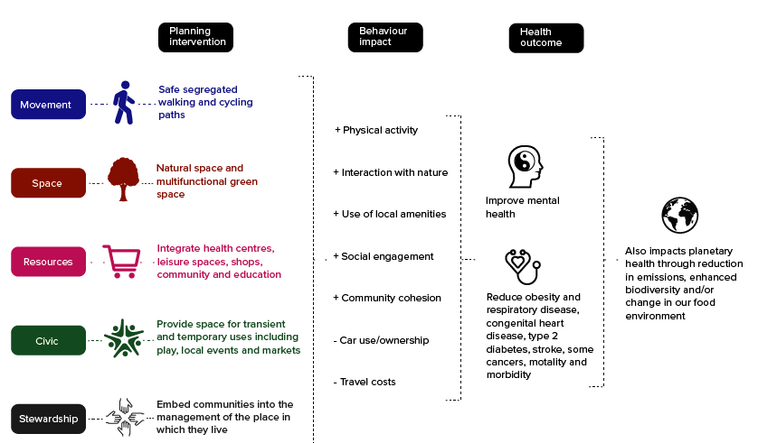
How do the Place and Wellbeing Outcome themes work in real life?

Slide 25
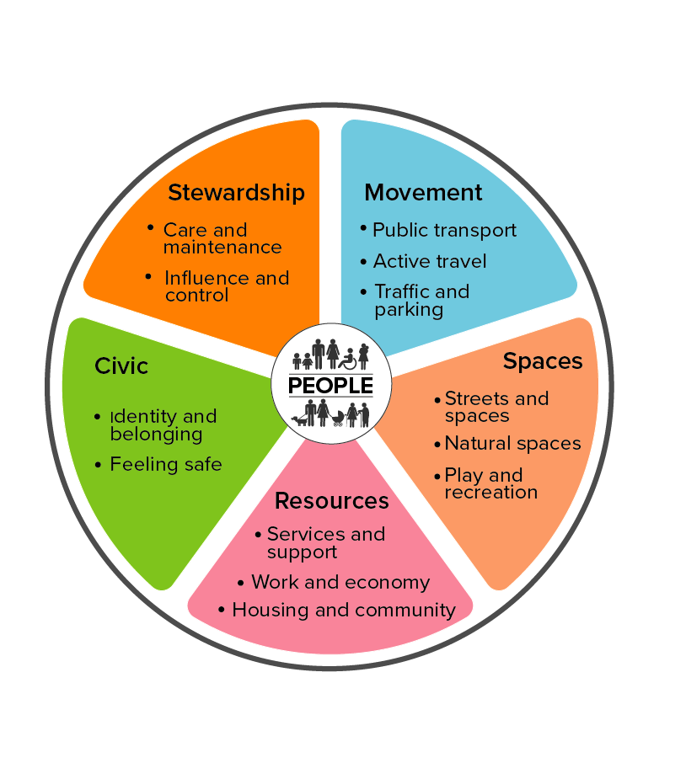
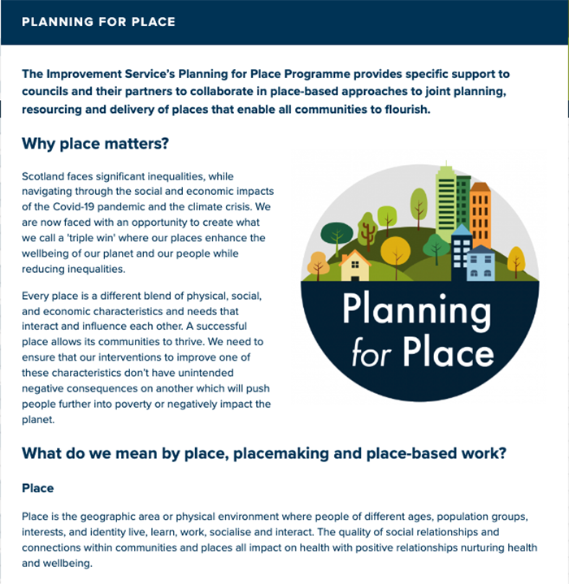
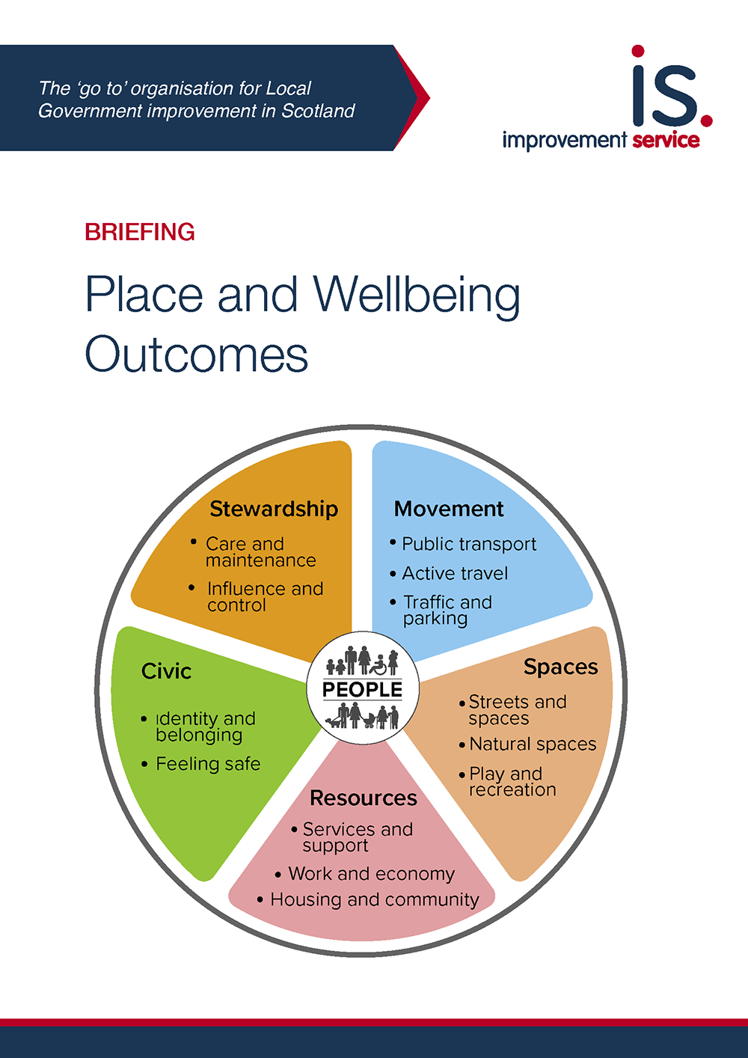
Place and Wellbeing Outcomes

Slide 26
Place and Wellbeing Outcomes
Sustainable Development Goals (SDG)
National Outcomes Framework
Covid Recovery Strategy
Key policy
Public Health Priorities
Net zero emissions targets
A New Future for Scotland’s Towns
20 minute neighbourhoods
Christie Commission
Place Principle
Social Determinants of Health
Place & Wellbeing Outcomes
Key approaches

Slide 27
Shaping Places for Wellbeing approach
✔️What we mean by place and why it matters
✔️What taking a place-based approach means
✔️Shaping Places for Wellbeing Programme

Slide 28
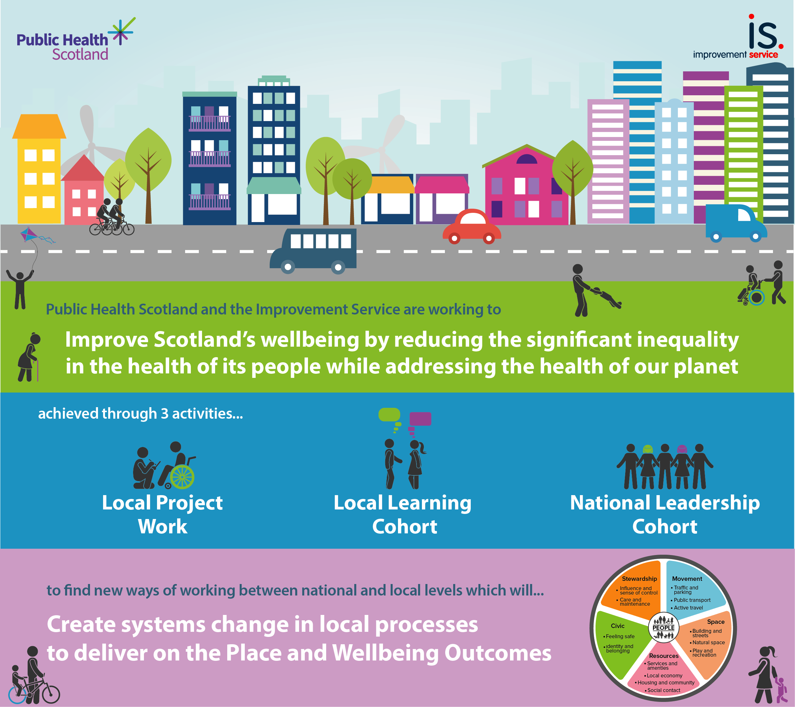
Notes:
Slide summarising the programme activity

Slide 29
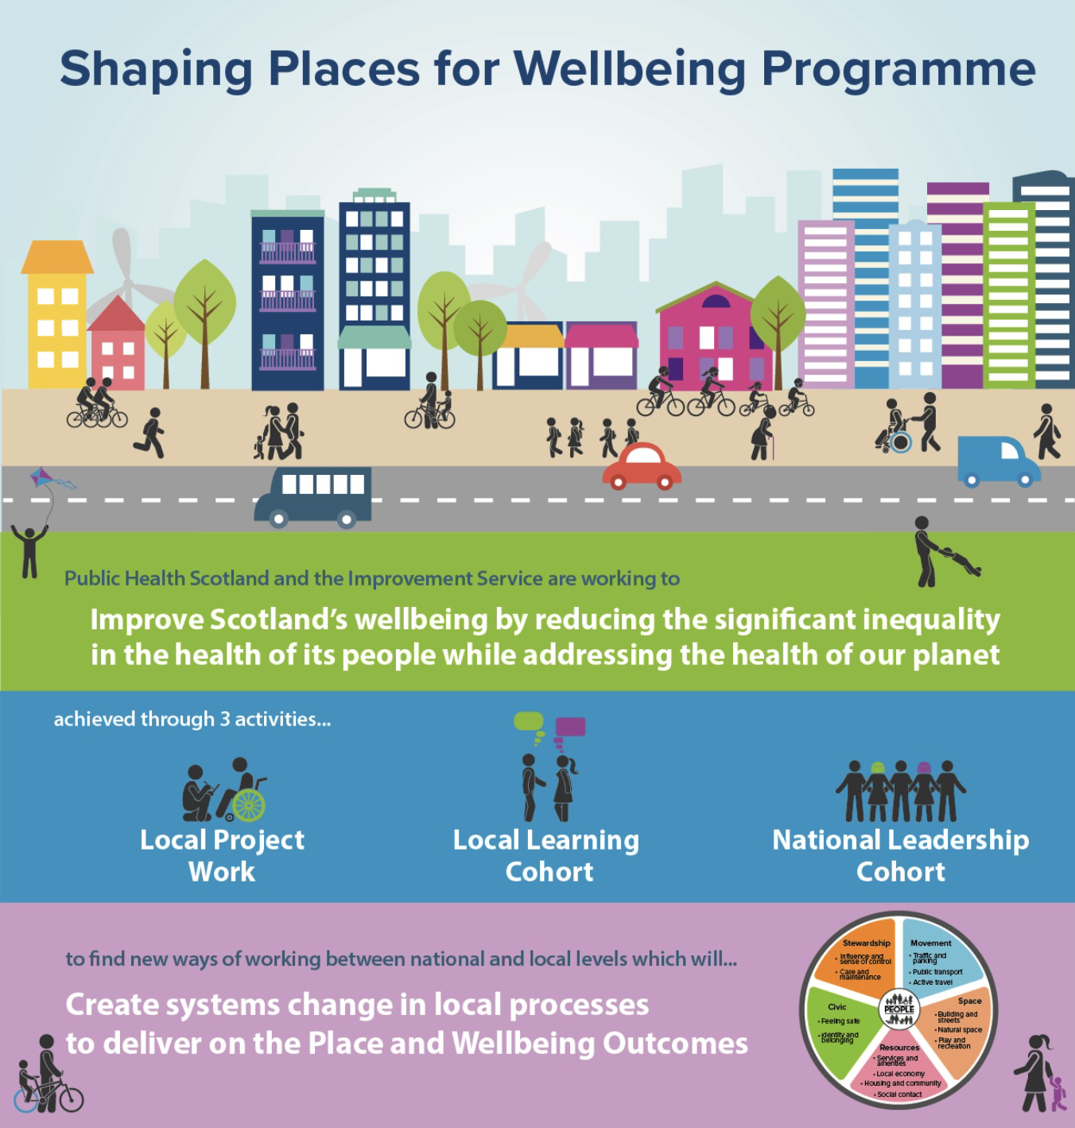
Three activities:
Council and NHS Board in Project Towns:
Alloa
Ayr
Clydebank
Dalkeith
Dunoon
Fraserburgh
Rutherglen
Replication
Reflection, learning, sharing between Project Towns
All Towns Steering Groups
“How to” Guides enable replication
Confidence
Causes of change
Representatives from:
Scottish Govt Directorates
All COSLA Boards
Public Health Scotland
Improvement Service
Health Foundation
Notes:
Use these slides to what suits you presentation – don't need to include them all

Slide 30
Shaping Places for Wellbeing approach
PEOPLE
Inequality they are experiencing
Inequality data
Quantitative
Qualitative
PLACE
All the features that have a positive impact
Place and Wellbeing Outcomes
DECISIONS
How they impact people and place
Place & Wellbeing Assessments
Briefing Papers
Leadership & governance

Slide 31


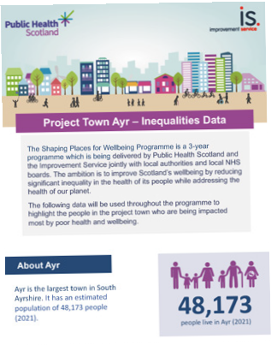
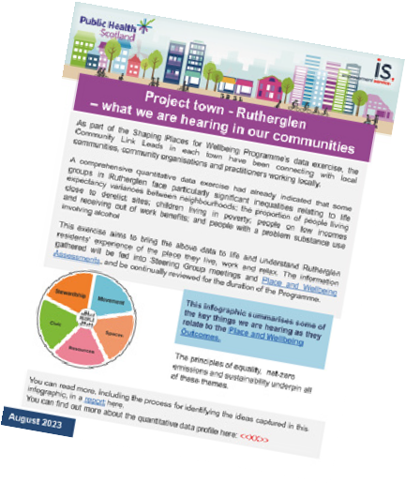
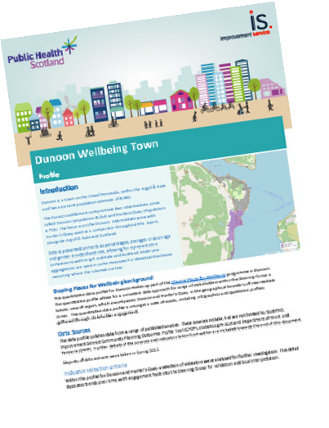


People: Data Led
PHS/Quantitative Data Profile
Quantitative Data Infographic
Community Link Lead/Qualitative Report
Community Link
Lead Visual Summary of Key Insights
Produced by Public Health Scotland’s Local Intelligence Support (LIST) team
Reviewed by the Steering Group
‘Sense checked with local stakeholders
Highlighted key areas of inequality
‘Sense checked’ key areas of inequality
Identified additional inequalities
Identified opportunities
for collaboration and communication
Summarised perceptions of inequality
Mapped links with Place and Wellbeing OUtcomes
Identified shared learning across
towns
Used insight to inform data led decision making
Place and Wellbeing Assessments
Outcome Improvement Plan
Local Place Plan
Area Plans

Slide 32
Place: what we need to get right in every place
Using the Place and Wellbeing Outcomes

Slide 33
Decisions: Place and Wellbeing Assessments
Strategies, plans and proposals
What could be done to improve its impact on place and, thus, wellbeing?
How does the plan, policy or decision impact on each of the features we need to get right in a place?
How does it impact on those population groups most impacted by inequalities?

Slide 34
Decisions: Place and Wellbeing Assessments
Year | Alloa​ | ​Ayr ​ | Clydebank​ | Dalkeith | Dunoon​ | Fraserburgh | Rutherglen​
2022 (9) | Draft Interim Climate Change Strategy​ Wellbeing Hub Location NHS Forth Valley Healthcare Strategy 2016-2021 | Wallacetown Housing Regeneration​ Sustainable Development & Climate Change Strategy Review​ | Implementation of the Clydebank Town Centre Development Framework ​ West Dunbartonshire Health Social Care Partnership Strategic Plan​ |  | Western Seaboard Marine Gateways, Dunoon Waterfront proposal, submitted as part of the UK Levelling Up Fund application |  | South Lanarkshire Economic Strategy ​
2023 (20) | Local Development Plan Vision and Strategic Objectives Local Outcome Improvement Plan Interim Climate Change Strategy – 2023 | Local Housing Strategy Accessible Ayr | Green Travel Plan Safe Delivery Improvement Group Strategy (Community Planning Partnership) | Single Midlothian Plan Dalkeith Regeneration Development Framework Central Dalkeith & Woodburn Community Action Plan | Argyll and Bute Health & Social Care Partnership Strategic Plan​ Local Police Plan Argyll and Bute Economic Strategy Active Travel Hub | Beachfront Masterplan Aberdeenshire Health & Social Care Partnership Strategic Plan Fraserburgh merging schools project | ​Rutherglen Town Centre Action Plan Burnhill Neighbourhood Plan South Lanarkshire Local Development Plan 2
2024 (2) | Wellbeing Hub 2 |  |  | Midlothian Integration Joint Board Strategic Commissioning Plan 2025 to 2040 |  | Clatt School

Slide 35
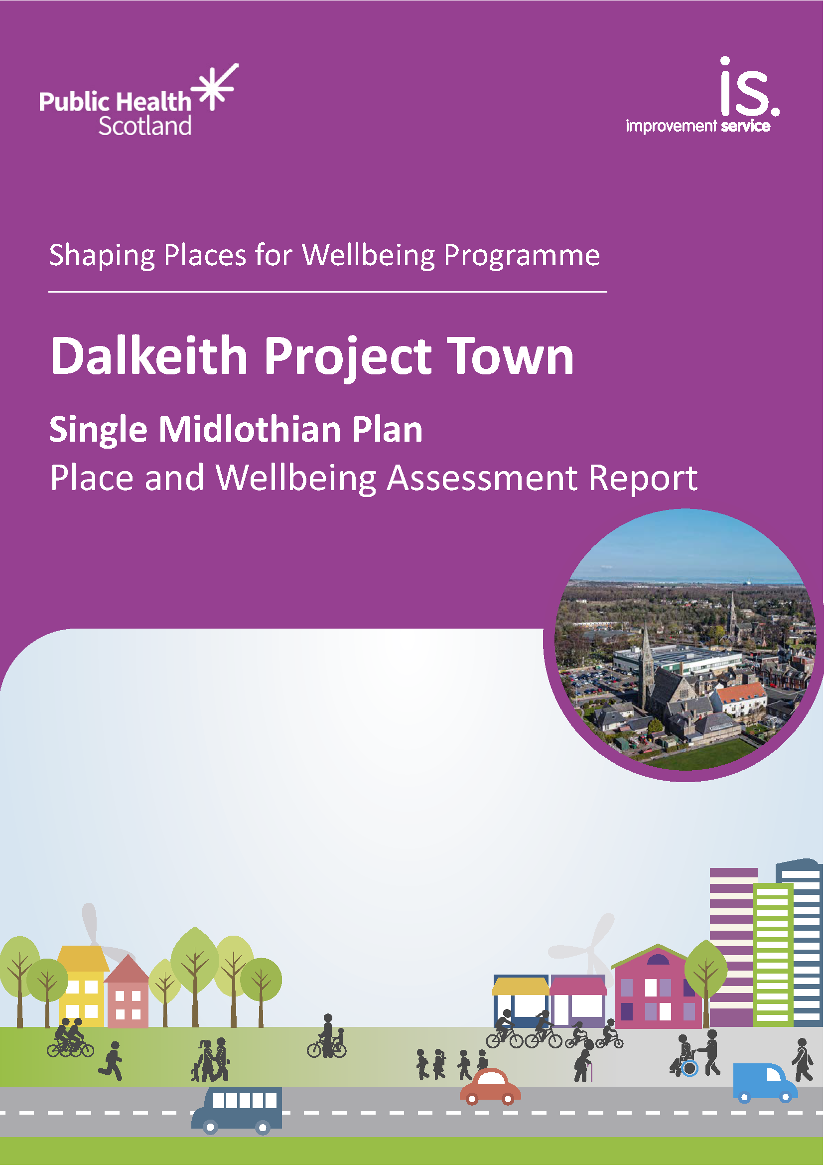
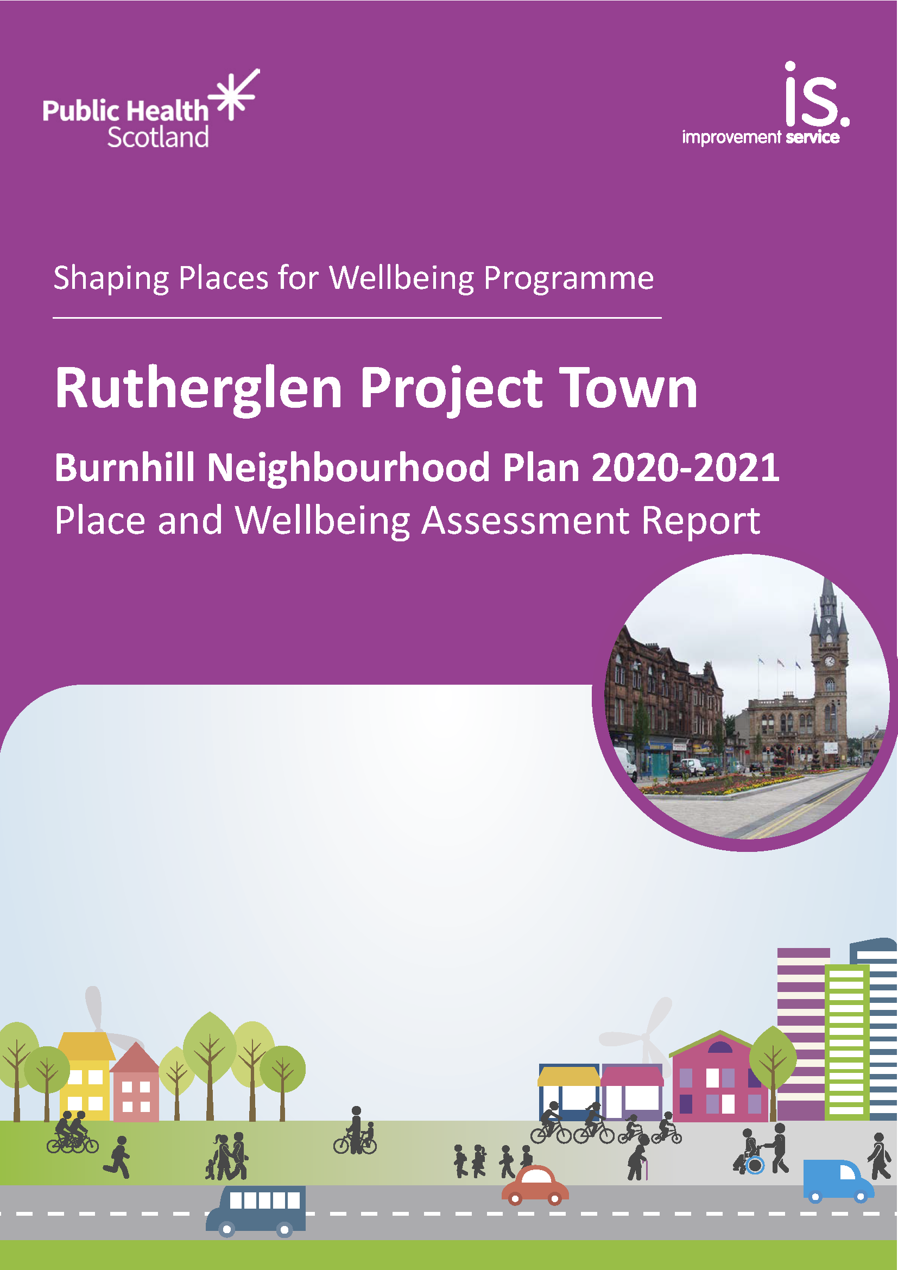
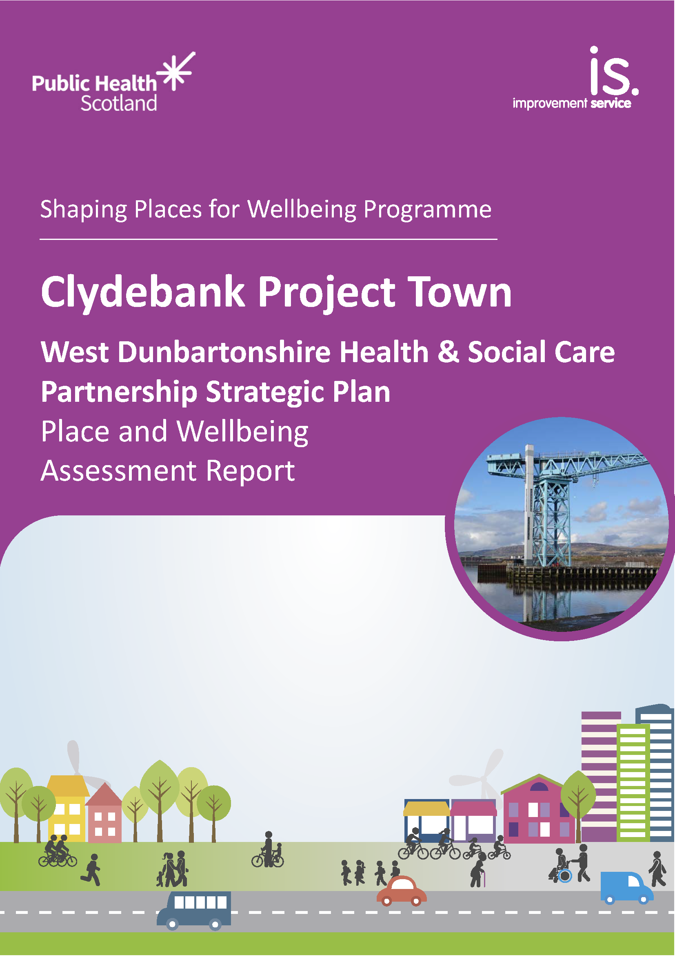
Decisions: Place and Wellbeing Assessments
31 Place and Wellbeing Assessments have now been completed and all reports can be found on the website
They range in their coverage from high level policy at regional level to more specific proposals at a local scale.
A 'How to Guide' has been produced

Slide 36
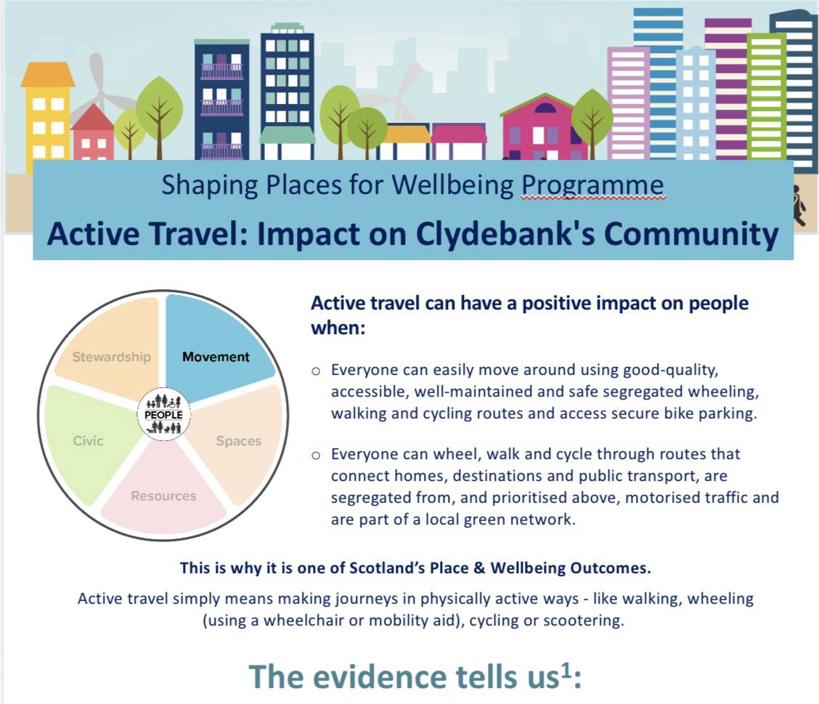
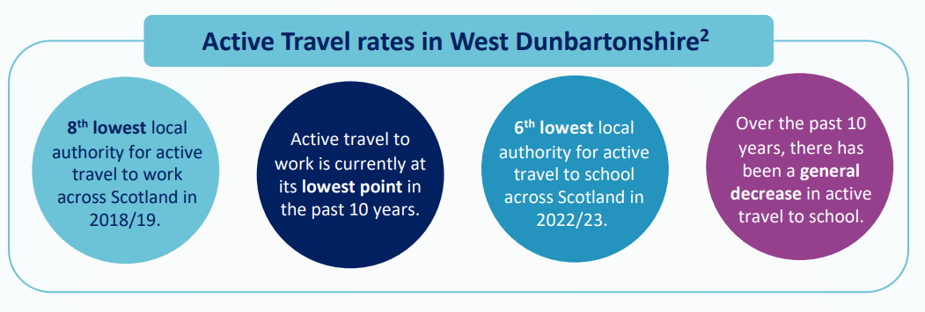
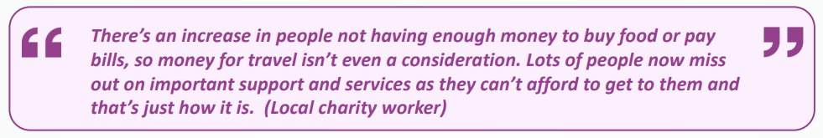
Place: what we need to get right in every place
Place and Wellbeing Outcome Briefings

Slide 37
Impact and shared learning

Slide 38
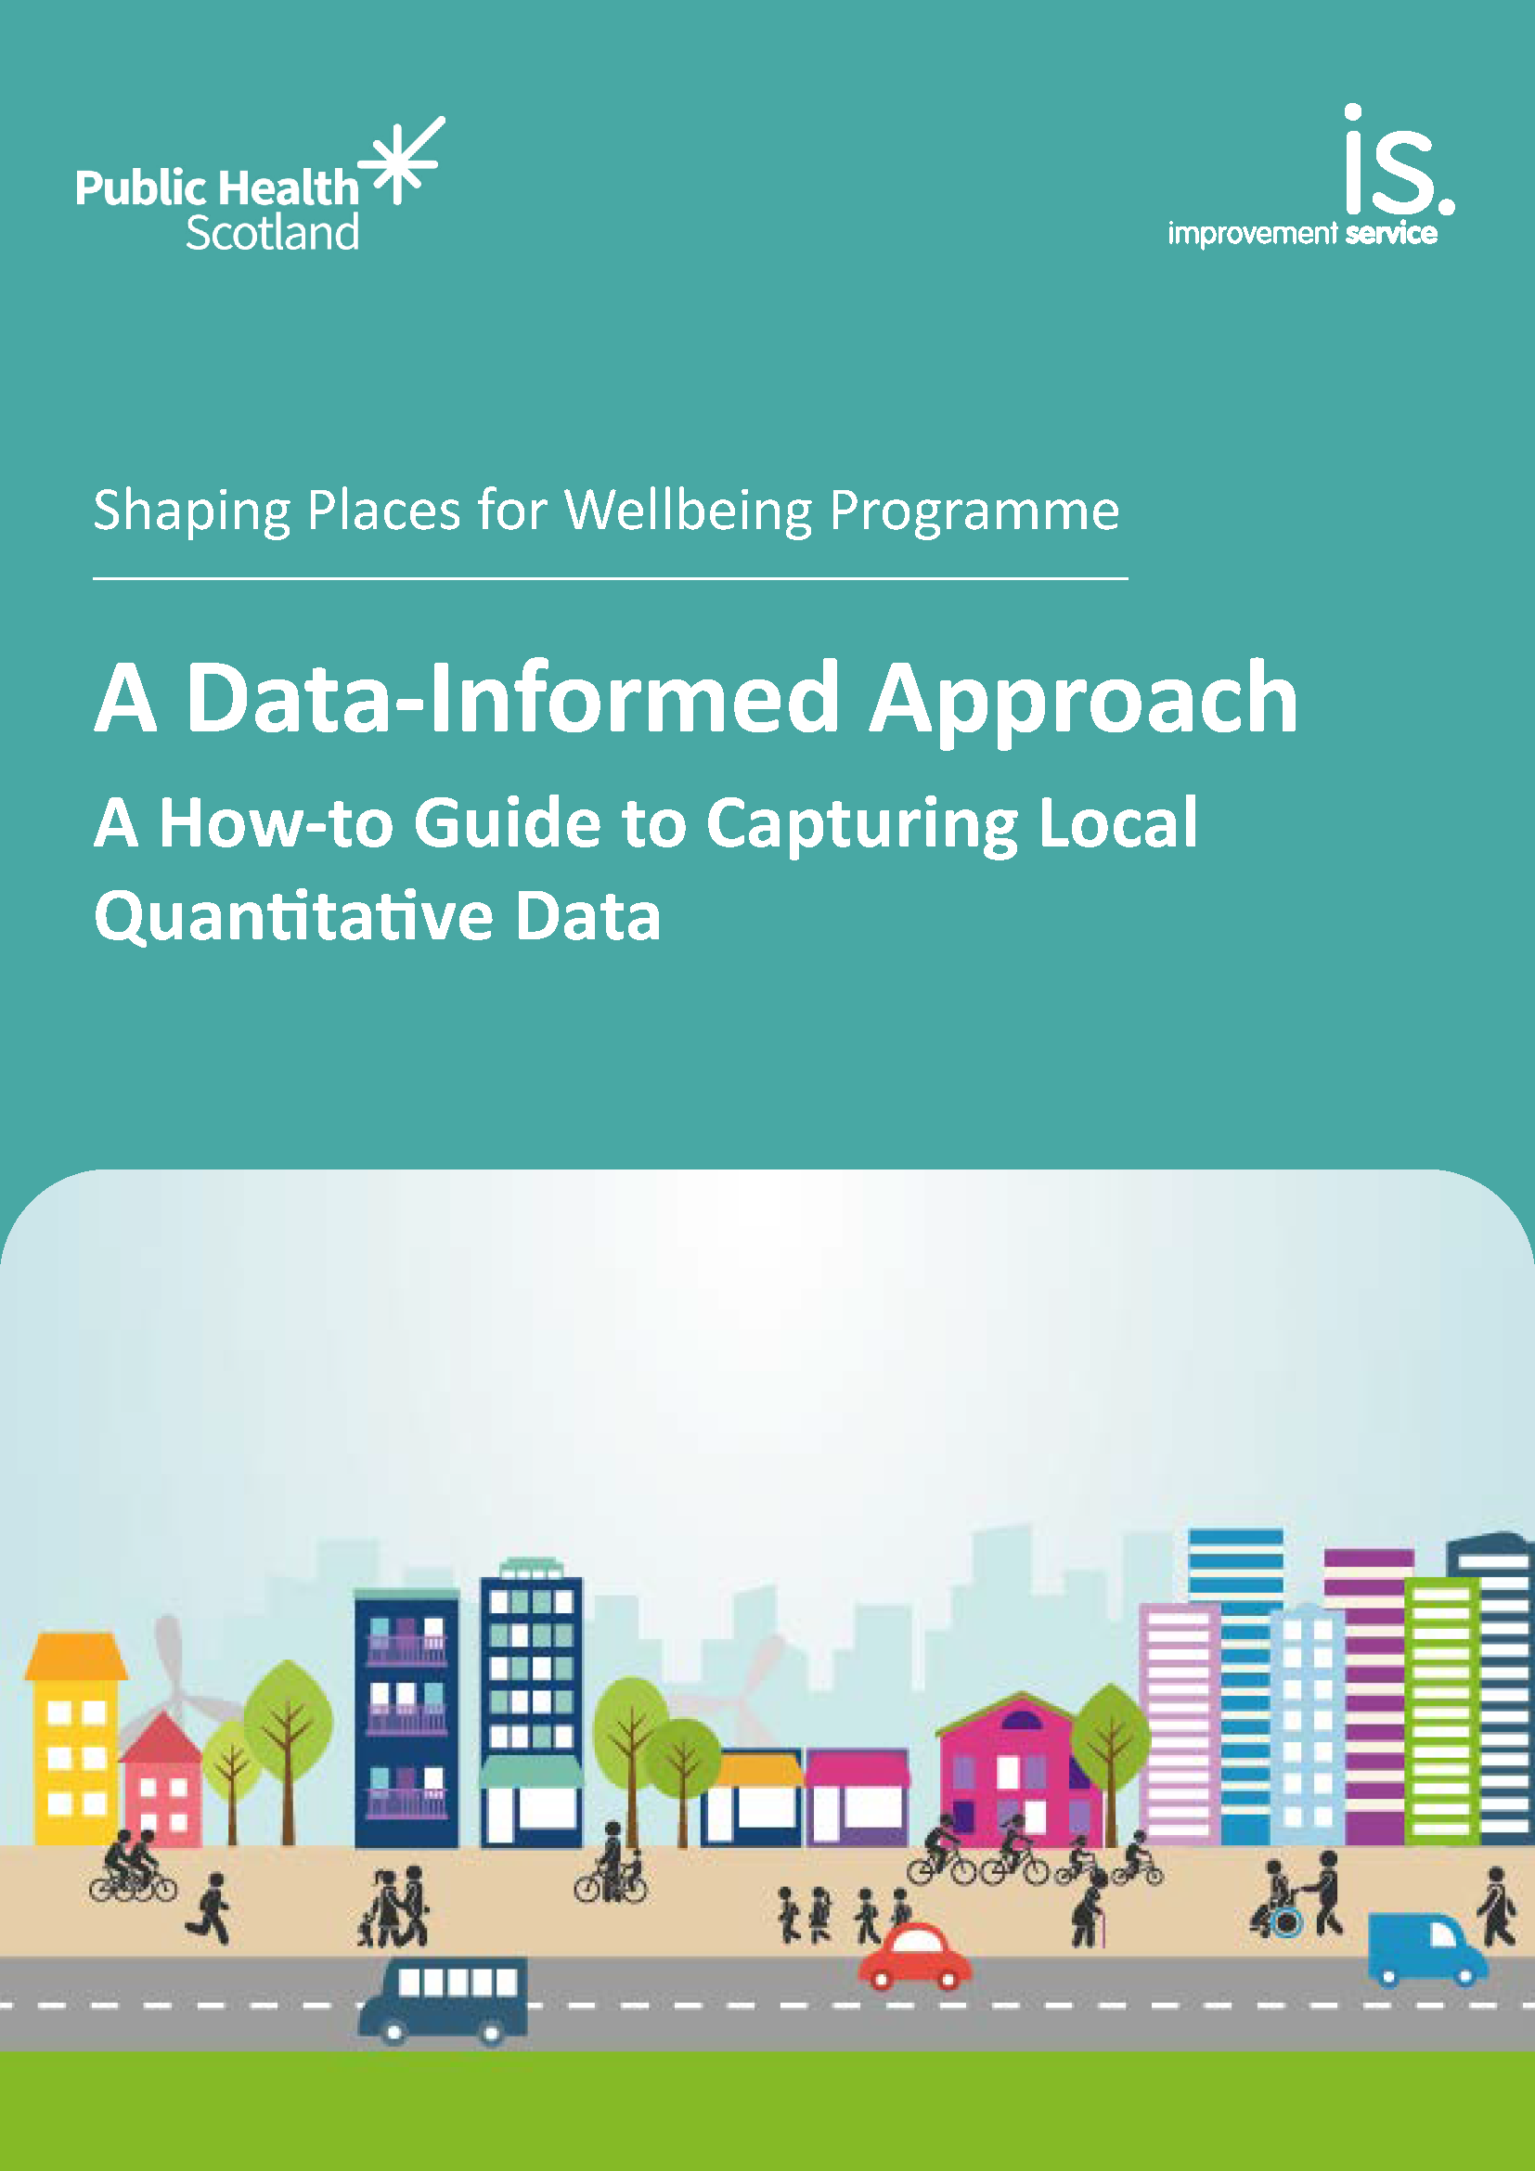
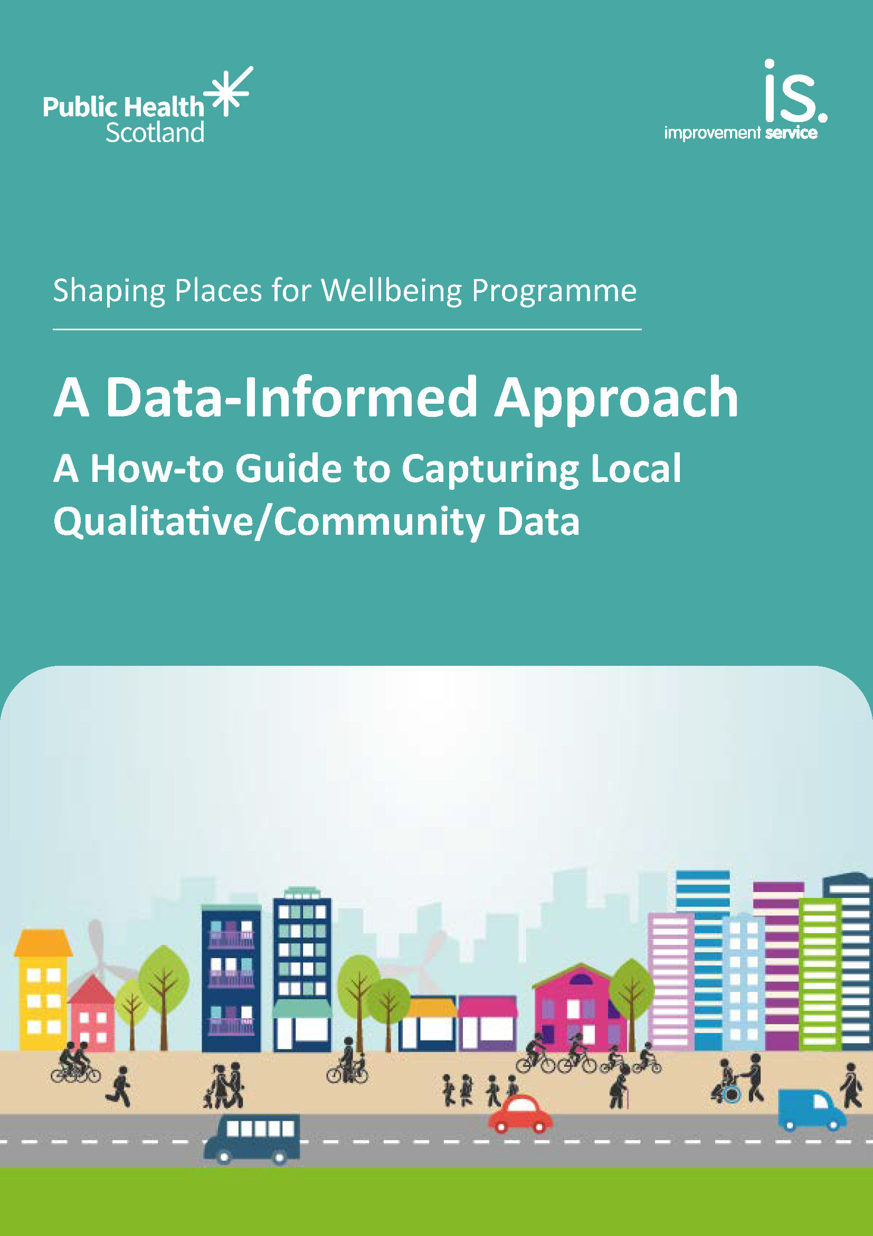
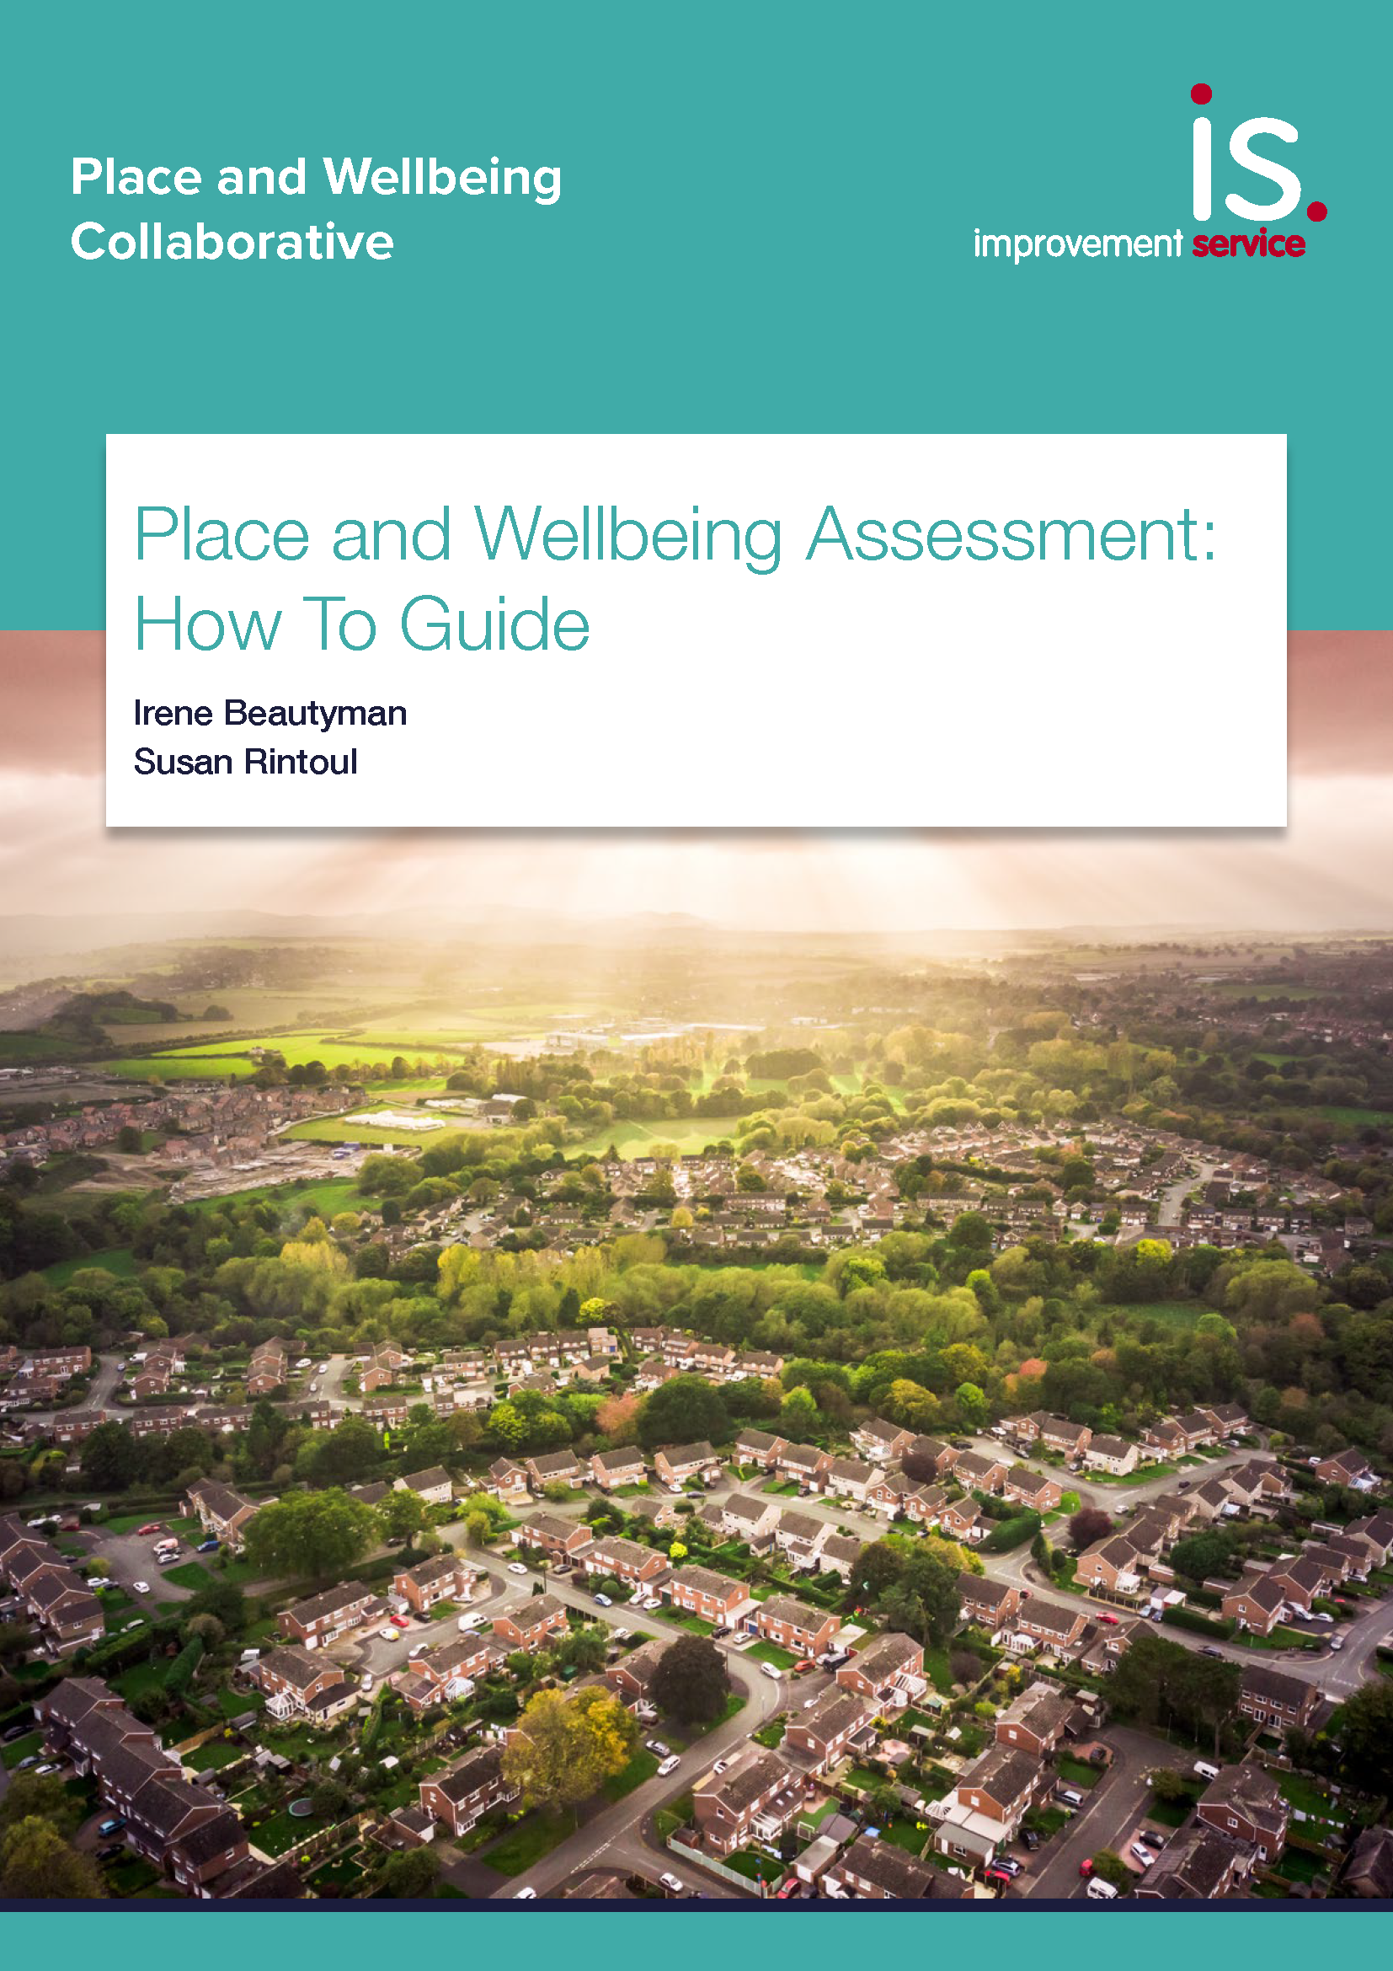
Sharing Learning: Output
'How to' guides
Producing qualitative data profiles
Producing quantitative data profiles
Place and Wellbeing Assessment guide

Slide 39
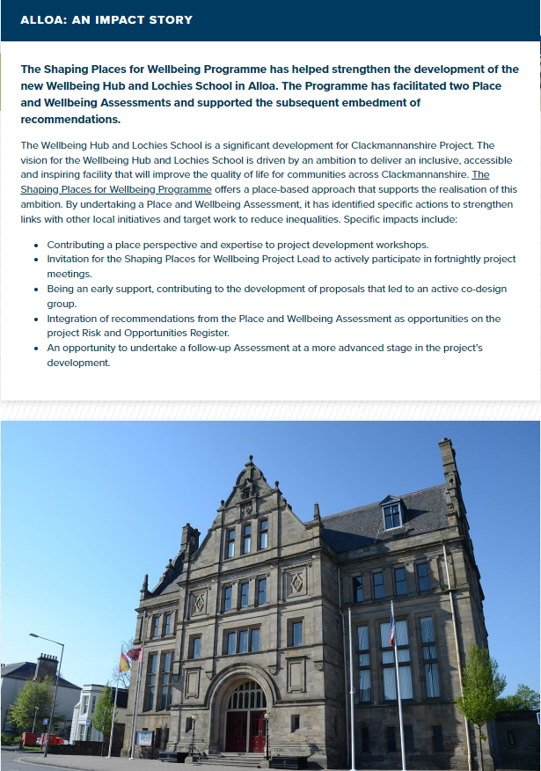
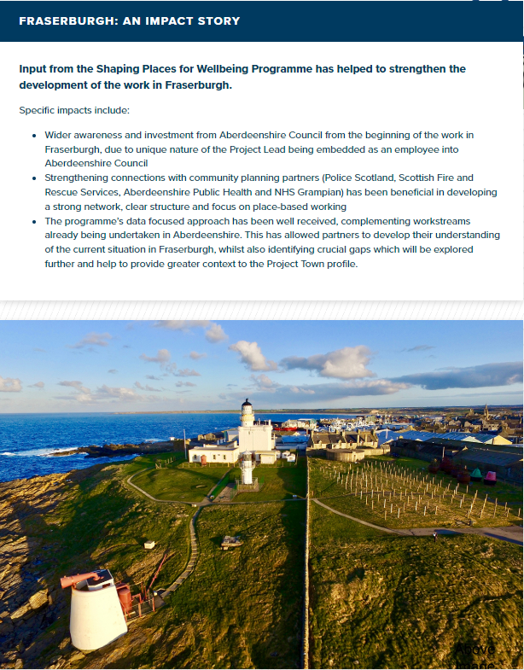
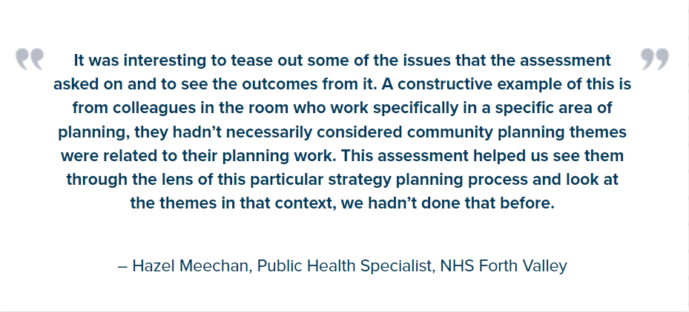
Shared Learning: Impact Stories
All the Project Town information and Impact Stories can be accessed here

Slide 40
Impact in Project Towns
Aberdeenshire Council rolling out approach council wide
South Ayrshire embedded Outcomes in Council Plan
South Lanarkshire embedding approach into Local Development Plan and Neighbourhood Plans
Dunoon Community Development Trust using approach to inform impending Place Plan
Dalkeith Local Community Plan structured around the Outcomes

Slide 41
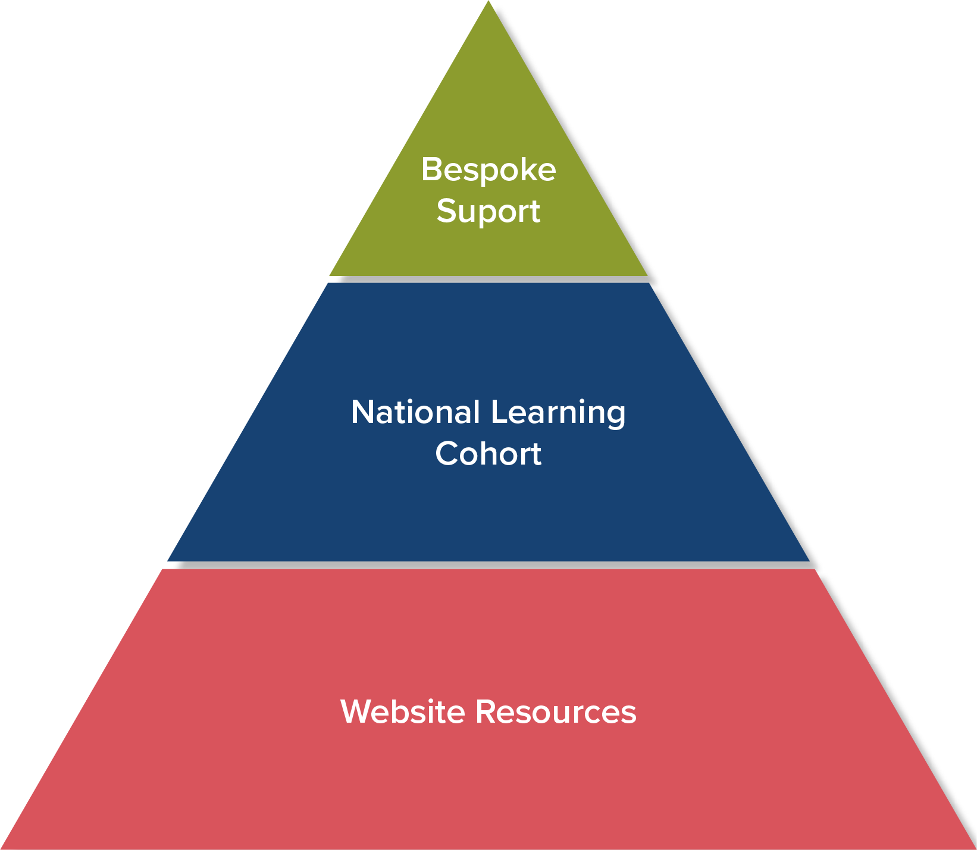
Shaping Places for Wellbeing Programme support sits at three levels

Slide 42
Further Masterclasses:
Place: Place and Wellbeing Outcomes Thursday 10th October 2pm – 3pm. Register here
People: Quantitative and qualitative data Thursday 31st October 2pm - 3pm. Register here
Decision making: Place and Wellbeing Assessments Thursday 21st November 10am –11 am. Register here
Place based approaches in action

Slide 43
What next?
Expand and enhance quantitative data informing decisions
Scaling up community insight into decision making
Strengthened support to Planning Authorities

Slide 44
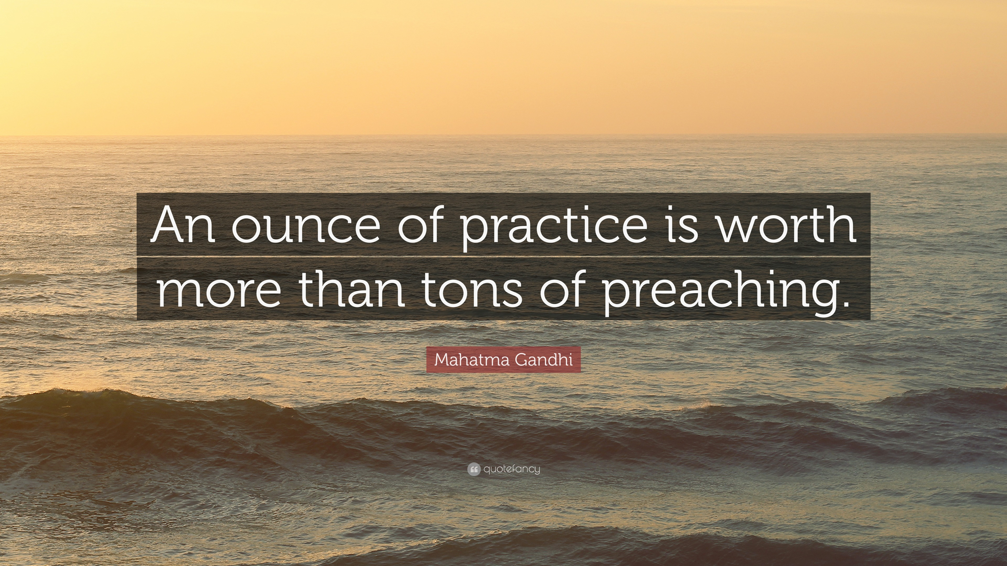

Slide 45
Find out more!
Webpage links and how to contact us
Place and Wellbeing Outcomes
Shaping Places for Wellbeing Programme
X (formerly Twitter) @Place4Wellbeing @PlaceNetworkSco @IreneBeautyman
Planning and Place Based Approaches LinkedIn
Email: placeandwellbeing@improvementservice.org.uk
​

Slide 46
Thank you for your time!
​

