Slide 1

Increasing Financial Capability
Through a Co-ordinated Approach
WEBINAR
27th of June 2018
Introduction – Overview of the Financial Capability work stream and the Financial Capability Practitioner Toolkit
(Sandra Sankey & Johanna Eriksson, Money Advice Outcomes Project, Improvement Service)
‘A partnership approach in Renfrewshire during Financial Capability Week’
(Diane Dunn, Policy Development Officer, Partnerships and Inequalities, Renfrewshire Council)
‘West Lothian Money Week’ part of the Anti-Poverty Strategy
(Nahid Hanif, Senior Advisor, Projects & Developments West Lothian Council)
‘Falkirk’s Fairer Money Week at the Grangemouth’s Advice and Support Hub’
(Kenny Bowie, Senior Debt Advice Officer, Falkirk Council)
Discussion & Questions

Slide 2
The Financial Capability Work stream
One of five workstreams within the Money Advice Outcomes Project at the Improvement Service.
Key deliverables 18/19
Produce draft guidance on the essential requirements that will promote and support financial capability interventions within the workplace (focus on Local Authority Employer)
Support Local Authorities to apply the draft guidance and identify potential improvement areas.
Support and promote Local Authority participation in the themed week 12-18 November 2018
Help showcase various good practice and different approaches taken

Slide 3
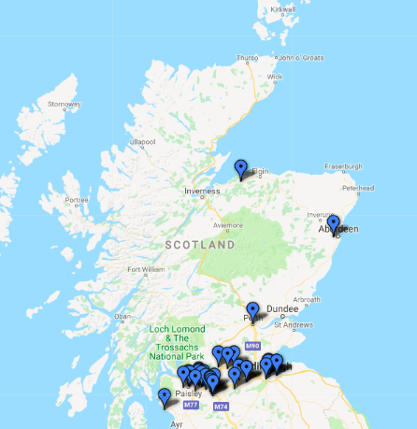
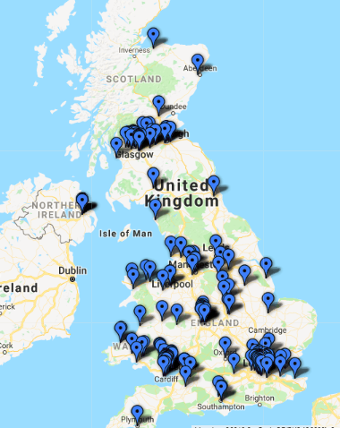
Talk Money Scotland Week
Aim to raise awareness about financial capability across Scotland, and encourage organisations to work together to address this issue.
Organisations are encouraged to share their latest insight, getting together to learn from one another and find new and better ways to change lives through better money management.
Notes:
This years Fin Cap Week has been rebranded to Talk Money Scotland Week.

Slide 4

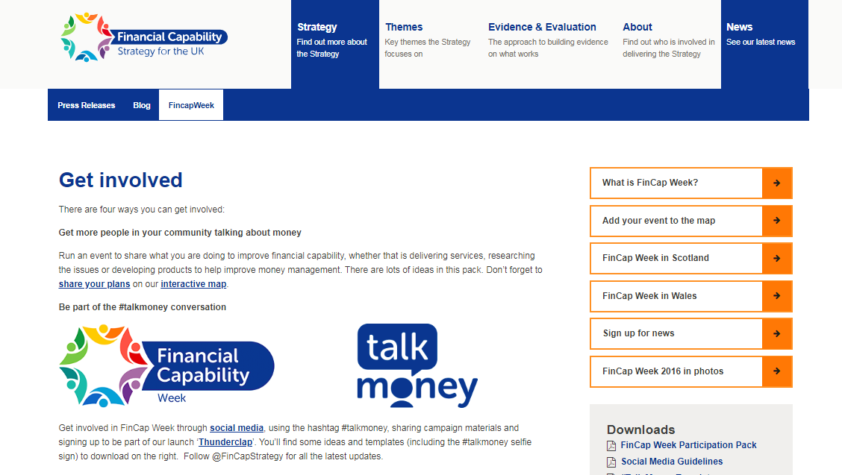
Participation Pack
The 2018/19 participation pack will be published by the end of June.
Help you plan how your organisation can get involved.
Includes examples of how people have been involved in previous years.
Step-by-step guide to help you plan your event and a range of templates and other resources.
Sign up to be notified when pack is published here.

Slide 5

How can you get involved?
Organise an event during the week to get key stakeholders together
Organise a best practice session with other local practitioners
Get involved on social media
Review what you are doing and how you might do it differently
Promote your service to a new audience
Promote or review your local Financial Inclusion or Wellbeing Strategy.
We are here to help so please get in contact to discuss how we can offer support at
Sandra
Sandra.Sankey@improvementservice.org.uk, 07771 958964
Johanna
Johanna.Eriksson@improvementservice.org.uk, 07774 765837

