Slide 1
Child Poverty and Covid
Challenge Poverty Week session with the Improvement Service
8 October 2020 #ChallengePoverty
Notes:
1.03m people are in poverty in Scotland
200k adults and 40k children (half in PRS, half in the social sector) are in poverty ONLY because of their high housing costs …
Numbers & proportion in social sector have fallen, whereas no's doubled in PRS

Slide 2
Before the pandemic, just over 1 million Scots of all ages were in poverty.
Higher risks for children, renters, disabled people, lone parents, BME groups and households out of work.
Scotland not on course to reach interim child poverty targets by Spring 2024.

Slide 3
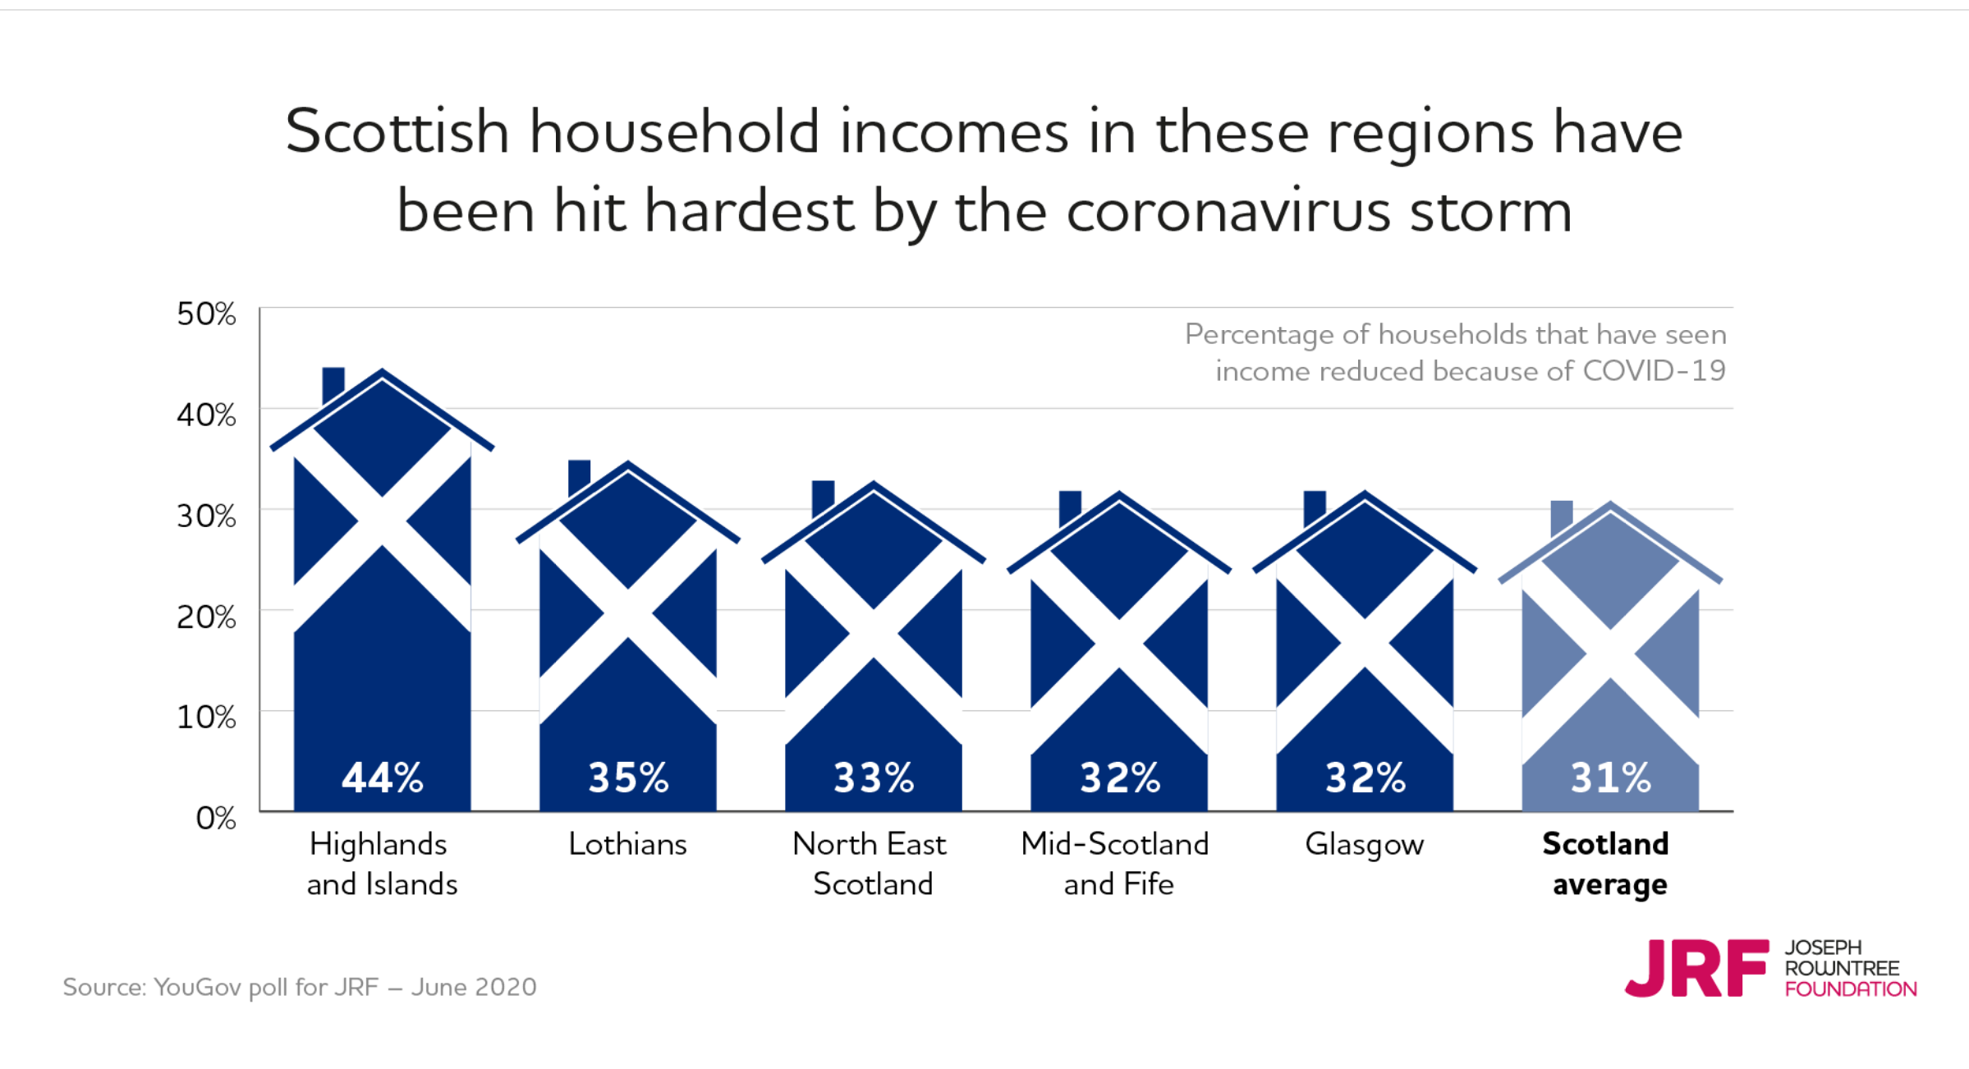
Financial squeeze: households with reduced income
Notes:
Moray – August – 32% of all jobs protected by furlough;

Slide 4
Impact of COVID
“The general skintness has been hard and been exacerbated by changes to how we shop – we are having to get more things from the corner shop, which is more expensive than the supermarkets. And because we’re both home all the time, we’re spending more money on food and fuel.”
Respondent to survey, Dundee Fighting for Fairness

Slide 5
By May, c. one in three Scottish households were either on furlough, self-employment support or had made a new out-of-work Universal Credit claim.
The combined rate was highest in mainland rural authorities followed by Glasgow and West/South Scotland.
By August, Moray had the highest furloughed rate (32%). Three quarters (77%) in accommodation & food had been furloughed.

Slide 6
Work: poverty rates by sector and drop in hours
Notes:
77% on furlough in hospitality = accommodation and food services; 42% in manufacturing; sectoral concentration…

Slide 7
“It is a problem that people from BME communities generally are facing …discrimination is one of the reasons. People with relevant experience and qualifications find it difficult to secure a well-paid job. They are either not kept in the organisation where the internship has been undertaken or offered a low-paid job. Helping employers to train and then keep hold of people…developing a more diverse workforce where their competences are valued…One solution would be to raise awareness on workplace discrimination and ensure training is taken up by every organisation in Scotland.”
Taylor, Glasgow
Notes:
Suggest we just show this briefly after Aimee has spoken rather than reading it out. It amplifies one of the points Aimee will make.

Slide 8
Social Security: rise in Universal Credit claims by local authority
A significant rise in Universal Credit claims has already happened, in and out of work. Places with high poverty rates before the pandemic have been most affected, but rural areas are at risk due to high proportions of people in sectors supported by temporary protections.
Notes:
Add speaking notes here…

Slide 9
Housing: private rent pressures
Notes:
The original graphic with the map is no longer in the report so have replaced with this one.

Slide 10

Edinburgh Poverty Commission
A Just Capital
A Call to Action to end poverty in the city

Slide 11
Work: a recovery that cuts poverty
Invest in those most likely to be in poverty – women and especially lone parents, Black and Minority Ethnic communities, disabled people and carers, places and sectors most at risk
Extend an opportunity guarantee for all: strengthen job protection measures, increase the Transition Training Fund and improve pathways from training into good jobs
Boost the Parental Employment Support Fund and disability employment support – and extend until 2026.
Remove barriers: flexibility in childcare and in jobs, digital inclusion, affordable transport, serve remote and rural areas as well as towns and cities

Slide 12
Social Security: strengthen the lifeline
Holistic support from trusted agencies - improve access to advice and support services embedded in local hubs and improve people’s experiences with DWP.
Use Scottish and local powers to automate, boost take up and uprate payments
Keep the lifeline: maintain the UK increase in Universal Credit/Working Tax Credit and extend to other low-income benefits.
Scottish Child Payment: extend support to school-age children faster - interim arrangement in 2021-22 to top-up payments to families via local government
Explore a Minimum Income Guarantee for working-age people

Slide 13
Housing: a strong preventative approach
Creating homes, not offering tenancies – enshrining ‘dignity and respect’ for tenants and understanding ‘prevention duty’ broadly
Kindness and taking the time to know your tenants
Driving down the higher costs faced by low income households – landlords going further to offer tenants a good deal on the cost of energy, broadband, insurance, transport...
Affordability – invest in 53,000 new affordable homes in Scotland by 2026, 70% for social rent.
Both UK and Scottish Governments – working with landlords and lenders - should prepare to step in with additional legislative protection and help with housing costs if existing support for renters proves insufficient to keep people in their homes.

Slide 14
Housing: creating homes not just providing tenancies
“When I moved in, there was no floor coverings, urine on the walls and faeces in the bathroom. I was told it was ‘within the guidelines’. I had to spend £80 on cleaning products and do it myself. I was 20 years old, with a one-year-old baby in tow and I had to lay carpets myself, with a bread knife.”
Alex, remote rural Scotland
“We need to put housing and humanity together – bringing kindness where it is lacking in the housing sector.”
Taylor, Glasgow
Notes:
Creating homes, not just tenancies – enshrining principles at local level and broad definition of prevention duty
Setting affordability in the context of ‘real’ costs of living/ rent (transport, rurality. Etc)
Landlords to do more to offer competitive services (digital, utility, etc) & help tenants navigate systems
Kindness and relationships

Slide 15
Participation: Equal Partners in Scotland’s recovery
The Fairer Scotland duty – making these rights ‘real’
Address the gap between policy and practice: Listening and acting on the insights of experts by experience
Actively shift power & resources: this is not consultation
The Promise (Care Review) & 10,000 Voices: commit to listen and act

