Slide 1
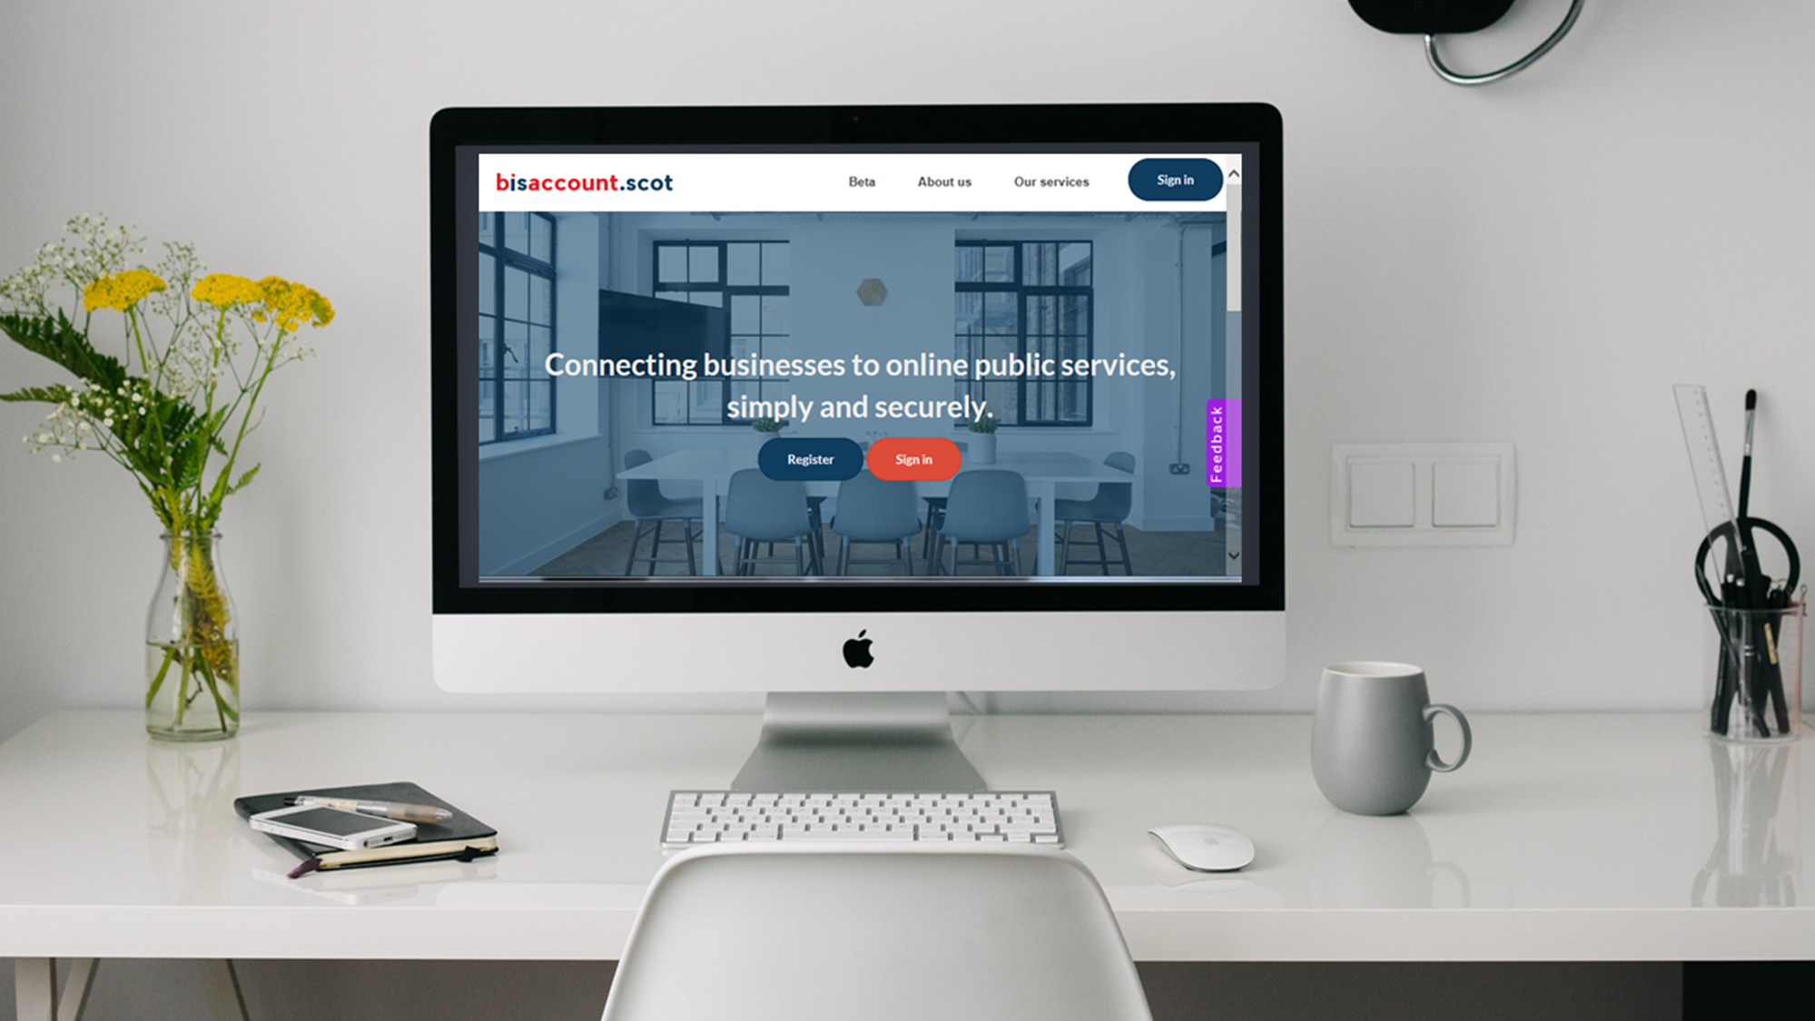


Slide 2


a simple and secure single sign-in authentication service, designed to help businesses prove who they are when transacting with public services online.
Enable service providers to verify against their own data sets that the business referenced is a real business.
Remove administrative burden and cost when using or transacting with public services.
Enable businesses and the public sector to transact safely and securely.

Slide 3
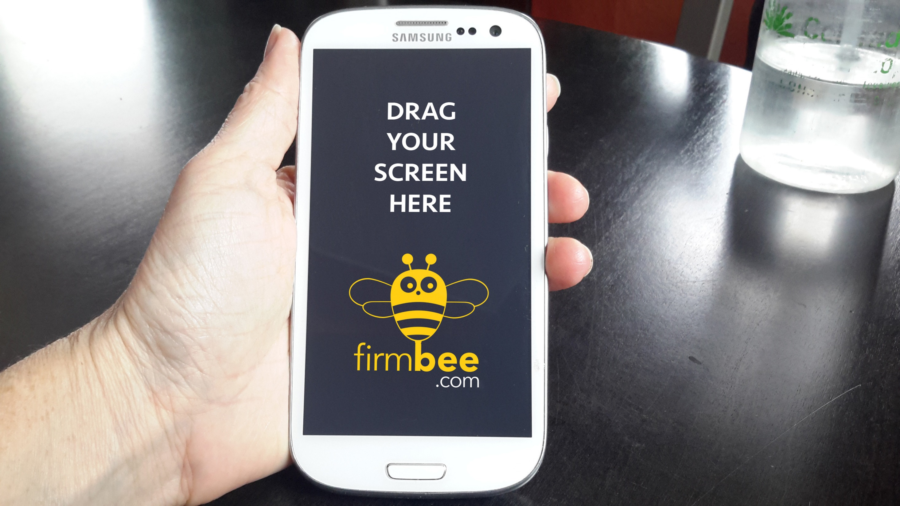
For public service providers, bisaccount.scot will provide:
A secure & trusted service
Standards-based
Easy-to-integrate

Slide 4


Contact Us
Andy Campbell
andrew.campbell1@improvementservice.org.uk
07766443459

