Slide 1

Scotland’s roadmap to COVID-19 recovery and renewal:
key actions for supporting vulnerable people and communities
Taking a trauma-informed approach
Laura James, Improvement Service
The ‘come to’ organisation for local government improvement in Scotland

Slide 2

The uneven impact of COVID-19
The impacts of the crisis have not been felt equally. Groups, and parts of Scotland, facing poverty, inequality and other social harms have felt the impact of the pandemic more than others and there are now higher numbers of people experiencing poverty, who are food insecure, income insecure, and at risk of homelessness and rough sleeping. Without purposeful intervention, we will see deepening inequalities, especially for those who are most marginalised and experience multiple discriminations.
It is important we lead a recovery that tackles these inequalities and builds on our experiences over the past few months and the powerful examples of community empowerment, agile service delivery and strong partnership working that has been demonstrated across Local Government and communities.
- COSLA Blueprint for Scottish Local Government, September 2020
We work closely with local government partners to better align policy, improvement and delivery

Slide 3
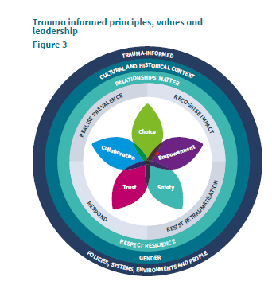

Vulnerable communities, inequalities & COVID-19
What do we mean by vulnerable communities?
How do inequalities intersect?
How has COVID-19 caused and exacerbated inequalities?
Trauma and inequality
Figure: NHS Education for Scotland, Trauma Training Plan
We provide a wide range of practical improvement support

Slide 4

Five key actions for supporting vulnerable communities
Identifying vulnerable people and communities and the uneven impact of COVID-19
Prioritising prevention and early intervention
Including the voices of lived experience
Strengthening workforce wellbeing and development
Adopting a joined-up, person-centred whole systems approach
We broker additional resources for local government to support improvement

Slide 5








What does a trauma-informed approach look like?
Taking a joined-up approach
Engaging with people with lived experience
Strengthening workforce knowledge and skills
Collecting data and information
Supporting workforce wellbeing
Using existing resources and support
Trauma-informed leadership
We help councils deliver against local and national priorities

Slide 6





Useful Resources
Learn more about a trauma-informed approach and useful resources:
http://transformingpsychologicaltrauma.scot/
Watch NHS Education for Scotland animation, “Opening Doors”, on why tackling trauma is everybody’s business: http://transformingpsychologicaltrauma.scot/understanding-trauma/
IS Thought Leadership Series: “Scotland’s roadmap to COVID-19 recovery and renewal: five key actions for supporting vulnerable people and communities” (forthcoming publication)
Poverty and trauma briefing, The Robertson Trust (2020)
“Taking a trauma-informed lens to Scotland’s COVID-19 recovery, renewal and transformation” Elected Member Briefing (forthcoming publication)
Series of deep dive events to explore how a trauma-informed approach can support key COVID-19 recovery and renewal priorities (info coming soon)
Any questions, please get in touch:
Laura.james@improvementservice.org.uk
We help support and develop effective and informed local political leaders

