Slide 1
Scotland's Place and Wellbeing Outcomes and their role in the Shaping Places for Wellbeing Programme
Masterclass 2
Irene Beautyman
Place and Wellbeing Partnership Lead
Improvement Service & Public Health Scotland

Slide 2
Place and the Place and Wellbeing Outcomes
✔️ Masterclass 1
✔️ Why have them and what are they
✔️ How to use them: Shaping Places for Wellbeing Programme

Slide 3
Place and the Place and Wellbeing Outcomes
✔️ Masterclass 1
✔️ Why it matters to have them
✔️ How to use them: Shaping Places for Wellbeing Programme

Slide 4
Masterclass 1: Place based approaches
✔️What we mean by place and why it matters
✔️What taking a place based approach means
✔️Shaping Places for Wellbeing Programme

Slide 5
Who?
Public Health Scotland
v
v
NHS Boards
Impacts on strategic decision-making
Improvement Service
Health and social Care Partnerships
Strategic decision-making impacts on a place
v
Local Authorities
Third Sector
Impacts on a place
Communities
Other statutory Authorities
Private sector
Scottish Government

Slide 6
Key parts to a place-based approach
PEOPLE
What they are experiencing
PLACE
ALL the features that have a positive impact
DECISIONS
How they impact people and place

Slide 7
Place and the Place and Wellbeing Outcomes
✔️ Masterclass 1
✔️ Why have them and what are they
✔️ How to use them: Shaping Places for Wellbeing Programme

Slide 8
Take a place based approach
PEOPLE
Inequality they are experiencing
Inequality data
Quantitative
Qualitative
PLACE
All the features that have a positive impact
Place and Wellbeing Outcomes
DECISIONS
How they impact people and place
Place & Wellbeing Assessments
Briefing Papers
Leadership & governance

Slide 9
Place and Wellbeing Collaborative
Public Health Scotland
Directors of Public Health
COSLA
Improvement Service
Health Improvement Managers
Heads of Planning Scotland
'A shared ambition to improve the places where we live, work and relax in.'

Slide 10
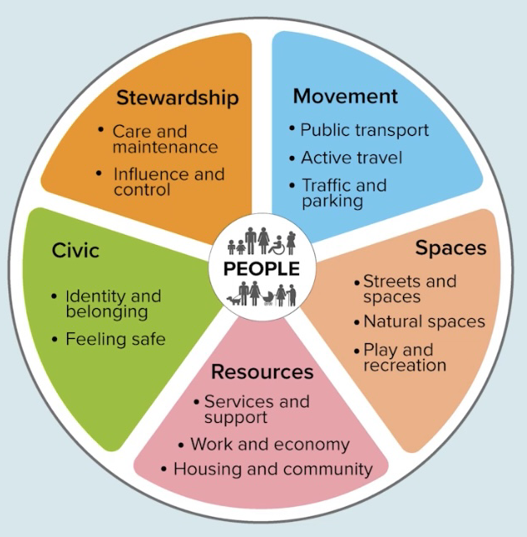
Place and Wellbeing Outcomes
The evidenced and preventative features every place needs to enable:
wellbeing of people
equality
net-zero emissions and sustainability.
TRIPLE WIN!

Slide 11
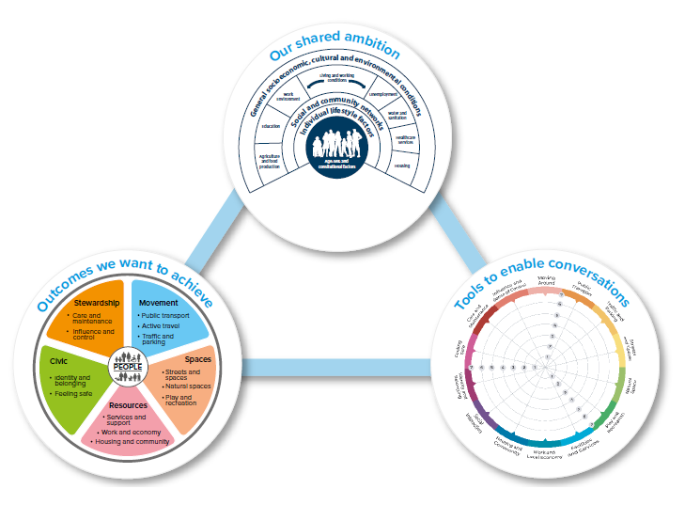
The Place and Wellbeing Outcomes
Evidence:
that shaped the Place Standard Tool
from the World Health Organisation and
other UK public health bodies
All of the Outcomes are interconnected, a need to work across outcomes is critical

Slide 12
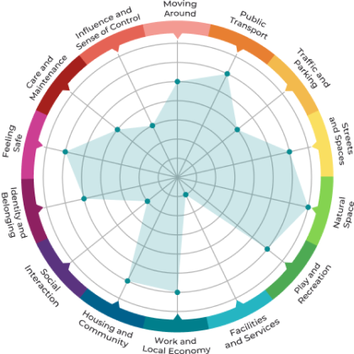
Place and Wellbeing Outcomes context
The Outcomes are the evidenced end result we want to achieve
The place standard tool is how we engage people in conversations about their place and capture perceptions on how they feel the Outcomes are being achieved
Both are underpinned by the same evidence
Outcomes are the end result we want
Tool to capture community insight

Slide 14
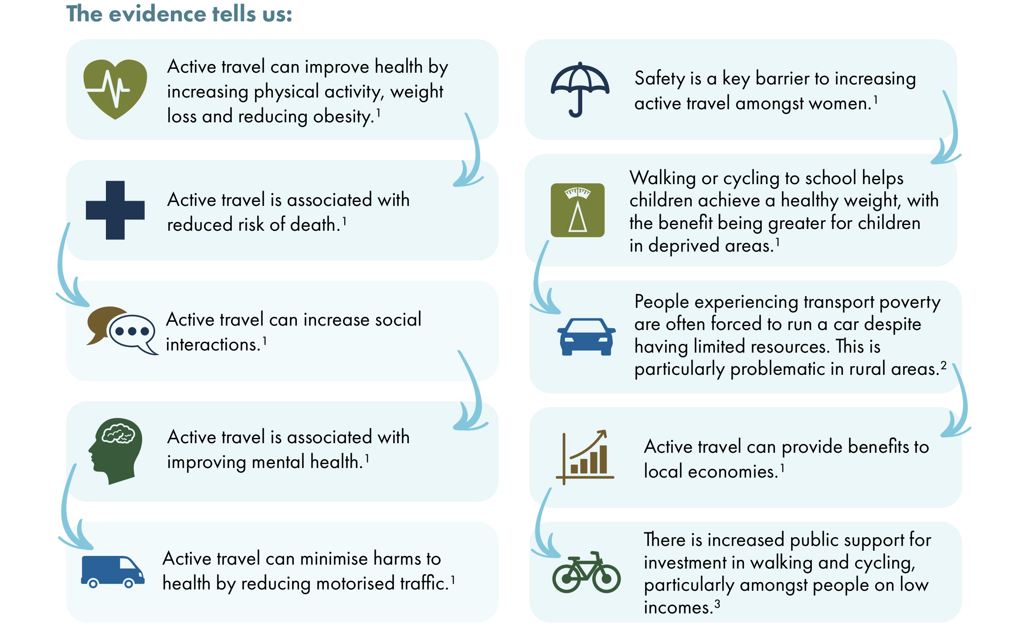

Slide 16
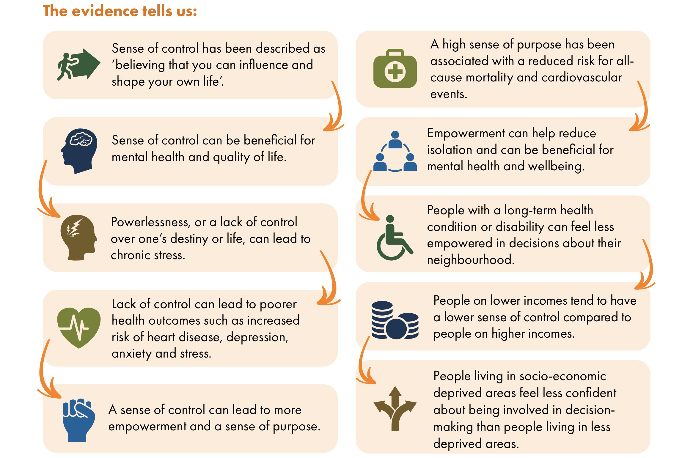

Slide 17
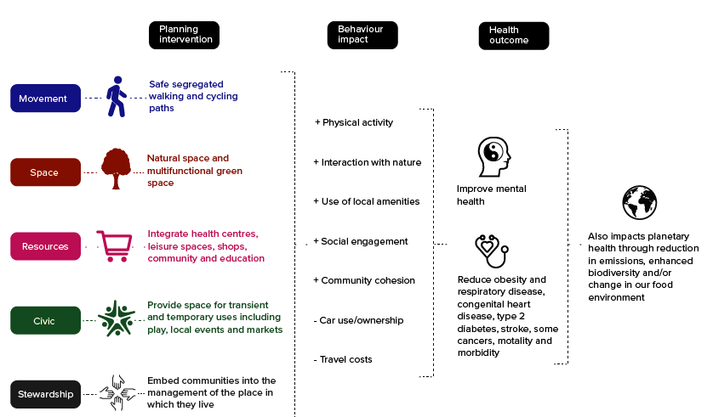
How do the Place and Wellbeing Outcome themes work in real life?

Slide 18
Place and Wellbeing Outcome: Natural Spaces
Intervention = Improving access to natural space and multifunctional green space
⬇️ Impact ⬇️
Health and wellbeing
+ physical activity
- reducing obesity
+ improvement in mental health
- reduction in depression and stress
+social engagement
+ healthy maintenance of the immune system
Climate
+ interaction with nature
- air and noise pollution
+ environmental benefits
+ improved natural flood management
+ community food growing
Inequality
+community cohesion
+ provides benefits to local economies
+ ability to contribute to economic environment
The 'triple win'

Slide 19
Place and Wellbeing Outcomes
Sustainable Development Goals (SDG)
National Outcomes Framework
National Planning Framework 4
Key policy
Public Health Priorities
Net zero emissions targets
A New Future for Scotland’s Towns
Local Living
Christie Commission
Place Principle
Social Determinants of Health
Place & Wellbeing Outcomes
Key approaches

Slide 20
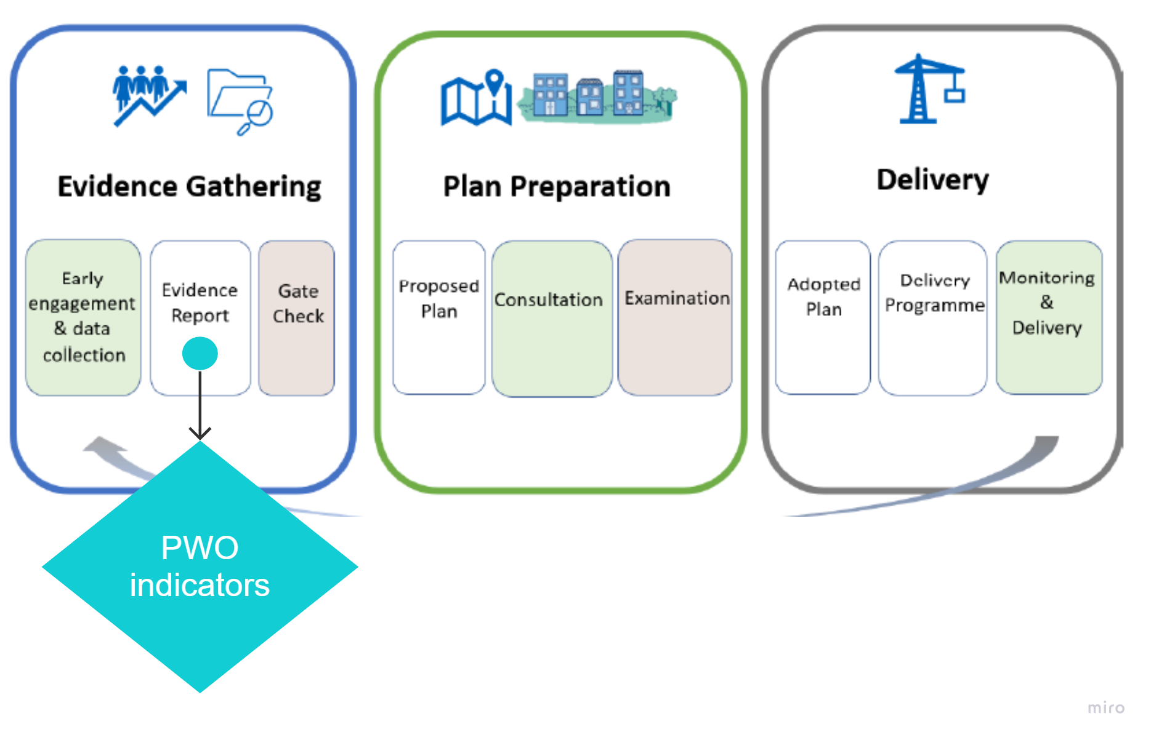
Place and Wellbeing Outcomes Indicators
A core set of indicators that can be measures and reviewed over time to assess the contribution to the delivery of the Place and Wellbeing Outcomes.
Measure and review our delivery of a place where people can thrive.

Slide 21
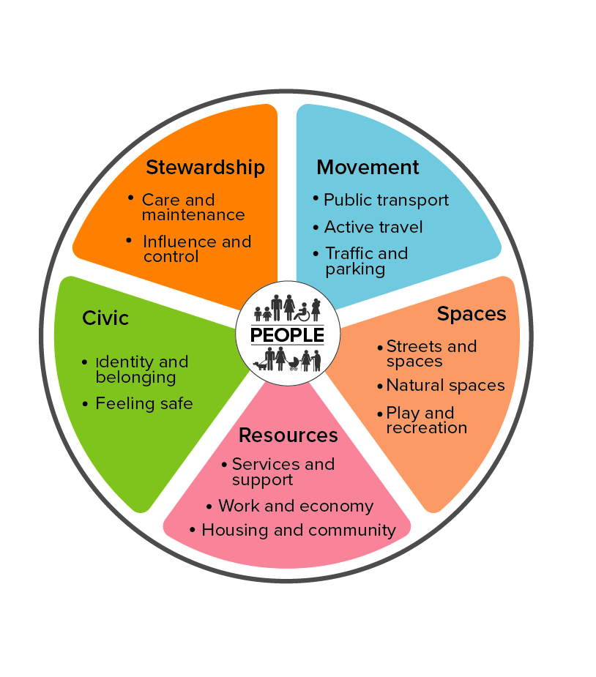
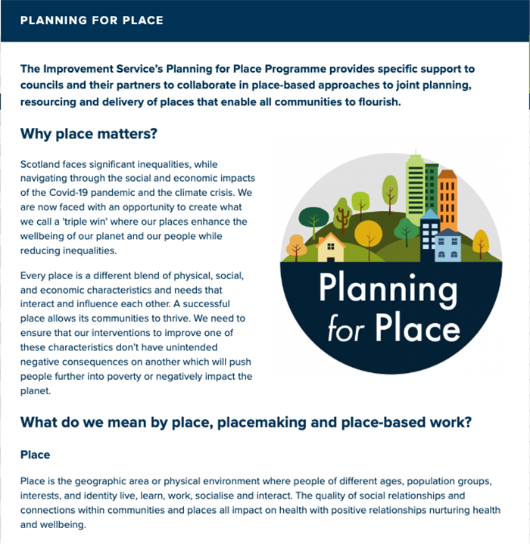
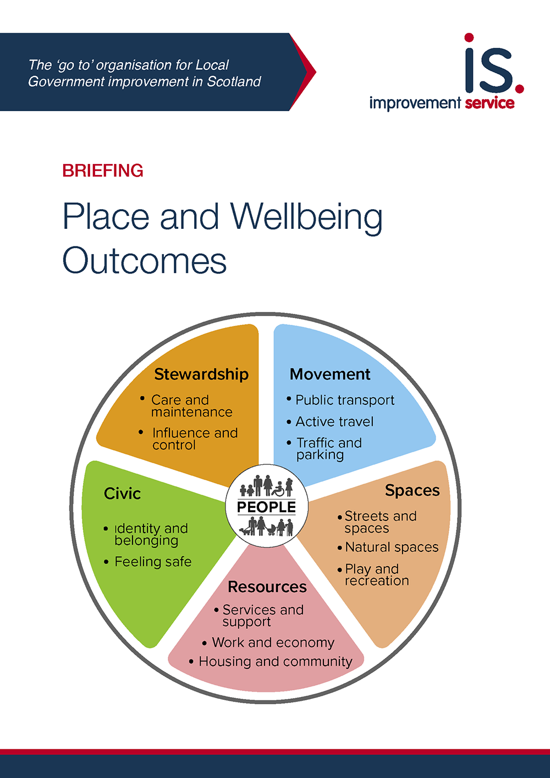
Place and Wellbeing Outcomes

Slide 22
Place and the Place and Wellbeing Outcomes
✔️ Masterclass 1
✔️ Why have them and what are they
✔️ How to use them: Shaping Places for Wellbeing Programme

Slide 23
Notes:
Slide summarising the programme activity

Slide 24
Three activities:
Council and NHS Board in Project Towns:
Alloa
Ayr
Clydebank
Dalkeith
Dunoon
Fraserburgh
Rutherglen
Replication
Reflection, learning, sharing between Project Towns
All Towns Steering Groups
“How to” Guides enable replication
Confidence
Causes of change
Representatives from:
Scottish Govt Directorates
All COSLA Boards
Public Health Scotland
Improvement Service
Health Foundation
Notes:
Use these slides to what suits you presentation – don't need to include them all

Slide 25
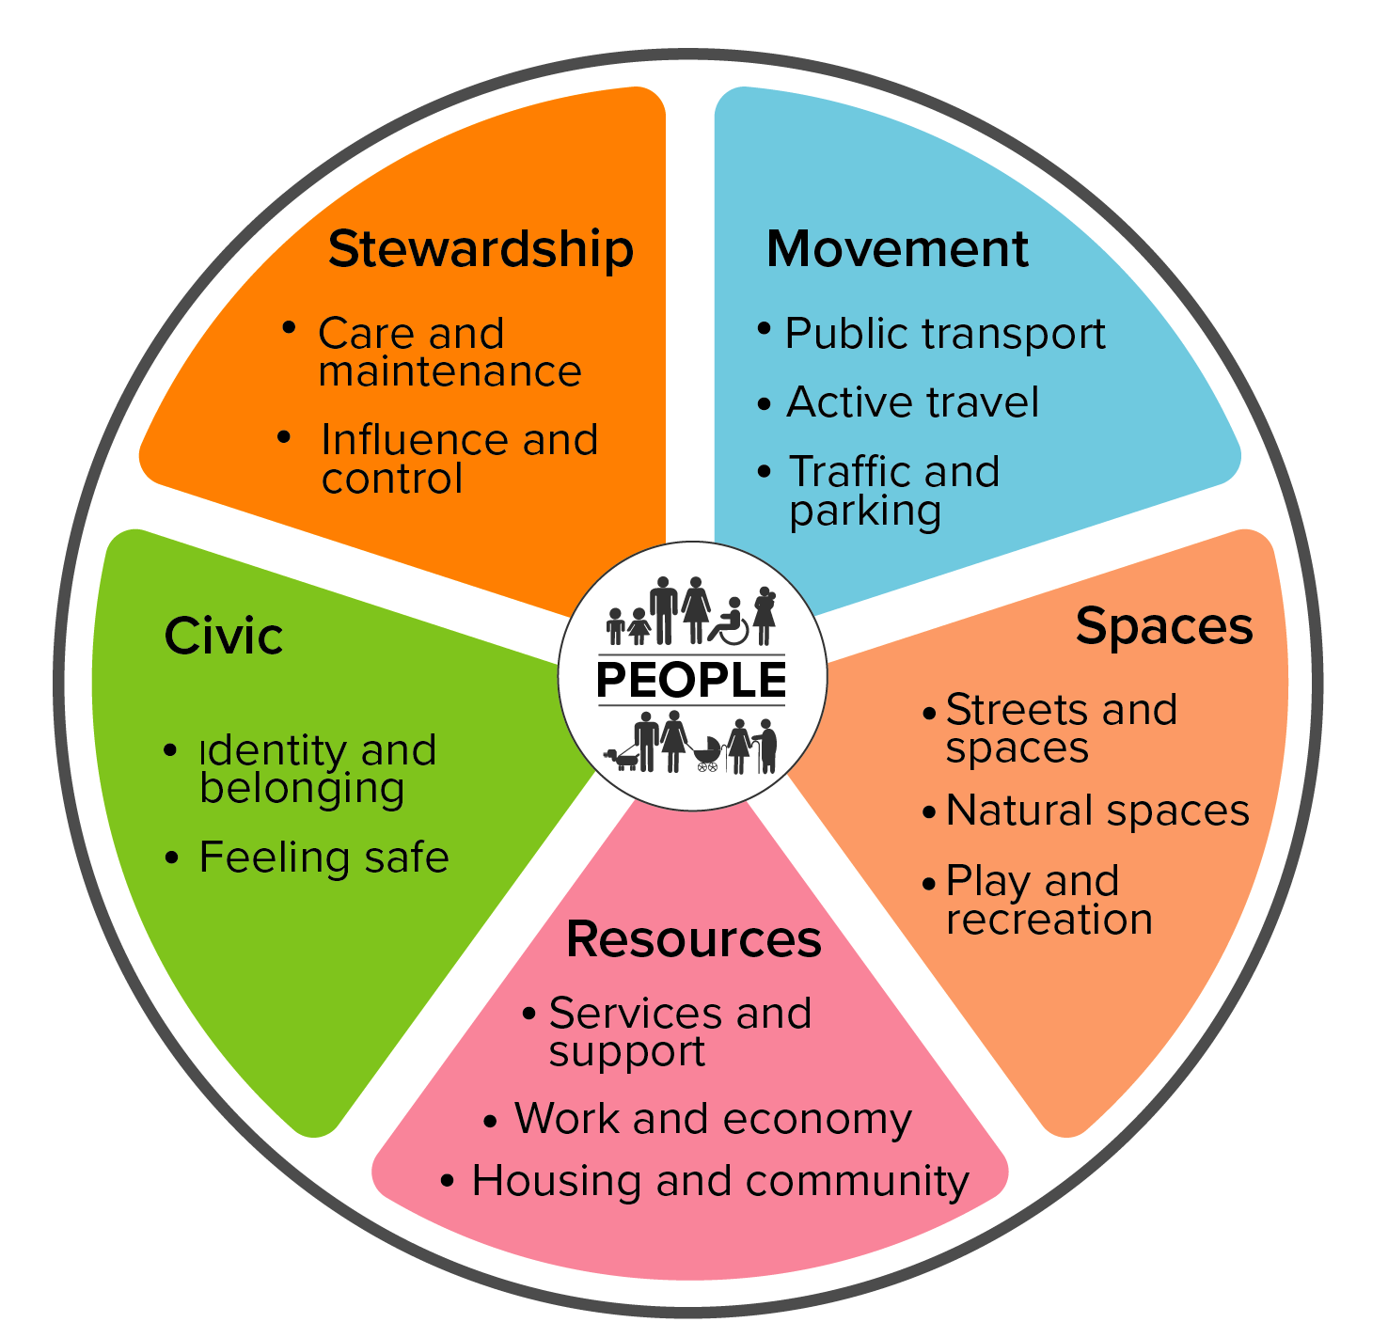
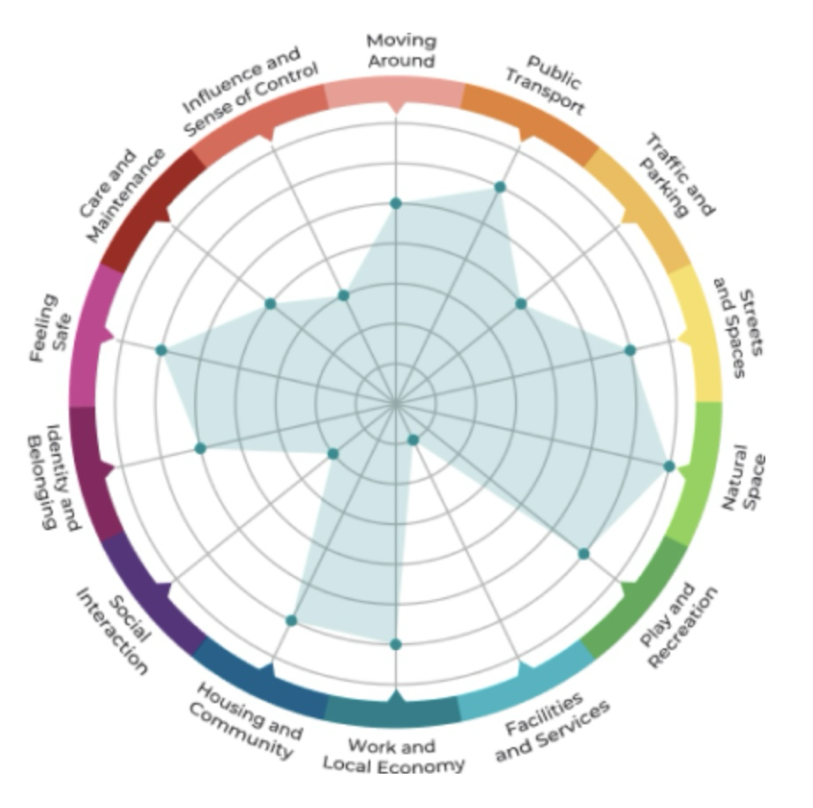
Shaping Places for Wellbeing approach
PEOPLE
Inequality they are experiencing
Inequality data
Quantitative
Qualitative
PLACE
All the features that have a positive impact
Place and Wellbeing Outcomes
DECISIONS
How they impact people and place
Place & Wellbeing Assessments
Briefing Papers
Leadership & governance

Slide 26
Decisions: Place and Wellbeing Assessments
Strategies, plans and proposals
What could be done to improve impact on place and, thus, wellbeing?
How does the plan, policy or decision impact on each of the Place and Wellbeing Outcomes?
How does it impact on those population groups most impacted by inequalities?

Slide 27
Decisions: Place and Wellbeing Assessments
Year | Alloa​ | ​Ayr ​ | Clydebank​ | Dalkeith | Dunoon​ | Fraserburgh | Rutherglen​
2022 (9) | Draft Interim Climate Change Strategy​ Wellbeing Hub Location NHS Forth Valley Healthcare Strategy 2016-2021 | Wallacetown Housing Regeneration​ Sustainable Development & Climate Change Strategy Review​ | Implementation of the Clydebank Town Centre Development Framework ​ West Dunbartonshire Health Social Care Partnership Strategic Plan​ |  | Western Seaboard Marine Gateways, Dunoon Waterfront proposal, submitted as part of the UK Levelling Up Fund application |  | South Lanarkshire Economic Strategy ​
2023 (20) | Local Development Plan Vision and Strategic Objectives Local Outcome Improvement Plan Interim Climate Change Strategy – 2023 | Local Housing Strategy Accessible Ayr | Green Travel Plan Safe Delivery Improvement Group Strategy (Community Planning Partnership) | Single Midlothian Plan Dalkeith Regeneration Development Framework Central Dalkeith & Woodburn Community Action Plan | Argyll and Bute Health & Social Care Partnership Strategic Plan​ Local Police Plan Argyll and Bute Economic Strategy Active Travel Hub | Beachfront Masterplan Aberdeenshire Health & Social Care Partnership Strategic Plan Fraserburgh merging schools project | ​Rutherglen Town Centre Action Plan Burnhill Neighbourhood Plan South Lanarkshire Local Development Plan 2
2024 (2) | Wellbeing Hub 2 |  |  | Midlothian Integration Joint Board Strategic Commissioning Plan 2025 to 2040 |  | Clatt School

Slide 28
Dunoon Active Travel Hub
Increases access to walking, wheeling and cycling opportunities
Active Travel
Public Transport
Play and Recreation
Provides space for people to come together
Sense of Belonging
Services and Support
Street and Spaces
Collaboration between Council and community organisation with local knowledge
Improves the welcome to the town by upgrading and celebrating heritage
Work and Economy
Sense of Belonging
Volunteers involved in refurbishment using traditional skills
Influence and Control
Sense of Belonging
Sense of belonging
Work and Economy
Services and Support
Feeling Safe

Slide 29
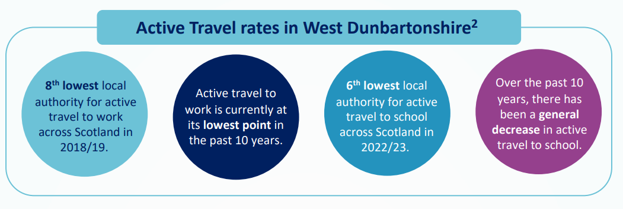
Place: what we need to get right in every place
Place and Wellbeing Outcome Briefings

Slide 30
Impact and shared learning

Slide 31
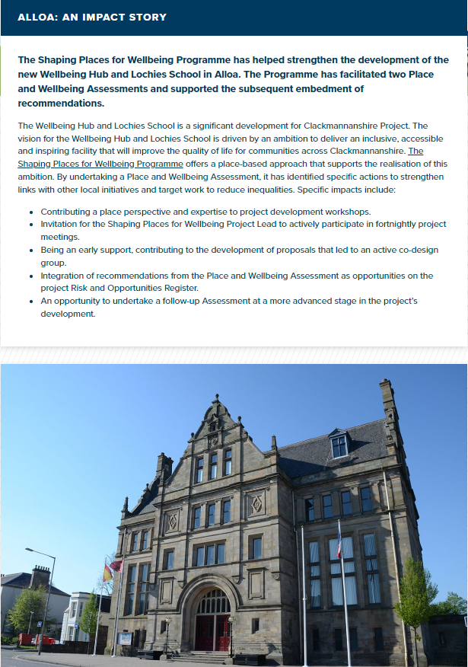
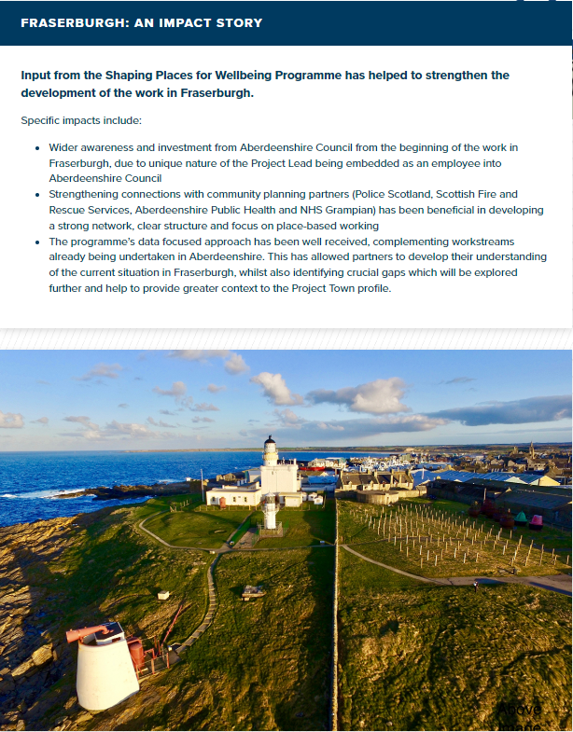
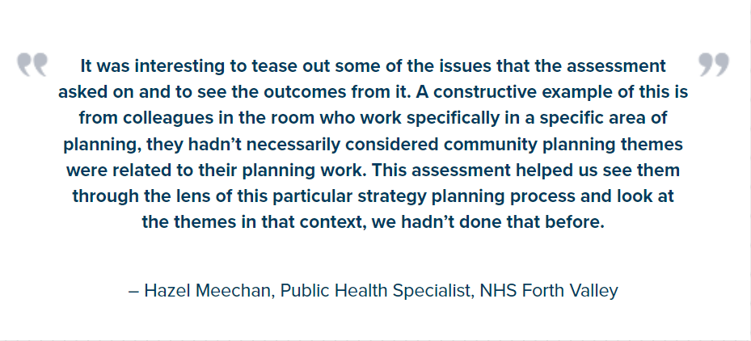
Shared Learning: Impact Stories
All the Project Town information and impact stories can be accessed here

Slide 32
Impact
Aberdeenshire Council using Outcomes in Place Strategy
South Ayrshire embedded Outcomes in Council Plan and Local Outcome Improvement Plan
Dalkeith Local Community Plan structured around the Outcomes
Ayrshire & Arran Health Board using Outcomes to structure consultation responses to planning applications

Slide 33
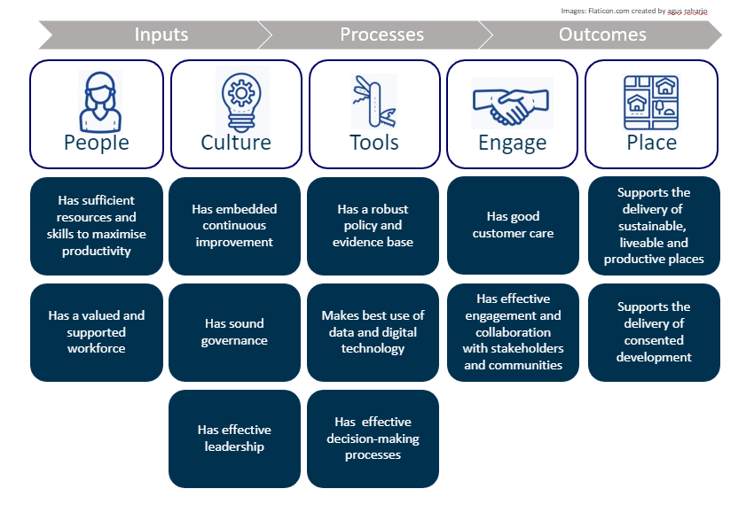
National Planning Improvement Framework
Attributes of a high performing planning authority

Slide 34
“The Place and Wellbeing Outcomes give a good framework and are starting to have an influence from a strategic perspective.“
Kevin Anderson, Service Lead, South Ayrshire Council

Slide 35
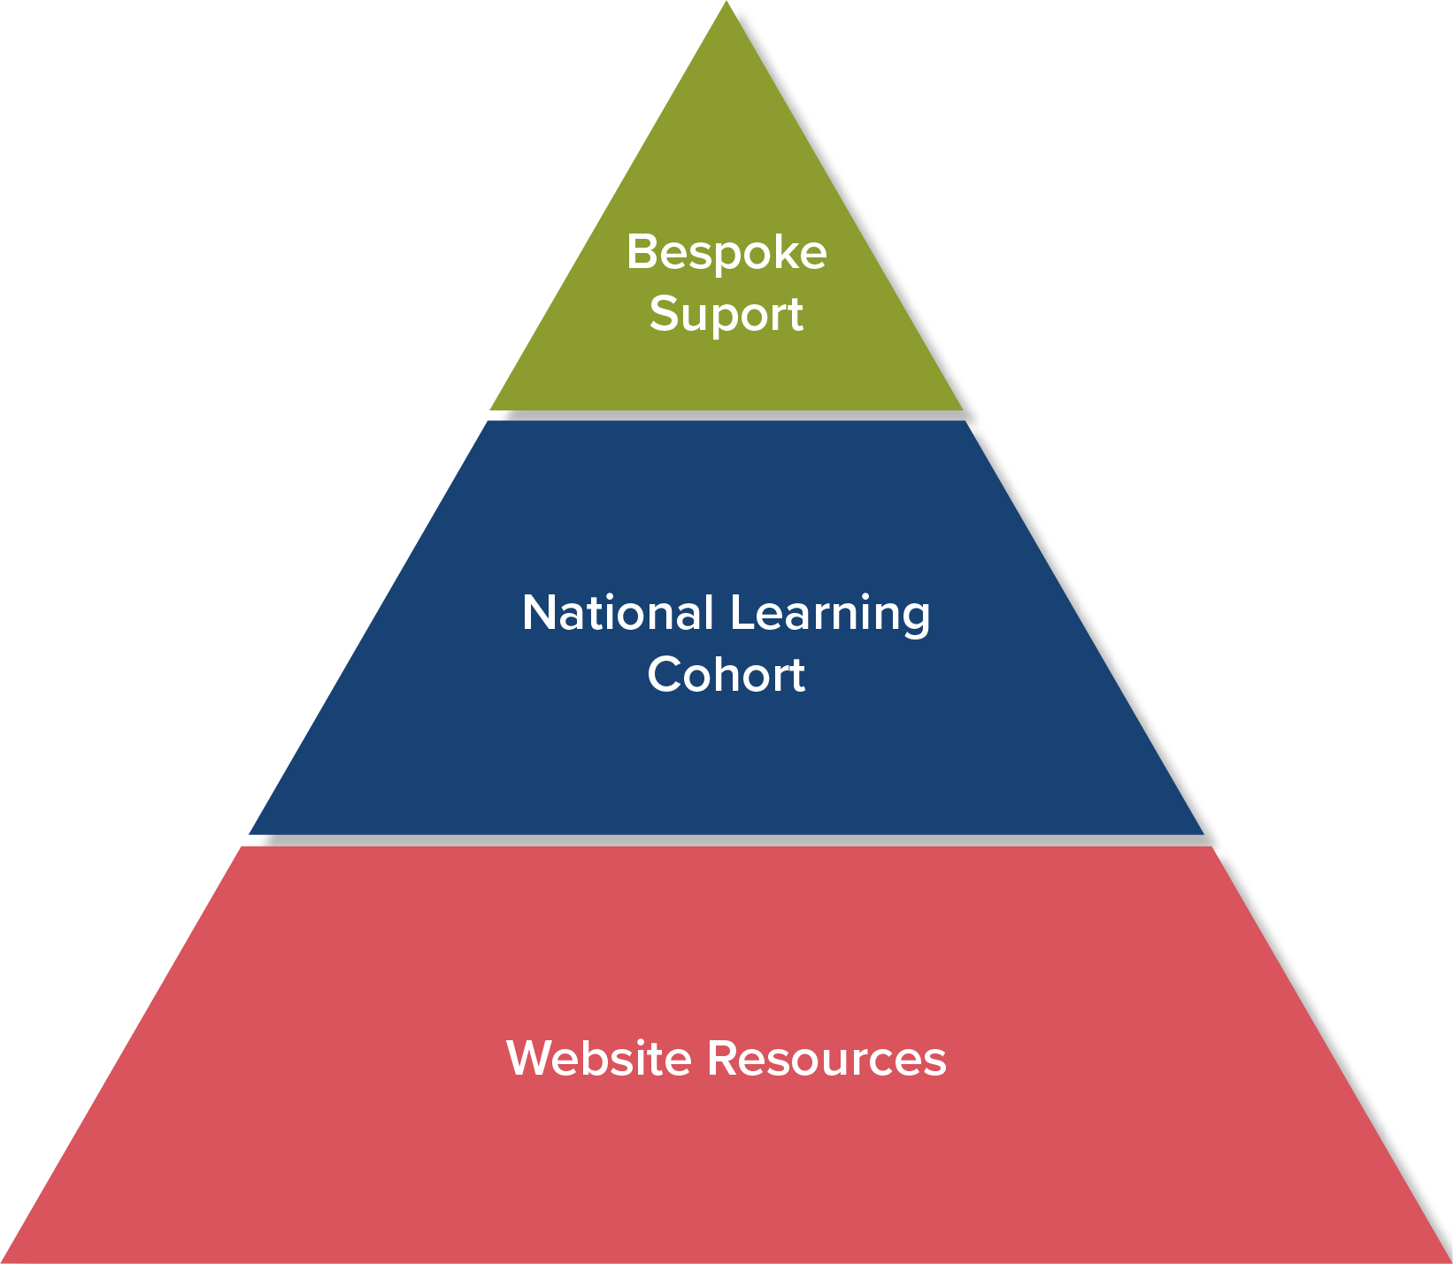
Shaping Places for Wellbeing Programme support sits at three levels

Slide 36
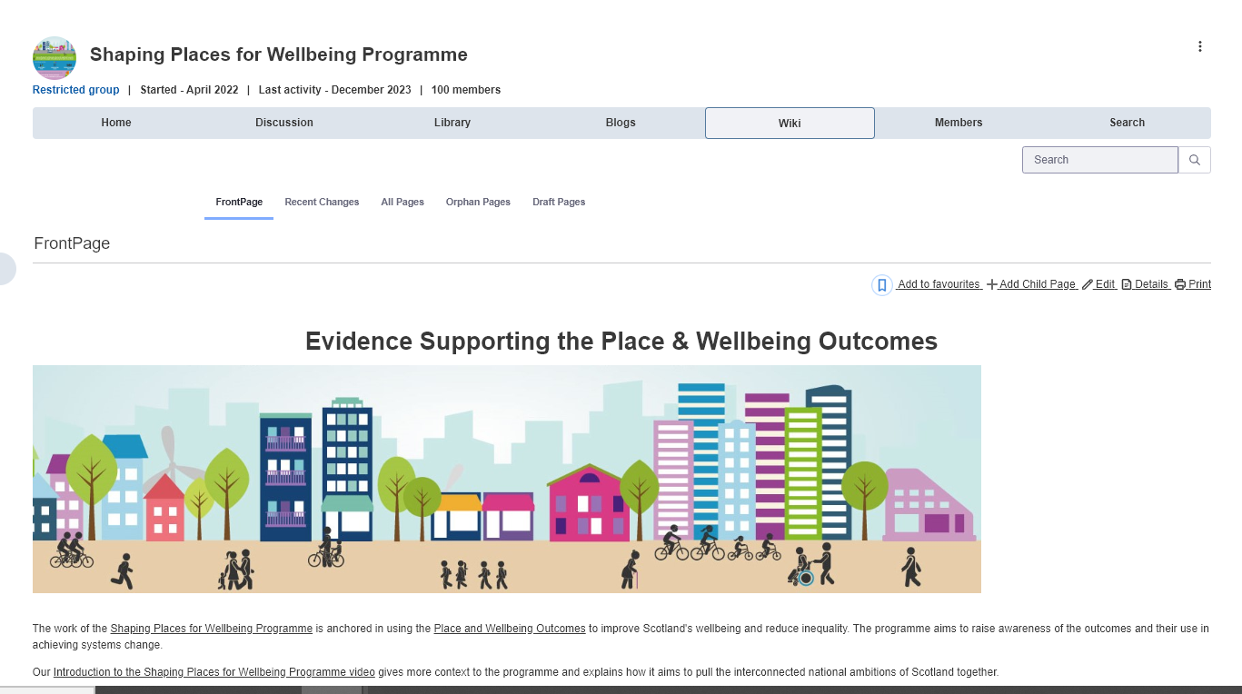
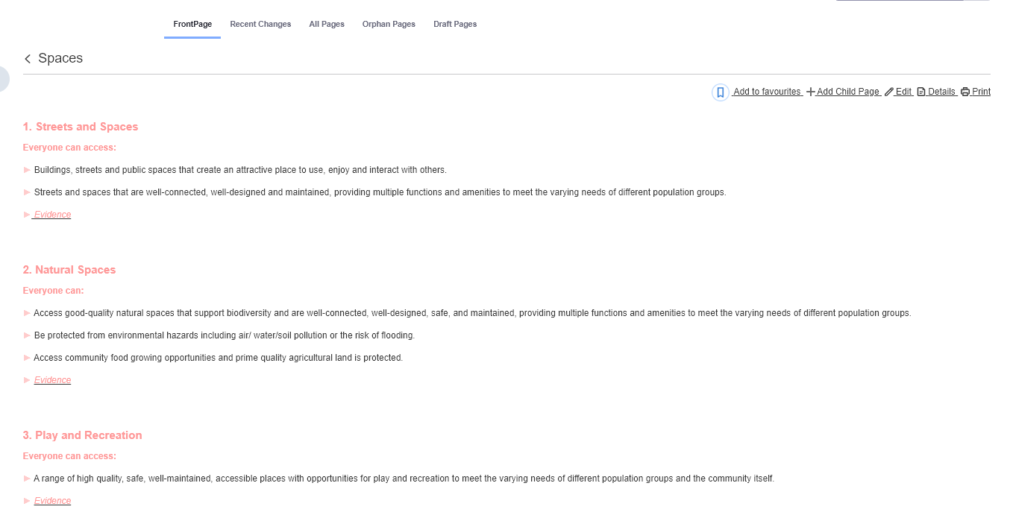
Resources - Place and Wellbeing evidence - KHub
Evidence behind the Place and Wellbeing Outcomes

Slide 37
Further Masterclass:
People: Quantitative and qualitative data
Decision making: Place and Wellbeing Assessments
Place based approaches in action

Slide 38
What next?
Expand and enhance Place and Wellbeing Outcome indicators
Scale up understanding and use of Outcomes
Strengthened support to Planning Authorities

Slide 39
What can we all do?
Expand understanding of role of the Outcomes
- Share this masterclass
Embed the Outcomes into strategies, plans and proposals
Take a place based approach to decision making

Slide 40
Find out more!
Webpage links and how to contact us
Place and Wellbeing Outcomes
Shaping Places for Wellbeing Programme
X (formerly Twitter) @Place4Wellbeing @PlaceNetworkSco @IreneBeautyman
Planning and Place Based Approaches LinkedIn
Email: placeandwellbeing@improvementservice.org.uk
​

Slide 41
Thank you for your time!
​

