Slide 1
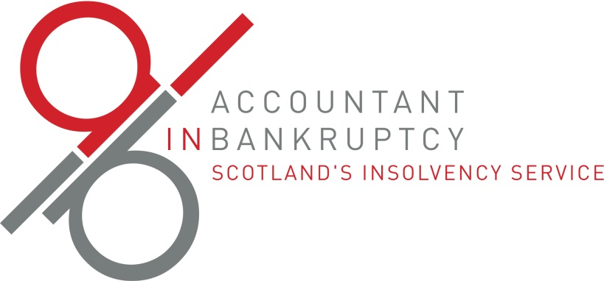








Scotland’s Debt Solutions
Are they fit for purpose?
What would improve the landscape?

Slide 2
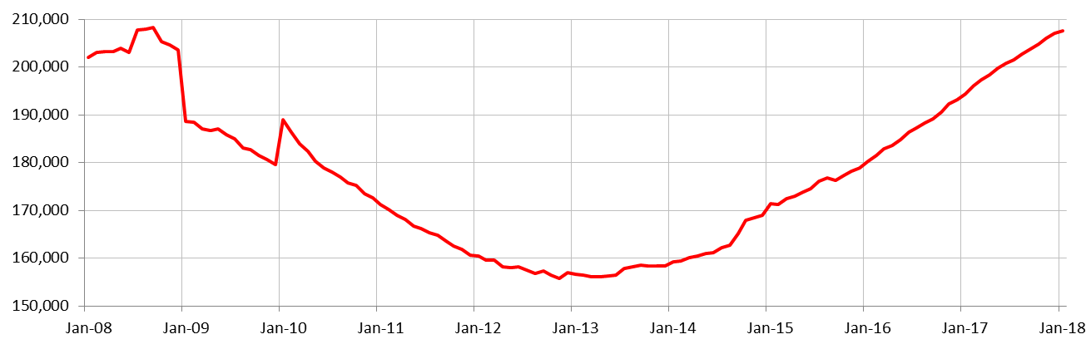
Bank of England
Total consumer credit lending to individuals

Slide 3
How much Debt Advice is needed?
Peter Wyman’s Review of Funding of Debt Advice (UK level)
8.3 million people over-indebted
20.5% are likely to seek debt advice
= Demand for advice for 1.7 m people
Roughly free sector capacity to help 1.1m people
Whatever the numbers, a big shortfall

Slide 4
Bankruptcies 2017-18
Just over 4500 bankruptcies in 2017-18
Around 75% debtor led, 25% creditor petitions
AIB Trustee in 83% of cases, 750 private trustees
7 IPs taking more than 25 cases - together covering roughly 50% of total appointments.
Tail covered by another 47 IPs, given 54 appointment takers in all.

Slide 5
Protected Trust Deeds 2017-18
Just under 6,000 in total
6 firms did more than 200 – 89%
Another 24 firms make up the tail, 16 of which did less than 10
Increasing share of statutory solutions

Slide 6
Debt Arrangement Scheme
Around 2,400 approved in 2017-18
15 fee charging firms and 63 free-to-client advice organisations submitted at least one DAS application
but only 8 and 14 of these respectively submitted more than 10

Slide 7
Fee Charging Sector
7 IPs taking more than 25 bankruptcy cases
6 firms did more than 200 PTDs
8 firms did more than 10 DAS
A small world – and getting smaller?
And the same happening in the free sector?

Slide 8
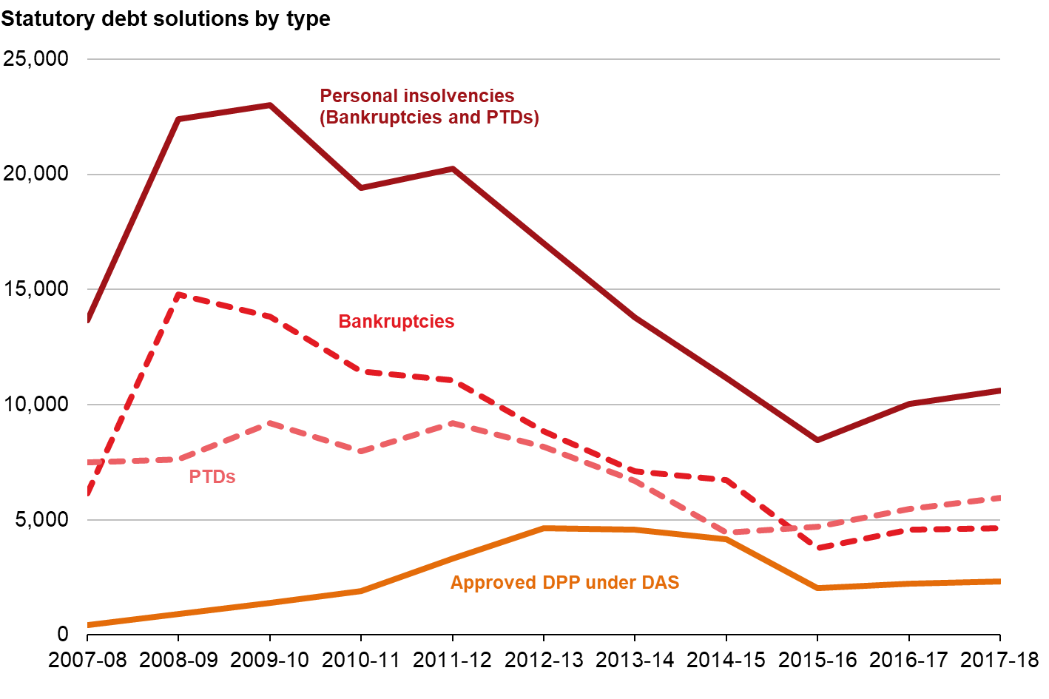
Long Term Trends

Slide 9
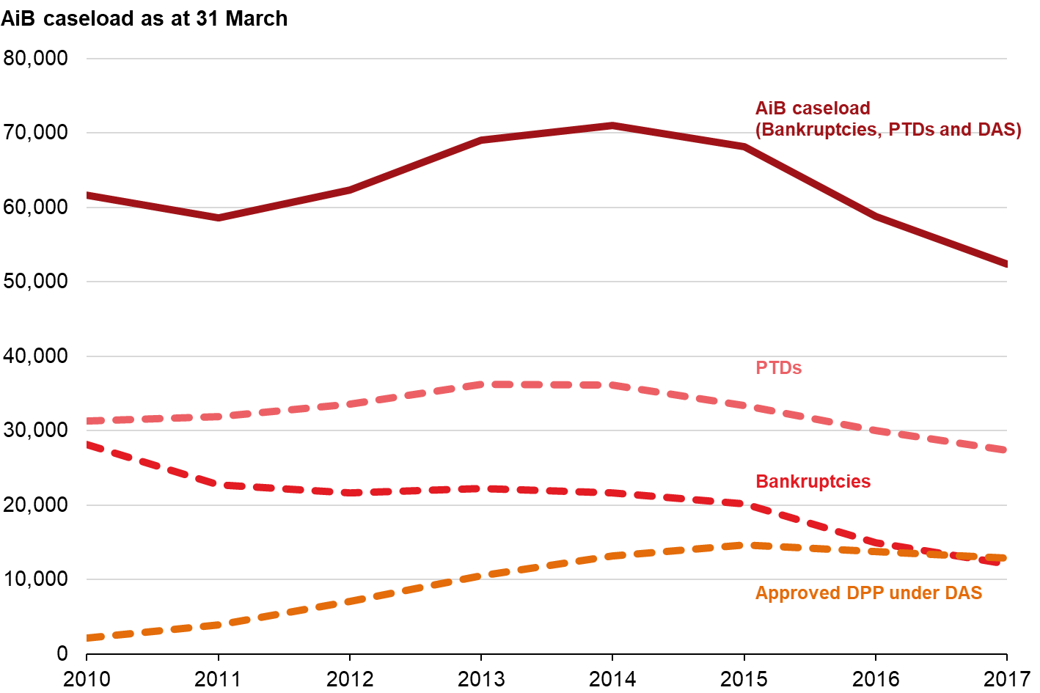
AiB Live Caseload at Year End

Slide 10
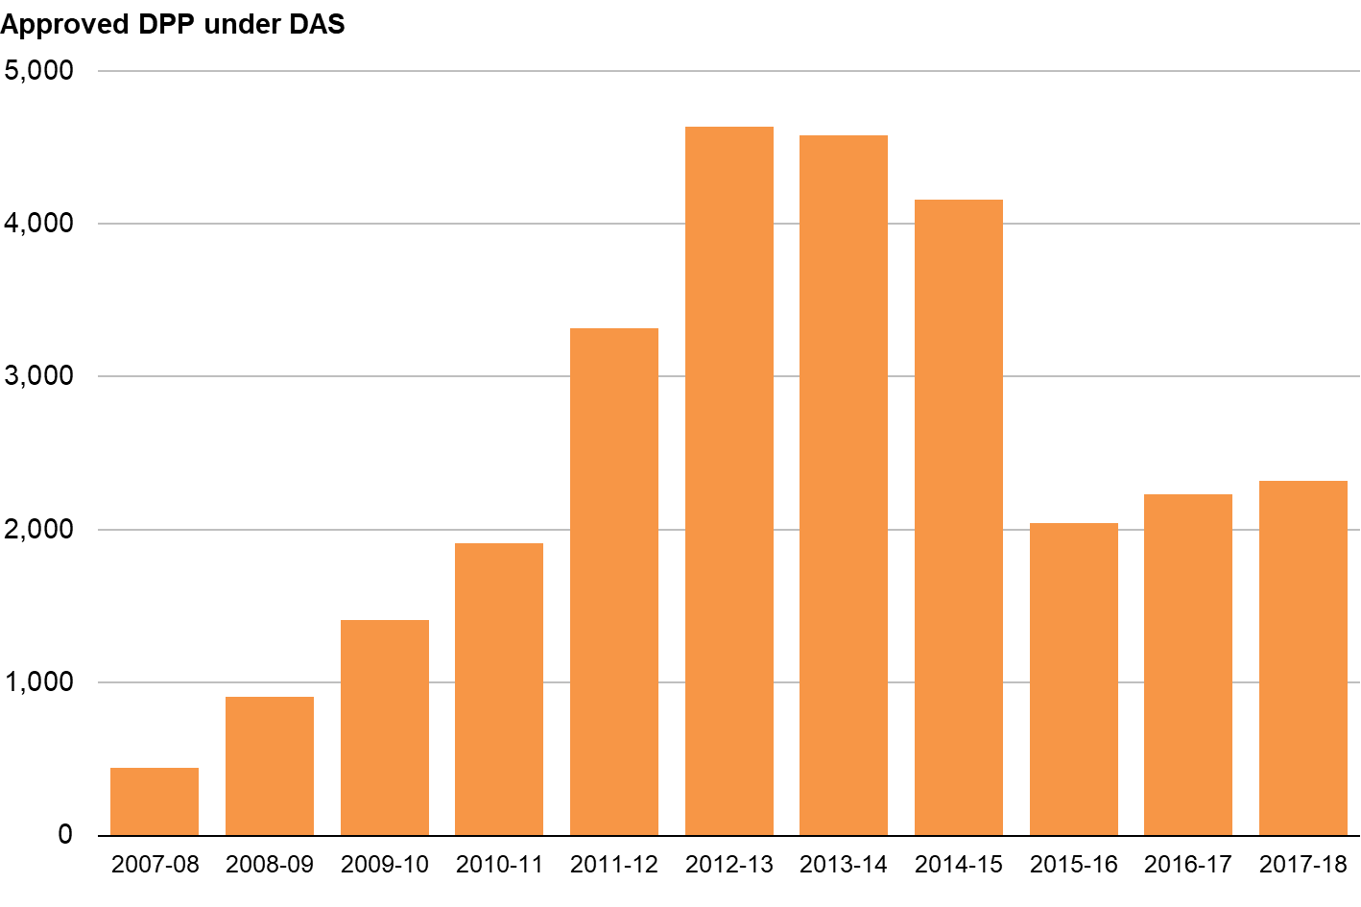
DAS Volumes

Slide 11
DAS – The Basics
All debts must be included
All creditors repaid at same rate
Debtor contribution is determined by the Common Financial Tool assessment – flexibility introduced
Debtor’s access to new credit limited – but action taken
Debtor must maintain current liabilities
DAS available to individuals, couples and a limited number of business entities

Slide 12
DAS Debtor Benefits
Allows time to pay off debts over an extended period with a single regular payment
Protects assets including family home
Provides protection against debt enforcement before & during application process and post approval
Interest, fees and charges on debts are frozen and written off on successful completion
No minimum and no maximum debt levels
No fixed timescale for repayment
A flexible solution where repayments may be varied

Slide 13
DAS Creditor Benefits
Minimum 90% of debt repaid
First payment received after 6 weeks
Ease of payment – collected on creditors’ behalf and distributed by a DAS Payments Distributor
Statutory framework in place to support process
Creditors consulted on individual proposals so have the ability to influence outcomes
All DAS process can be conducted electronically
All creditors treated the same – not “who shouts loudest”
Debtors have to keep up current liabilities or plan falls

Slide 14
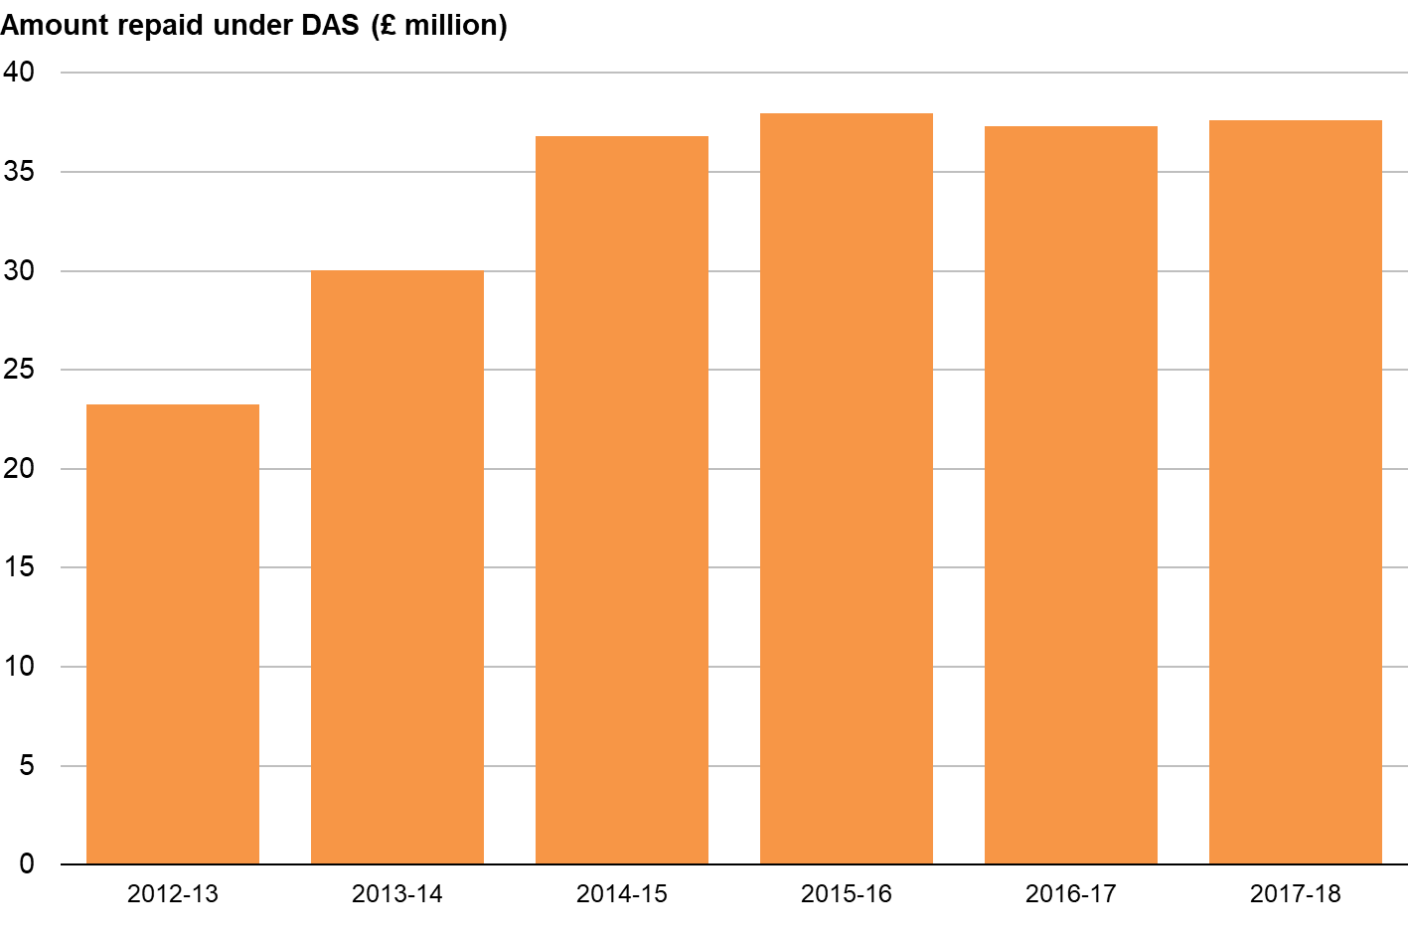
DAS Creditor Returns

Slide 15
Biggest DAS creditors
Creditors with over £1m debts in DAS DPPs approved in 17-18:
Lloyds (HBOS) RBS
Barclaycard Tesco Bank
HMRC Capital One
Arrow Global/Capquest
TSB
(Total debt covered by live DPPs = £235m ish)

Slide 16
Potential Market for DAS?
Grant Thornton estimated that at the start of 2012 there were between 520,000 and 645,000 debt management plans ongoing, with between 300,000 and 375,000 of these provided by fee-charging debt management firms – at a UK level.
Why would anyone in Scotland choose a DMP over a DAS?

Slide 17
Future DAS Regulations
AiB exploring options for future changes to DAS, a consultation exercise will be held this year. We aim to explore how we can:
Reduce bureaucracy to lighten administrative burden
Enable free sector to cover their costs and reward fee chargers who generate DAS cases – with AiB to take (at least) a back stop role as a payments distributor
Examine options for Continuing Money Adviser fees
Explore how to improve completion rates
Changes to be introduced in 2019

Slide 18

Breathing Space

Slide 19
Protected Trust Deeds – rising volumes
Year | Trust Deeds Protected
2014-15 | 4,437
2015-16 | 4,709
2016-17 | 5,470
2017-18 | 5,958

Slide 20
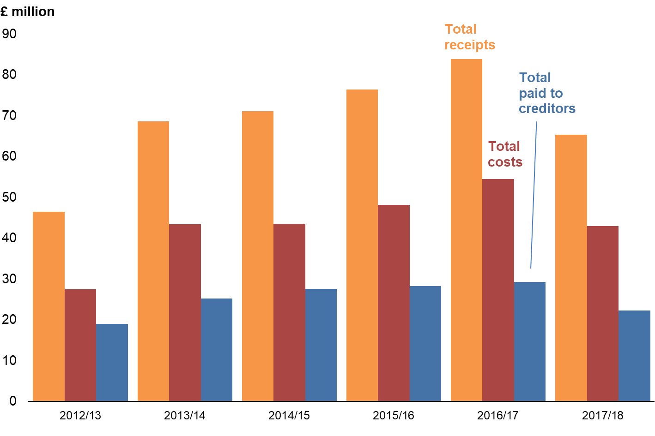
Receipts, Costs & Dividends
For PTDs concluded in 2017-18, average dividend was 17.8 pence in the £ compared with 19.8 pence in the £ in 2016-17.

Slide 21
Protected Trust Deeds – a bad example
Total debt £5872
Contributions £5664 (£118 a month)
Total admin costs in PTD £4663
Available to creditors £1209
Anticipated dividend £0.17/£
In a DAS, same debtor would have paid contributions for two more months
Potential return to creditors £5300

Slide 22
New Regulations
Consultation conducted in 2016, the following changes are being considered:
Inclusion of outlays and disbursements included in initial fee
Creditor claims to be submitted within 120 days
Revised voting arrangements – emphasis on active engagement
Consideration of protection where debts can be paid via contributions
Aiming for the revised regulations to be laid this year

Slide 23
Protected Trust Deeds v Debt Arrangement Scheme
Outcome for creditors:
PTD = 20p in the £
DAS = 90p in the £
If moving more cases from PTDs to DAS means DAS outcome falls to 75p in the £, would that be worthwhile?

Slide 24
Further Consultations
Common / Standard Financial Statement
Consultation on Bankruptcy and Debt Advice (Scotland) Act to take place in 2018/19
Response to diligence consultation
Corporate Insolvency rules modernisation – legislation laid in Parliament. Live from April 2019

Slide 25
Thank you for listening
Any Questions?

Slide 26

Thank You
Alex Reid
Accountant in Bankruptcy
alex.reid@aib.gsi.gov.uk

