Slide 1
Local Government Data Platform Phase 1 – Key findings & Recommendations
Agenda Item 6
A discovery phase aiming to better understand the complexity in the current reporting landscape in order to improve governance and to identify opportunities for streamlining reporting requirements and processes.
Emily Lynch, Improvement Service

Slide 2
Key Findings
Lack of focus on outcomes
Significant & growing volume of reporting
Little clarity on purpose & use
Lack of automation in collection & validation
Systems & processes poorly orchestrated and co-ordinated
Notes:
The current reporting regime reveals a lack of focus on outcome improvement. The New Deal for Local Government allows us to think differently about how we can work together to make better use of data to drive the desired improvement in outcomes.
The volume of reporting that Councils are required to provide is growing at an accelerated rate, driven in part by the increasing proportion of Local Government funding which is ringfenced or provided with the expectation it will be spent on specific services. The scale of reporting, alongside a lack of co-ordination and lack of automation in the return process creates a significant burden for Local Authorities. The volume is undermining our confidence in the quality of data returned, and also our ability to derive useful insights and use the available data effectively to inform evidence-based decision making. An ever-greater local government resource is required to service reporting commitments, leaving less capacity to focus on what is important locally, and to undertake the value-added work of analysis, interpretation and use. In addition, the cost of producing this volume of data is unnecessarily high and will only keep growing. The increasing proportion of ringfencing and associated reporting is reducing the flexibility Local Government has to make decisions and use resources flexibly to deliver on outcomes for people in their communities.
There is a lack of oversight or awareness of what data is being collected, or where there may be duplication, or opportunities for better alignment or linking of datasets. There is a lack of clarity and transparency in relation to the purpose and use of much of the data collected. Beyond the publication of statistics, it is not clear how the information is used at a national level for policy development or funding decisions. There is also insufficient evidence of how the data is being used at a local and/or national level to drive improvement in outcomes or support a greater focus on prevention. The data which is requested by national bodies is often not perceived to be useful for local authorities in relation to improving outcomes, with relevance, quality and timeliness issues continuing to undermine the value and use of data reported.
There is an over-reliance on data collection approaches which do not support automated collection or validation of data, creating resource implications for both Local Government and Scottish Government, and also significant time lags in publication.
Councils systems and processes used to return data are often poorly orchestrated and co-ordinated, adding to the resource burden and undermining their ability to derive maximum value from available data. Configuration of Council data management systems does not currently support ‘one button’ reporting, and leads to the creation of complex, often manual and resource intensive processes to transform and prepare data for reporting. Data quality and completeness issues within LA systems result in significant resource being focussed on validation and checking of data. Data architecture does not facilitate efficient data flow, data sharing, data linkage, data analytics and data access to maximise value and use. Councils are engaging with data transformation and data maturity agendas, but cite challenges in relation to internal capacity, skills, capability, leadership and workforce buy-in.

Slide 3
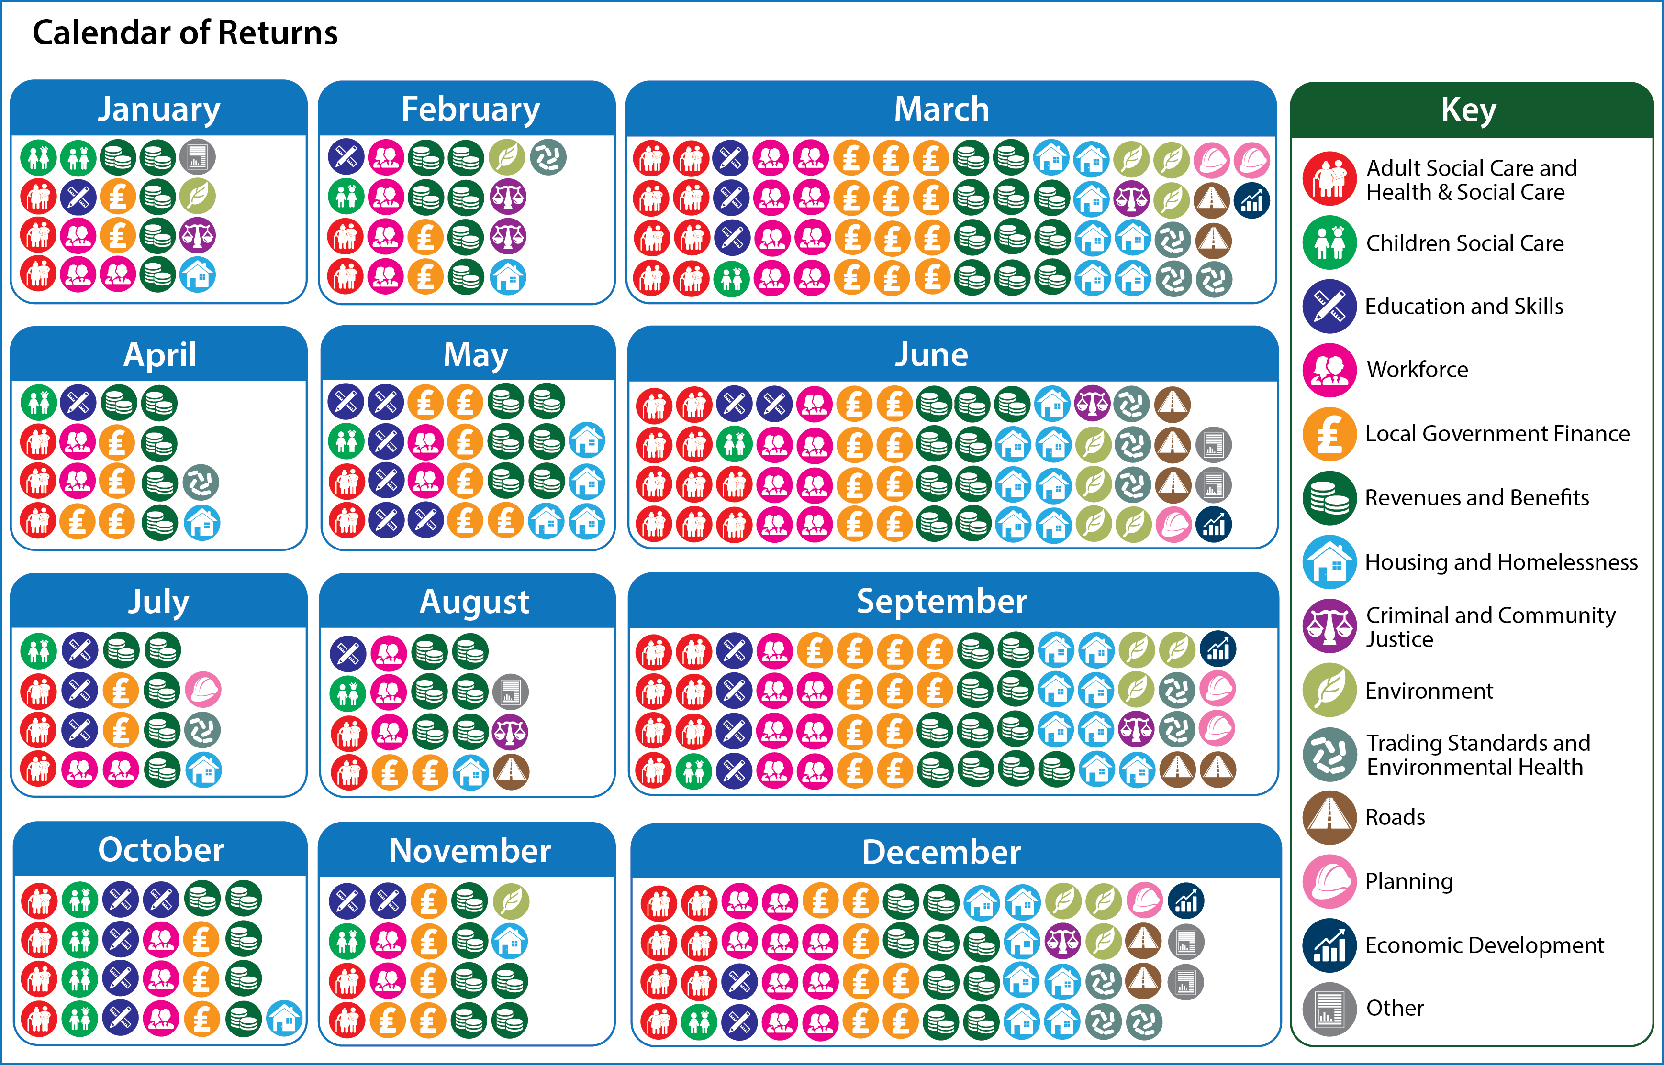

Slide 4
Recommendations
LG & SG should use the New Deal for Local Government and underpinning partnership agreement to ensure a focus on reporting which is essential to evidence improvement in outcomes in partnership, ensuring that we take account of existing data reporting and consider streamlining and reducing where possible.
LG & SG should work together to:
Build trust around delivery, and a focus on only the data required to evidence outcome improvement.
Develop a protocol and governance mechanism to agree and implement future reporting (+online register of data returns)
Reduce the overall volume of data reporting by reviewing relevance, usefulness and duplication
Ensure greater use and re-use of collected data in driving improvement in outcomes
Review the extent to which the Crerar recommendations have been implemented
The IS, COSLA & Digital Office should work with Scottish Government to seek opportunities for improvements in national co-ordination, orchestration, standardisation, and (where applicable) automation to reduce burden.
The IS, COSLA & Digital Office should work with Councils to prioritise local improvements in data quality and data standards.
Notes:
Local Government and Scottish Government should use the New Deal for Local Government and underpinning partnership agreement to ensure a focus on reporting which is essential to evidence improvement in outcomes in partnership, ensuring that we take account of existing data reporting and consider streamlining and reducing where possible.
Specifically, against this current context, Local Government and Scottish Government should work together to:
Build trust around delivery, and a focus on only the data that is required to evidence outcome improvement.
Develop a protocol and governance mechanism to agree and implement any future reporting that is required, within a new assurance and accountability framework (part of the Partnership Agreement).
Reduce the overall volume of data reporting, focussing on policy relevance and impact on improving outcomes, and identifying areas of duplication.
Operationalise the high-level principles developed to support reviews of relevance and usefulness of current and future data reporting.
Promote and ensure greater use and re-use of collected data in driving improvement in outcomes
Utilise the Calendar of Returns to improve planning and co-ordination of existing reporting.
Develop and operationalise ongoing hosting and updating arrangements for the List of Data Returns, including the development of an online register of data returns.
Review the extent to which the Crerar recommendations have been implemented and ensure that issues in relation to the collection and reporting of data are fully linked into the evolving scrutiny landscape.

Slide 5
Next Steps – Phase 2
4 Workstreams
Improving governance and delivering reductions in the reporting landscape, including establishing a formal (and definitive) online register of data returns.
Improving data standards to enhance the quality and reuse of provision of data returns.
Improving orchestration of data returns using scheduled workflows to initiate data returns and track progress of completion, running a proof-of-concept with selected returns.
Automation of data collection and distribution, running a proof-of-concept with selected returns to establish capacity and ability to provide and support further automation.
Will focus on simplification and streamlining of the reporting landscape, as well as delivering improved co-ordination of the data collection that continues to be necessary for assurance purposes, reducing the effort for manual data collection and improving the re-use of data collected
Notes:
Set against the context of the New Deal and Partnership agreement, Phase 2 of the Local Government Data Platform project will focus on simplification and streamlining of the reporting landscape, as well as delivering improved co-ordination of the data collection that continues to be necessary for assurance purposes, reducing the effort for manual data collection and improving the re-use of data collected.
This phase will build on the findings in Phase 1 and take forward the recommendations outlined under the 4 workstreams above.
Resourcing & Timescales
The Improvement Service is funding a Project Manager to oversee the delivery of Phase 2 of this project, which is scheduled to last for six months, running from May to October 2023. As with Phase 1, Phase 2 will continue to be a collaborative endeavour and it will be critical that the IS Project Manager can draw upon the expertise, skills and capacity within the Digital Office for Scottish Local Government, Public Health Scotland, COSLA and local authorities themselves.
Governance/Reporting
The existing Oversight Group will advise on overall strategic direction and delivery of Phase 2. This group is jointly chaired by Solace and COSLA, and draws membership from the IS, LGDO, Public Health Scotland and Scottish Government. The LGBF Board will continue to provide an advisory role for this work. Upon completion of Phase 2, a report outlining the progress achieved, along with recommendations for future phases of this project will be shared with Solace and COSLA. This will provide an opportunity to ‘take stock’ in relation to wider progress, and to secure wider system commitment and appropriate resource contributions for future phases.

