Slide 1


Maternity Matters

Slide 2

Background
Current long standing relationship with NHS Professionals
Historically Midwives not good at making referrals to Financial Inclusion Services
How do we engage with NHS Professionals who do not currently engage?
How do we engage with clients who currently do not engage with any services?
How do we make a difference to one of the most vulnerable client groups?
How do we measure the difference we make?

Slide 3


Slide 4
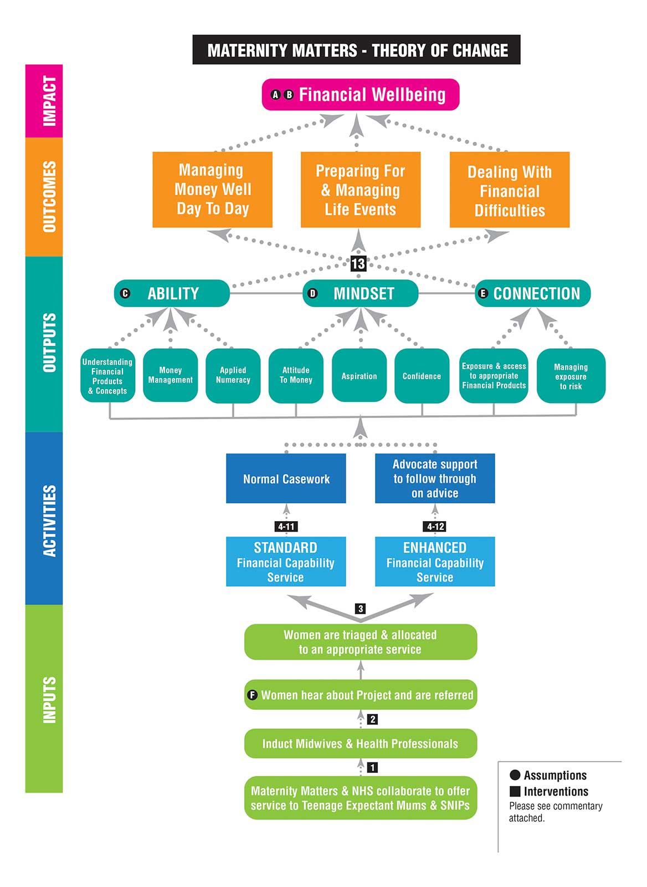

Slide 5
What we do different?
Completely changed our referral system – co-location
Buy-in from Mid-wives!
Amended and refined our referral protocol
Changed our method of Engagement with clients
Using a Carrot to get Results!

Slide 6
How we will Measure and Evaluate?
35 Point Pre-questionnaire completed at initial meeting
Post questionnaire completed at conclusion of Standard intervention
Post questionnaire completed at conclusion of Enhanced intervention
Independent Evaluation by Ipsos Mori & SQW

Slide 7
Targets & Progress to date

Slide 8

Questions?

