Slide 1




Introduction to Hydrogen
Module 3: Transportation and Storage
Prof Julia Race
University of Strathclyde
Dr Katriona Edlmann
School of GeoSciences, University of Edinburgh
Notes:
Hello my name is Julia Race.
I am a Professor of Naval Architecture, Ocean And Marine Engineering at The University of Strathclyde and I will take you through Module 3.
This session will provide an overview of hydrogen transport and storage.
00:20

Slide 2

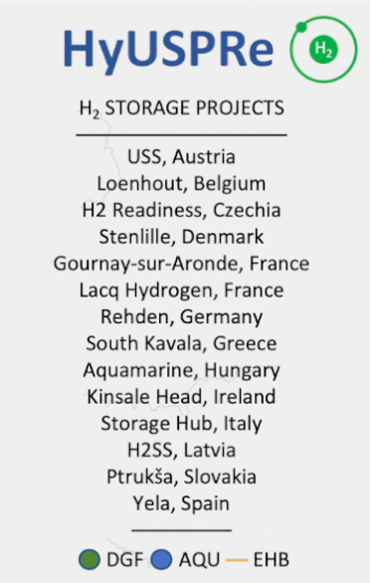

Repurposing pipelines
H₂
4,500 km of hydrogen pipelines
in operation worldwide
Net energy capacity of a pipeline converted to H₂ from natural gas is only slightly smaller. Depends on compression and pumping costs
Retrofitting pipelines can save
65-90% of the cost of new
pipeline development
CO₂
Hydrogen Network
Cavanagh et al. 2023. D1.5: www.hyuspre.eu/index.php/downloads/
Notes:
There are currently 4500 km of hydrogen pipelines in operation worldwide, so we are very familiar with material selection and safe pipeline operations. Nearly half of these pipelines are in the USA, along the Gulf Coast, where hydrogen is transported as a chemical feedstock from producers to industrial sites where it is used, for example, in the production of ammonia. In Europe the longest hydrogen pipeline is a 964 km network operated by Air Liquide which delivers hydrogen for chemical and petrochemical use in the Netherlands, Belgium, and France.
An important consideration for transporting hydrogen is that while methane has three times the calorific heating value of hydrogen, hydrogen can be transported at much higher velocities than methane, meaning that the overall net energy transportation capacity of a pipeline converted to hydrogen from natural gas is only slightly smaller, depending on compression and pumping costs.
There is a huge global investment in developing hydrogen pipelines, and the European Hydrogen Backbone is looking to establish hydrogen supply corridors by 2030 and progressively connecting European and neighbouring regions. This is to be realised by converting pipelines that fall redundant due to declining natural gas demand, to minimise stranded assets and by developing new infrastructure where needed. Retrofitting pipelines can save 65-90% of the cost of new pipeline development.
02:20

Slide 3
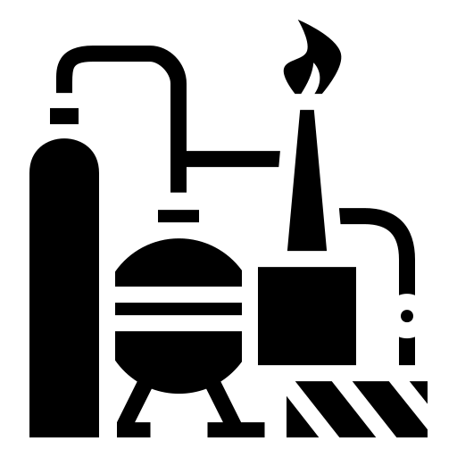

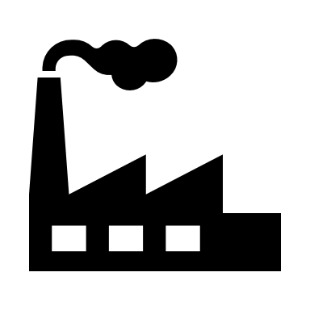




Developing a hydrogen network
Typical natural gas pipeline network
PRODUCTION
GATHERING SYSTEM
PROCESSING FACILITY
TRANSMISSION SYSTEM
DISTRIBUTION SYSTEM
END USE
POWER GENERATION
Onshore
Steel
Onshore
Steel
INDUSTRY
Cast iron
Heavy industry
Offshore
Corrosion resistant alloys
Offshore
Chemical
Steel
Polyethylene
Refineries
Potential hydrogen pipeline network
TRANSPORT
PRODUCTION
GATHERING SYSTEM
GATHERING FACILITY
TRANSMISSION SYSTEM
DISTRIBUTION SYSTEM
Road
Rail
Green
Hydrogen
H
Aviation
Steel
Steel
Shipping
Blue
Hydrogen
Scottish Carbon Capture & Storage
H
www.sccs.org.uk
Steel
Polyethylene
HEATING
Polyethylene
Hydrogen CPD Course | April 2024
Notes:
It is anticipated that the development of a hydrogen pipeline network will be analogous to the development of a natural gas pipeline network. It is therefore instructional to consider the component parts of a typical gas pipeline network. In a gas system, gathering pipelines or flow lines collect the gas from the well head and transport it back to a rig or processing facility where it is partially processed, primarily to remove water.
Gas from a number of different wells could be collected at a single processing facility. The gas is then transported via transmission pipelines which transfer the gas from an offshore to an onshore facility, or for long distances between onshore facilities. Transmission pipelines are generally between 6” to 56” in diameter and operate at high pressure. In order to deliver the gas to industrial users and domestic customers, the gas undergoes pressure reduction before transfer to the distribution pipeline system. The distribution pipelines are typically 2-10” in diameter and operate at pressures of < 7bar.
A hydrogen network would look very similar to this – gathering lines might collect hydrogen from a number of production sites either onshore or offshore to a gathering facility – transmission pipelines would transport the hydrogen from the facility, for example, offshore wind farms or between industrial clusters onshore, and distribution lines would transport the hydrogen to industrial and domestic end users. So the development of a hydrogen network would share many of the characteristics of the natural gas pipeline network, however there are a few additional considerations that have to be taken into account.
Gas moves through the transmission pipeline network as a result of pressure difference between the inlet and the outlet of the pipe. This pressure difference is generated using compressors that raise the pressure at the inlet. As the gas travels through the pipeline it loses pressure due to frictional loss and therefore compressor stations are required at specified distances along the pipeline to raise the pressure again and maintain the differential.
Although the density of hydrogen is lower than that of methane, the energy density per unit volume is about a third that of natural gas. Therefore to attain an energy flow that is equivalent to natural gas at any given pressure, the volume speed of hydrogen in the pipeline needs to be increased threefold relative to natural gas. This increases the velocity of the gas in the pipeline and also has an impact on the types of compressors used, potentially requiring an increase in compressor capacity in the network for the increased volumes of gas.
Gas transmission pipelines tend to be constructed from plain carbon steel although stainless steel and corrosion resistant alloys can also be used in highly corrosive environments. High strength polyethylene and low strength steel is used in the distribution system although older gas distribution pipelines can be made from cast iron.
It is likely that hydrogen pipelines will be constructed from steel and polyethylene for new pipelines - more on this later– although as there are still cast iron mains in the distribution system.
The compatibility of cast iron for ahydrogen service is being investigated.
06:30

Slide 4

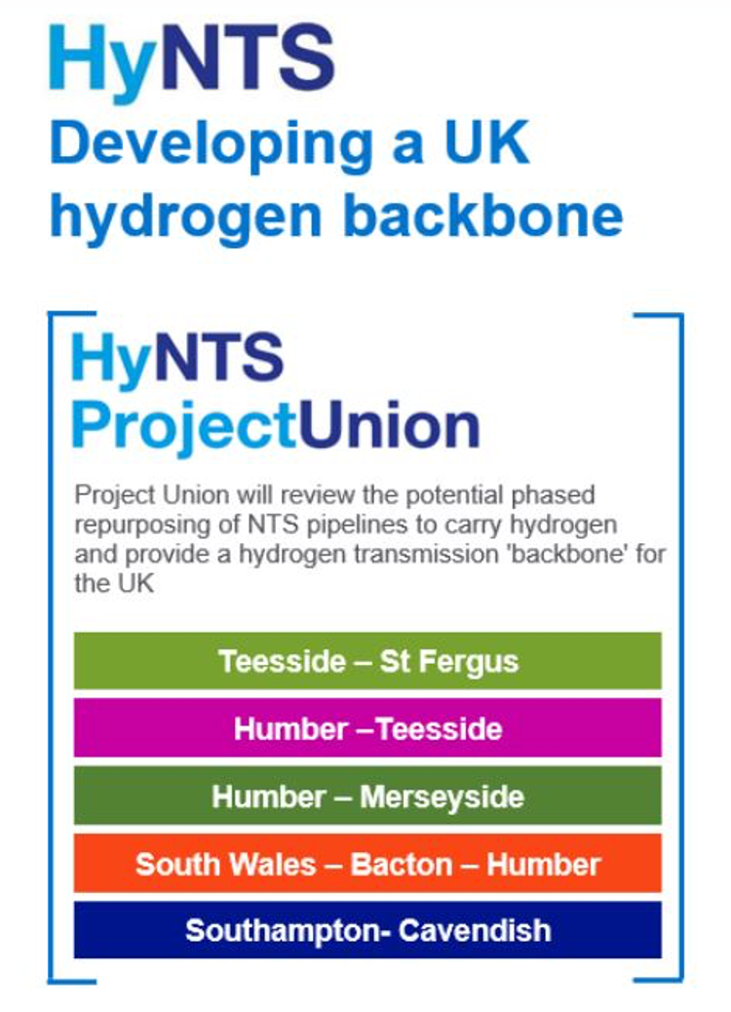
Connecting UK clusters
H₂
CO₂
Hydrogen Network
Source: National Grid, Project Union
Notes:
Industrial clusters not only serve as hubs for the growth of local hydrogen economies, but in time will connect to support the wider growth and connectivity of the hydrogen economy.
The HyNTS project is focused on developing a UK hydrogen pipeline backbone, to provide the necessary high pressure and volume hydrogen transmission network for delivering hydrogen to industrial and power users across the country; In the same way as the National Transmission System or NTS does for natural gas today.
It is also designed to connect the European Hydrogen Backbone network to make the most of European hydrogen import and export opportunities.
07:30

Slide 5


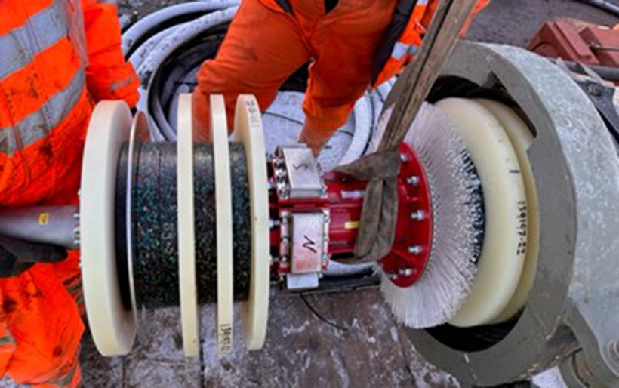
Network: hydrogen in pipelines
NTS – National Transmission System
LTS – Local Transmission System
UK LTS = 11,000 km
SGN LTS = 3,300 km
H₂
CO₂
Hydrogen Transport
https://www.sgn.co.uk/news/lts-futures-blog-courtney-west
https://www.sgn.co.uk/news/sgn-deliver-ps299m-national-strategic-hydrogen-transmission-and-storage-project
Notes:
If the National Transmission System or NTS is the artery of the gas network, the Local Transmission System or LTS are the veins of the gas energy network, delivering gas from the NTS to towns and cities across the country.
Launched in April 2022, SGN’s £30 million LTS Futures project is a three-year project assessing the viability of repurposing Great Britain’s 11,000 km Local Transmission System from natural gas to 100% hydrogen.
The LTS futures project involves repurposing a decommissioned pipelines to hydrogen through a live trial.
A statistically representative pipeline between Granton in Edinburgh and Grangemouth has been selected and over the past year a wide range of detailed survey and assessment evaluation tests were undertaken to check for any issues ready for the live hydrogen trial.
In the last few weeks Ofgem has given permission to continue to the second stage gate which is to connect the pipeline to a hydrogen supply from project partners, INEOS at Grangemouth, in advance of the live hydrogen trials.
09:00

Slide 6
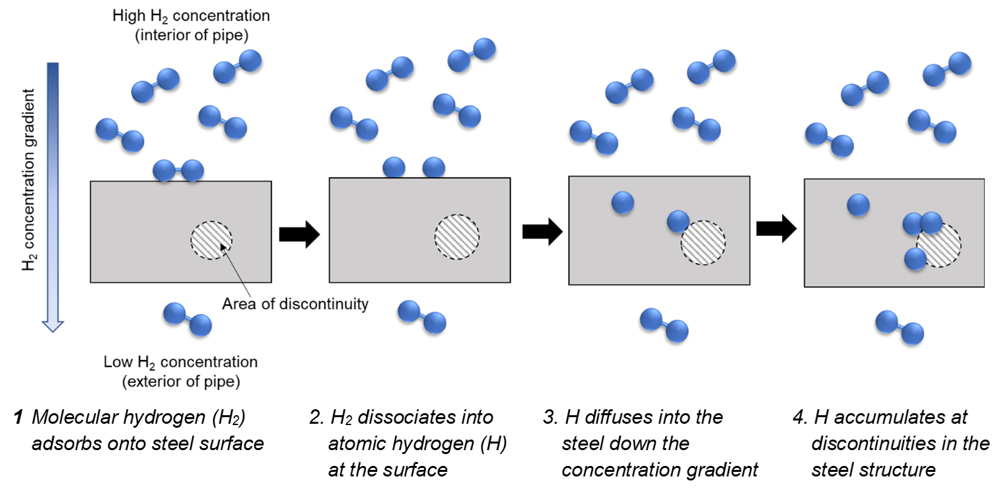
Hydrogen diffusion and embrittlement
H₂
CO₂
Hydrogen Network
Notes:
Compared with natural gas, hydrogen has particular features that affect the design of the steel pipelines.
Atomic hydrogen (dissociated from hydrogen gas on the steel surface) can diffuse into the steel structure and permeate through the steel from areas of high to low concentration.
This has an effect on the storage capacity of the pipeline, but more critically, the hydrogen can accumulate in the microstructure of the steel and degrade the ductility and toughness (termed “hydrogen embrittlement”), which can lead to cracking.
09:40

Slide 7
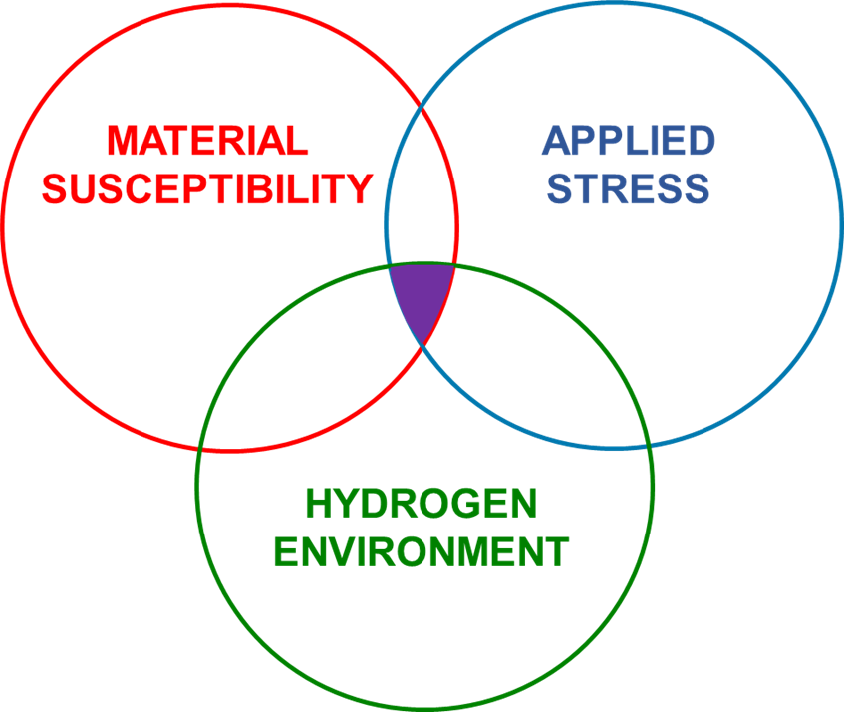
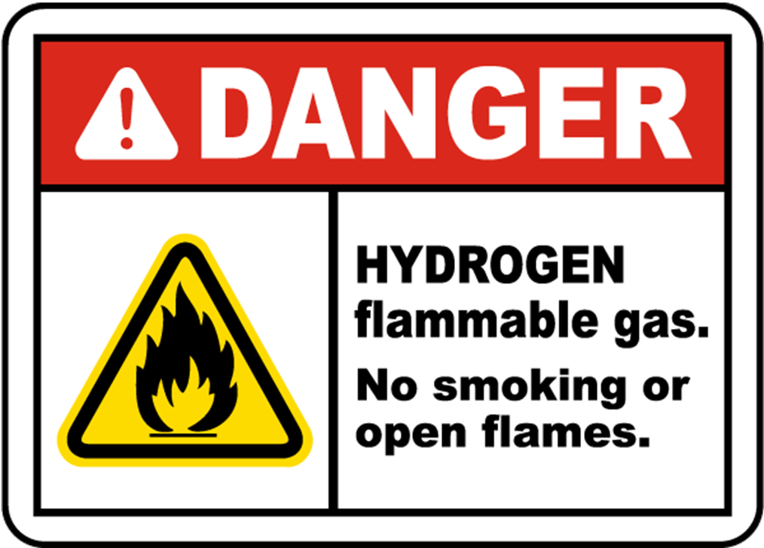
Pipeline safety considerations
H₂
Standards limit:
  Strength of steel that can be used for hydrogen pipelines
  Maximum operating stress
ASME B31.12:
  Maximum grade of steel (X52)
  Maximum stress 30-50% of yield stress
CO₂
Hydrogen Network
Notes:
The extent to which hydrogen affects the properties of pipeline steel is dependent on the microstructure of the steel, the loading conditions on the pipeline, in terms of the applied stress, and the nature of the environment containing the hydrogen.
In general, the susceptibility of a steel to hydrogen embrittlement increases with increasing strength. Consequently, the standard for hydrogen pipelines in the USA, ASME B31.12, advises a limitation on the maximum strength of steel that can be considered for hydrogen pipelines (Grade X52, which has a minimum yield stress of 358 MPa) and suggests a limitation on the maximum operating stress of the pipeline of between 30-50% of the minimum yield stress of the pipeline. This limitation on material grade may affect the suitability of some pipelines in the network for repurposing from natural gas to hydrogen.
When developing a pipeline network, and in particular when deciding on the route of a new pipeline, the risks associated with an escape of gas have to be considered to ensure that the risk of failure is as low as reasonably practicable to protect life, property, and the environment. Here we make a distinction between a leak event and a rupture event.
As mentioned previously, hydrogen is easily able to permeate more readily through materials than methane, increasing the risk of leakage through joints and seals. Hydrogen can also permeate through polymer materials (for example the material used for distribution pipelines) and does this at higher rates than methane, although the total loss of hydrogen by permeation is not considered economically significant due to the lower energy losses. As methane is colourless and odourless, leaks are difficult to detect, so an odorant is added to the gas that alerts the public to a potential leak. Odorants that are compatible with hydrogen gas are also being developed although it has to be ensured that they are compatible with the intended end use as some odorants can poison fuel cells and therefore have to be removed at the point of use.
For hydrogen pipelines, as is the case for natural gas pipelines, the consequence of large-scale failure or rupture of the pipeline is a release of a cloud of gas into the atmosphere which, if it were to find a source of ignition, would burn. The procedures for conducting a dispersion and thermal analysis for a release of natural gas from a pipeline, which subsequently ignites, are well understood and robust risk assessment methodologies are in place, regulated through pipeline standards. However, when conducting consequence analysis for a hydrogen pipeline there are some differences that need to be taken into account.
Firstly, as mentioned previously, hydrogen is lighter than methane and therefore it disperses more quickly away from the point of release. However, the flammability range of hydrogen is much wider than that of methane which means that it requires less air to burn. In open areas, hydrogen will burn quickly however a hydrogen fire radiates less heat than a natural gas fire so the risk of thermal damage is reduced compared with methane. Understanding these differences and including them in the well-established risk assessment procedures for gas pipelines ensures that hydrogen transmission and distribution pipelines can be designed and constructed safely.
13:45

Slide 8
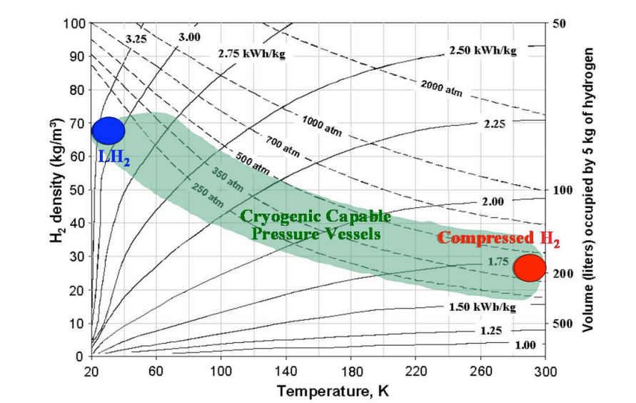
Hydrogen Storage in Surface Tanks
H₂
CO₂
Hydrogen Storage
Surface tanks
Compressed Gas
Cold & Cryo Compressed
Liquid H₂
https://www.osti.gov/servlets/purl/1213633
Notes:
Commercial automotive hydrogen storage technologies occupy the extremes of this phase diagram.
Hydrogen is often stored as a compressed gas (red dot) at ambient temperature (horizontal axis), very high pressure (dotted lines), and relatively low density (vertical axis).
Hydrogen is much more compact as a cryogenic liquid (blue dot) but with higher energetic cost (solid lines indicate the theoretical minimum work, also known as thermomechanical exergy) to compress and/or liquefy hydrogen.
Cryogenic capable pressure vessels have flexibility to operate across a broad region (shaded in green) of the phase diagram, and therefore can be fueled with gaseous H2 at a low energetic cost when energy or fuel cost savings are important or with Liquid H2 when a long driving range, or low-pressure operation is desired.
15:05

Slide 9
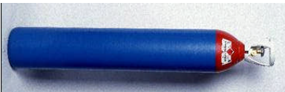
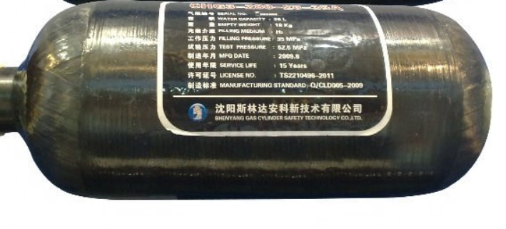
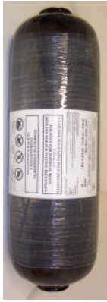

Compressed Gas Hydrogen(CGH2)
Vessel Type | Type I | Type II | Type III | Type IV
Vessel Photos
Vessel Descriptions | Steel Range from small cylinders up to jumbo tubes | inner layer made of metal outer layer of glass fiber composite. | a metallic liner (usually Al) a fully wrapped composite shell (bears majority of pressure load) | a polymeric liner (usually high-density polyethylene) wrapped with a carbon fiber or carbon/glass fiber composite shell.
Typical Applications | Bulk transport ground storage | High pressure storage | Special applications like medical, paint ball, firefighting and aerospace - storage for industrial gases | Special applications like medical, paint ball, firefighting and aerospace storage for industrial gases
H₂
CO₂
Hydrogen Storage
Notes:
Hydrogen can be compressed and stored in a gaseous form under high pressures. This requires storage tanks to have pressures of 350-700 bar (5000-10,000 psi). High-pressure gaseous hydrogen storage is currently the most commonly used and mature hydrogen storage technology. It is stored by high pressure to compress hydrogen into a high-pressure vessel. The high-pressure gaseous hydrogen storage device has a fixed hydrogen storage tank, a long tube gas cylinder and a long tube bundle, a cylinder and a cylinder group, and a vehicle hydrogen storage bottle.
There are 4 types of high-pressure cylinders for tank storage. Type I are pressure vessels of metal material. H₂ for industrial gas is stored in Type I tanks, which have pressures between 150 and 300 bar. These are currently the most widely used and cheapest high-pressure tanks, but they are not suitable for use on vehicles due to their heavy weight.
Type II pressure vessels are made of a thick metal ring liner wrapped with a carbon fibre or glass fibre material. They are used as high-pressure tanks in hydro generators, as they can withstand up to 1000 bar.
Type III tanks are pressure vessels consisting of an internal metal liner, to prevent hydrogen leakage by diffusion, fully wrapped with composites, which can withstand the mechanical stress. By removing thick metal walls and increasing composites, these vessels are less weighty than Types I and II.
Type IV tanks, shown are pressure vessels made of a high-density polymer liner, which acts as a gas diffusion barrier, fully enclosed with a carbon fibre compound. These tanks are equipped with metal valves for hydrogen refuelling and supply. They can withstand pressures of up to 700 bar. Type III and IV vessels are designed for portable applications, for which weight savings are essential, where pressures between 350 and 700 bar are required. However, these vessels are much more expensive due to the use of carbon fibre.
17:40

Slide 10
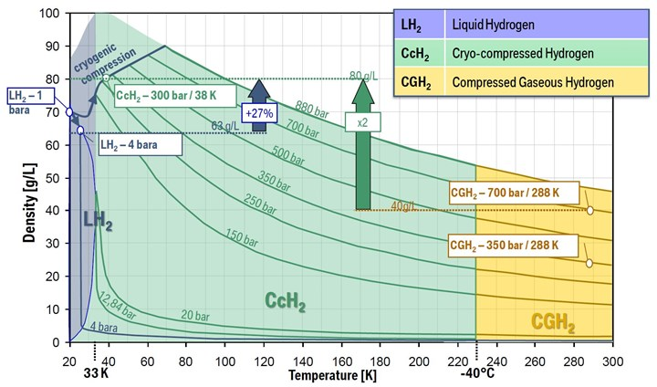



Cold & Cryo Compressed Hydrogen
H₂
CO₂
Hydrogen Storage
DOI:10.5772/intechopen.1003040
Liquid H₂
Cryo Compressed H₂
Compressed Gas
Notes:
Cryo-Compressed H2 provides a solution between the two extremes of Compressed H2 at ambient temperature and high pressure (700 bar) and Liquid H2 below its boiling point of -253°C/20 K at ambient pressure.
Cryo-Compressed H2 not only offers the highest density for H2 in the vehicle storage tank but also requires less conditioning effort and corresponding equipment for refueling, regardless of whether the Hydrogen Refuelling Solution is starting with compressed gas H2 or liquid H2 as a fuel.
18:25

Slide 11
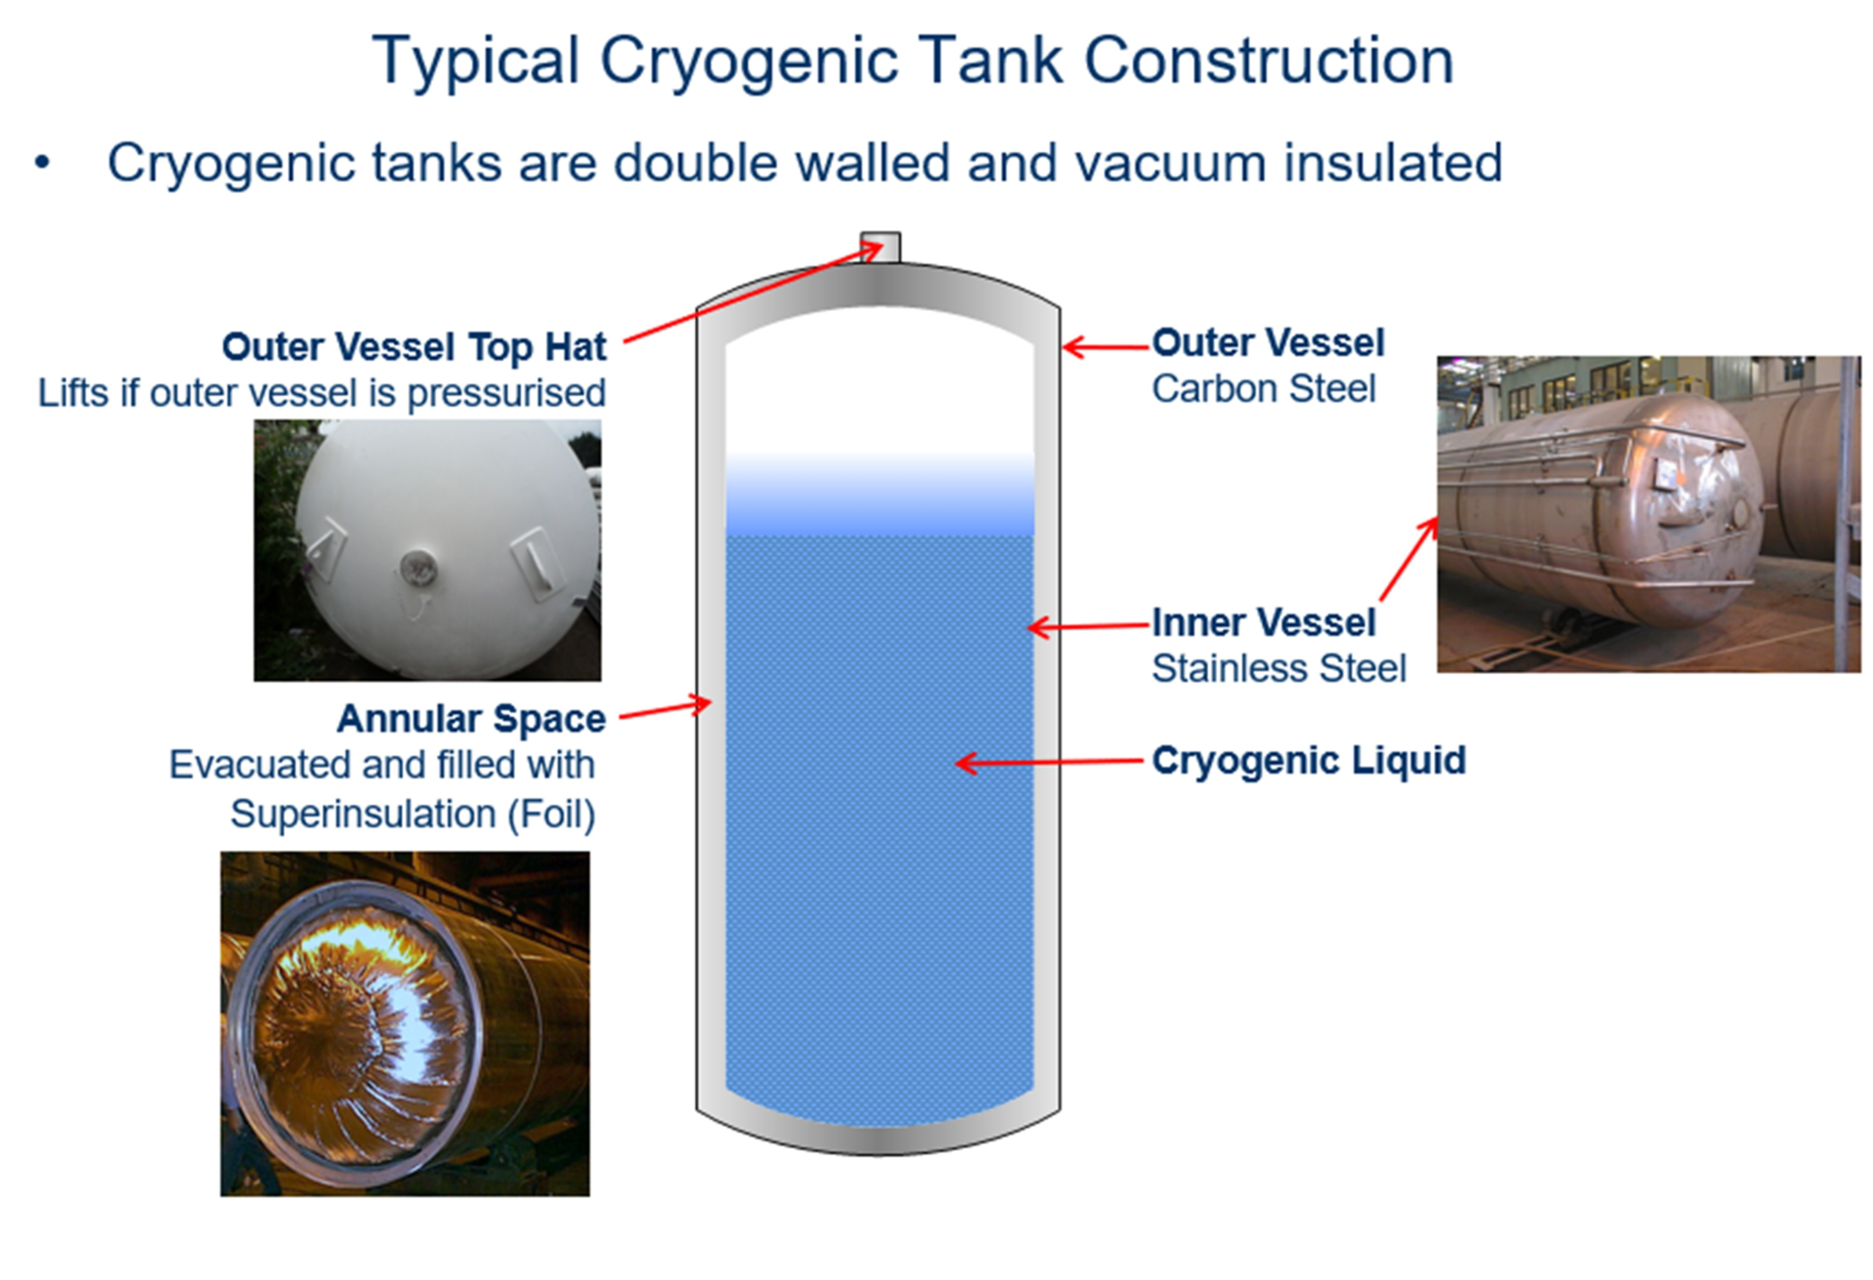
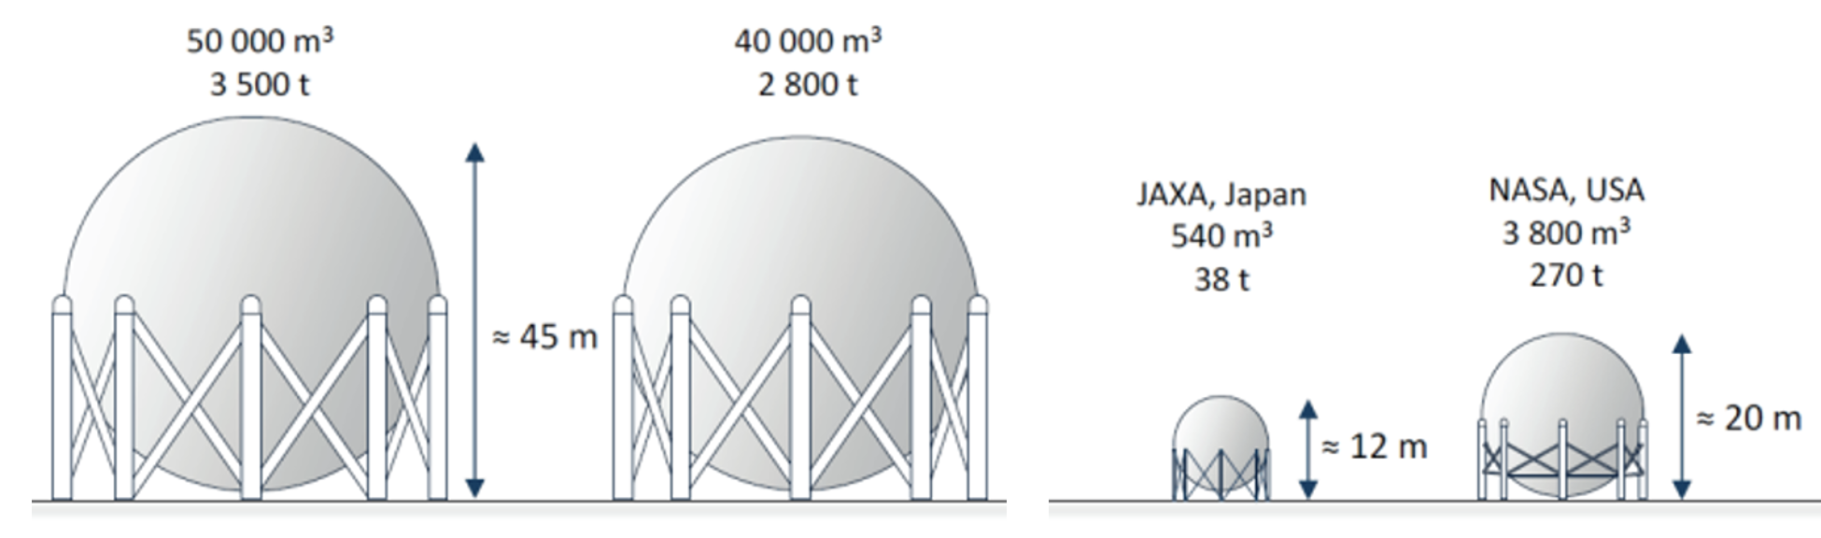
H₂
CO₂
Hydrogen Storage
https://h2tools.org/bestpractices/liquid-storage-vessels
https://maritimecleantech.no/wp-content/uploads/2016/11/Report-liquid-hydrogen.pdf
Notes:
Hydrogen can be stored cryogenically in a liquid form.
Low temperatures are required to stop the liquid hydrogen from boiling off back into a gas, which occurs at -252.8°C. Liquid hydrogen has a higher energy density than gaseous hydrogen.
However, hydrogen liquefaction, getting it down to the required temperatures, can be costly, consuming 4-10 kWh/kg which is almost equivalent to the cost of one-third of liquid hydrogen.
19:15

Slide 12
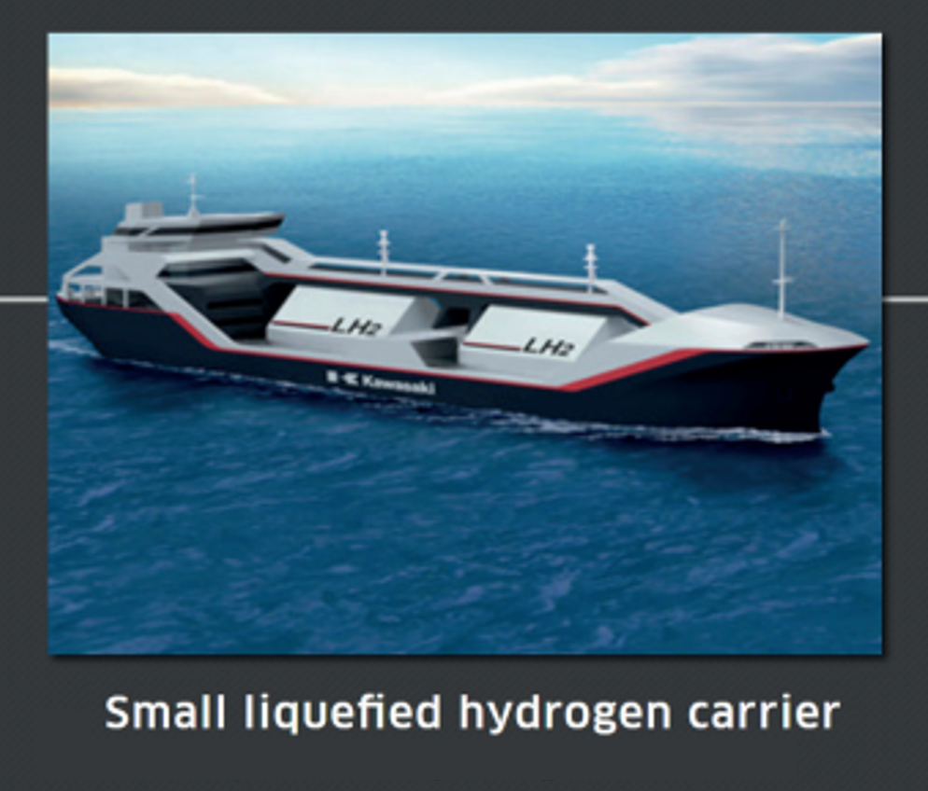
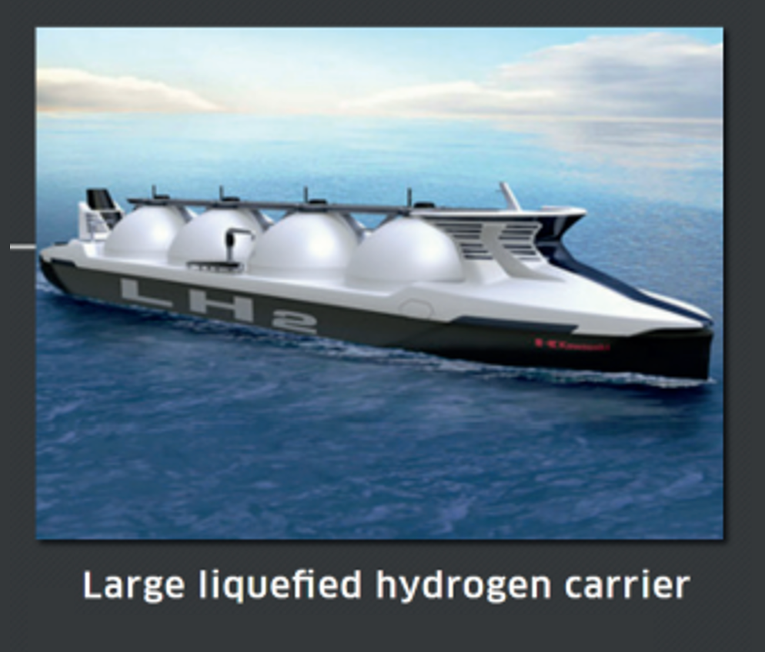
Liquid Hydrogen Storage
H₂
Aerospace industry: major user of LH₂
Liquid H₂ storage tanks
for a range of volumes
Distribution by heavier trucks and extended-range ships
LH₂ requires higher insulation quality, vacuum jacket
CO₂
Hydrogen Storage
maritimecleantech.no
Notes:
Liquid hydrogen storage vessels require excellent adiabatic devices to insulate them from boiling vaporization.
In addition, storage tanks and facilities for cryogenic liquid hydrogen storage must be insulated to prevent evaporation should any heat be carried into the liquid hydrogen due to conduction, convection, or radiation. Cryogenic storage tanks are perhaps the part of the value chain with the highest technology readiness level, as several suppliers offer storage solutions for a range of volumes.
Liquified H2 is transported in tank trucks and stored in cryogenic vessels including specially designed ships.
20:05

Slide 13
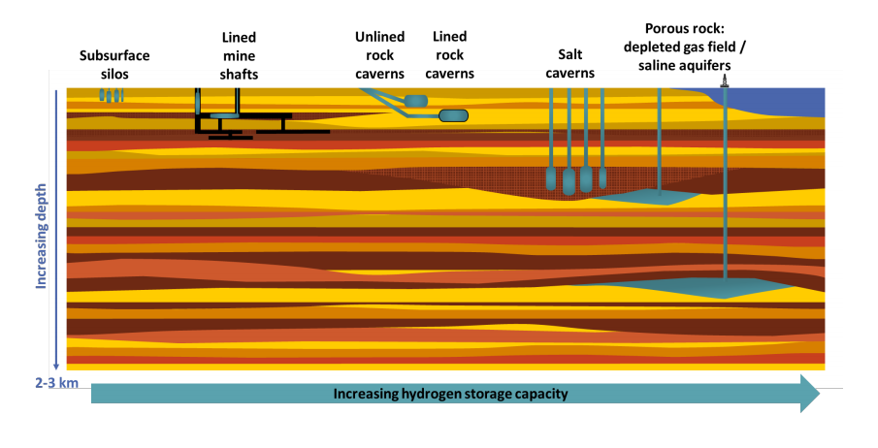
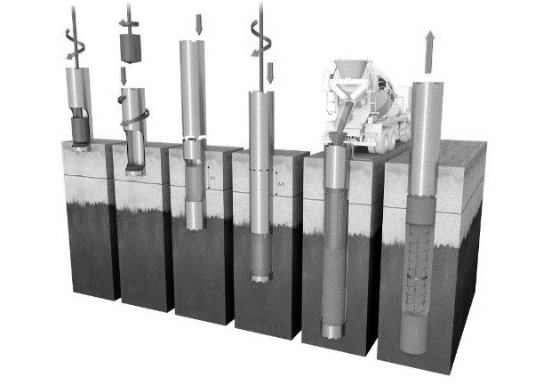
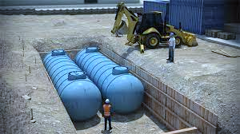

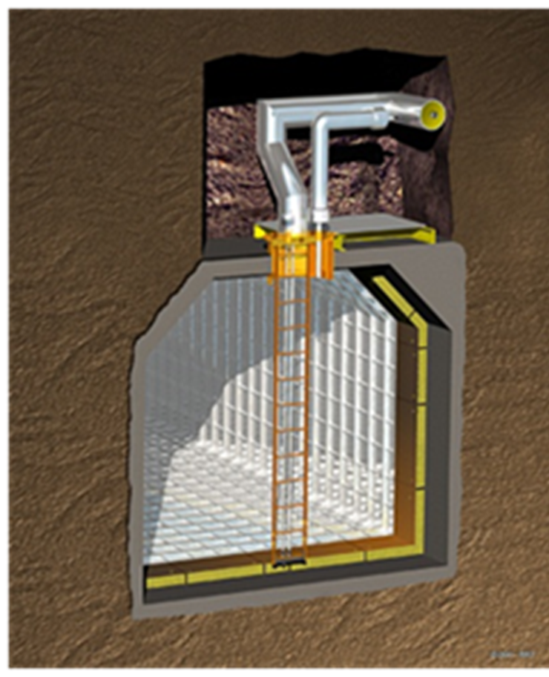
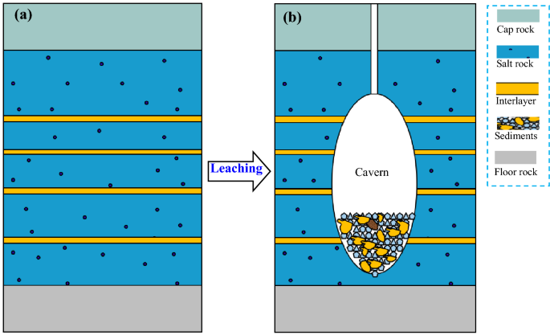
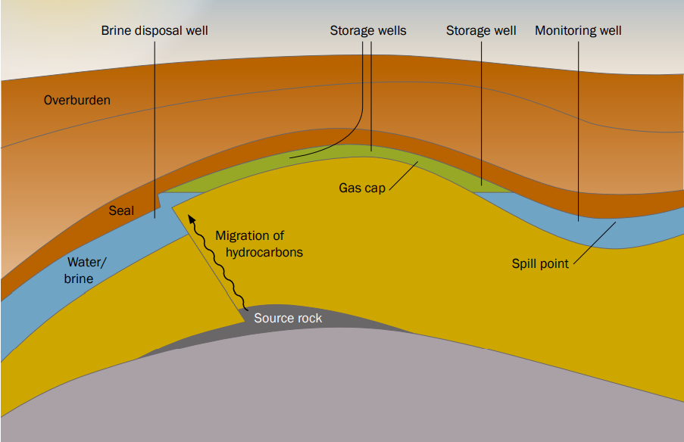
Underground Hydrogen Storage
Subsurface silos (lined mine shafts)
Delivers kW to MW over days
Subsurface tanks
Delivers kW to MW over days
Lined rock caverns
Delivers MW to GW over weeks
Salt caverns
Delivers GW over weeks to months
Porous rock reservoirs
Delivers TW over months
Scottish Carbon Capture & Storage
www.sccs.org.uk
Hydrogen CPD Course | April 2024
Notes:
Moving up from the kW to TW scales of hydrogen storage required for Net Zero takes us beyond the capacity of above-ground storage tanks.
And into the realm of subsurface storage to deliver the required volumetric capacities.
There is a wide range of underground geological hydrogen storage technologies available which include:
kW and MW scale storage in subsurface silos and tanks
GW scale storage in lined rock caverns
GW to TW scale storage in solution mined salt caverns
Ultimately onto TW scale storage in porous rocks such as depleted gas reservoirs and porous aquifers
21:00

Slide 14
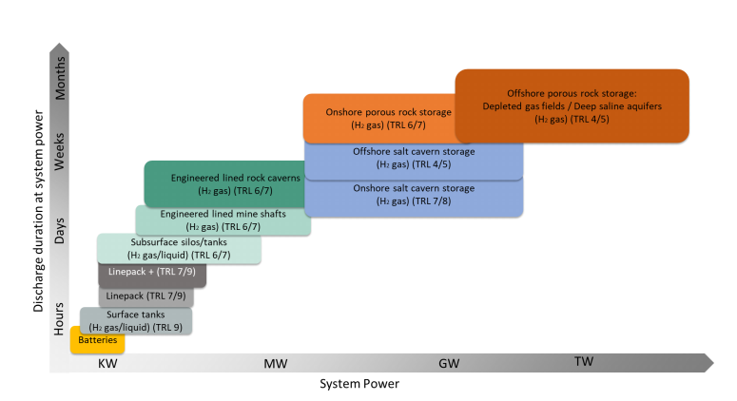

Grid scale hydrogen storage
The UK National Grid Future Energy Scenarios by 2050:
System transformation:
56 TWh H₂
Consumer transformation:
10 TWh H₂
Only geological H₂ storage provides MW-TW scale, discharge durations of hours to months
https://www.nationalgrideso.com/document/283101/download
https://www.lyellcollection.org/doi/full/10.1144/SP528-2022-88
Notes:
The UK National Grid Future Energy Scenarios illustrates the scale of grid storage required.
The graph on the left shows the relatively small amount of consumer hydrogen needed by 2050, 10 TWh (yellow bars), relative to the system transformation at over 50 TWh (blue bars).
The graph on the right illustrates that this transformation to grid-scale storage will require a change from engineered surface tanks to engineered subsurface geological storage.
Only geological storage provides the MWs to GWs of capacity needed for months of discharge.
22:00

Slide 15
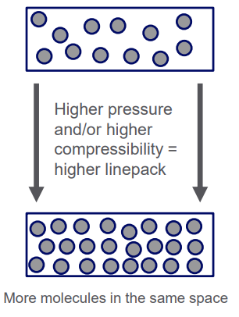
Line pack storage
H₂
High pressure national transmission pipelines currently used for natural gas storage.
Due to the low volumetric density of hydrogen this same network would be anticipated to store only 25% of this level of energy.
Will need additional network storage to make up for this = LINEPACK+
CO₂
Hydrogen Storage
https://www.nationalgrideso.com/document/283101/download
Notes:
Within the existing gas network, one of the most important short term storage technologies is line packing, i.e. increasing the amount of hydrogen in the existing high pressure national transmission pipelines.
This is where the gas in the pipelines is increased in pressure, enabling a higher energy density within the pipeline, that is then ready for deployment when there is high demand.
So for example this will occur overnight when demand is low, the NTS is pressurised with more gas which is then ready to deploy in the morning when demand rises.
Due to the low volumetric density of hydrogen this same network would be anticipated to store only 25% of this level of energy and work is underway to investigate the impact of this.
22:55

Slide 16
Hydrogen storage experience
H₂
Aquifer storage of hydrogen (town gas)
Salt cavern storage of hydrogen
Ketzin, Germany 62% hydrogen town gas – now closed
Beynes, France 50% hydrogen town gas from 1956-1972
Teesside, UK 95% hydrogen- from 1959
Kiel, Germany 62% hydrogen
Lobodice, Czechia 50% hydrogen town gas from 1965
Clemens Dome, US 95% hydrogen
Moss Bluff, US 95% hydrogen
Hydrogen storage in engineered rock caverns
HYBRIT, Sweden 100% hydrogen
Spindletop, US 95% hydrogen
CO₂
Hydrogen Storage
Notes:
We do have experience of storing hydrogen in geological formations to demonstrate the technical and commercial feasibility of underground hydrogen storage.
It began with the commercial storage of town gas, which was 50% hydrogen, in porous aquifers over many decades. Lobodice in Czechia is now a natural gas storage site. Kiel in Germany is now operating with natural gas. HYBRIT decarbonised steel production in Sweden.
We have also stored 100% hydrogen in three salt caverns in the UK for over 50 years for the chemical industry and the new Swedish Hybrit lined rock cavern which is providing hydrogen storage for decarbonised steel manufacturing has just begun gas tightness testing with hydrogen.
There is however limited experience with the required fast cycling needed during hydrogen storage, and there are several pilot hydrogen projects underway around the world, including two in the UK, one in the Aldborough salt caverns and the second in the Rough gas storage site.
24:10

Slide 17
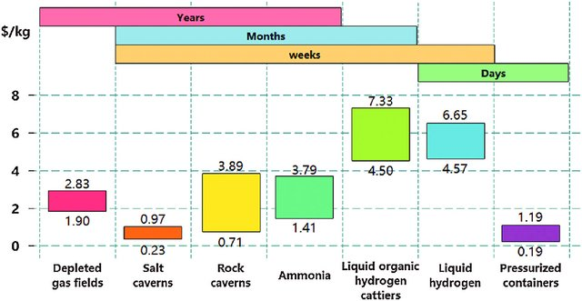
Hydrogen storage costs
H₂
Comparison of H2 storage technology costs at different time scales
CO₂
Hydrogen Storage
Geological Storage
Above ground storage options
Cao et al., 2021: https://doi.org/10.32604/jrm.2021.015722
Notes:
There is significant uncertainty surrounding hydrogen storage costs, and the figure on screen shows our best guess at the moment for cost per stored kg of hydrogen for the geological storage of hydrogen in depleted gas fields, salt caverns, and rock caverns, and for the storage of liquid, compressed, or chemically bonded hydrogen in above ground containers.
One thing that is for certain is that, for grid scale storage, geological storage will be the most cost-effective option. But until we have operational pilot sites it will be impossible to tie down the actually capex, opex, cycling frequency, injection rates, production rates, and round trip efficiencies from underground hydrogen storage.
25:10

Slide 18
Thank you for your attention
Module 3: Transportation and Storage Completed
Prof Julia Race
University of Strathclyde
Dr Katriona Edlmann
School of GeoSciences, University of Edinburgh
Notes:
This concludes the third module of the hydrogen course.
The next module, Module 4, covers hydrogen HSE and Regulations.
Thank you for attention. Please note down any questions or comments and bring them to the webinar that completes this course.
25:40

