Slide 1
Place and Wellbeing Assessments and the Shaping Places for Wellbeing Approach
Masterclass
Irene Beautyman
Place and Wellbeing Partnership Lead
Improvement Service & Public Health Scotland

Slide 2
Place and Wellbeing Assessments and the Shaping Places for Wellbeing approach
✔️Place based approach context
✔️Why and how of a Place and Wellbeing Assessment
✔️Impact and moving forward

Slide 3
Place and Wellbeing Assessments and the Shaping Places for Wellbeing approach
✔️Place based approach context
✔️Why and how of a Place and Wellbeing Assessment
✔️Impact and moving forward

Slide 4
Who?
Public Health Scotland
v
v
NHS Boards
Impacts on strategic decision-making
Improvement Service
Health and social Care Partnerships
Strategic decision-making impacts on a place
v
Local Authorities
Third Sector
Impacts on a place
Communities
Other statutory Authorities
Private sector
Scottish Government

Slide 5
National Planning Framework 4 NEW outcomes are
Meeting the housing needs of people living in Scotland including, in particular, the housing needs for older people and disabled people,
Improving the health and wellbeing of people living in Scotland,
Increasing the population of rural areas of Scotland,
Improving equality and eliminating discrimination,
Meeting any targets relating to the reduction of emissions of greenhouse gases, within the meaning of the Climate Change (Scotland) Act 2009, contained in or set by virtue of that Act, and
Securing positive effects for biodiversity

Slide 6
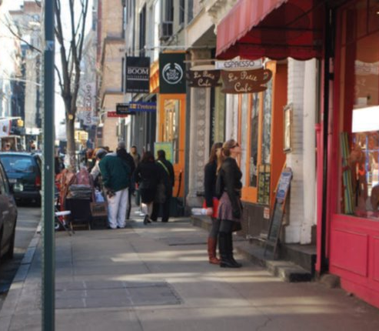
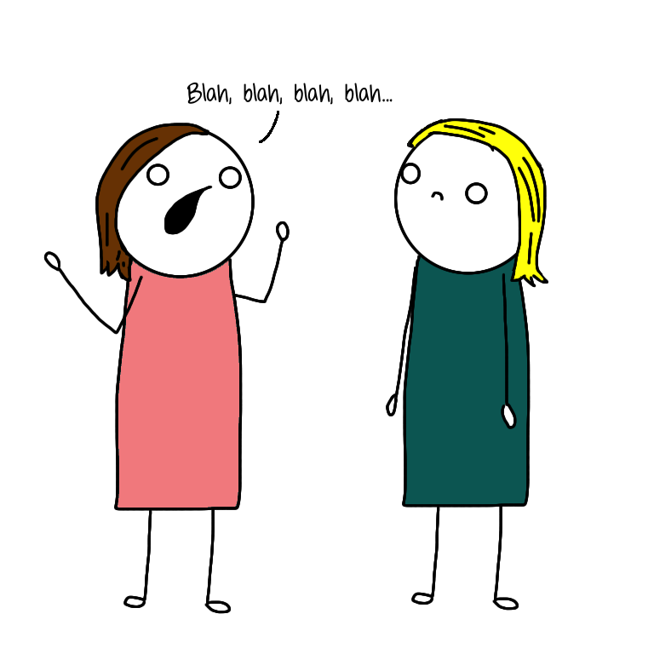
We ALL create places that have a positive or negative impact on wellbeing and inequality

Slide 7
Key parts to a place-based approach
PEOPLE
What they are experiencing
PLACE
ALL the features that have a positive impact
DECISIONS
How they impact people and place

Slide 8
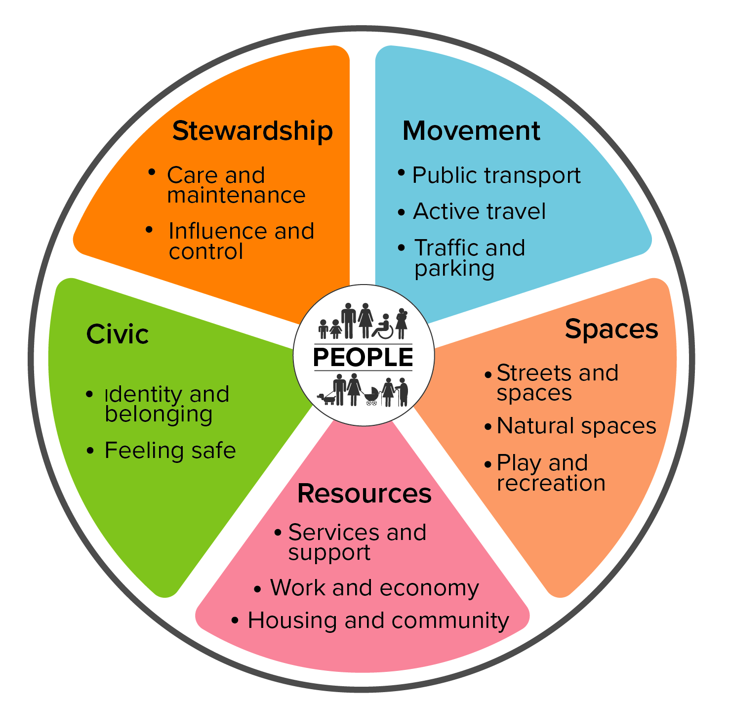
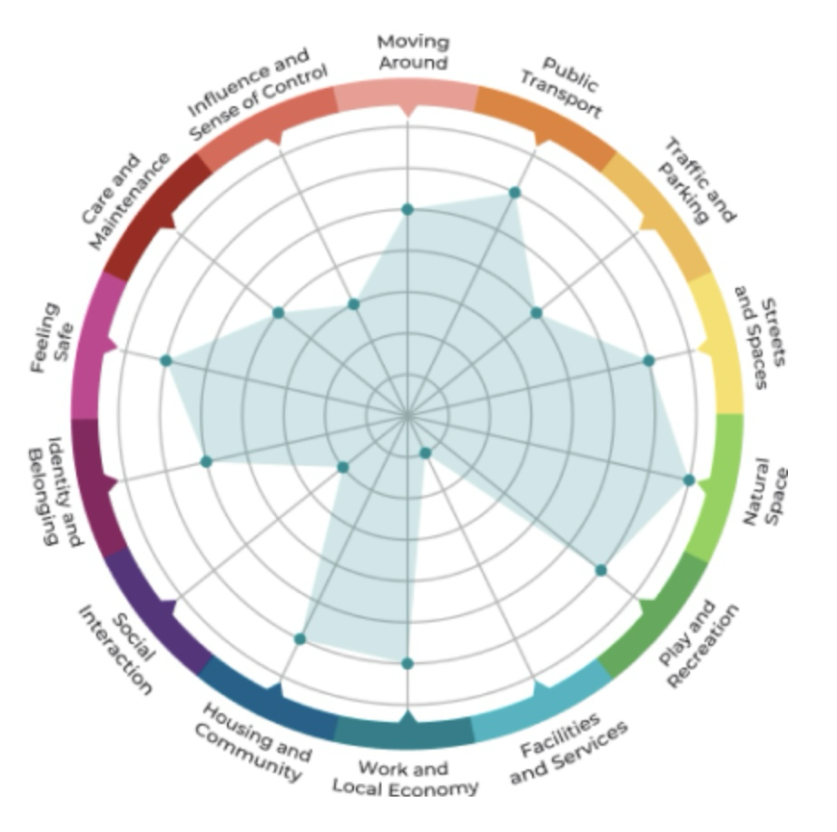
Key parts to the Shaping Places for Wellbeing approach
PEOPLE
What they are experiencing –
inequality
Inequality data
Quantitative
Qualitative
PLACE
All the features that have a positive impact
Place and Wellbeing Outcomes
DECISIONS
How they impact people and place
Place & Wellbeing Assessments
Briefing Papers

Slide 9
Focus for this Masterclass
PEOPLE
What they are experiencing –
inequality
Inequality data
Quantitative
Qualitative
PLACE
All the features that have a positive impact
Place and Wellbeing Outcomes
DECISIONS
How they impact people and place
Place & Wellbeing Assessments
Briefing Papers

Slide 10
Place and Wellbeing Assessments and the Shaping Places for Wellbeing approach
✔️Place based approach context
✔️Why and how of a Place and Wellbeing Assessment
✔️Impact and moving forward

Slide 11
Notes:
Slide summarising the programme activity

Slide 12
Three activities:
Council and NHS Board in Project Towns:
Alloa
Ayr
Clydebank
Dalkeith
Dunoon
Fraserburgh
Rutherglen
Replication
Reflection, learning, sharing between Project Towns
All Towns Steering Groups
“How to” Guides enable replication
Confidence
Causes of change
Representatives from:
Scottish Govt Directorates
All COSLA Boards
Public Health Scotland
Improvement Service
Health Foundation
Notes:
Use these slides to what suits you presentation – don't need to include them all

Slide 13
Focus for this Masterclass
PEOPLE
What they are experiencing –
inequality
Inequality data
Quantitative
Qualitative
PLACE
All the features that have a positive impact
Place and Wellbeing Outcomes
DECISIONS
How they impact people and place
Place & Wellbeing Assessments
Briefing Papers

Slide 14
Project Town Activity - Future ambitions
Identify current ambitions of strategy, policy & actions impacting Town
(Project Lead)
Highlight those with opportunity to influence:
due for renewal, draft, early stages
(Project Lead)
Prioritise 3 to 4 to receive system change support from Shaping Places for Wellbeing Programme "lens"

Slide 15
Decisions: Place and Wellbeing Assessments
Strategies, plans and proposals
What could be done to improve its impact on place and, thus, wellbeing?
How does the plan, policy or decision impact on each of the features we need to get right in a place?
How does it impact on those population groups most impacted by inequalities?

Slide 16
Dunoon Active Travel Hub
Increases access to walking, wheeling and cycling opportunities
Active Travel
Public Transport
Play and Recreation
Provides space for people to come together
Sense of Belonging
Services and Support
Street and Spaces
Collaboration between Council and community organisation with local knowledge
Improves the welcome to the town by upgrading and celebrating heritage
Work and Economy
Sense of Belonging
Volunteers involved in refurbishment using traditional skills
Influence and Control
Sense of Belonging
Sense of belonging
Work and Economy
Services and Support
Feeling Safe

Slide 17
All Project Towns - Completed Place and Wellbeing Assessments – 2022 - 2024
34 completed
Year | Alloa​ | ​Ayr ​ | Clydebank​ | Dalkeith | Dunoon​ | Fraserburgh | Rutherglen​
2022 (9) | Draft Interim Climate Change Strategy​ Wellbeing Hub Location NHS Forth Valley Healthcare Strategy 2016-2021 | Wallacetown Housing Regeneration​ Sustainable Development & Climate Change Strategy Review​ | Implementation of the Clydebank Town Centre Development Framework ​ West Dunbartonshire Health Social Care Partnership Strategic Plan​ |  | Western Seaboard Marine Gateways, Dunoon Waterfront proposal, submitted as part of the UK Levelling Up Fund application |  | South Lanarkshire Economic Strategy ​
2023 (20) | Local Development Plan Vision and Strategic Objectives Local Outcome Improvement Plan Interim Climate Change Strategy – 2023 | Local Housing Strategy Accessible Ayr | Green Travel Plan Safe Delivery Improvement Group Strategy (Community Planning Partnership) | Single Midlothian Plan Dalkeith Regeneration Development Framework Central Dalkeith & Woodburn Community Action Plan | Argyll and Bute Health & Social Care Partnership Strategic Plan​ Local Police Plan Argyll and Bute Economic Strategy Active Travel Hub | Beachfront Masterplan Aberdeenshire Health & Social Care Partnership Strategic Plan Fraserburgh merging schools project | ​Rutherglen Town Centre Action Plan Burnhill Neighbourhood Plan South Lanarkshire Local Development Plan 2
2024 (4) | Wellbeing Hub 2 |  |  | Midlothian Integration Joint Board Strategic Commissioning Plan 2025 to 2040 |  | Clatt School Foveran & Tipperty school merger proposal Fraserburgh Harbour

Slide 18
Decisions: Place and Wellbeing Assessments
Process:
Pre-assessment planning & setup
The Assessment session
Capturing conversation and recommendations in an Assessment Report
Moving forward with recommendations

Slide 19
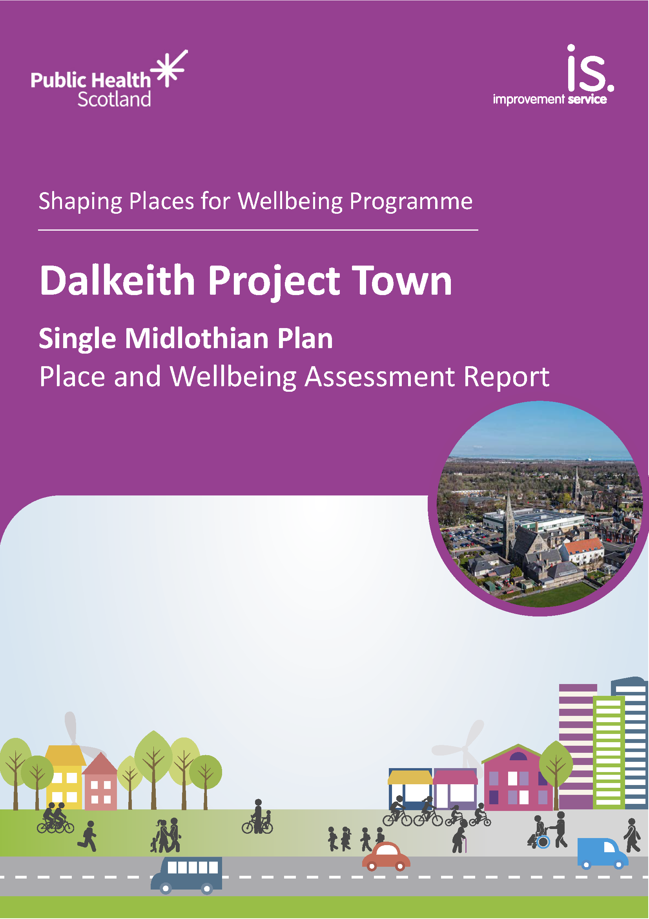
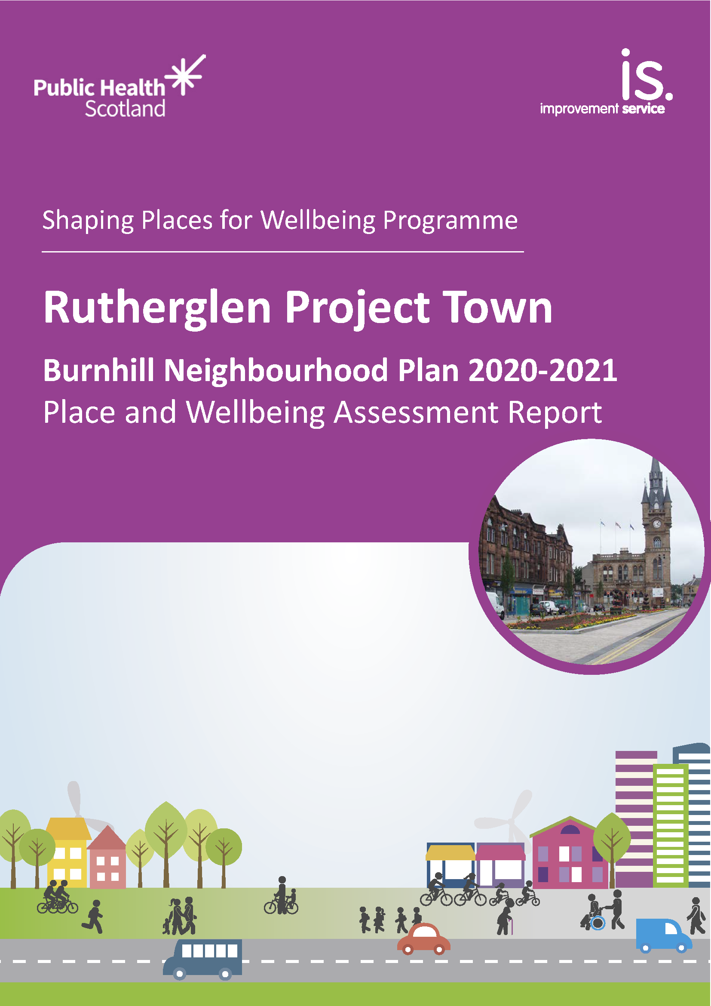
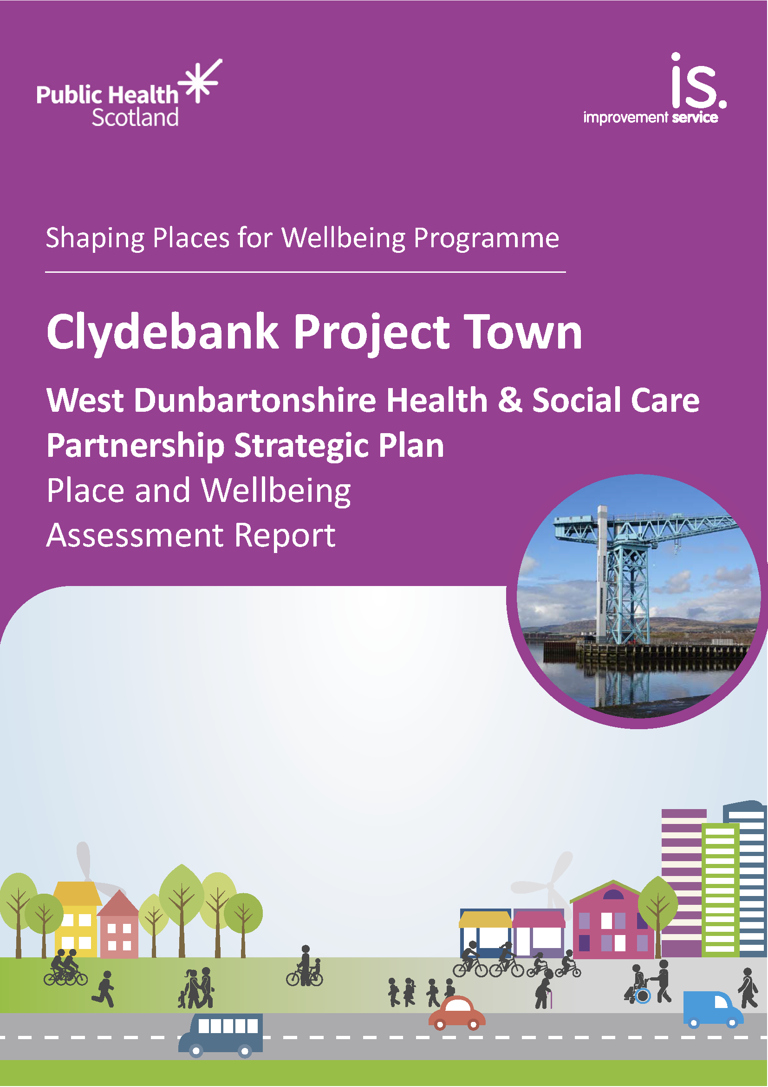
Decisions: Place and Wellbeing Assessments
Place and Wellbeing Assessments reports can be found on the website
They range in their coverage from high level policy at regional level to more specific proposals at a local scale.
A 'How to Guide' has been produced

Slide 20
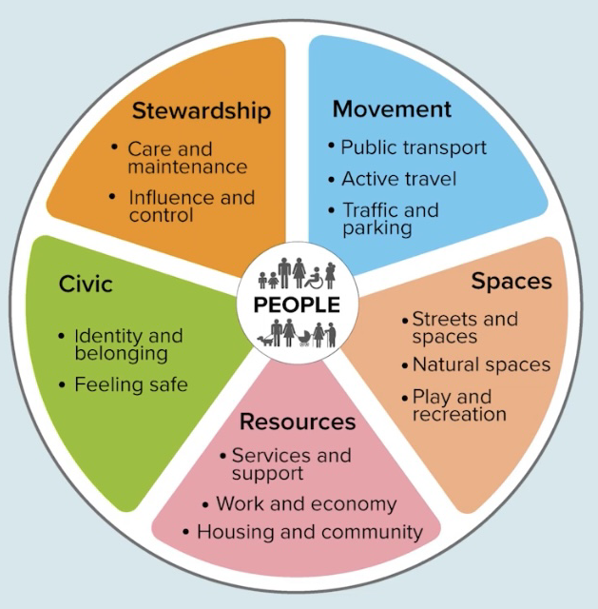
Local Project Town Activity
Place and Wellbeing Assessments:
Range of perspectives in the room
Enhance collaborative links
Clarity on governance of process
Group led recommendations

Slide 21
Place and Wellbeing Assessments and the Shaping Places for Wellbeing approach
✔️Place based approach context
✔️Why and how of a Place and Wellbeing Assessment
✔️Impact and moving forward

Slide 22
Mechanisms of change
Shaping Places for Wellbeing Programme
October 2024
This document presents the mechanisms of change that the Shaping Places for Wellbeing Programme has theorised to be supporting system change.
We have used the term "mechanisms of change", as described by New Philanthropy Capital (NPC). Mechanisms of change are the link between the activities we deliver (e.g. Place and Wellbeing Assessments) and the outcomes we’re hoping to achieve (e.g. more plans using a place and wellbeing lens) – they are the causes of change. The mechanisms describe how we hope our Programme will be experienced by anyone engaged with our delivery. If those experiences, thoughts and feelings can be carried forward and endure then we are more likely to achieve the system change we hope for.
Through working with seven Project Towns in 2022-2024, we learnt that when undertaking local work using a place-based approach, change is more likely when some mechanisms of change are experienced.

Slide 23
Using Place and Wellbeing Assessments
We believe change is more likely when:
Participants have a foundational and mutual understanding of place, the Place and Wellbeing Outcomes, and the Programme.
Participants have an understanding and familiarity with the document being assessed.
Assessment participants, including the decision makers/document owner, feel supported by seniors and colleagues to take part in the process.
Participants feel equally valued and safe to openly contribute during the Assessment.
The decision makers/document owner believe the Assessment process adds value to their work.
The decision makers/document owner have a sense of ownership over the process from pre-Assessment to post-Assessment stage.
The decision makers/ document owner are open to the feedback given through the Assessment and believes it to be constructive.
Participants remain engaged for the duration of the Assessment.

Slide 24
Embedding recommendations from a Place and Wellbeing Assessment
We believe change is more likely when:
Recommendations are understood.
Recommendations are respected and believed to give added value to document.
The decision makers/ document owner and relevant team(s) believe the recommendations are actionable and achievable.
The decision makers/document owner and relevant team(s) believe that system change is possible, and that the recommendations support change.
The decision makers/document owner and relevant team(s) feel confident communicating and building partnerships with all relevant stakeholders to embed recommendations.
The decision makers/document owner and relevant team(s) feel a sense of ownership and leadership over the embedment of recommendations.
The decision makers/document owner and relevant team(s) feel confident, empowered and equipped to progress recommendations, and try new approaches.
The work suggested by the recommendations is believed to align with existing priorities.

Slide 25
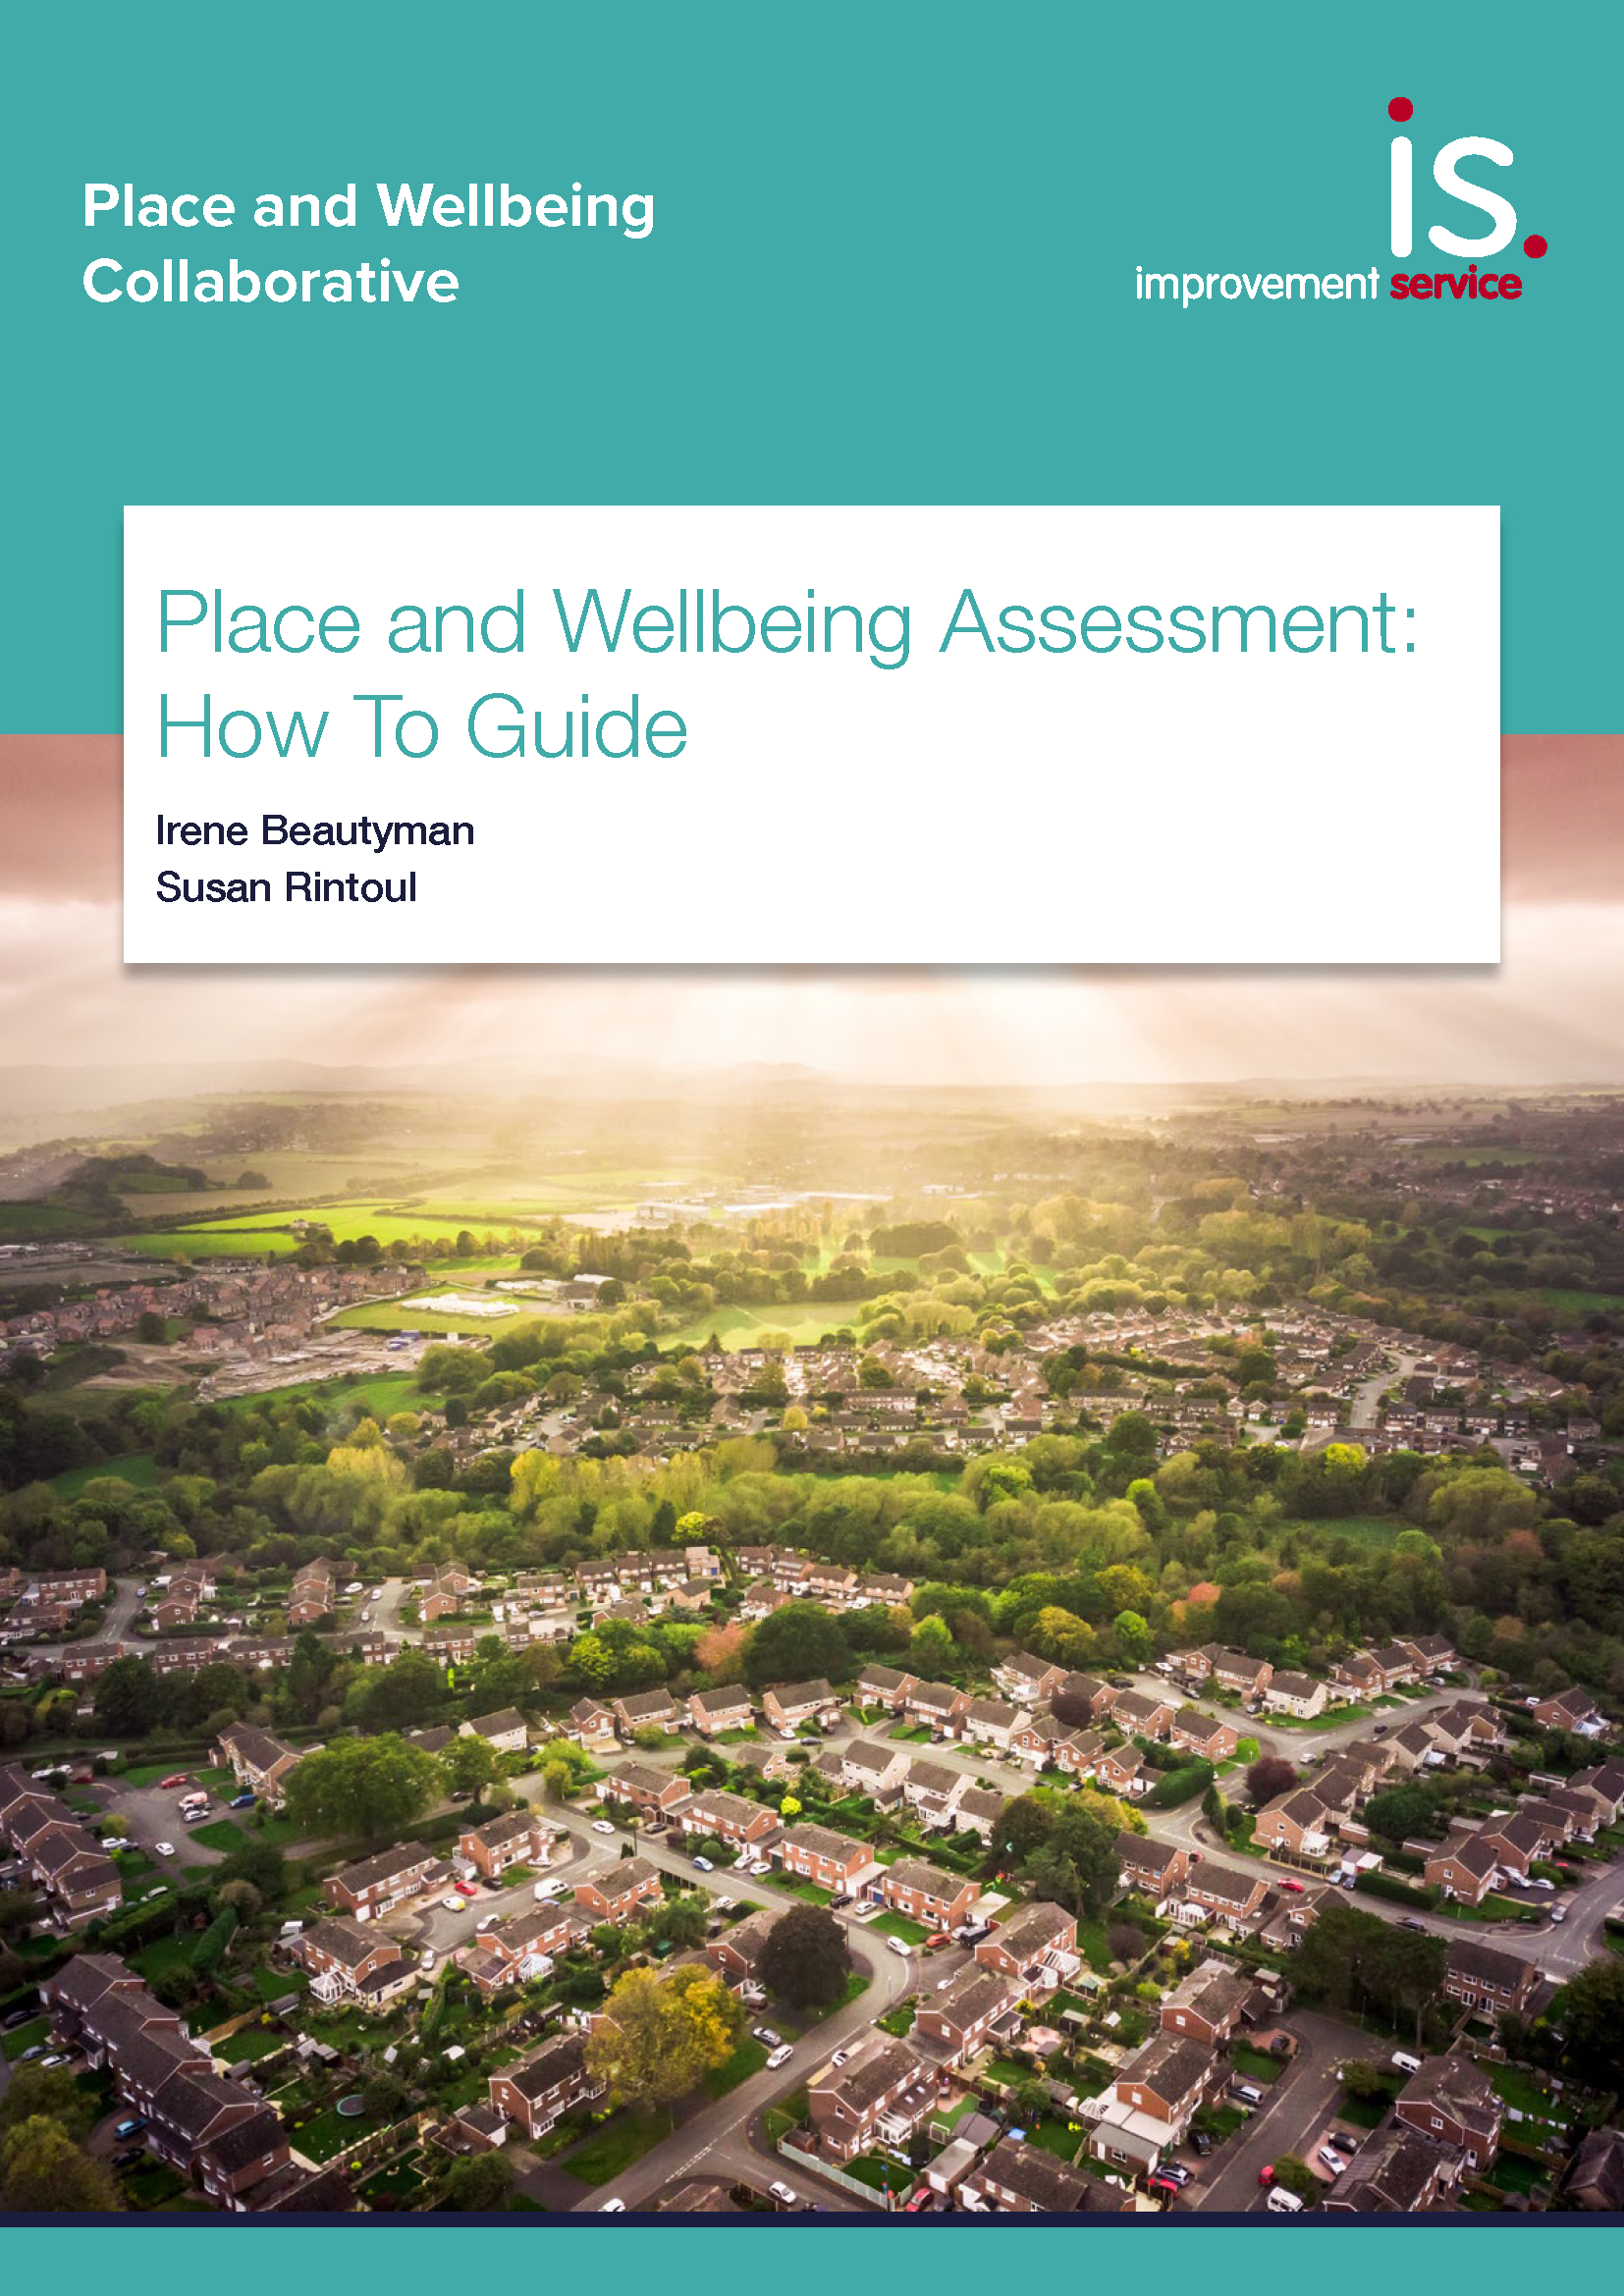
Sharing learning: output
Preparation
Session
Report For example the importance of RECOMMENDATIONS
Examples of recommendations
Assessment fits with other assessments, e.g. Integrated Impact Assessment etc

Slide 26
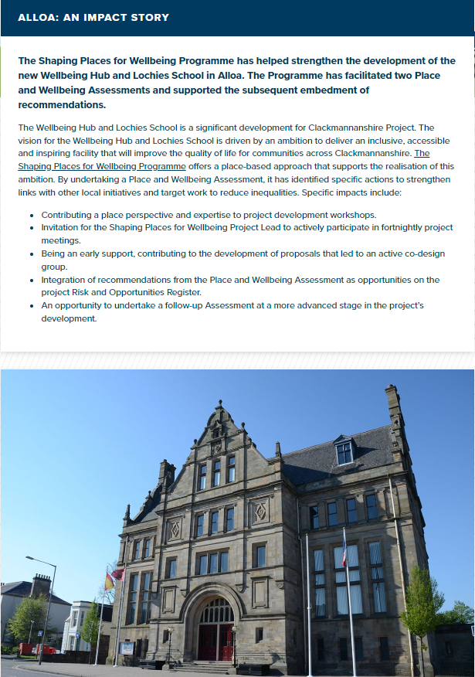
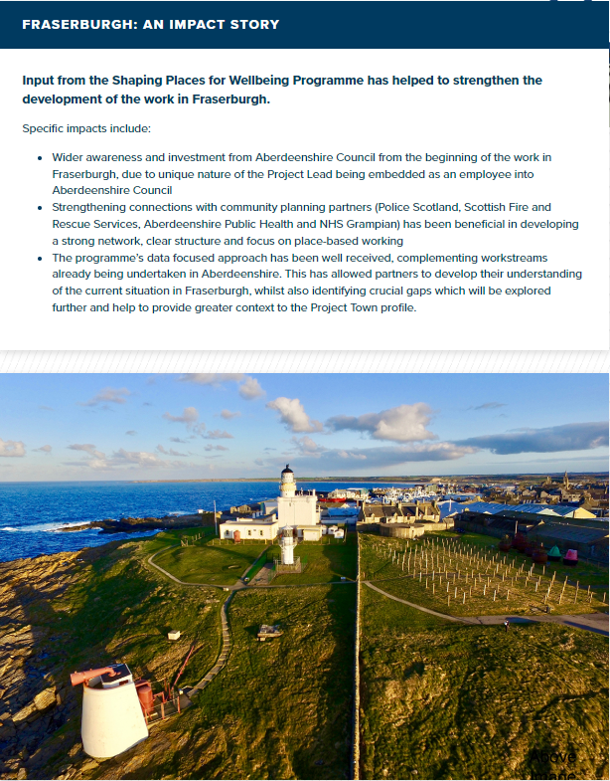
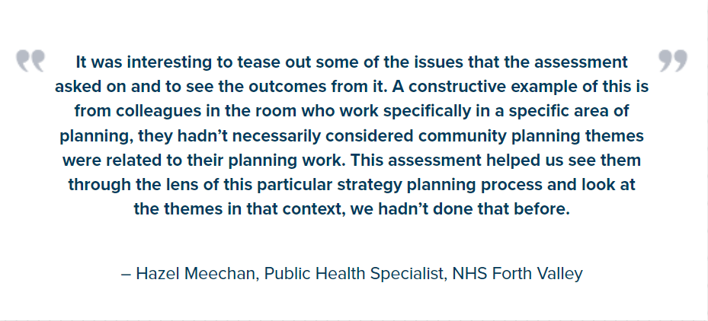
Shared Learning: Impact Stories
All the Project Town information and impact stories can be accessed here

Slide 27
Local Project Town Activity
"Much more mindful of people and communities perspective; ‘how’ people use things and how services ‘fit in."
"Thinking internally, externally on a micro level."
"Thinking through a different perspective."
"I thought about things I wouldn’t normally have thought about."

Slide 28
Place & Wellbeing Assessment: Fraserburgh Primary School Merger
“ The Place & Wellbeing Assessment undertaken on the Fraserburgh Schools Merger provided an opportunity to have a detailed discussion, with all key partners, about how the plans have considered the local communities and the impact on the town of Fraserburgh. This discussion was valuable, and it was clear to see how this process would be beneficial at the start of a project, as part of the consultation phase, to explore the intended and unintended, positive and negative consequences to communities.
I feel undertaking this type of assessment at an early stage of a project, would help to speed up the processes and provide information that would be valuable to the completion of the Integrated Impact Assessments. The assessment provides a clear and replicable place-based structure to facilitate place-based decision making. ”
Maxine Booth
Quality Improvement Manager
Education Development
Aberdeenshire Council

Slide 29
.
Impact in Project Towns
Aberdeenshire Council rolling out approach council wide
South Lanarkshire embedding approach into Neighbourhood Plans
Dunoon Community Development Trust using approach to inform impending Place Plan

Slide 30
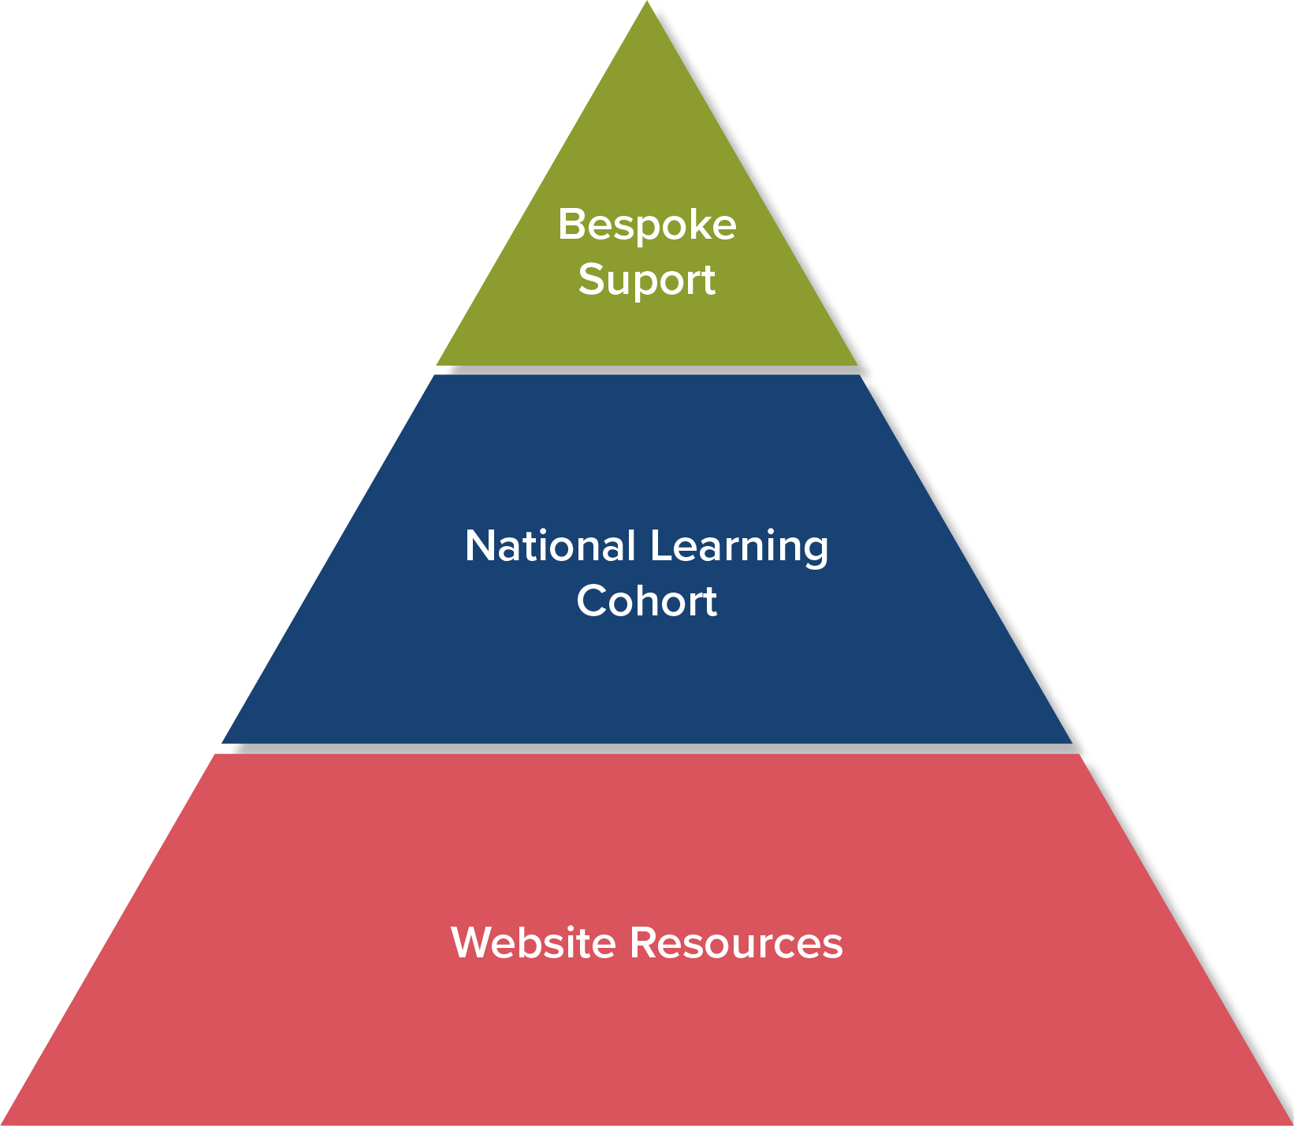
Shaping Places for Wellbeing Programme support sits at three levels

Slide 31
Bespoke support - Place and Wellbeing Assessments supported up to December 2024
Local authority | Document assessed | Date of assessment
Edinburgh Council | Corporate Property Implementation Plan | 10 December 2024
Shetland Islands Council | Shetland’s Partnership Plan Place-based Programme of Change public sector projects | February 2024
Inverclyde Council | TBC | TBC
Scottish Government - Digital Inclusion Alliance | Mock Place and Wellbeing Assessment of a local authority Digital Inclusion Strategy | 4 December 2024
1 completed

Slide 32
Masterclass series:
Place and the Shaping Places for Wellbeing Approach
Place: Place and Wellbeing Outcomes
People: Quantitative and qualitative data
Decision making: Place and Wellbeing Assessments
Place based approaches in action

Slide 33
What next?
Expand and enhance quantitative data informing decisions
Place and Wellbeing Outcome Indicators
Capturing community insight on inequality
Capturing Assessment write up
Strengthened support to Planning Authorities

Slide 34
Find out more!
Webpage links and how to contact us
Place and Wellbeing Outcomes
Shaping Places for Wellbeing Programme
X (formerly Twitter) @Place4Wellbeing @PlaceNetworkSco @IreneBeautyman
Planning and Place Based Approaches LinkedIn
Email: placeandwellbeing@improvementservice.org.uk
​

Slide 35
Thank you for your time!
​

