Slide 1

Place based approaches Masterclass: examples

Slide 2
Agenda
✔️ Context for today
✔️ Fraserburgh and Aberdeenshire
✔️ Child poverty in Carlton Ward, Glasgow

Slide 3




Key parts to a place-based approach
PEOPLE
What they are experiencing
PLACE
ALL the features that have a positive impact
DECISIONS
How they impact people and place

Slide 4



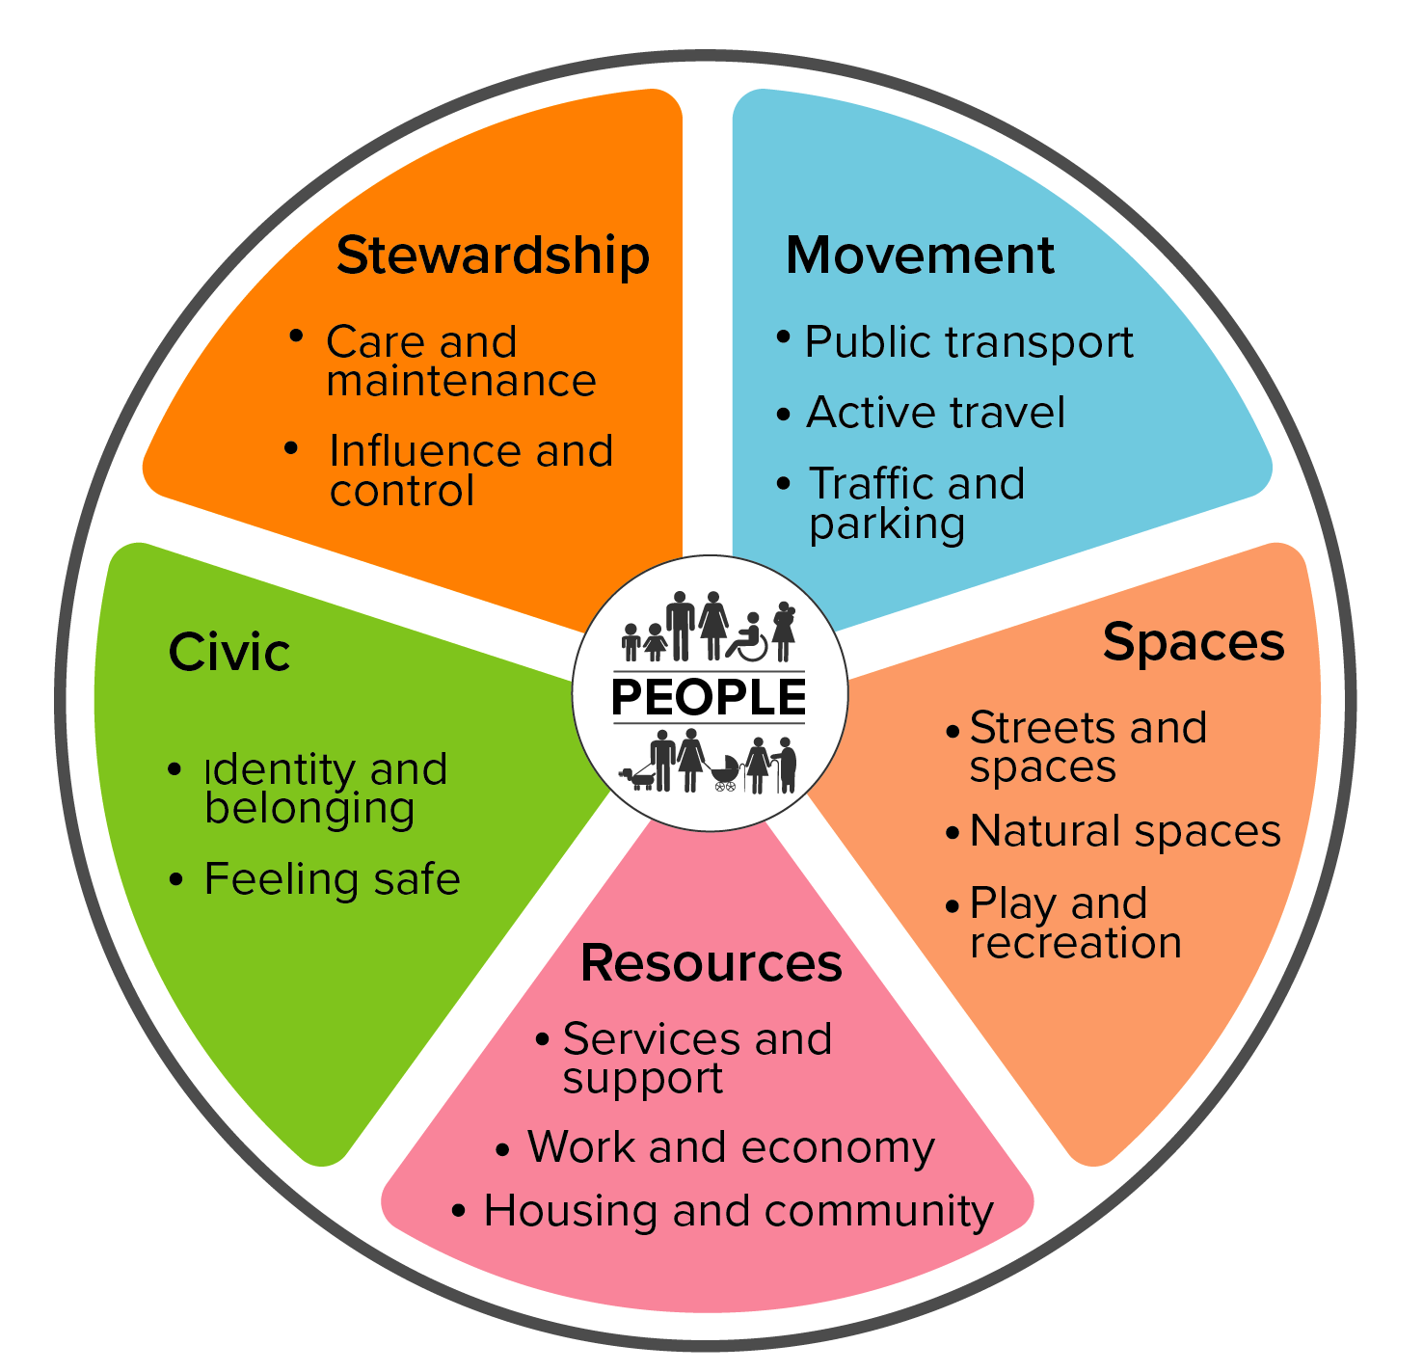
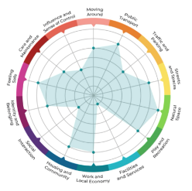
Take a Shaping Places for Wellbeing place-based approach
PEOPLE
Inequality they are experiencing
Inequality data
Quantitative
Qualitative
PLACE
All the features that have a positive impact
Place and Wellbeing Outcomes
DECISIONS
How they impact people and place
Place & Wellbeing Assessments
Briefing Papers
Leadership & governance

Slide 5
Aberdeenshire Council Place Strategy & Policy
Angela Keith, Area Manager Banff & Buchan
Laura Stewart, Project Manager
Matthew Smart, Community Link Lead

Slide 6
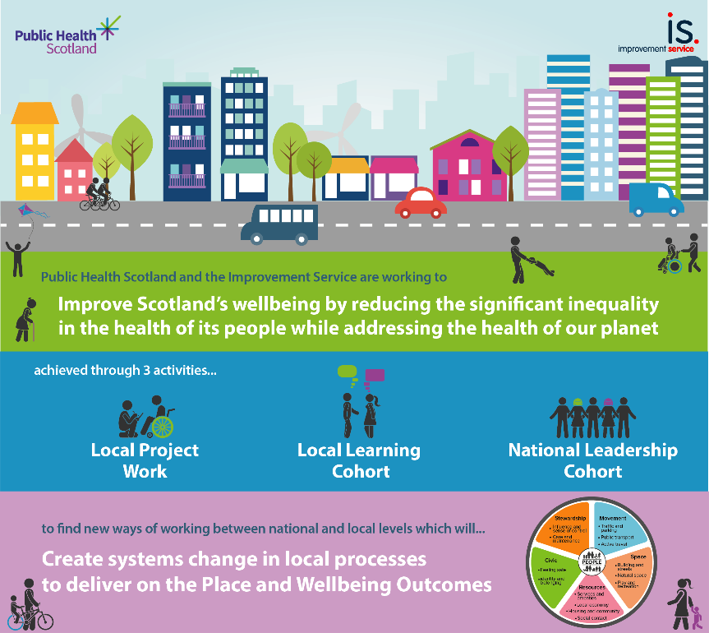
Shaping Places for Wellbeing: Fraserburgh
Project Town ( 1 of 7 across Scotland)
Quantitative and Qualitative Reports / Infographics
Steering Group (representation from Local Community Planning Partners)
4 Place & Wellbeing Assessments - plus wider support
Place & Wellbeing Outcome Briefings
Innovative approach – Community Champions Group
Shared Learning – internal and external
Helped inform Place Strategy development

Slide 7
Place Strategy and Policy
Agreed by Full Council June 2024
  17 Place Plans to be developed across Aberdeenshire (Academy catchment areas)
  supplemented and informed by Community Action Plans and/or Local Place Plans
Endorsed by Aberdeenshire Community Planning Partnership September 2024
Underpins Aberdeenshire Council Transformation Programme
Builds on a strong foundation and provides clarity on how to achieve the vision and objectives for our places

Slide 8
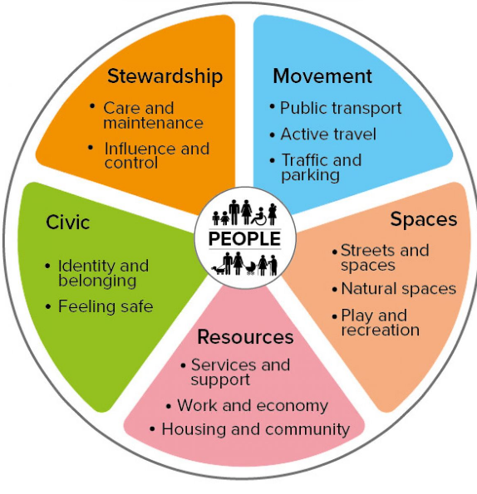
Place Policy
The Place Policy supports :
Aberdeenshire Councils Strategic Priorities
Place Principle
National Planning Framework 4: Six qualities of Successful Places
Place and Wellbeing Outcomes
Climate Change and Sustainability

Slide 9
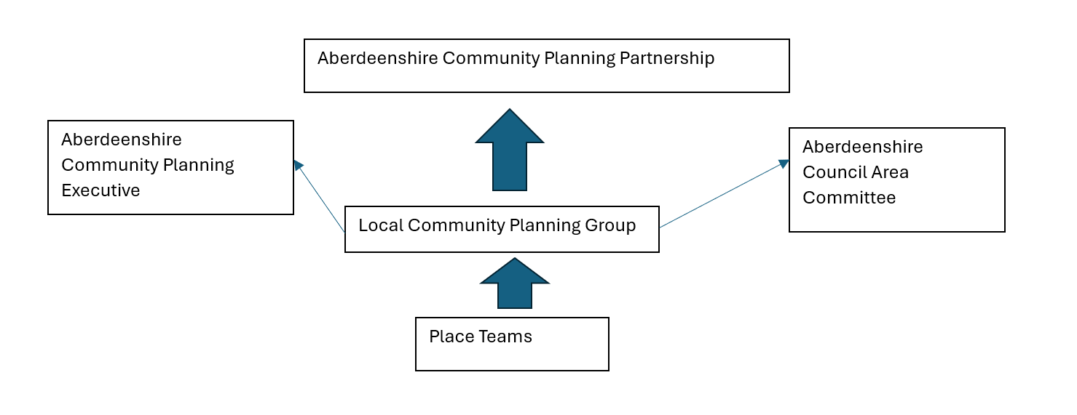
Proposed Governance and Structure

Slide 10

Place Workstreams
Place Toolkit
6 Areas of Focus:
Governance
Funding and Resource
Training and Culture
Community Engagement
Data and Performance
Toolkit

Slide 11

1. Governance
Alignment with CPP Governance Framework
Structure
Terms of Reference for groups/teams in toolkit process
Terminology, language and comms (link with workstream 3)
Council Governance – including Area Committee remit and Scheme of Governance
Governance to support funding requirements (link with workstream 2)
Link with workstream 2 – procurement governance
‘Place’ in the IIA
Reporting schedule – Council and CPP
This Photo by Unknown Author is licensed under CC BY-NC-ND

Slide 12

2. Funding and Resource
Working with the Budget/resource/capacity gaps
Place Fund/Reserve – how to make decisions in an equitable way (if/when available)
External Funding opportunities
Alignment with Council’s procurement governance (link with workstream 1)
HoS Operational plans – the two-way flow
Link with CPP financial governance
Cost of community planning across the Council
This Photo by Unknown Author is licensed under CC BY-SA

Slide 13

3. Training and Culture
Leadership and Direction from the top to set Place Based Culture
Training focus on LCPG/Place Group, Place Teams/Networks
Bespoke training and awareness of approaches to Communities
Shaping Places for Wellbeing – embedding into Business as Usual for Service delivery as per Place Policy
Internal and External comms to support move to place-based approach
Link with Future Aberdeenshire and transformation themes
Good news stories, examples of how SPfW and Place based activities are having a positive impact.
This Photo by Unknown Author is licensed under CC BY-SA

Slide 14

4. Community Engagement
Review work of sub-group
Test feasibility
Support package including Training (link with workstream 3)
Cost/resource implications (link with workstream 2)
Comms for Communities
Local Development Plan – how to engage together
This Photo by Unknown Author is licensed under CC BY-SA

Slide 15

5. Data and Performance
Geographical coverage for a Place Plan - GIS requirement
What does success look like for a Place Plan?
How to record, monitor and report?
Place and Wellbeing Outcomes embedded
Link to Council Plan, Priorities and Performance – including HoS Plans
Link to Tackling Poverty & Inequalities LOIP
Place LOIP
CP Partners’ Priorities
Data Hub
Place data
Access to partner data – and vice versa
Data provision in place plans

Slide 16
6. Toolkit
Finishing and launching Storymap for Toolkit and Place Plan Template
Production and finalising support documents for phases
Updating Storymap with outcomes of other workstreams
Working/Liaison with Community Planning Partners
Content and link with LDP

Slide 17
Bringing the Community with us
Area Teams are leading the engagement with Communities and Partners
Providing clarification around the What / Why / Where / How / When
Place Networks – bringing partners together to facilitate collaboration and joined up working for each ‘Place’
Understanding assets, issues and needs of a ‘Place’
Working collaboratively with partners and stakeholders to develop the ‘place’ to deliver better outcomes for people that live there
Involves all relevant agencies (Health, Council , Emergency Services) in and to co-ordinate services to best meet Place Outcomes
Be influenced and led by local people and stakeholder organisations
Links to Community Wealth building

Slide 18
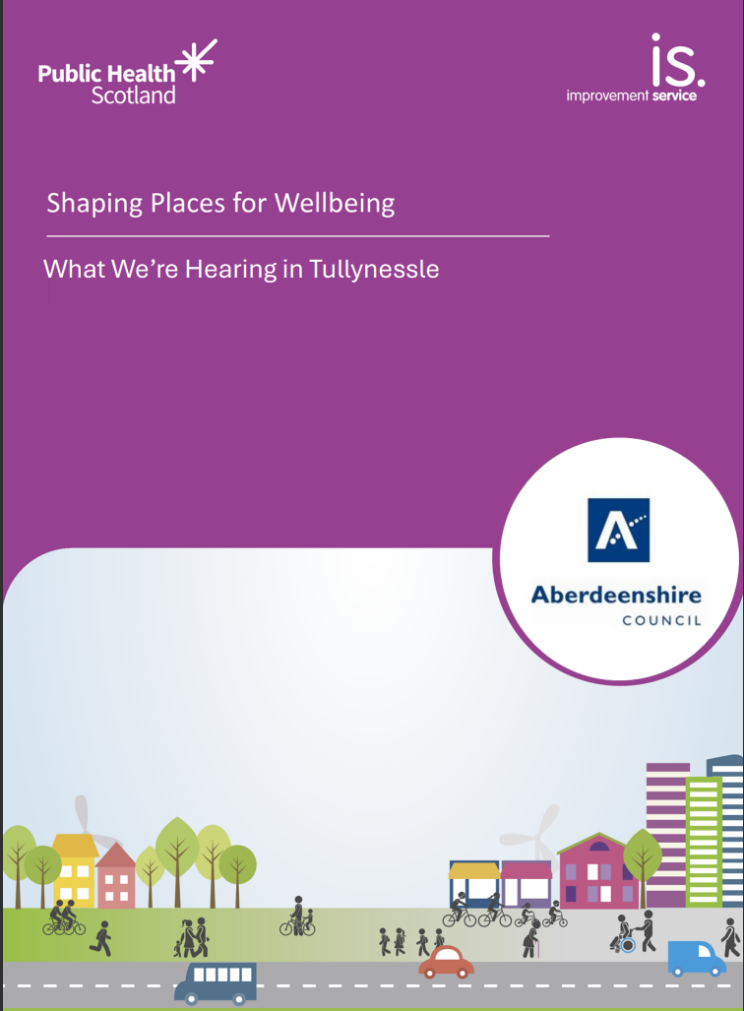
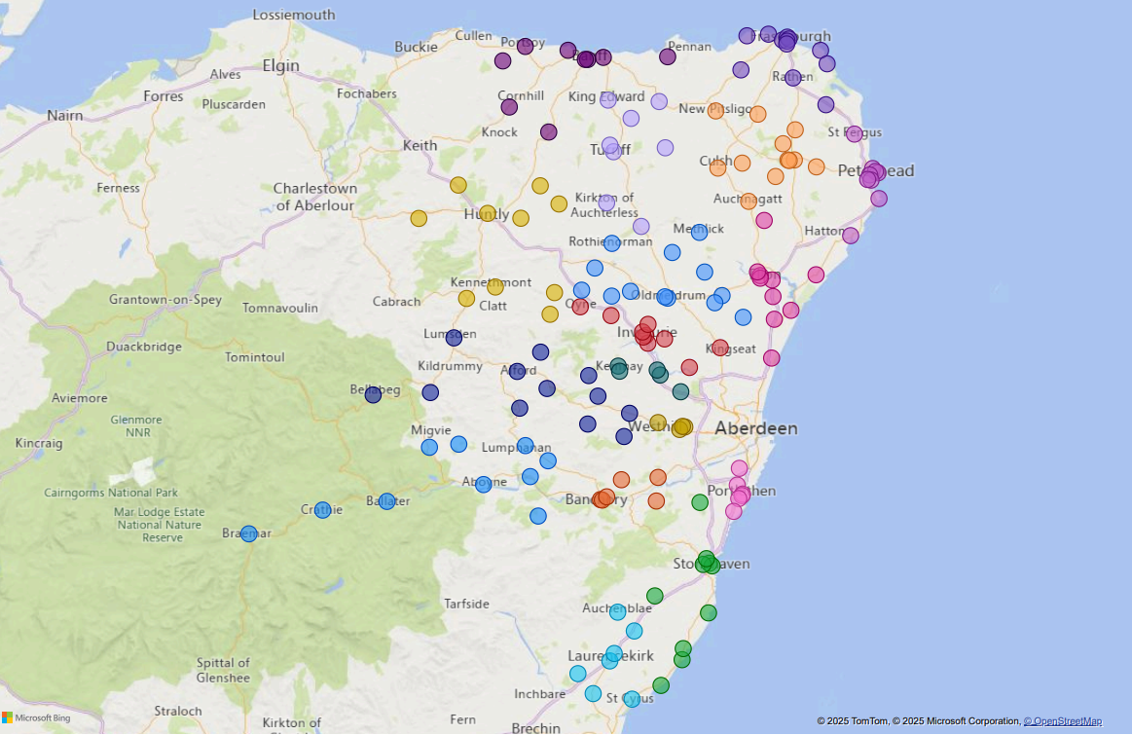
Embedment in Practice
Aberdeenshire Learning Estates Adoption and Implementation
Looking across the whole of Aberdeenshire
Place & Wellbeing Assessments – evidence-based discussions to support decision making
Allow the community to ‘be heard’ and ‘to hear’

Slide 19



Applying a place-based approach.
Example: Calton Ward Demonstration of Change

Slide 20
Key Elements of a place-based approach.
Knowing what people in an area are experiencing.
Understanding the evidenced features every place needs.
Considering the impact of the decisions we are making on both of these.

Slide 21
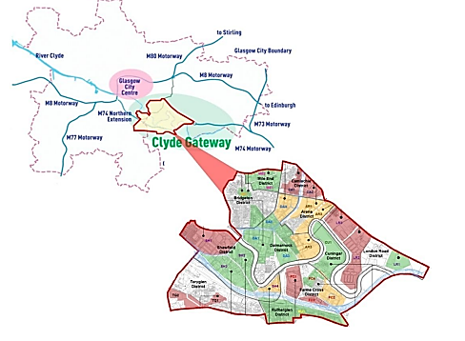
Clyde Gateway Site
Geography

Slide 22
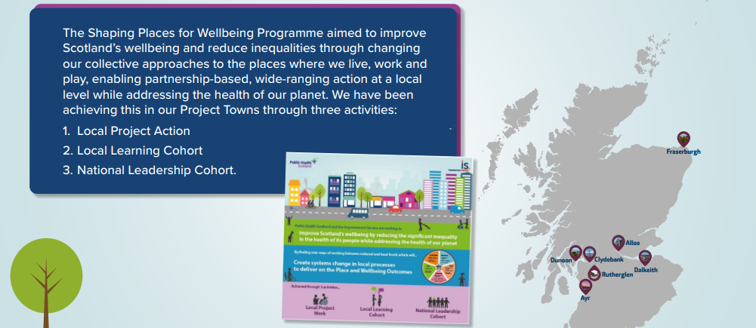
Shaping Places for Wellbeing

Slide 23

Rutherglen Project Town paper
Clyde Gateway
Supporting Families: Access to Childcare
Clyde Gateway
Calton Ward: Demonstration of Change

Slide 24

10 “booster” wards
Calton
Canal
Drumchapel / Anniesland
East Centre
Garscadden / Scotstounhill
Govan
Greater Pollok
Linn
Southside Central
Springburn / Robroyston
Fairer Futures Partnerships in Glasgow aim to reduce child poverty by providing targeted support, fostering collaboration between various agencies, and using data-driven approaches to identify and address the needs of families in specific areas.

Slide 25
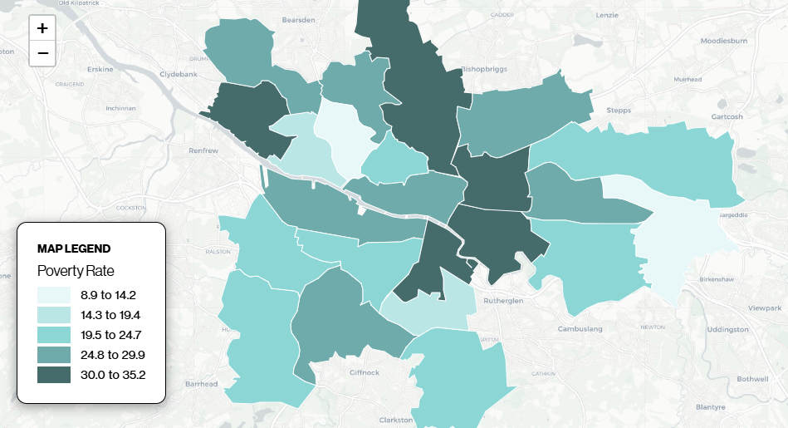
Child Poverty Map

Slide 26
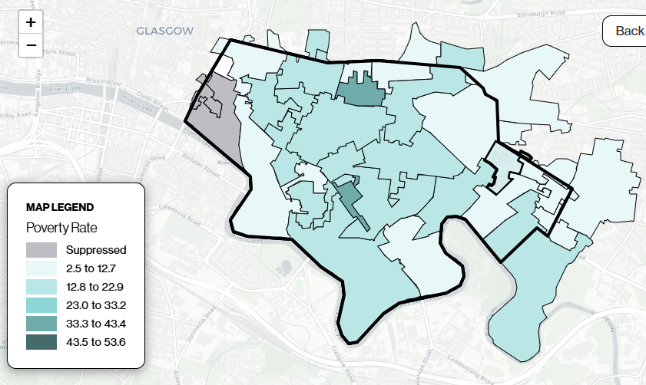
Child Poverty Map

Slide 27




Calton Ward Demonstration of Change
Four “enablers” to sustainable employment in the Calton Ward:
Childcare
ESOL – English for Speakers of Other Languages
Community Engagement
Employer Engagement

Slide 28
Calton Ward Demonstration of Change
Four “enablers”:
Childcare
Hypothesis: Many families on the cusp of poverty face barriers to sustainable employment due to a lack of affordable and accessible childcare, especially with 49% of families in Calton ward, with multi age children finishing statutory education at different times. This can perpetuate a cycle of financial instability and underemployment.
Assumptions: Non-statutory (informal or community-based) childcare could help bridge the gap by offering more flexible and cost-effective solutions that statutory services might not provide (e.g breakfast clubs, afterschool childcare or playschemes running over holiday periods in addition to maximising on statutory childcare offer. Supporting sustainable employment helps families increase income, improve financial stability, and reduce dependence on benefits.

Slide 29
Calton Ward Demonstration of Change
ESOL – English for Speakers of Other Languages
Hypothesis: There is a need to build sustainable capacity and expertise to improve outcomes for people who have English as a second language to develop their English language skills, thus increasing their ability to seek, gain and sustain employment.
Assumptions: On the assumption that the current level ESOL of activity is maintained, cX% of the Ward's population will not progress from basic English to English which can support an economic outcome.
Community Engagement
Hypothesis: Working through existing interventions engaging with a wide range of residents to test the proposed change will be easier to manage and deliver. The existing level of community support provides a "safety net" preventing increased "crisis intervention".
Assumptions: Clyde Gateway's partners, networks and community groups/ committee will provide time to support the DoC. Where input is out of scope, Clyde Gateway will seek to ensure input is redirected and appropriately actioned.

Slide 30

Calton Ward Demonstration of Change
Employer Engagement
Hypothesis: By actively involving employers in creating flexible, family-friendly work environments, parents are more likely to find employment opportunities that align with their caregiving responsibilities. An increasing amount of employers are reporting that they have high quality jobs and vacancies that they are unable to fill, to change this, employer engagement at an earlier stage is necessary.
Assumptions: CG's partners will be willing to provide time and support the DoC. Employers will acknowledge the benefits of becoming involved with the DoC.

Slide 31
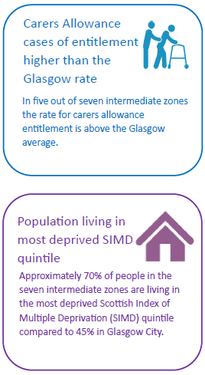
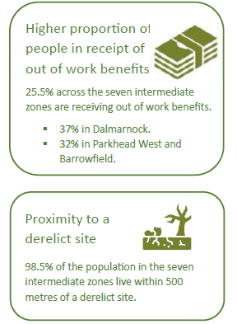
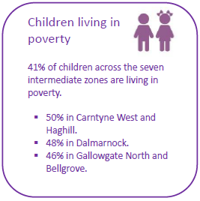
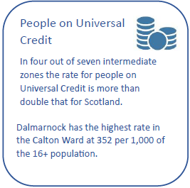
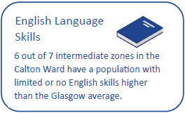
Calton Ward Data Profile Findings

Slide 32

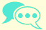
Calton Ward: What we are hearing in the community
Levels of anxiety in young people, including teenagers is of great concern, recognising that anxiety is stopping young people from engaging in services that includes social and learning opportunities.
Young people are missing out on social and learning opportunities due to caring responsibilities.
The role of carers and the impact of caring.
Young people and mental health.
There is a real need to provide ongoing conversational English classes and a recognition of the links between English skills and a feeling of belonging to the community.
People report that they value meaningful engagement and that they want to be involved.
English language skills.
Strong history of community-led development and action.

Slide 33
So what?
What is the wider impact on the community of the Demonstration of Change?
Community and Society
Enabler
Intended
Impact
Impact on the Data
Wider Outcomes
Place and Wellbeing Outcomes
e.g. Childcare, ESOL, Community Engagement, Employer Engagement.
e.g. sustainable employment.

Slide 34
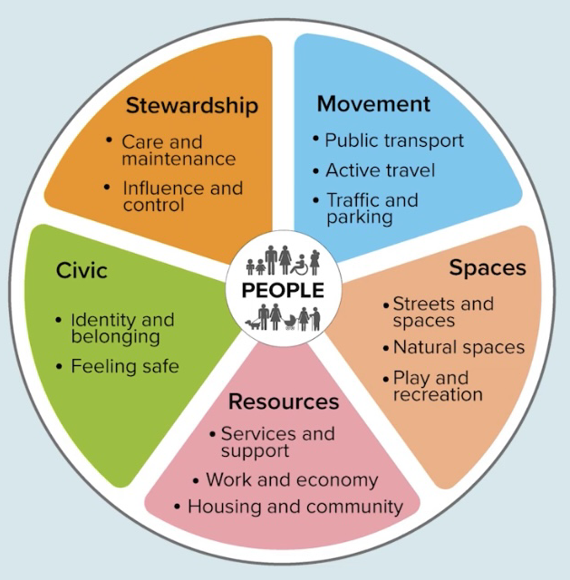
Place and Wellbeing Outcomes
What every place needs to:
Enable wellbeing of people
Reduce inequalities in our communities
Build towards net-zero emissions and sustainability

Slide 35
Resources: Work and Economy
Work and Economy can have a positive impact on people when everyone benefits equally from a local economy that provides:
Essential goods and services produced or procured locally.
Good quality paid and unpaid work.
Access to assets such as wealth and capital, and the resources that enable people to participate in the economy such as good health and education.
A balanced value ascribed across sectors such as female dominated sectors and the non-monetary economy.

Slide 36
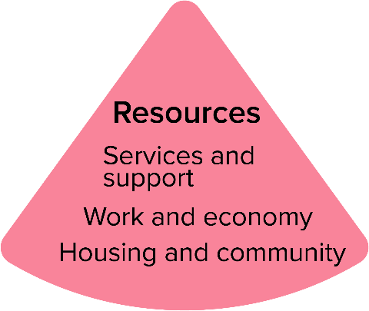
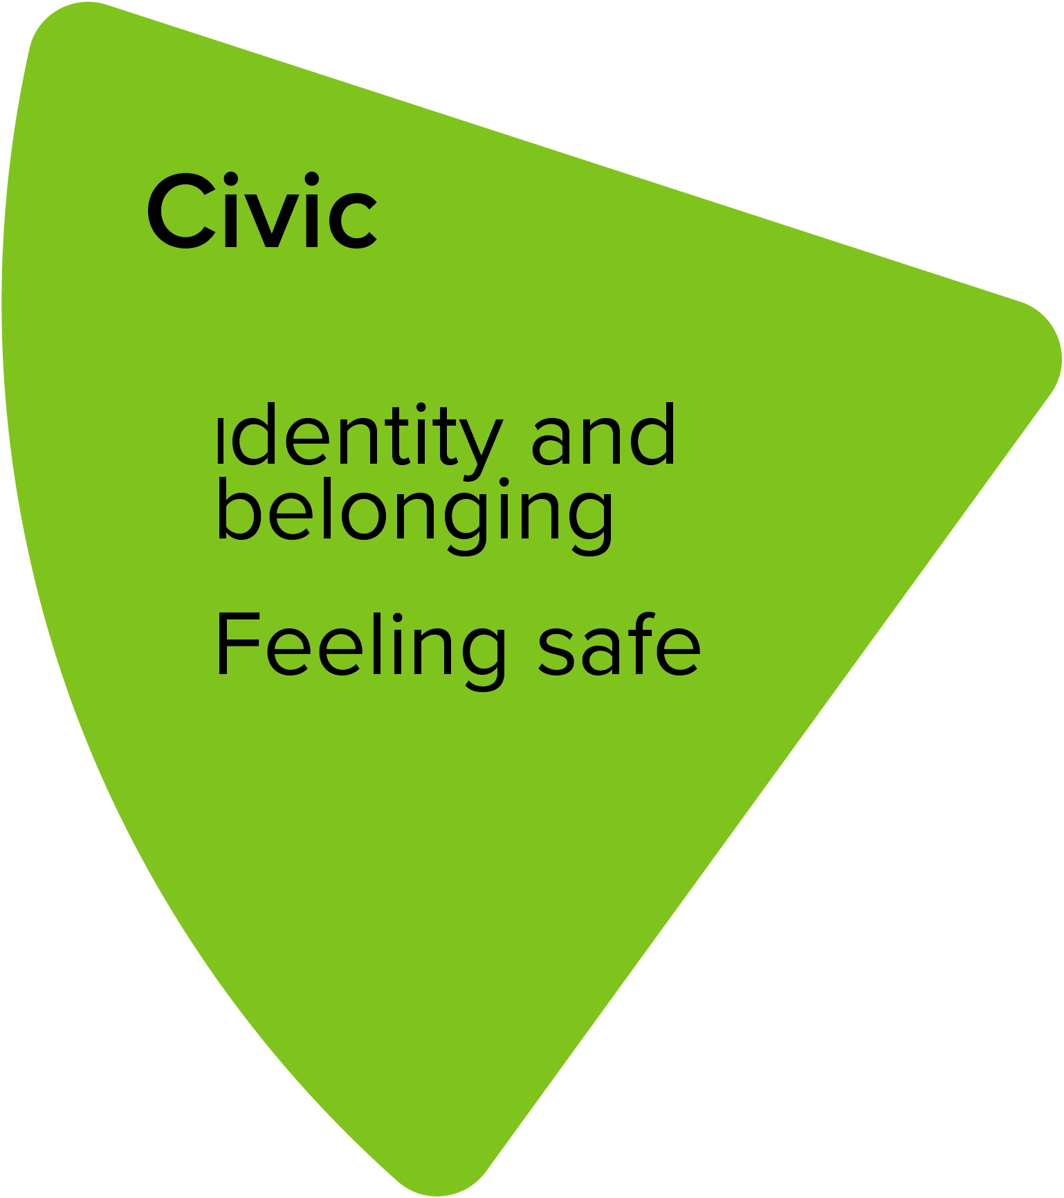
Calton Ward Demonstration of Change and the Place and Wellbeing Outcomes
Social Cohesion:
Childcare services can foster community connections. They provide a space for parents to meet, share resources, and build support networks, enhancing social ties and community resilience.
Language:
By providing ESOL classes this provides an opportunity for people to build connections and feel part of the community, increasing a sense of belonging.
Economic Benefits:
Accessible childcare allows parents to work, contributing to the local economy.
Support:
Community engagement allows for identifying what services and support are required and what would make a difference – whole family approach.

Slide 37
Ongoing considerations:
Burden of Disease and links to child poverty and sustainable employment.
How data profile is being used outside of Clyde Gateway.
Gathering of qualitative data how we continue to do this whilst sharing the qualitative data infographic.
Marmot (South Lanarkshire).
Rolling out into other wards, including data profiles.
Digital mapping of data profiles.

