Slide 1
Child Poverty, Health & Wellbeing

Slide 2
Child poverty in Scotland
  Scale of child poverty
  Causes of child poverty
  Impact on children’s health and wellbeing
Child Poverty Act (Scotland) 2017
  Local Child Poverty Action Reports
Local actions
Financial Inclusion Referral Pathways- Health & Money and welfare rights services
  The Cost of School
  Education partnership approaches

Slide 3
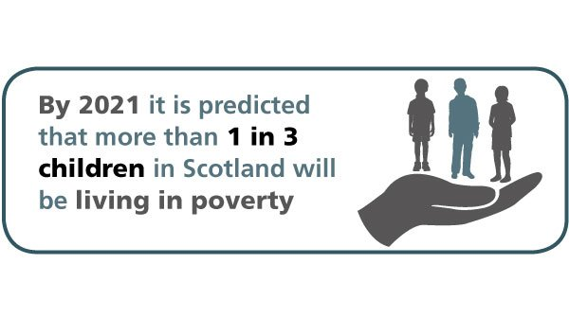

Slide 4
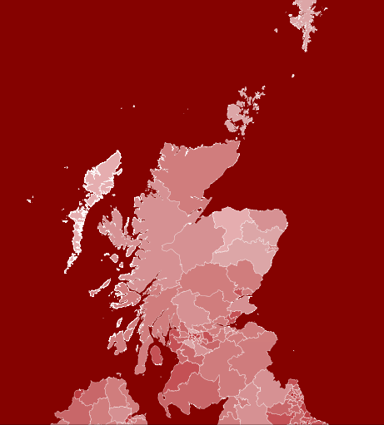
End Child Poverty
Poverty is holding children and families under it’s grip in every Local Authority in Scotland

Slide 5
Who’s affected?
Two-thirds of children in poverty in Scotland live in working households
Most children in Scotland living in poverty live in families
  with one or two children
  headed by a couple
  where no-one is disabled
  in white Scottish households
  where the mother is aged 25 or older

Slide 6
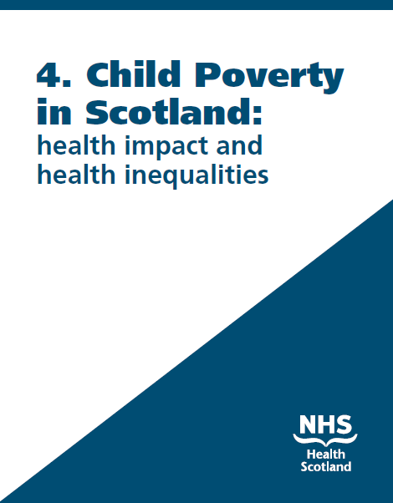
What’s the impact?
Children and families living in poverty suffer greater health and social inequalities than their better-off peers
Those in the most deprived areas are at greater risk of poorer health outcomes than children from better off families or from more affluent areas
Child poverty and low income : Health impact and health inequalities (PDF, 281.7KB)

Slide 7
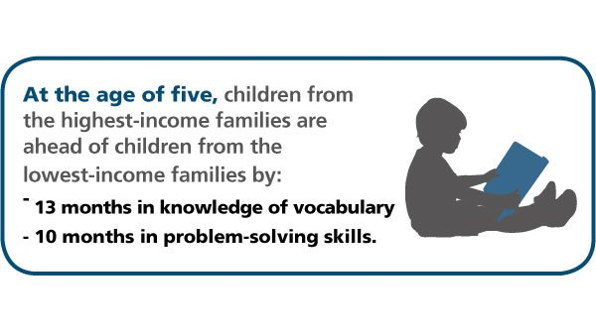
Educational outcomes
Children from low income households and disadvantaged areas tend to have worse outcomes than their better-off peers in terms of cognitive development and school achievement.
This can impact upon educational outcomes.

Slide 8
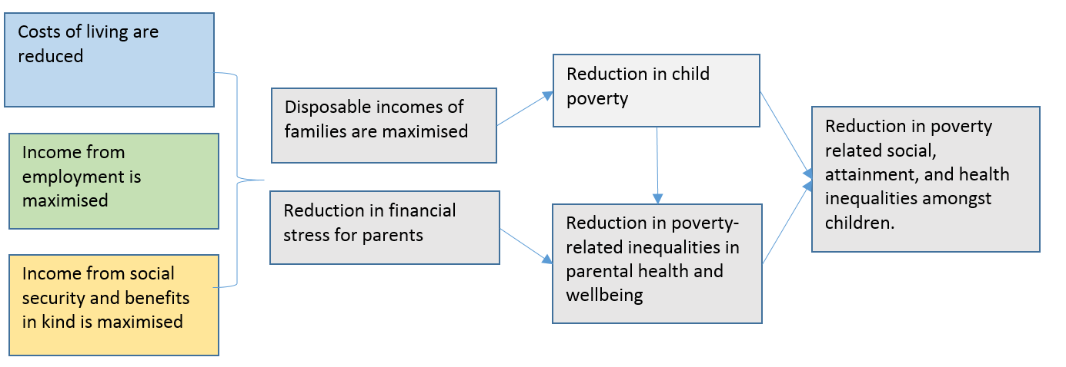
National and Local action to reduce child poverty
To meet the 2030 targets in Child poverty (Scotland) Act 2017 to reduce child poverty local partners should focus on activities which contribute to the following 3 key outcomes:

Slide 9
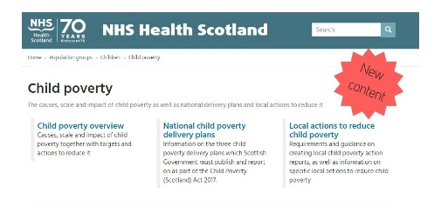
  www.healthscotland.scot/child-poverty

Slide 10
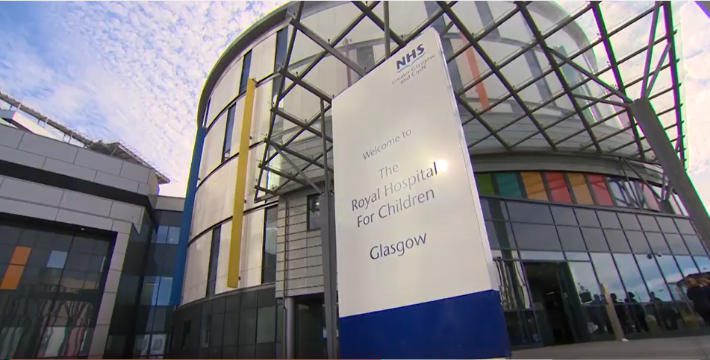
Local Actions to reduce child poverty
Financial Inclusion Referral Pathways between
Health and Money and Welfare Advice services

Slide 11

Social Return on Investment (SROI)
£1 investment £39 social & economic benefits

Slide 12
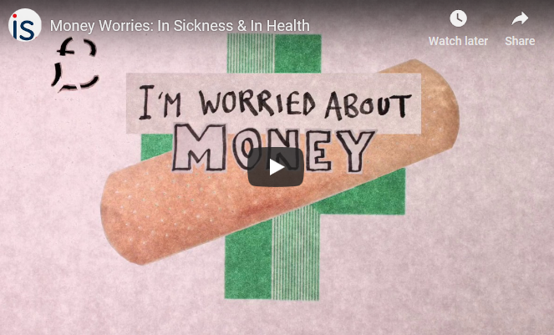

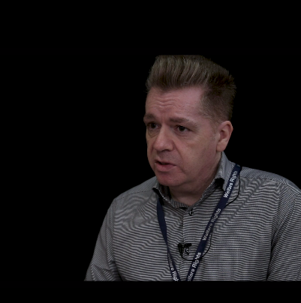
Money Worries in Sickness and Health
http://www.improvementservice.org.uk/money-worries-in-sickness-and-in-health.html

Slide 13
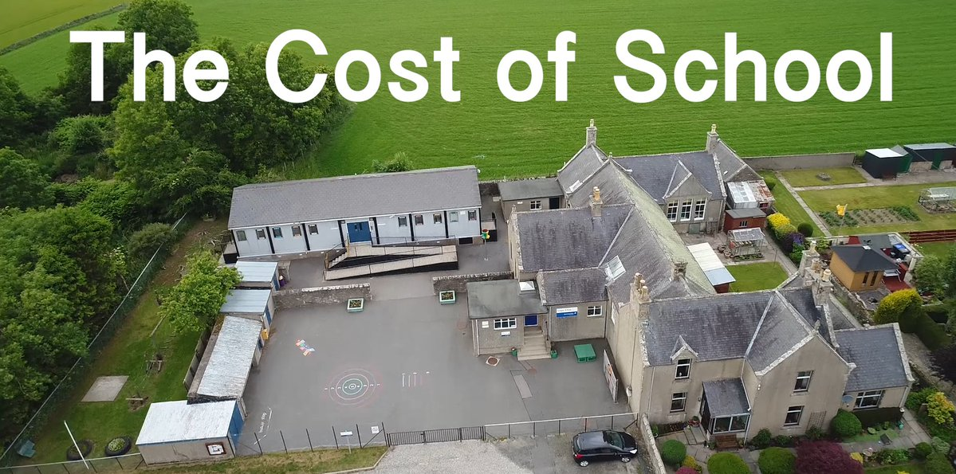
“Education is free but a lot of school things are not”
Member of the Children’s Parliament , Age 11
http://www.healthscotland.scot/cost-of-school

Slide 14
Local Actions on the Cost of School Day
Holiday Programmes/Cost of School Holidays
Automation of School Clothing Grant entitlement (& Education Maintenance Allowance (EMA)
Income Maximisation in schools – Money Advice and Welfare Rights Advisers in Schools

Slide 15
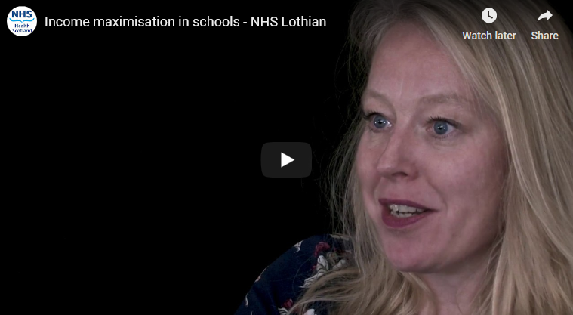
Income Maximisation in School
www.healthscotland.scot/child-poverty
Notes:
S

Slide 16
Together we can and will right the wrong of child poverty.
Email: ashleigh.jenkins3@nhs.net
Child Poverty Webpages: www.healthscotland.scot/childpoverty
Twitter: @NHS_CYPF (Children, Young People and Families)

Slide 17
Discussion

