Slide 1




Introduction to Hydrogen
Module 2: Production & Demand
Dr Ali Hassanpouryouzband
School of GeoSciences, University of Edinburgh
Dr Priya Bhagavathy, Dr Arash Badakhsh
Power Networks Demonstration Centre, University of Strathclyde
Notes:
Hello my name is ___ _____
I am __________ at The University of ________, and I will take you through Module 2.
This session will provide an overview of hydrogen production and demand.

Slide 2

Production from many technologies
H₂
CO₂
Hydrogen
Production
Hassanpouryouzband et al. "Hydrogen Energy Futures - Foraging or Farming?“, Chemical Society Reviews, 2024
Notes:
Globally, the shift towards hydrogen energy is gaining momentum. It's increasingly recognized not just as a fuel, but as an energy carrier with the potential to decarbonize various sectors, including transportation, power generation, and industries like steel manufacturing.
In terms of production, hydrogen is versatile. It can be generated from a variety of resources which we have summarised in this figure. Traditional methods primarily use natural gas or other fossil fuels with around 96% of hydrogen produced today, but the future lies in tapping into cleaner sources. This includes nuclear power, biomass, and particularly renewable sources like solar and wind energy, which Scotland is rich in. There are also naturally occurring hydrogen which we will delve deeper in upcoming slides.
Understanding the standards and regulations governing hydrogen production is crucial. The International Organization for Standardization (ISO) provides guidelines under ISO/TC 197 for hydrogen technologies, covering aspects like safety, purity, and production methods. The European Union also has directives and benchmarks focusing on sustainable and low-carbon hydrogen production. UK Government has set standards to ensure that the final Greenhouse Gas (GHG) Emission Intensity for our Hydrogen Product does not exceed 20 grams of CO₂ equivalent per megajoule, based on Lower Heating Values (LHV).
In Scotland, harnessing our robust renewable energy resources for hydrogen production is not just an environmental imperative but an economic opportunity. It aligns with Scotland’s goals for carbon neutrality and economic diversification, placing us at the forefront of the green energy revolution.
However, transitioning to a hydrogen-based energy system requires strategic planning. This includes investing in infrastructure, ensuring regulatory frameworks are in place, and fostering public-private partnerships. By doing so, we can facilitate a smooth transition that benefits both our environment and our economy.

Slide 3
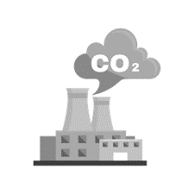
Fossil fuel hydrogen
H₂
Global Grey H₂ production: 94 Mt
CO₂ emissions in 2022: 900 Mt
UK grey H₂ for 31 sites: 1.9 kt/day
23 TW per year
Current markets:
refining, ammonia, methanol
$131 billion industry in 2022
$175 billion industry in 2032
CO₂
Grey hydrogen
Reforming of natural gas
or gasification of coal
Efficiency: 75-80%
95 – 99% H2 purity
10 - 20 kg CO2 per H2
$0.7 – 2.4 per kg H2
Hydrogen
Production
Fossil
fuels
Hydrogen
Notes:
Now that we have covered why we need hydrogen and where it can be most usefully deployed to support Net Zero, let's move on to the production of hydrogen. There is a lot of jargon surrounding hydrogen production and a whole rainbow of colours to describe the different options, but in practise there are four basic types of hydrogen.
First up is grey hydrogen, which accounts for 99% of the current hydrogen production market, with 94 million tonnes of hydrogen produce globally in 2022. Grey hydrogen is produced by heating methane gas with high temperature steam, in a process called steam methane reforming (“SMR”) or through steam powered gasification of coal. This process is efficient, resulting in a cost of under 2 dollars per kg. However, it releases between 10 and 20 kg of CO2 for every kg of hydrogen produced and was responsible for ~900 million tonnes of CO2 emissions in 2022. As context this is more than double the entire emissions from the UK in that same year.
Decarbonising grey hydrogen production is a key driver of new low hydrogen production technologies.
The UK produces nearly two thousand metric tonnes of grey hydrogen per day, which is the equivalent of 23 TWh per year. 99.8% is produced as grey hydrogen with unabated emissions from 31 sites, mostly produced on site for consumption within the same facility, there is very little available for open sale.

Slide 4

Low-carbon fossil fuel hydrogen
H₂
Zero emission through carbon capture and storage (CCS)
Only 1% of hydrogen production includes CCS worldwide
No blue hydrogen currently in UK
Future blue hydrogen UK projects:
  Acorn, Scottish Cluster
  HyTeeside, East Coast Cluster
  HyNet, NW Cluster
CO₂
Blue hydrogen
Grey hydrogen with carbon
capture and storage (CCS)
95 – 99% H2 purity
3 - 10 kg CO2 per H2
$1.5 – 4 per kg H2
Hydrogen
Production
Fossil
fuels
Hydrogen
CO2
CO2
CO2
*UK Low carbon hydrogen standards:
GHG intensity of 20 gCO2e/MJLHV of produced hydrogen or less
Notes:
Blue hydrogen is essentially grey hydrogen, with the CO2 emissions captured and stored securely in deep geological formations. Globally around 1% of hydrogen produced is blue hydrogen.
Blue hydrogen costs are between 1.5 and 4 dollars per kilogram of hydrogen, which is around 1-2 dollars per kg more than grey hydrogen, reflecting the cost of the carbon capture and storage.
It is worth mentioning here the need for standards associated with what counts as low carbon hydrogen, as this is certainly a murky area - is say the use of CO2 captured during hydrogen production for enhanced oil recovery truly low carbon hydrogen?
There is now a global effort to define what constitutes ‘low carbon hydrogen’ at the point of production based on the lifecycle emissions across the entire production chain. The UK published their low carbon hydrogen standard last year and to be considered low carbon, hydrogen must have a GHG emissions intensity of 20 grams of CO2 per MJ of produced hydrogen or less. This is in line with European and other standards ensuring an open export route.
In the UK, there are no current blue hydrogen production sites, but there are a number of blue hydrogen projects the pipeline totalling 14.3GW production capacity through the Acorn project in Scotland and the HyNet project around Liverpool and the Teeside East Coast Cluster.

Slide 5

Electrolysis of water to H₂ & O₂
H₂
Global market: $3.2 billion in 2021
Annual growth of 39.5% to 2030
Current UK production:
2.21 metric tonnes (26 GWh)
120 UK green H2 pipeline projects:
from 2 MW to 5 MW to <100 MW
Underway: Dolphyn project
Green hydrogen
Green hydrogen
Water electrolysis
(AEM/PEM/SOEC)
$3-6 per kg H2
CO₂
Hydrogen
Production
Renewable
Electricity
Water
Oxygen
Hydrogen
NB: Most global hydrogen strategies anticipate green hydrogen dominating by 2050
Notes:
Green hydrogen uses renewable electricity to run electrolysers, which split water into hydrogen and oxygen and has negligible CO2 emissions.
It is a proven technology that needs to be scaled up to reduce costs as currently green hydrogen stands at 2-3 times the cost of grey and blue hydrogen. The global green hydrogen market size was valued at USD 3.2 billion in 2021 and is expected to expand at a compound annual growth rate of 39.5% from 2022 to 2030.
There are three different types of electrolysers, the most widely deployed with 62% of the market share are alkaline electrolysers followed by polymer electrolyte membrane or PEM electrolyzers with 24% of the market share with Solid Oxide Electrolyzers having a 14% market share. It is anticipated that alkaline electrolyzers will remain the largest market.
There are significant innovations underway to improve the efficiency of electrolysers and reduce the cost of the produced hydrogen, this include the ability for electrolysers to run on seawater as is being piloted in the UK Dolphyn project.
The UK currently produces 2.21 metric tonnes (26 GWh) green hydrogen from 14 sites. However, the UK’s green-hydrogen pipeline comprises around 120 production projects that range in size from 2MW-5MW to more than 100MW, many of which are linked to large, offshore wind projects.
While the UK is taking a twin track approach to low carbon hydrogen production with blue and green, it is anticipated that by 2050 blue hydrogen will be phased out and green hydrogen production will dominate.

Slide 6
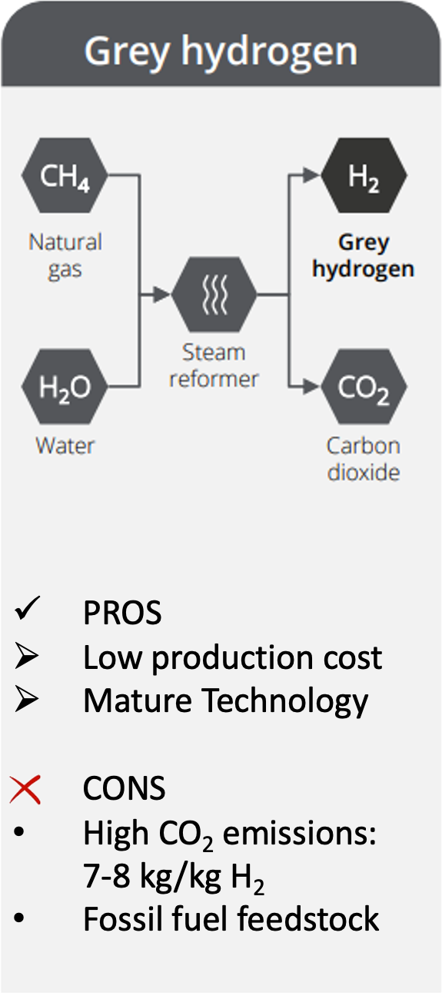
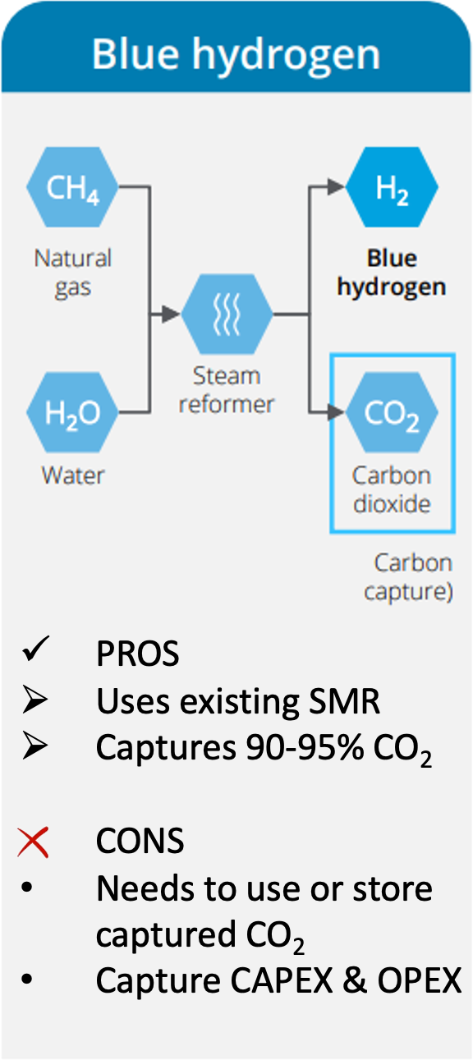
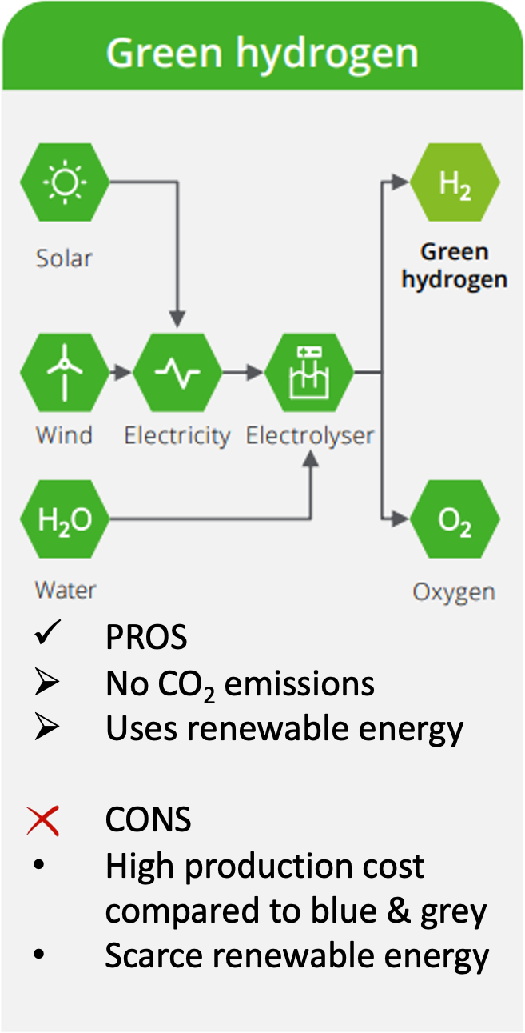
Technologies: Pros & Cons
H₂
CO₂
Hydrogen
Production
Notes:
Source: Deloitte analysis, Hydrogen Council
Blue and green hydrogen are the two key low-CO2 alternatives that could replace carbon-intensive grey hydrogen, which represents 95% of the hydrogen production today.

Slide 7
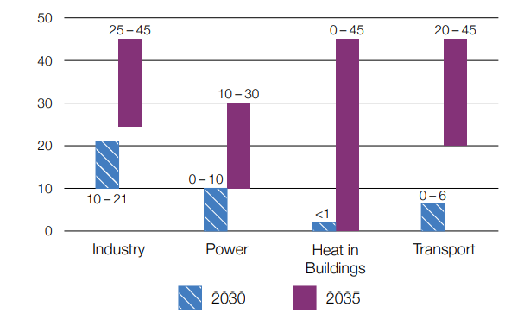
UK hydrogen demand to 2035 (TWh)
H₂
CO₂
Hydrogen Demand
Ref: BEIS analysis, UK Hydrogen Strategy, 2021
*Figure does not include blending into the gas grid
Notes:
As mentioned previously Low carbon hydrogen is anticipated to make up 20-35% of UK final energy consumption by 2050, but what does that actually look like in terms of amount of hydrogen required?
There are a plethora of hydrogen demand scenarios available that range from the sublime to the ridiculous – the image on screen provides some indication of how the UK government anticipates how the use of hydrogen in the UK is likely to develop in the near- to medium-term. The analysis suggests potential hydrogen demand of up to 37 TWh by 2030 split across industry, power and transport, not including use of hydrogen for blending into the gas grid.
This could rise to 55-165 TWh by 2035 if we are to meet our sixth carbon budget, which is a legally binding target that places a restriction on the total amount of greenhouse gases the UK can emit over a 5-year period and is tied to our path to Net Zero by 2050.
We immediately encounter a discrepancy between the 37 TWh hydrogen demand needed by 2030 and what will be delivered in practise, as the UK government low carbon hydrogen generation target is 10 GW by 2030.

Slide 8
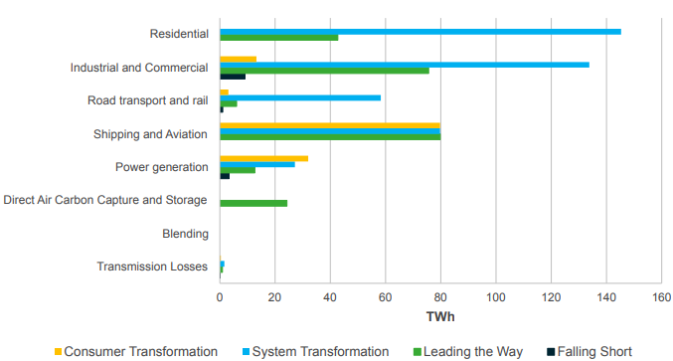
Low carbon hydrogen demand 2050
National Grid Future Energy Scenarios
H₂
CO₂
  130 TWh/year: Consumer Transformation Scenario
  435 TWh/year: System Transformation Scenario
Hydrogen Demand
Ref: https://www.nationalgrideso.com/document/283101/download
Notes:
As context it is sensible to look at how much hydrogen we may need within our future Net zero energy system.
Projecting forward to 2050 using the UK Net Zero strategy modelling and the National Grid future energy scenarios that achieve Net Zero which is shown on screen - in both high electrification scenarios, there will be the requirement for between 130 and 240 TWh per year hydrogen required for industrial, commercial, transport and power generation.
If we look at the scenarios that include some allowance for hydrogen for heat, then the hydrogen required increases to between 435 and 500 TWh per year.
These are significant numbers of hydrogen generation, but it is worth bearing in mind that we currently produce 23 TWh per year of grey hydrogen.

Slide 9
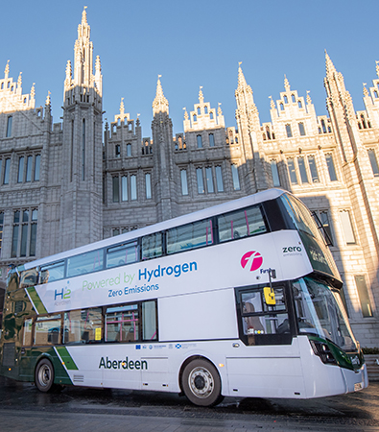
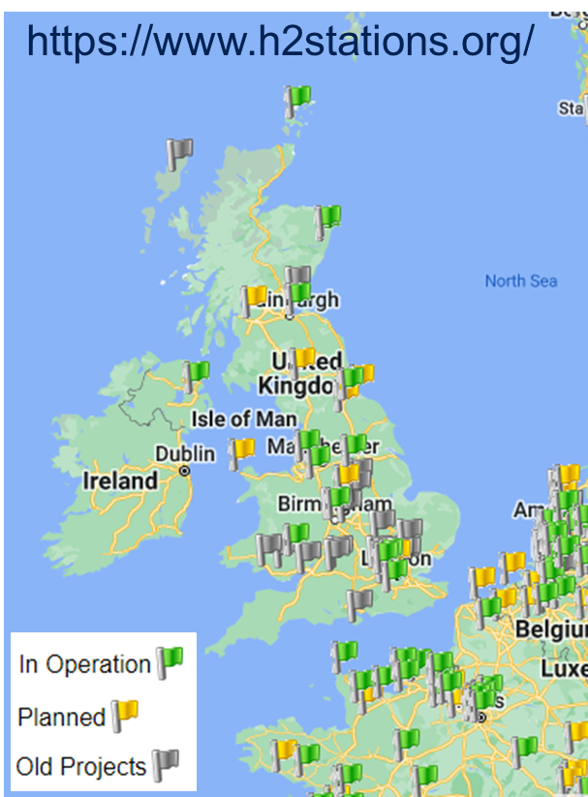

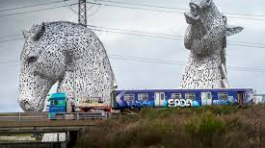
Hydrogen for Transport
H2 refuelling network
Aberdeen H2 vehicles
Zero Emission Trains
Birmingham HydroFLEX
St Andrews H2 Accelerator
HyFlyer: Hydrogen fuel
cells in aircraft
HySeas: marine hybrid electric drive system
H₂
CO₂
Hydrogen Demand
Notes:
Having covered hydrogen production and network implementation I will now highlight some of the ongoing hydrogen use projects, starting with transport.
I really like hydrogen transport projects as they also develop grass roots acceptability of hydrogen, making it every day and somewhat boring, which is exactly what we want.
There are a number of hydrogen powered vehicle demonstration projects ongoing across the UK.
Aberdeen has been successfully operating a fleet of 57 hydrogen fuel cell vehicles and included the installation of 2 new hydrogen fulling stations, which will enable them to grow their hydrogen powered fleet even further. If more councils follow suit and install hydrogen fuelling stations, this could enable the wider uptake of hydrogen vehicles due to increased access to fuelling stations across the country.
There are two projects underway to convert existing trains to a hydrogen fuel cell electric powertrain. This is important as only around 40% of the UK’s rail tracks are currently electrified so alternatives to diesel are necessary.
Other projects of note are the HyFlyer project which is replacing the conventional powertrain in an aircraft with electric motors, hydrogen fuel cells and gas storage, and it achieved its first successful flight in September 2020.
And the HySeas project which is aiming to demonstrate that fuel cells may be successfully integrated with a proven marine hybrid electric drive system.

Slide 10
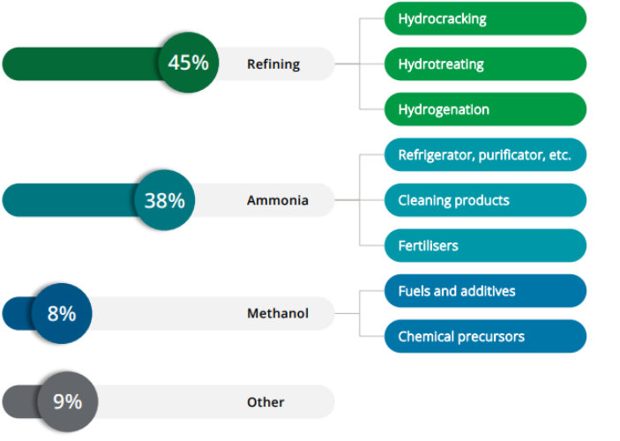


Current use in EU industry
H₂
CO₂
Hydrogen Demand
About 10 million tons
of hydrogen is already used in EU industries
Mainly as feedstock for the production
of ammonia, and in refining
FCH, Linde Gas, IEA, Deloitte Analysis
Notes:
Ref: FCH, Linde Gas, IEA, Deloitte Analysis
Today, about 10 million tons of hydrogen is already used in the EU industry, mainly as feedstock for the production of ammonia and in the refining industry.
In the chemical industry, hydrogen is mostly used as feedstock to produce ammonia. Ammonia is mainly used as a fertiliser but it is also a key component of various household cleaning products under the form of ammonium hydroxide. In industrial processes, ammonia serves as a refrigerator, purificator and chemical stabilizer.
In addition to ammonia, hydrogen is involved in the production of methanol, which is mainly used as a chemical building block to produce other chemical compounds, fuels and additives. In the refining industry, hydrogen is used in the conversion of crude oil for:
• Breaking large molecules into smaller molecules with higher added value (Hydrocracking)
• Removing contaminants such as sulfur, nitrogen and metals from crude oil fractions (Hydrotreating)
• Stabilizing some chemical products (Hydrogenation).

Slide 11
H₂ Services to the electricity grid
H₂
 | Current Role | Demand Prospective
Co-firing ammonia in coal power plants | No deployment so far | 20% co-firing by 2030 lead to 670 Mt NH3 (120 Mt H2)
Flexible power generation | Few commercial gas turbines using H2 and around 1,600 MW of fuel cell units | 1% H2 gas-fired by 2030 generating 90 TWh power (4.5 Mt H2)
Long-term and large-scale energy storage | Three salt cavern storage sites for hydrogen in the US and another three in the UK | High need for large-scale storage for seasonal imbalances
Back-up and off-grid power supply | Few demonstration projects using fuel cells/ battery storage | Telecommunications growth and need for reliable power supply
CO₂
Hydrogen Demand
Ref: The Future of Hydrogen, IEA, 2019
Notes:
Hydrogen plays a negligible role in the power sector today: it accounts for less than 0.2% of electricity generation.
This is linked mostly to the use of gases from the steel industry, petrochemical plants and refineries. But there is potential for this to change in the future.
Cofiring of ammonia could reduce the carbon intensity of existing conventional coal power plants, and hydrogen-fired gas turbines and combined-cycle gas turbines could be a source of flexibility in electricity systems with increasing shares of variable renewables.
In the form of compressed gas, ammonia or synthetic methane, hydrogen could also become a long-term storage option to balance seasonal variations in electricity demand or generation from Renewables.

Slide 12
Thank you for your attention
Module 2: Production & Demand Completed
Dr Ali Hassanpouryouzband
School of GeoSciences, University of Edinburgh
Dr Priya Bhagavathy, Dr Arash Badakhsh
Power Networks Demonstration Centre, University of Strathclyde
Notes:
This concludes the second module of the hydrogen course.
The next module, Module 3, covers hydrogen transport and storage.
Thank you for attention. Please note down any questions or comments and bring them to the webinar that completes this course.

