Slide 1

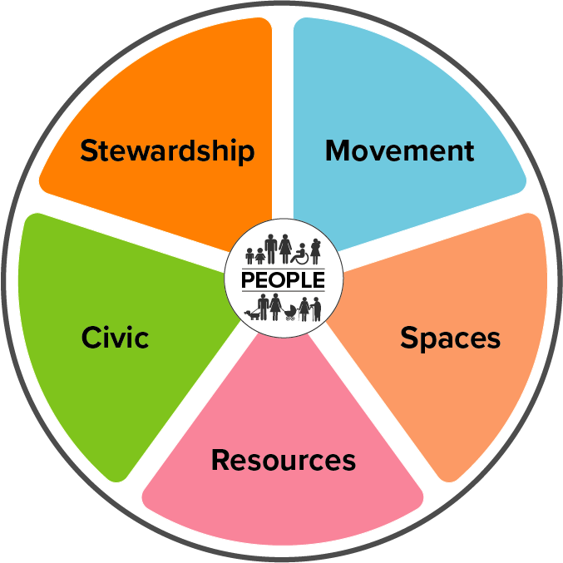
Alloa
– what we’re hearing in our communities
As part of the Shaping Places for Wellbeing Programme’s data exercise, the Community Link Leads in each town have been connecting with local communities, community organisations and practitioners working locally.
A comprehensive quantitative data exercise has already indicated that some groups in Alloa face particularly significant inequalities. Those groups are:
people experiencing deprivation in Alloa South and East; people with problem substance use involving alcohol; people experiencing poverty with a focus on children; and people experiencing ill health and dying prematurely.
This exercise aims to bring the above data to life, and understand Alloa residents' experience of the place they live, work and relax. The information gathered will be fed into Steering Group meetings and Place and Wellbeing Assessments, and be continually reviewed for the duration of the Programme.
This infographic summarises some of the key things we're hearing as they relate to the Place and Wellbeing Outcomes.
People are central to the Outcomes. The principles of equality, net-zero emissions and sustainability underpin all of these themes.
You can find out more about the quantitative data profile here.
You will be able to read more, including the process for identifying
the ideas captured in this infographic, in a report to be published soon.
Sept 2023

Slide 2


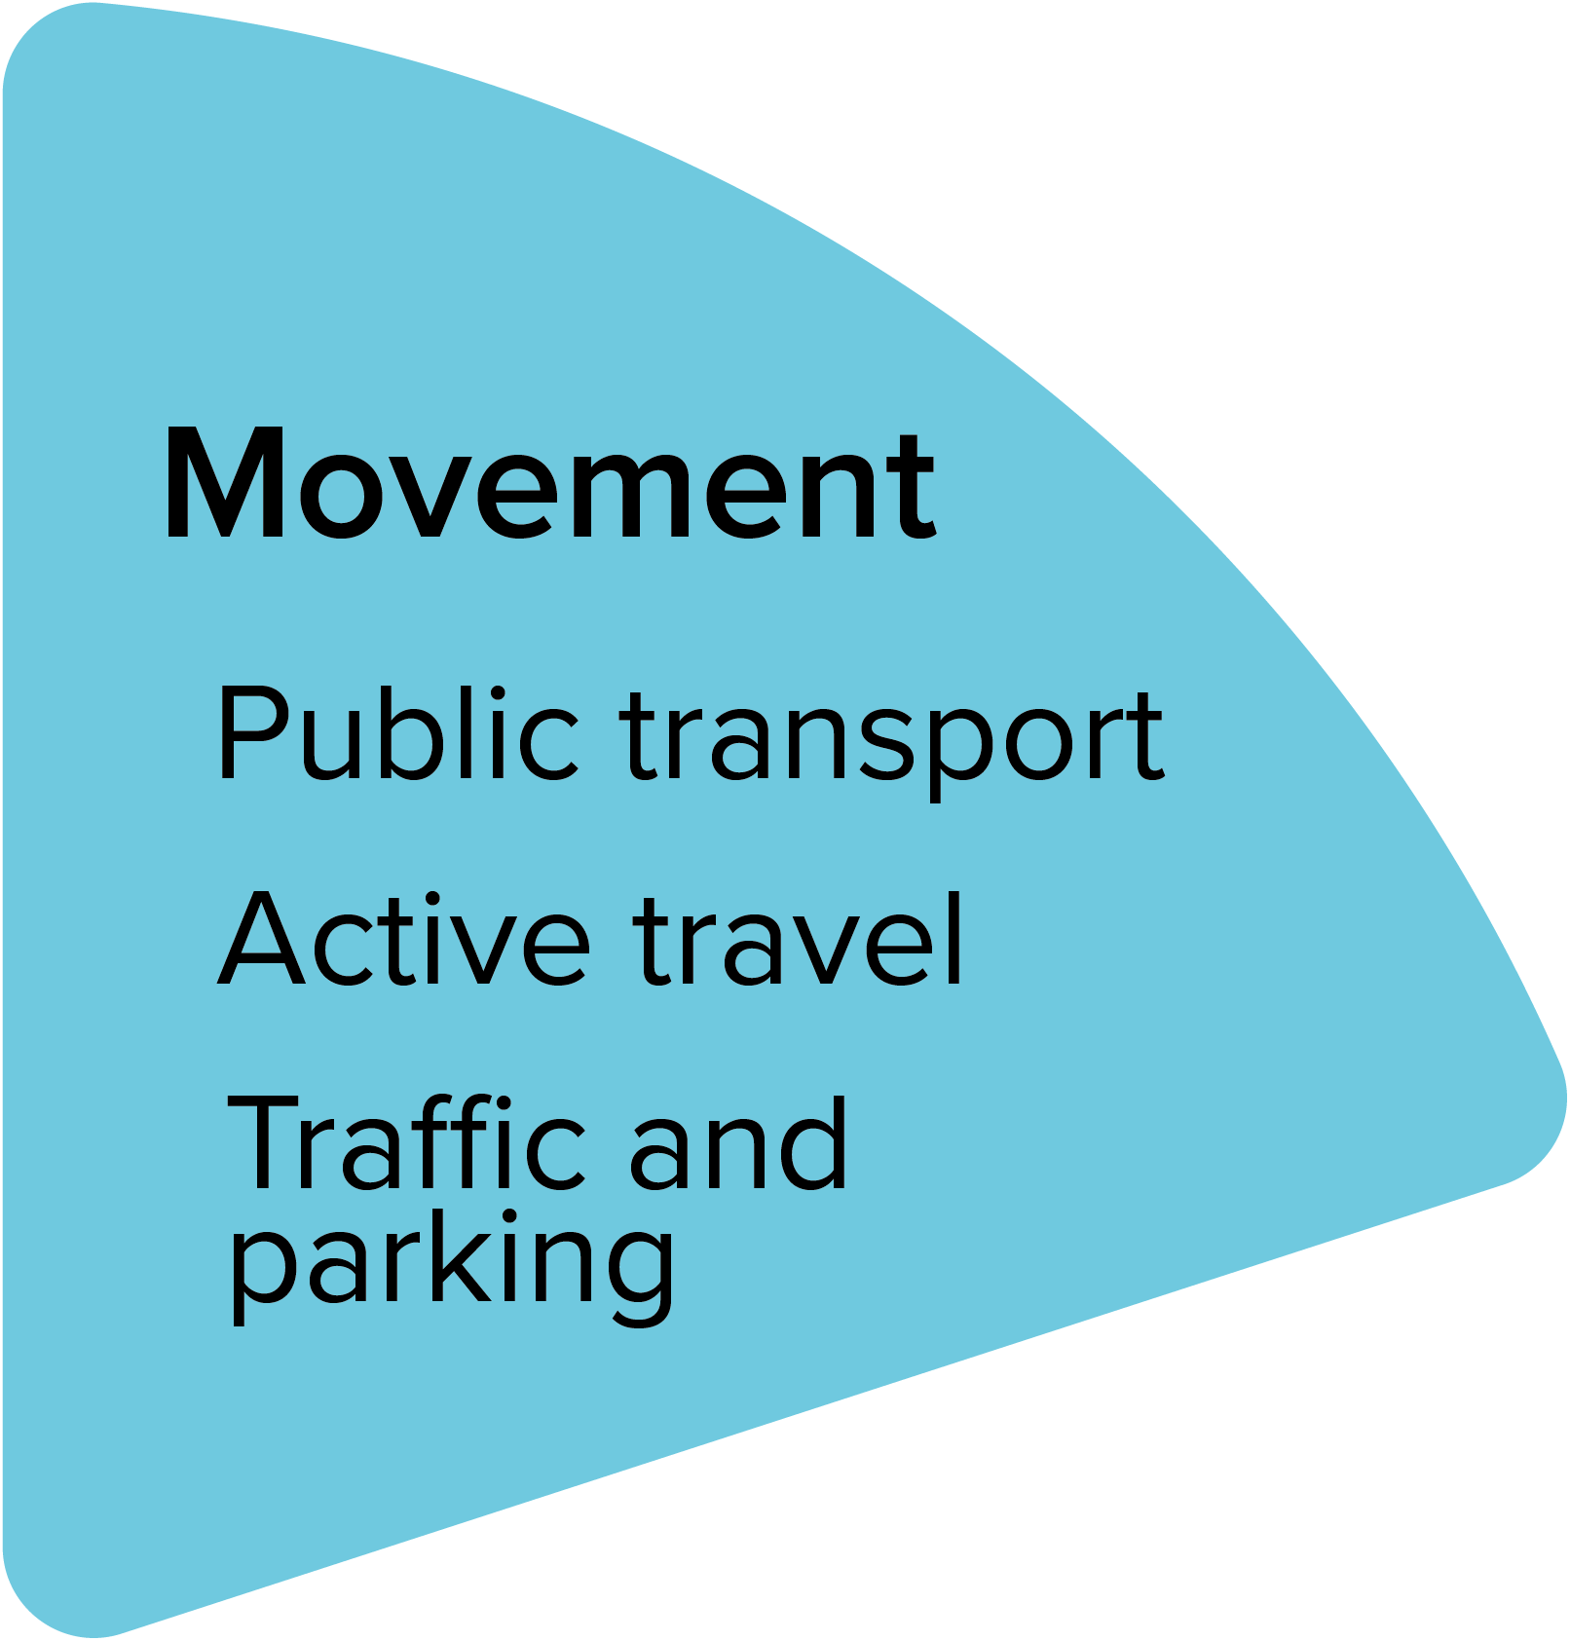
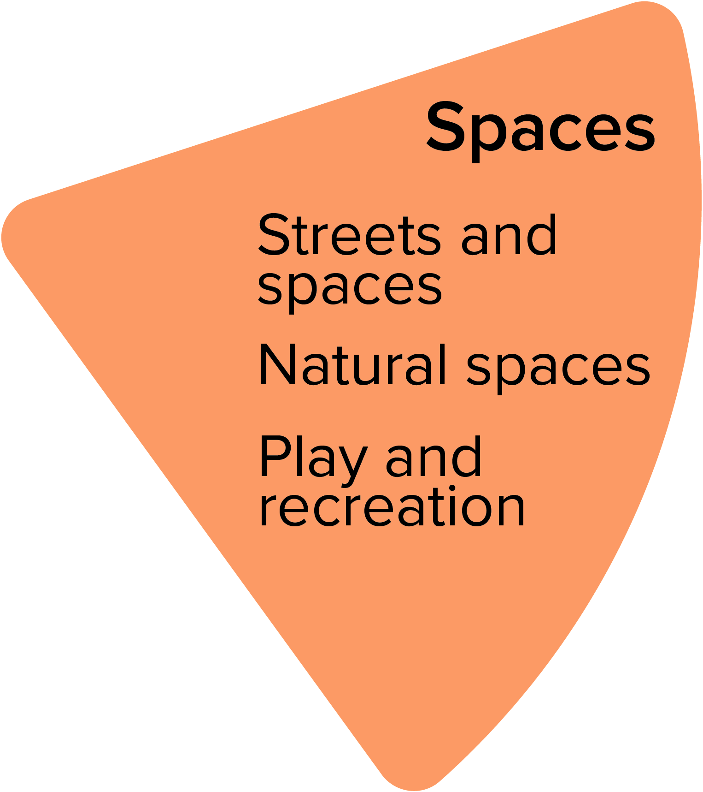
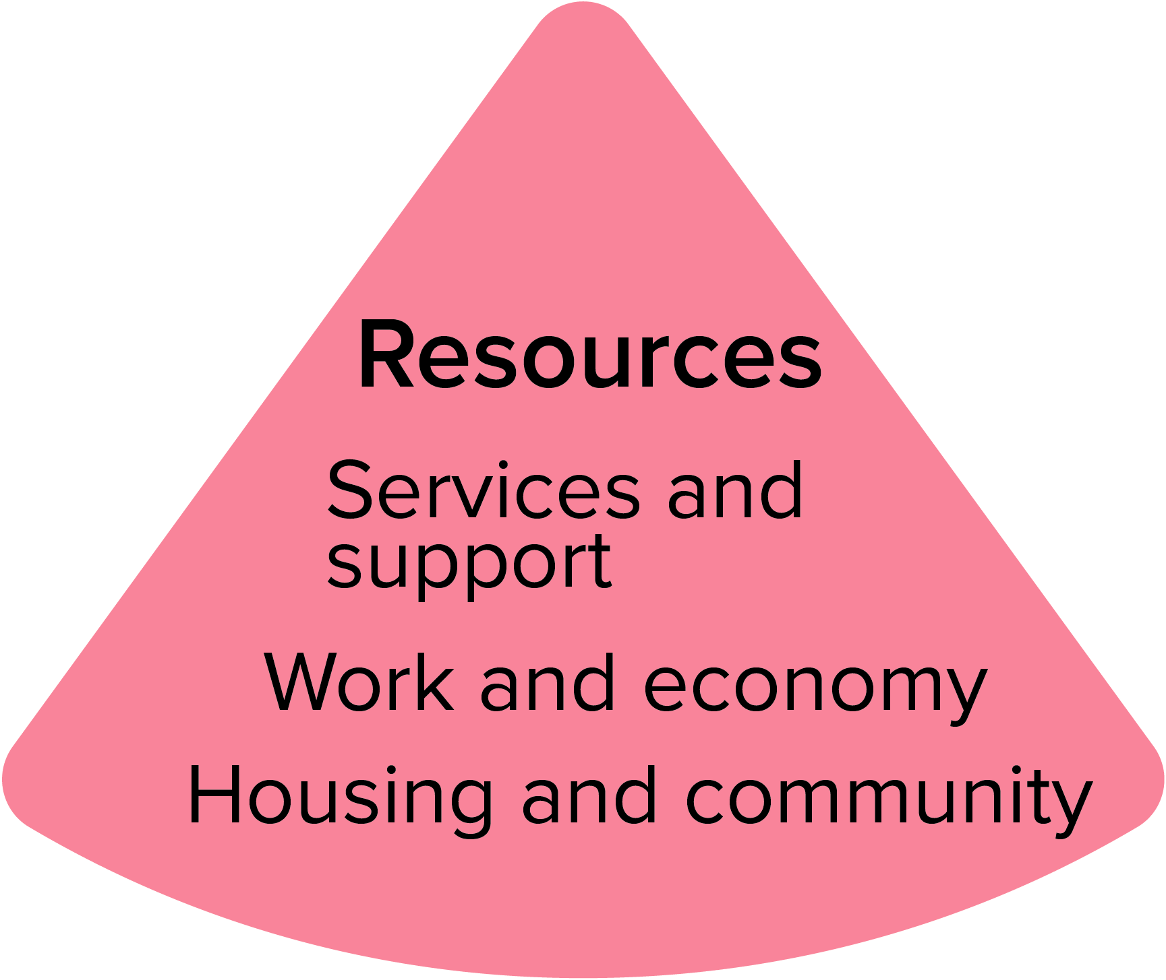
Mental health is a priority that we have limited data on.
Carers are a hidden group, often with unique and high need.
“Generational cycles” of trauma and behaviour exist in many families and communities.
Poor connectivity and public transport links between Alloa and other hubs in the region, like Stirling or Falkirk.
“Due to having to use more than one bus and trying to tie up the bus times, this can often result in long waits for people, often standing in miserable weather, it is very time consuming and the journey will take longer than the actual appointment or visit.” – Clackmannanshire resident
Green space is abundant and valued, but care and use of space could be improved.
Flood risk is a worry for some residents.
Cost is a frequent barrier to accessing leisure opportunities, including volunteering, especially since the cost of living crisis.
Lack of service provision can be frustrating, particularly when compared to other regions.
De-centralised local services are needed.
Services need to be more flexible, responsive and joined up to avoid people falling through the cracks.
Inaccessible services can deepen inequality.
Unemployment/low employment opportunities is an issue.
Insecure housing needs to be addressed.
“You can no longer walk in to speak to someone about a concern. What if people don't have access to a phone to book an appointment?” – resident

Slide 3
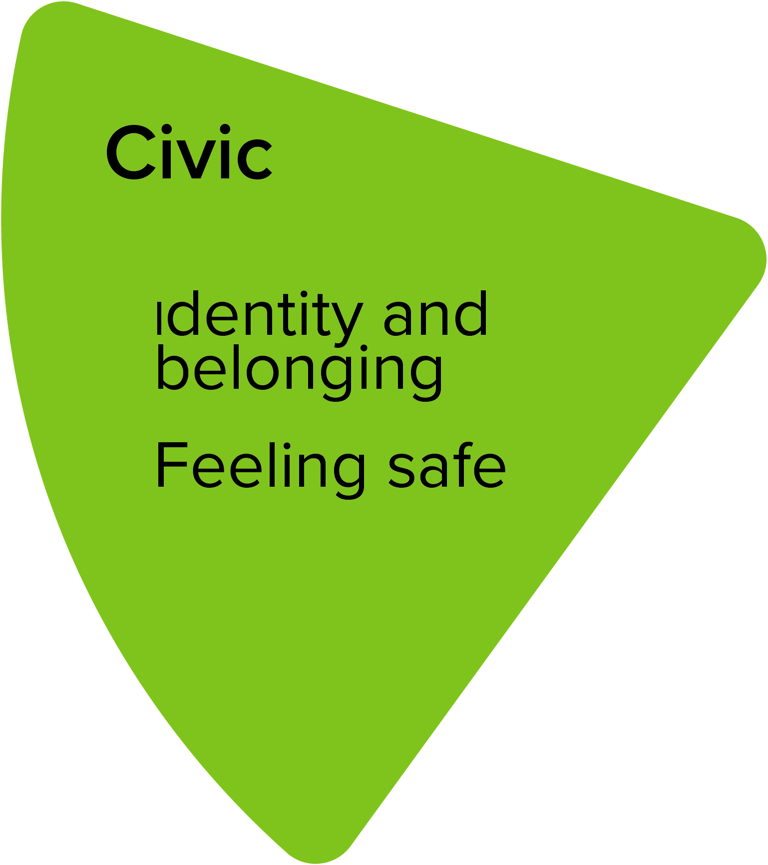
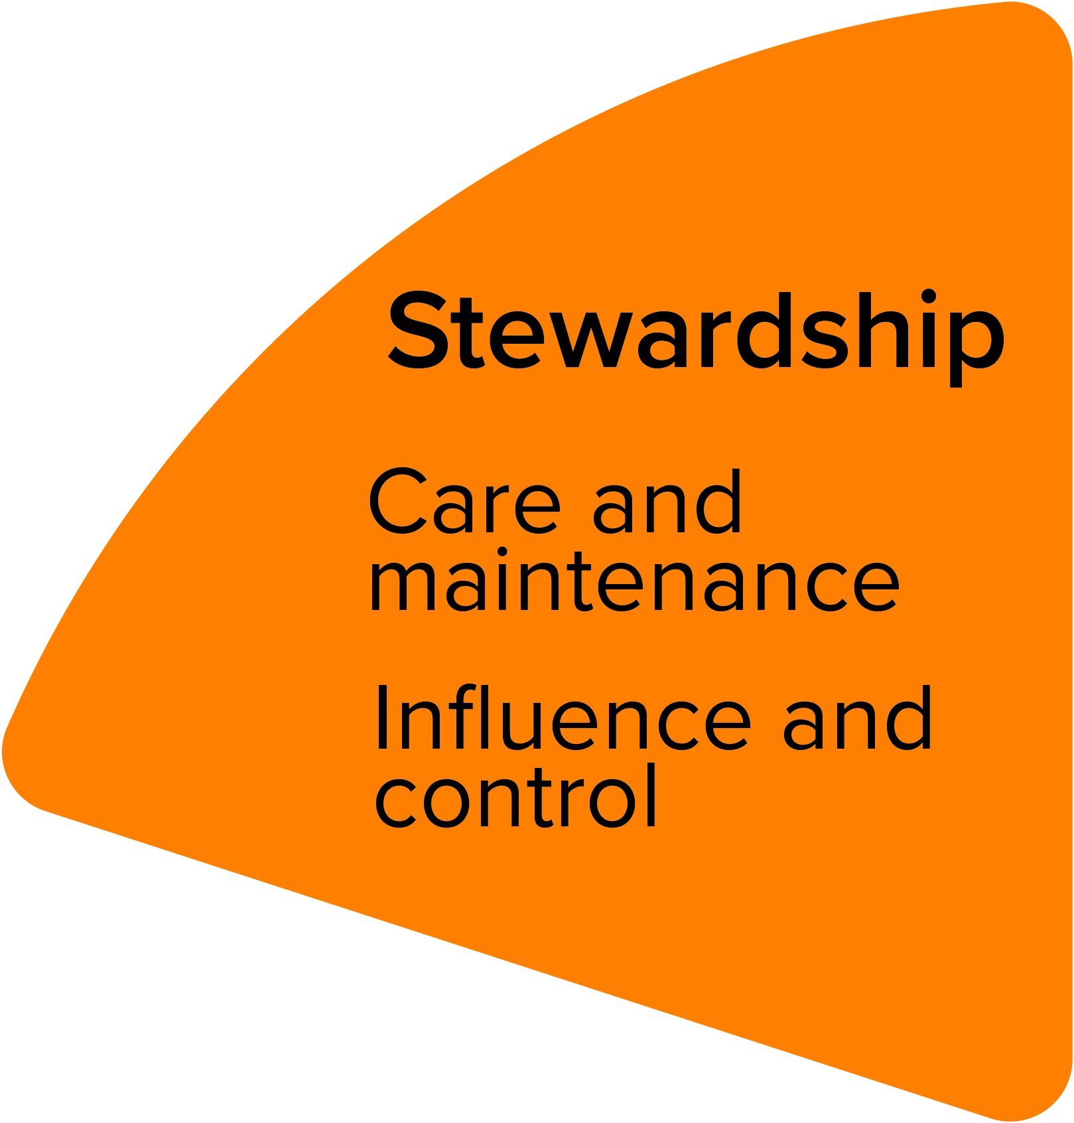
Good community spirit, but division between some neighbourhoods.
Sense of fatalism for some – an expectation across generations that things will not change.
Violence is a daily reality for some.
Minoritised communities can feel unsafe.
“Parents are stopping their children from playing together because they live in 'less desirable' areas.” - Alloa resident and parent
"We won't hold hands in certain areas within Clackmannanshire/Alloa. It isn't safe for us to show that we are together locally.” - lesbian couple.
Community and third sector initiatives are strong, but do not always feel valued by statutory services.
Disheartened by consultation processes – people not feeling their input is meaningful and choosing to disengage.
They prefer to keep themselves separate from the discussion as they don't want to get their hopes up for change. - members of community group
Shared learning
Across the seven Shaping Places for Wellbeing project towns, we’ve identified some shared messages about ways of working:
Communities value joint working and partnership approaches.
Communities want strong and consistent communication from and between all stakeholders.
Collective decision making by all stakeholders will strengthen partnerships.
“Who better to help solve problems and issues within communities than the local people.” - Alloa resident and group leader
bit.ly/shapingplacesforwellbeing
@place4wellbeing

