Slide 1



Introduction to Hydrogen
Module 1: Background
Dr Katriona Edlmann
School of GeoSciences, University of Edinburgh
Professor Tavis Potts
Department of Geography and Environment, University of Aberdeen
Notes:
Hello my name is Katriona Edlmann,
I am the chancellor's fellow in Energy at The University of Edinburgh, and I will be your guide to all thing's hydrogen within this SCCS Hydrogen Course. ​
This first session will provide an overview of why we need hydrogen, where it can be most usefully deployed to support Net Zero and what policies and funding are in place to support the Hydrogen economy in Scotland.​

Slide 2

Hydrogen for clean, efficient energy
H₂
CO₂
Highest energy per mass of any carrier fuel* ​
Zero carbon fuel: emission = water​
Can be sustainably produced​
Versatile, cheap, and efficient to transport
*At any pressure, the volumetric energy density of natural gas exceeds that of hydrogen by a factor of 3.2. Common liquid energy carriers like methanol, propane and gasoline surpass liquid hydrogen by factors 1.8 to 3.4, respectively. US DOE, 2015​
Pathway to Net Zero
Notes:
Hydrogen is essentially a chemical energy carrier, rather like natural gas.
It has the highest energy - per mass - of any fuel and, when it “burns” in air, it releases that stored energy, producing only water with no harmful greenhouse gases.
​
It can be produced sustainably from the electrolysis of water powered by renewable electricity and is a versatile energy carrier that can be compressed into a gas or liquid and transported and used in much the same way as natural gas is today.​
​

Slide 3
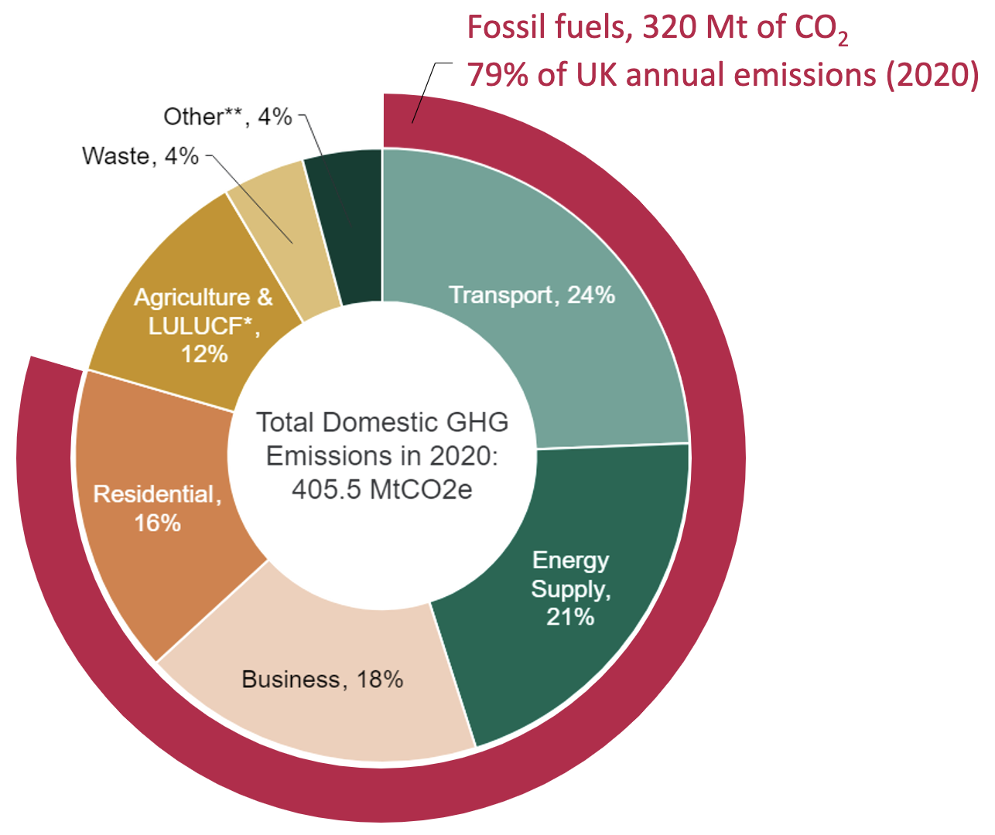

Decarbonising energy
H₂
CO₂
Reduction of emissions from electricity:​
    Energy efficiencies​
    Heat pumps​
Switching from coal to gas power generation
Increasing renewables​ mix
Limited progress reducing emissions in the
harder to electrify/decarbonise sectors
(80% still from fossil fuels)
Net Zero
Challenge
www.gov.uk/government/statistics/transport-and-environment-statistics-2022/transport-and-environment-statistics-2022​
Notes:
Hydrogen has spurred multiple waves of interest in the past without significant traction, often coinciding with global oil crises.
However, the target of Net Zero emissions by 2050 has meant that there is no hiding place for any emissions
and all sectors of the economy need to significantly cut their emissions​
To see how we can most effectively reduce emissions with current and future Net Zero technologies, it is helpful to understand the sources of these emissions. ​
As you can see in the figure on screen showing the total greenhouse gas emissions in the UK in 2020 by sector, over ¾ of these emissions are related to energy use from
fossil fuels across transport, energy supply, industrial processing, commercial business use and residential heat and cooking. ​
And while some progress has been made in reducing emissions by switching from coal to gas power generation, increased variable renewable energy generation, increased energy efficiencies and heat pumps, we still have a long way to go to reach our net zero targets, particularly in the harder to decarbonise sectors​.
It is worth highlighting that in 2022 over 80% of our total energy used still comes from burning fossil fuels. ​
​

Slide 4
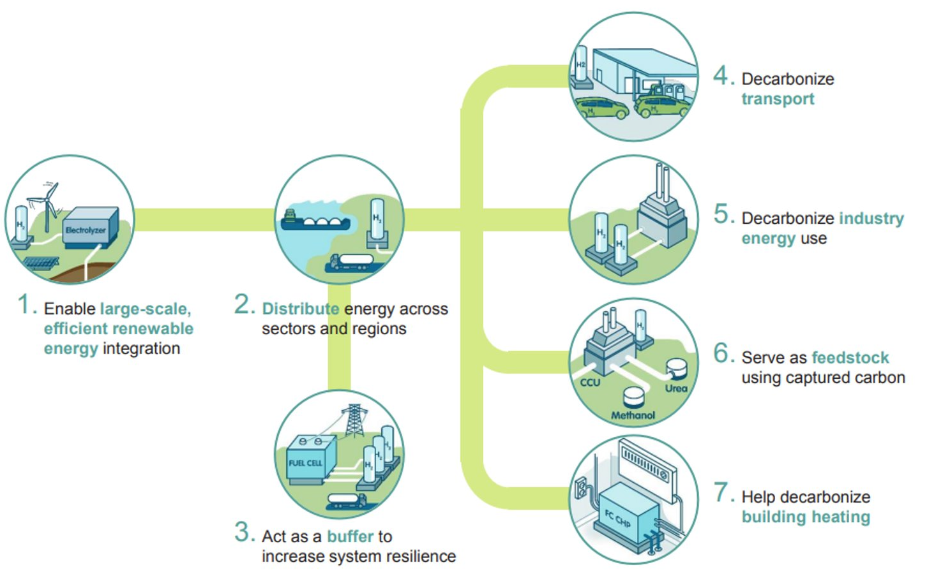
Hydrogen = clean, efficient energy​
H₂
Enable the renewable energy system Decarbonise the “hard to abate” sector
CO₂
Net Zero
Technology
hydrogencouncil.com/wp-content/uploads/2017/06/Hydrogen-Council-Vision-Document.pdf​
Notes:
The particular appeal of hydrogen is that it can do two things very well:​
It can support the expansion of our sustainable renewable energy system by providing large scale inter seasonal energy storage for renewable energy integration and distribution of energy across sectors, providing system resilience and energy security. ​
Hydrogen can also progress the decarbonisation of the hard-to-abate sectors, where full electrification is not currently possible. This includes long-haul transport and energy intensive industries that use high temperatures in their processes. It can also provide decarbonised feedstock for industry through the production of synthetic fuels using captured carbon and it can help to decarbonise building heat. ​
So, you can see why the potential for hydrogen to support Net Zero has captured the attention of policy makers and industry players around the world.

Slide 5
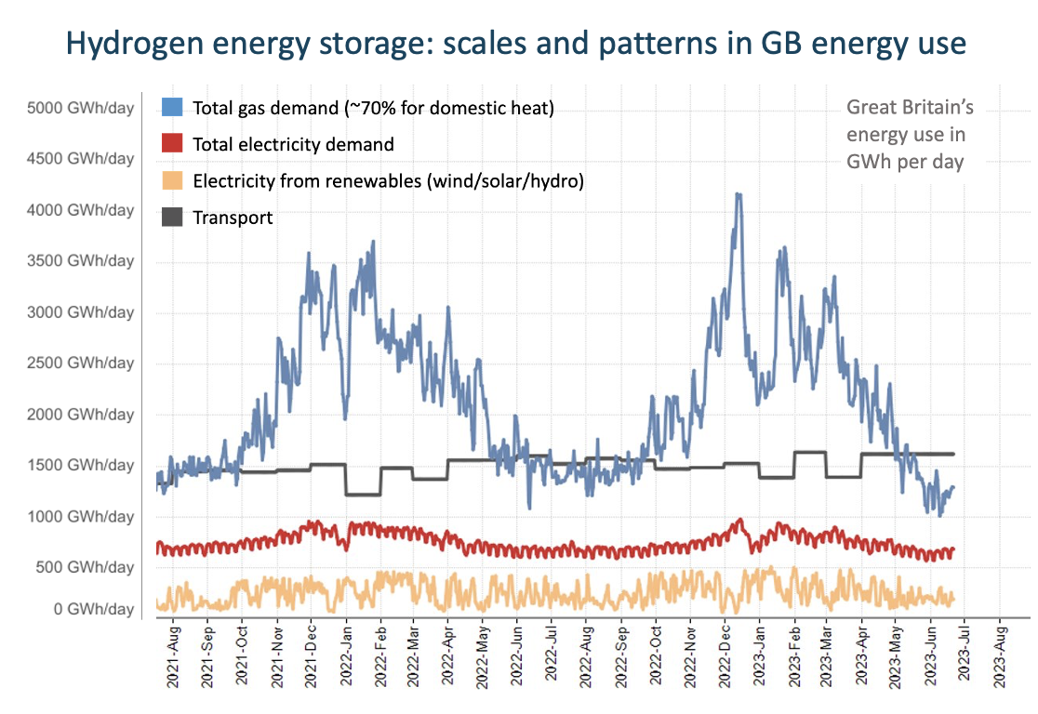
Decarbonising energy
Hydrogen energy storage​: scales and patterns in GB energy use​
Reduce overall energy demand
Energy demand increases by ~2000 GWh/day from summer to winter (delivered by gas)
= hydrogen energy storage
Increase variable renewable electricity to meet existing electricity demand
= hydrogen energy storage
Transport has a daily demand of ~1500 GWh almost entirely delivered by fossil fuels
Scottish Carbon Capture & Storage
www.sccs.org.uk
public.tableau.com/app/profile/grant.wilson/viz/GreatBritainsenergydailydata/GBenergyperday?publish=yes​
Hydrogen CPD Course | April 2024
Notes:
Within any discussion around decarbonising energy through the deployment of intermittent renewable electricity, I always think it is important do a reality check on the scale of the task ahead.
The figure on screen shows Great Britain's energy use in GWh per day, with the peach line representing the contribution of renewable electricity from wind, solar and hydro, the red line is the total electricity demand, the black line is the energy use for transport and the blue line is the total gas demand – of which around 70% is for domestic heating.​
It goes without saying that to move towards net zero we need to reduce our overall demand through energy efficiencies, building insulation and changing our own habits – none of which are an easy ask. ​
But concentrating on the figure on screen I wish to highlight three key messages:
The first is to highlight the huge fluctuation in energy demand from summer to winter, which can increase by 2000 GWh per day over a matter of weeks as the temperatures drop. This is primarily delivered by gas shown by the blue curve. As we move to an energy system based on variable renewable energy supported by well insulated housing stock and heat pumps, we will still need to ensure the additional reliable delivery of 1000’s of GWh additional renewable electricity per day in the winter. As renewable energy is inherently variable this will require TWhs of energy storage to ensure we can heat our homes throughout the winter, which can only be delivered by hydrogen.
Secondly, I want to highlight the current gap between total electricity demand in red and the delivery of renewable electricity in peach. Generally, the renewable energy peaks at around 400 GWh per day, but fluctuates enormously over very short time scales, the total electricity demand ranges between 800 and 1000 GWh per day depending on the season. To deliver our existing electricity demand from renewable sources will require a doubling of the existing electricity supply from renewable energy with a guaranteed supply of uninterrupted controllable electricity, which again will require GW scales of hydrogen energy storage to ensure the lights stay on as we transition from gas to renewable electricity generation.
The third message is a reminder of the very high energy demand from transport, shown as the black line, which is almost entirely delivered from fossil fuels. If there is a complete switch to electric vehicles, that will add an additional energy requirement of around 1500 GWh per day from variable renewable energy – again requiring GW’s of hydrogen energy storage to ensure a consistent uninterrupted electricity supply.
This provides a stark reminder that to electrify everything through variable renewable energy will require the delivery of 1000’s of GWh of additional renewable electricity and hydrogen energy storage to meet both daily and inter-seasonal decarbonised energy demands.​
​

Slide 6

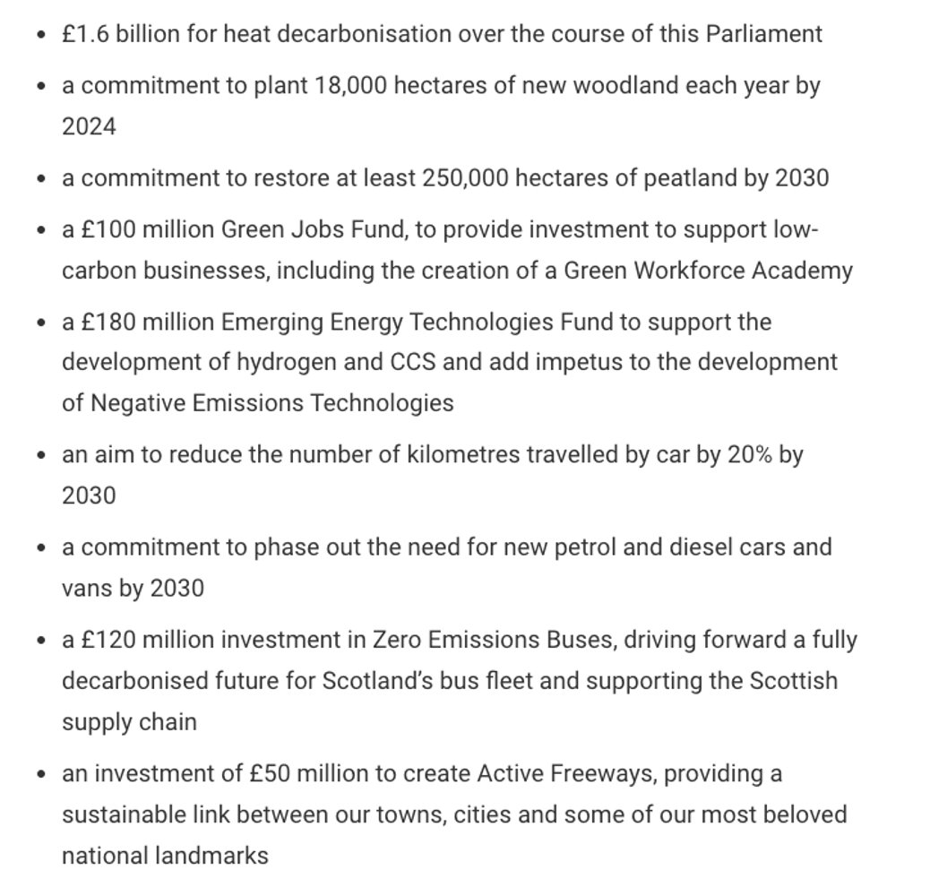
H₂
CO₂
Climate Change Plan
Notes:
Pick out relevant aspects of Scottish Government Climate Change Plan​

Slide 7

Hydrogen Net Zero target​
H₂
2023 UK energy mix
80% fossil fuels
20% electricity
10% renewables
CO₂
Energy
System
Balance
2050 UK Net Zero energy mix
70-80% Renewable Electricity
20-30% Hydrogen
Notes:
Given the complexity of our future energy system and the increasing requirement for energy storage:
All future energy scenarios in the UK that reach net zero require a significant contribution from hydrogen.
With analysis by the department for net zero and energy security estimating that hydrogen will make up 20-30 per cent of UK final energy mix ,
with the rest coming from renewable electricity – putting that into context:
This future projection for hydrogen use is the same as the current total energy provision from electricity​.
​

Slide 8
Additional considerations
H₂
Around 85% of UK homes are heated by gas, oil, LPG, or mineral oil
Only 4% of current UK properties have energy efficiency ratings that are suitable for heat pump installation
Fuel cell vehicles have a significantly reduced demand for critical minerals than batteries
£1.1 billion has been paid on the balancing mechanism for wind farm constraints, curtailing over 16.6 TWh of energy
For Net Zero there will be circumstances where the only available decarbonisation option is not perfectly efficient, or cost optimised
CO₂
Hydrogen
economy
Notes:
I just want to add in here a few important considerations that surround the role of hydrogen in supporting our Net Zero ambitions. ​
There is a significant push against hydrogen from some quarters as from an engineering perspective the efficiencies just don’t compare to renewable electricity and heat pumps, and this is true, but the world we live in is simply not as straightforward as that. Around 85% of the UK’s homes are currently heated by fossil fuels and only 4% have an energy performance certificate rating that makes them suitable for heat pumps. Heat pumps will be perfect for new homes but will simply not be suitable for our aging housing stock. ​
There are also those who believe traditional batteries can solve all our energy storage needs, and they certainly have an important role, but not for large energy storage needs. But more than that I want to highlight that batteries have an enormous demand for critical minerals, most of which come from regions with extremely questionable environmental, social and governance policies. Fuel cells have significant reduced critical mineral demands so would reduce this risk. ​
I also want to highlight that our electricity grid was not designed for a renewable energy system and the grid reinforcements program is not keeping pace with the growth in renewable energy, which means vast quantities of renewable energy are being wasted through curtailment. So far over 16.6 TWh of energy from renewables has been completely wasted costing bill payers 1.1 billion pounds and this will grow exponentially with the increased employment of offshore windfarms without adequate grid reinforcements. ​
I would say that to reach Net Zero we will have to be pragmatic, there will be times when the most perfectly efficient and cost optimised green technology option simply does not work at that moment in that setting - and we will need all of the available decarbonisation technologies. ​
​

Slide 9
Challenges
H₂
Policy and regulatory uncertainty
Investor confidence
Need for supply and demand coordination
Safety and public perception
Cost reductions for hydrogen production
Cost of increasing the energy density of hydrogen (compression/chemical carriers)
Need for enabling storage and transport infrastructure
CO₂
Hydrogen
economy
Notes:
There are a number of challenges we will face with the nascent hydrogen economy including the policy and regulatory uncertainty, investor confidence, coordination between supply and demand for market creation and growth, safety and public perception - all of which I covered in the previous session.​
In this session I will focus on the elephant in the room - the issue of cost – for the moment as we do not have significant natural hydrogen reserves to draw upon, hydrogen needs to be made and as such production costs are higher than fossil fuels and renewable electricity. ​
And while one kilogram of hydrogen contains a vast amount of energy, making it an efficient and lightweight energy carrier - because it is so light the amount of energy you get by volume is much lower than with other conventional fuels. To get that ideal, efficient kilogram of energy for transport, storage and use, hydrogen must be compressed, liquified or bonded into various hydrogen carriers, such as ammonia or methanol to get that better energy density by volume. This of course has further implications for cost and complexity. ​
We will also look at the steps needed to develop the transport and storage infrastructure networks and ensure their integration with existing energy systems, the renewable energy system and CCUS.​

Slide 10
Enablers
H₂
Establish targets & long-term policy signals = certainty for marketplace
Policies to support demand creation for low emission hydrogen
Policies to mitigate investment risks in infrastructure projects
Facilitate access to finance to accelerate deployment
Policies to promote innovation, strategic demonstration projects
and knowledge sharing
Establish appropriate regulatory frameworks, standards, safety and certification systems
CO₂
Hydrogen
economy
UK hydrogen policy is focused on facilitating cost reductions and the scaling of hydrogen that does not impose an unreasonable cost burden on consumers and deploys hydrogen where there is not an electrification alternative
Notes:
The adoption of hydrogen as a new energy vector is a complex endeavour that requires government intervention.​
At its simplest there are five key policy areas identified as necessary for hydrogen deployment: ​
First up is to establish targets and long-term policy signals to create a vision for the role of hydrogen providing investors with certainty that there will be a future marketplace for hydrogen. ​
Then we need policies to support the production and demand of low carbon hydrogen.​
To develop the market, we need policies that will mitigate investment risks and facilitate access to finance.​
To drive down costs we need policies that promote research and development along with strategic demonstration projects.​
And finally, is the need to establish appropriate regulatory frameworks, and low carbon hydrogen standards that are globally compatible, to facilitate trade and boost investor and consumer confidence in the hydrogen market.​
​
​

Slide 11
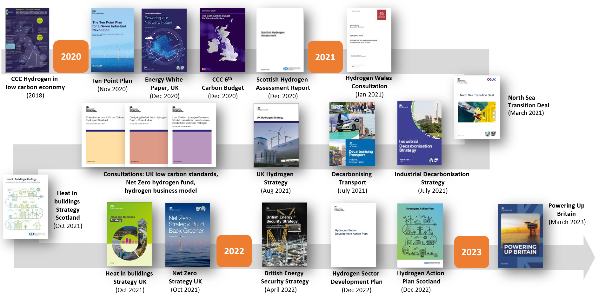
Enablers: the UK hydrogen policy landscape
Scottish Carbon Capture & Storage
www.sccs.org.uk
Hydrogen CPD Course | April 2024
Notes:
First up are long-term policy signals that provide stakeholders with certainty that there will be a future marketplace for hydrogen. The images on screen show just some of the key hydrogen related policies released in the last few years and it is a pretty crowded timeline, so much so that it is almost impossible to keep up with all of the hydrogen related policies, consultations and white papers.
Hydrogen’s journey began with the committee for climate change report on hydrogen in a low carbon economy in 2018 which began to explore the role hydrogen could play in supporting our Net Zero target. This was followed by the UK Government Ten point plan for a green industrial revolution, published in November 2020, which was the beginning of the formal adoption of hydrogen as key contributor to achieving Net Zero in the UK, specifically through Point 2: Driving the Growth of Low Carbon Hydrogen. However, hydrogen is instrumental in Point 4: Accelerating the Shift to Zero Emission Vehicles, Point 6: Jet Zero and Green Ships, Point 7: Greener buildings and Point 8: Investing in Carbon Capture, Usage and Storage.​
From then a whole host of policy documents, consultations and strategies have been published all related to developing a hydrogen economy, with a focus on industrial
decarbonisation, transport, heat and a just transition of the North Sea oil and gas industries as fossil fuels are phased out. This was coalesced into the UK hydrogen strategy published in August 2021.
The Russian invasion of Ukraine brought energy security front and centre resulting in the British Energy Security Strategy which address our underlying vulnerability to international oil and gas prices by reducing our dependence on imported oil and gas and rolling out even more renewables and hydrogen. This resulted in a doubling of our low carbon hydrogen production capacity target to 10GW by 2030.​
There is no doubt that the UK and devolved governments are fully committed to the decarbonisation opportunity presented by hydrogen.​

Slide 12
Enablers: business models
H₂
The UK Hydrogen Strategy and following British Energy Security Strategy committed to design new business models for hydrogen production, transport and storage infrastructure by 2025
The Hydrogen Production Business Model (HPBM), first published December 2022
The Hydrogen Transport Business Model (HTBM) minded position published in October 2023
The Hydrogen Storage Business Model (HSBM) minded position is expected in 2024
CO₂
Hydrogen
economy

Slide 13
Enablers: Low Carbon HPBM
H₂
The Hydrogen Production Business Model (HPBM) seeks to support production of hydrogen via a contractual support mechanism
Provides revenue support to hydrogen producers to overcome the operating cost gap between low carbon hydrogen and high carbon fuels
Similar to the CfD which successfully incentivised renewable power
The hydrogen production business model will be delivered through the Low Carbon Hydrogen Agreement (LCHA)​
Low Carbon Hydrogen Standard: 20 grams of CO₂e per megajoule of produced hydrogen or less up to the point of production
CO₂
Hydrogen
economy
Notes:
First up are the investment packages to stimulate hydrogen production through the low carbon hydrogen production business model. ​
​
The low carbon hydrogen production business model will provide revenue support to hydrogen producers to overcome the cost gap between low carbon hydrogen and high carbon fuels. This recognises that the price at which hydrogen can be sold will not cover the costs of production plus a reasonable return to investors. It delivers “top-up” payments to account for this difference and provides investors with a measure of revenue certainty. ​
​
The planned mechanism is similar to the contracts for difference model successfully used to decrease the cost of renewable electricity, but also includes a reward mechanism that incentivises producers to achieve higher sales prices, which will then reduce the size of the support payments.​
The hydrogen production business model will be delivered through the Low Carbon Hydrogen Agreement between a government appointed counterparty and the hydrogen producer.​
and it is important to reiterate that hydrogen will only be considered low carbon if it meets the UK Low Carbon Hydrogen Standard of 20 grams of CO2 per MJ of produced hydrogen or less at point of production.​

Slide 14
Enablers: Low Carbon HTBM
H₂
The minded to high-level design for the hydrogen transport business model (HTBM)is a Regulated Asset Base (RAB)
This works alongside an external subsidy mechanism, in the form of private law revenue support contracts
Will implement a RAB for hydrogen pipelines through gas transporter licences granted under the existing framework of the Gas Act 1986 ​
NB: DESNZ has not yet made any decisions on the configuration of roles and responsibilities between Ofgem and Government
CO₂
Hydrogen
economy
Notes:
Getting the produced hydrogen to the customer is a critical piece of the UK’s burgeoning hydrogen economy. The recently published UK government minded to position for the hydrogen transport business model is to use a Regulated Asset Base (RAB) alongside an external subsidy mechanism.​
Under the RAB model, storage providers/owners and operators of hydrogen pipelines would agree an “allowed revenue” conditional on operational performance targets being met. Revenues would be subsidised by an external funding mechanism whilst the hydrogen economy is in its infancy, transferring the risk to the external subsidy funder, and resulting in a guaranteed regulated return which will provide investors with certainty. ​
DESNZ proposes implementing a RAB for hydrogen pipelines through the gas transporter licences granted under the existing framework of the Gas Act 1986, however it has not yet made any decisions on the configuration of roles and responsibilities between Ofgem and Government.​

Slide 15
Enablers: Low Carbon HSBM
H₂
The minded position for the hydrogen storage business model
(HSBM) is not yet formally published
Indications are that the government favours a 15-year private
law revenue support contract
The HSBM will likely initially be focused on geological storage
The contracts will likely have a minimum revenue floor, negotiated bilaterally according to allocation criteria to be published later this year
​
NB: Price competitive processes not defined due to small number of projects
NB: Interface with pipeline regulation for transport is unknown
NB: Risk allocation between producers and customers also unknown
CO₂
Hydrogen
economy
Notes:
The minded to position on the hydrogen storage business model is not yet published but indications suggest the government favours a 15-year private law revenue support contract between a storage provider and a government-appointed counterparty for the hydrogen storage business model design. ​
This will be focussed on geological storage, though they are minded to retain optionality to support above-ground storage as needed.​
These contracts would have a minimum revenue floor and would be negotiated bilaterally according to allocation criteria to be published later this year. ​
There are still a few unknowns:​
A price competitive process is not yet decided due to the relatively small number of storage projects expected to come forward, ​
There is also uncertainty as to how storage will interface with pipeline regulation for transport and,
There is significant concern around how the government will ensure appropriate risk allocation between hydrogen producers and customers, especially given the Government’s position on not permitting sales through intermediaries under the Low Carbon Hydrogen Agreement.​

Slide 16
Enablers: funding support
H₂
2GW capacity
operational /
under construction
10GW capacity
operational
across Scotland
CO₂
NZHF: £240M support (CAPEX focus)
Ongoing HBM support e.g. via LCHA
2022
2023
2024
2025
STRONG INDUSTRY RECOGNITION THAT THE
DECISION TIMELINE NEEDS TO BE SPEEDED UP
Hydrogen
economy
2030
2022 key steps:
1st wave NZHF
1st electrolytic
allocation round
HBM/LCHA
consultation
2023 key steps:
2nd wave NZHF
2nd electrolytic
allocation round
1st HBM contracts
awarded
Notes:
These business models are backed by two key funding support mechanisms:​
​
The £240 million Net Zero Hydrogen Fund (NZHF) running from 2022 to 2025 to fund project development and capital expenditure.​
The Hydrogen Business Model (HBM) providing ongoing revenue support mechanism implemented via Low Carbon Hydrogen Agreements ​
​
In all instances there is strong recognition by industry that the decision making, negotiations around the contracts for differences and the timeline of implementation need to be significantly speeded up to enable project developers to move forward at pace and unlock early private sector investment – this a key recommendation from the UK Hydrogen champion Jane Toogood.​

Slide 17
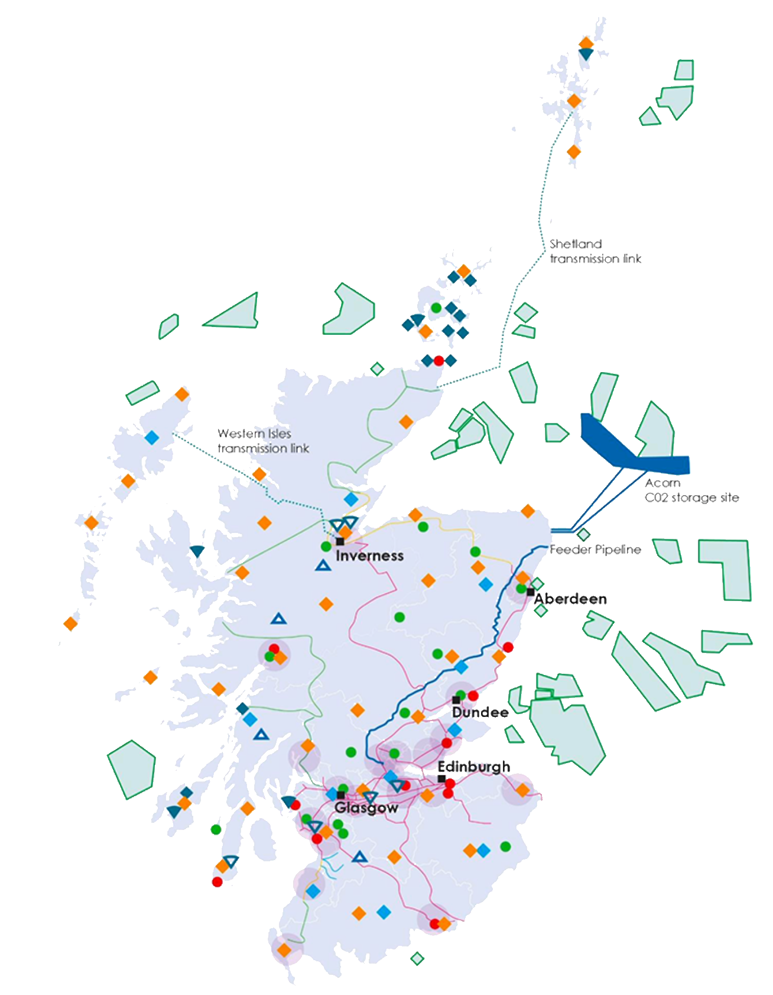
H₂
CO₂
Societal
Considerations
Professor Tavis Potts | University of Aberdeen

Slide 18






Scottish Carbon Capture & Storage
www.sccs.org.uk
Notes:
The debates, discussions and dialogues about how we shift to a different type of future, or a different social-technical system, have both historical and contemporary roots. In the 1980s there were large scale social movements against the she wind down of coal mining - like here the 1984 Coal Strike in Fife.
In modern society, Net Zero presents a different challenge, where there is a need to shift broader economic production and society at large towards decarbonisation and sustainability. Net Zero is fundamentally a human challenge, and both a social and technological challenge. People matter – through behaviours, choices, resistance and support. A just transition is fundamentally about ensuring these voices count, that the burdens and opportunities in Net Zero are fairly distributed and the process is open and inclusive.
In the context of Hydrogen, we’ve already seen examples where public sentiment can derail hydrogen trials if the consultation process is not fully thought through or given enough time to engage and build trust with communities.

Slide 19
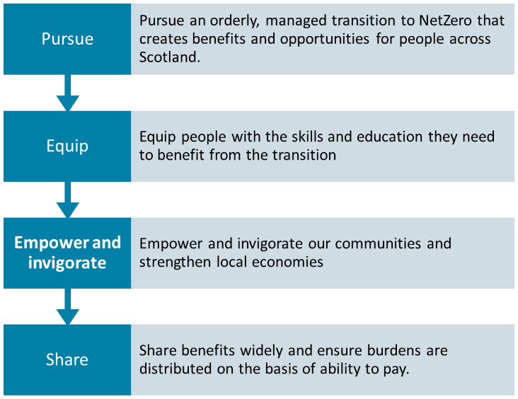
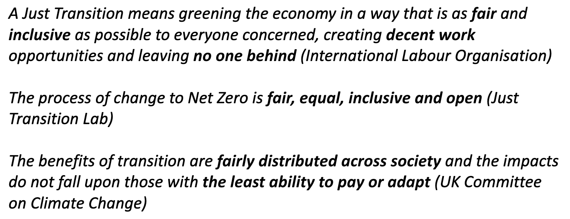
If the process of transition is not just, the outcome will never be….Climate Justice Alliance (US).
Job creation per se does not deliver ‘just’ outcomes.
Notes:
We are all familiar with the idea of transition – the movement from one system state (in this case a carbon intensive, fossil fuel based energy system) to a system that is more diverse, decarbonised, decentralised and (hopefully) democratic. While there is a loose consensus on the end point (Net Zero by 2050) there is a LOT of debate around the process of change, how fast we should go and how this should be managed.
There are many competing definitions, visions and principles of what a Just Transition means. While it is academically interesting to explore these, it helps us to boil this down to a few key interpretations and approaches. On the right in the blue, is the Scottish Government Just Transition Commissions interpretation of JT – pursuing a planned transition, equipping skills, empowering communities and local economies and there is fairness in the burdens and benefits.
In some of the other definitions these themes are repeated – you can see how there are similar principles embedded in just tranisitons – people count, it should be fair, there are questions of social justice and an inclusive process.
The "Just" refers to justice and draws upon both climate justice, energy justice and social justice. The common theme between these is that we should ensure that the benefits of transition are fairly distributed across society (not just to those who have the money and power) and the impacts must not fall upon those with the least ability to pay or adapt… ie. Don’t shaft people in the transition!!
In short, how we transition is important with fairness, equity, inclusivity and transparency at its heart.

Slide 20

Building & Training the Workforce
Diversification of Net Zero industries – Hydrogen production across the supply chain (all colours!); economics, planning & business case for Hydrogen use and deployment.
Skills – removing obstacles for labour mobility; Hydrogen qualifications; pathways for in demand skills & occupations.
Improving Equality, diversity and accessibility in the workforce.
H₂
CO₂
Community Revitalisation & Community Wealth
Community wealth – investment in communities, local supply chains, & infrastructure – how does Hydrogen contribute?
Addressing fuel poverty, marginalisation & disadvantage.
Community ownership of Hydrogen infrastructure
Integration of climate, biodiversity and wellbeing
Just Transition
& Hydrogen
Net Zero Jobs & Skills
Participation, Inclusion & Empowerment
Community Revitalisation
Who is at the ‘table’ with Hydrogen development
Gaining a social licence to operate?
Empowering voices – citizen assemblies
Empowering voices – deliberative actions
From consultation to genuine partnership
Local & traditional knowledge
Representation & capacity in planning
Notes:
The just transition agenda tends to be dominated by a focus on jobs –
While important this is not nearly enough, and will not develop the broad social base of support - and behaviours - required to achieve Net Zero.
One of the takeaways for this quick dip into just transition in this course is to understand that we consider Just Transition to have three operational elements – jobs and skills; community revitalisation & wealth; and participation and empowerment. These elements cross over and intersect – just transition fails if we cherry pick or just focus on one element.
When considering building and training the workforce of the future, in relation to hydrogen, a transition will focus on diversification of green jobs, the business case and planning; the investment in skills in the H economy and improving accessibility and diversity of the workforce.
Community revitalisation means investment and building local community wealth. Hydrogen could bring in opportunities for local supply chains and infrastructure but also opens the potential for community ownership of infrastructure. Addressing social concerns like endemic fuel poverty and housing are key elements of local transitions.
Who is at the table is important to consider. Just like in the recent examples of the H trials in Redcar England, getting participation and inclusion right is essential for success and gaining social licence to operate. This aspect of a just transition also ensures multiple voices are included in consultation and communities are empowered to engage and steer developments – both in local governance and involvement in development.

Slide 21
Thank you for your attention
Module 1: Background Completed
Dr Katriona Edlmann
School of GeoSciences, University of Edinburgh
Professor Tavis Potts
Department of Geography and Environment, University of Aberdeen
Notes:
This concludes the first module of the hydrogen course.
The next module, Module 2, covers hydrogen production and demand.
Thank you for attention. Please note down any questions or comments and bring them to the webinar that completes this course.

