Slide 1


Slide 2
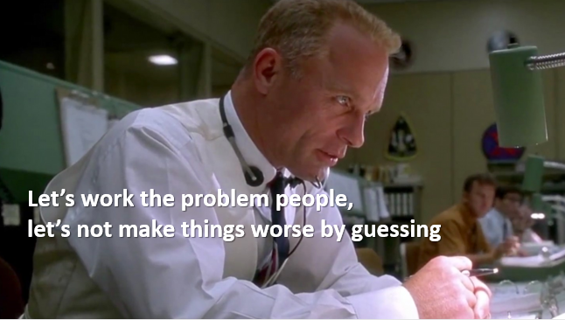
Evidence beats assertion
Ed Harris as Gene Krantz, Apollo 13

Slide 3

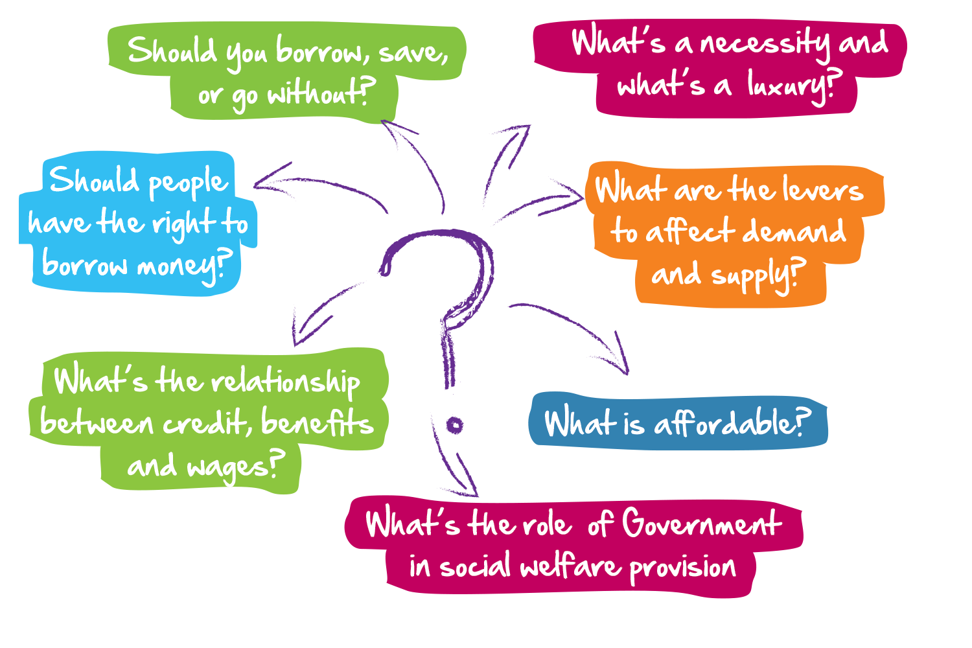
Contested area of public policy

Slide 4
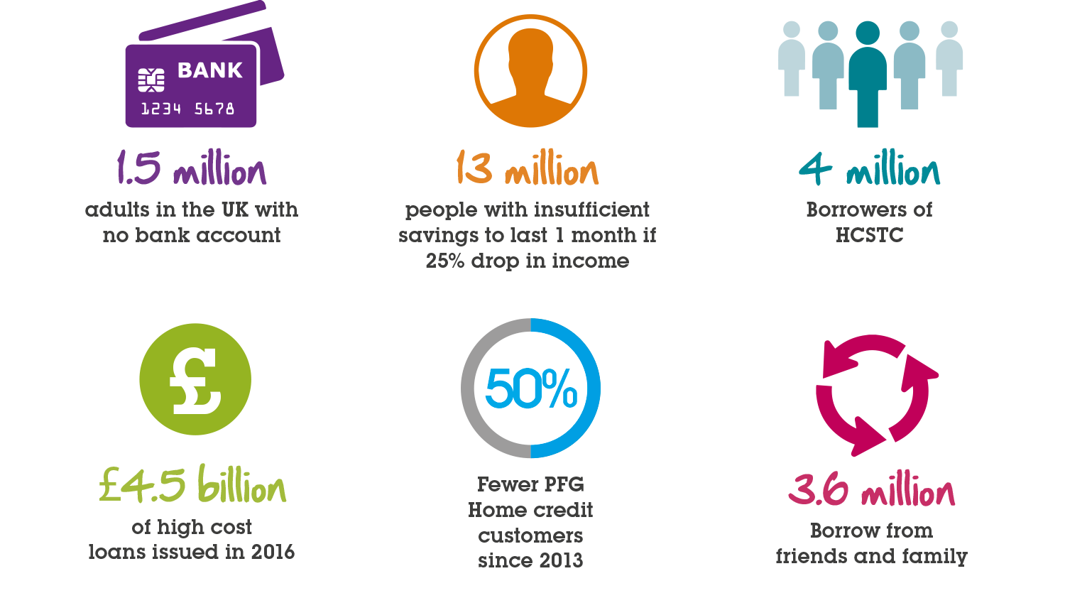
The challenge

Slide 5
FCA Financial Lives study
Selected characteristics (Scotland)
UK
Sco
SW
East
NE
H&I
G
EH

Slide 6
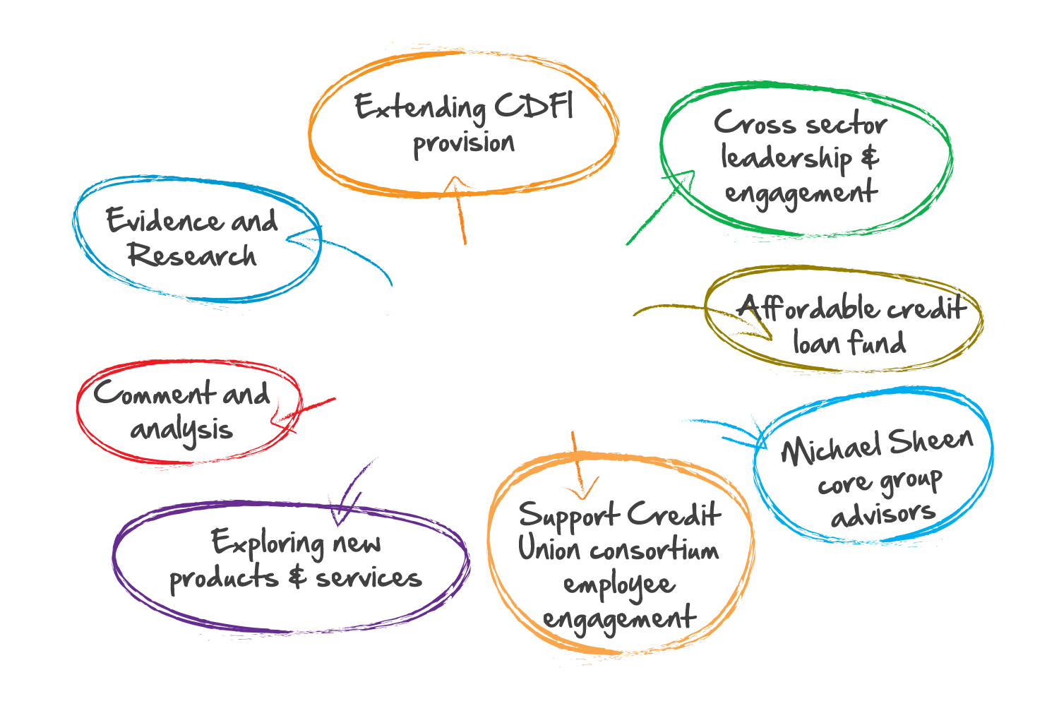
What are we doing?

Slide 7



Research released Nov 2018

Slide 8
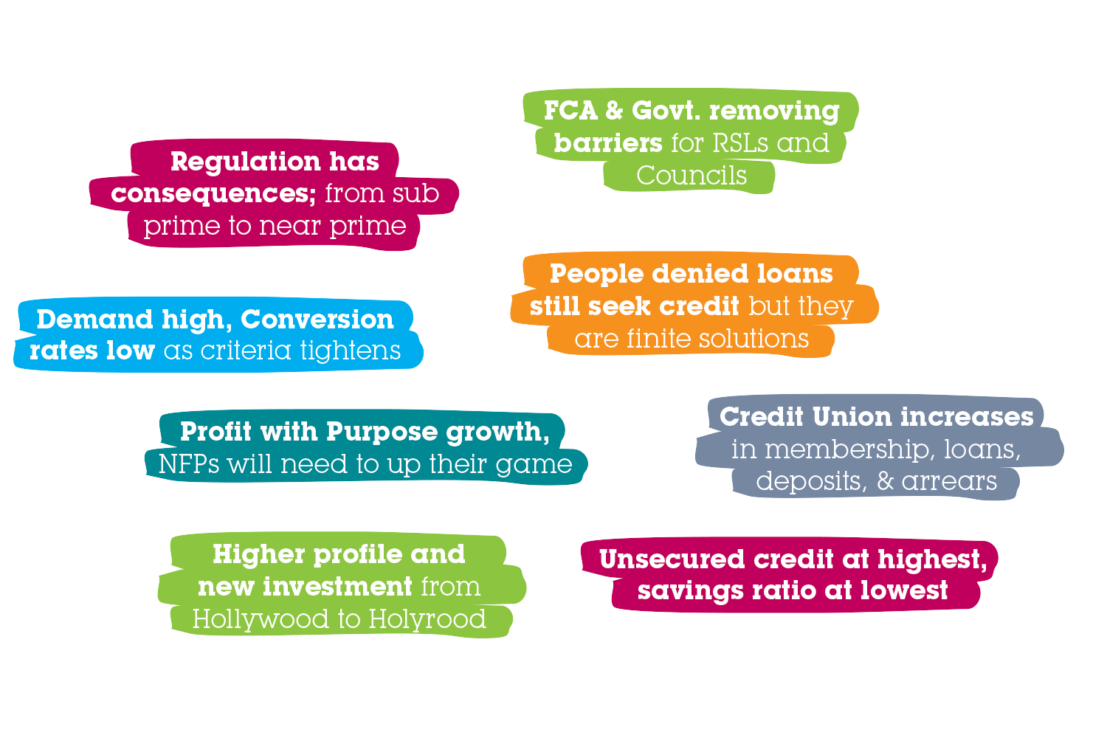
What are we seeing?

Slide 9
Big names under pressure

Slide 10
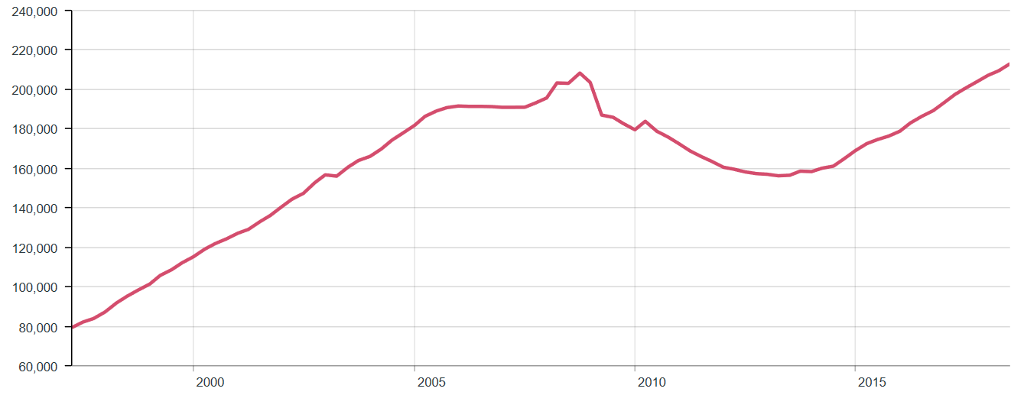
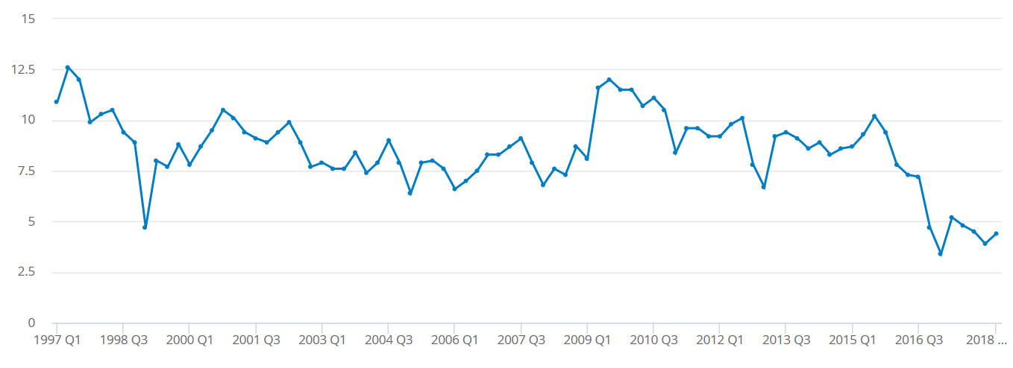
Credit up & savings down
Low Q1, 1997
£79bn
High Q2, 2018
£213bn
High Q2, 1997
12.6%
Low Q1, 2017
3.4%

Slide 11
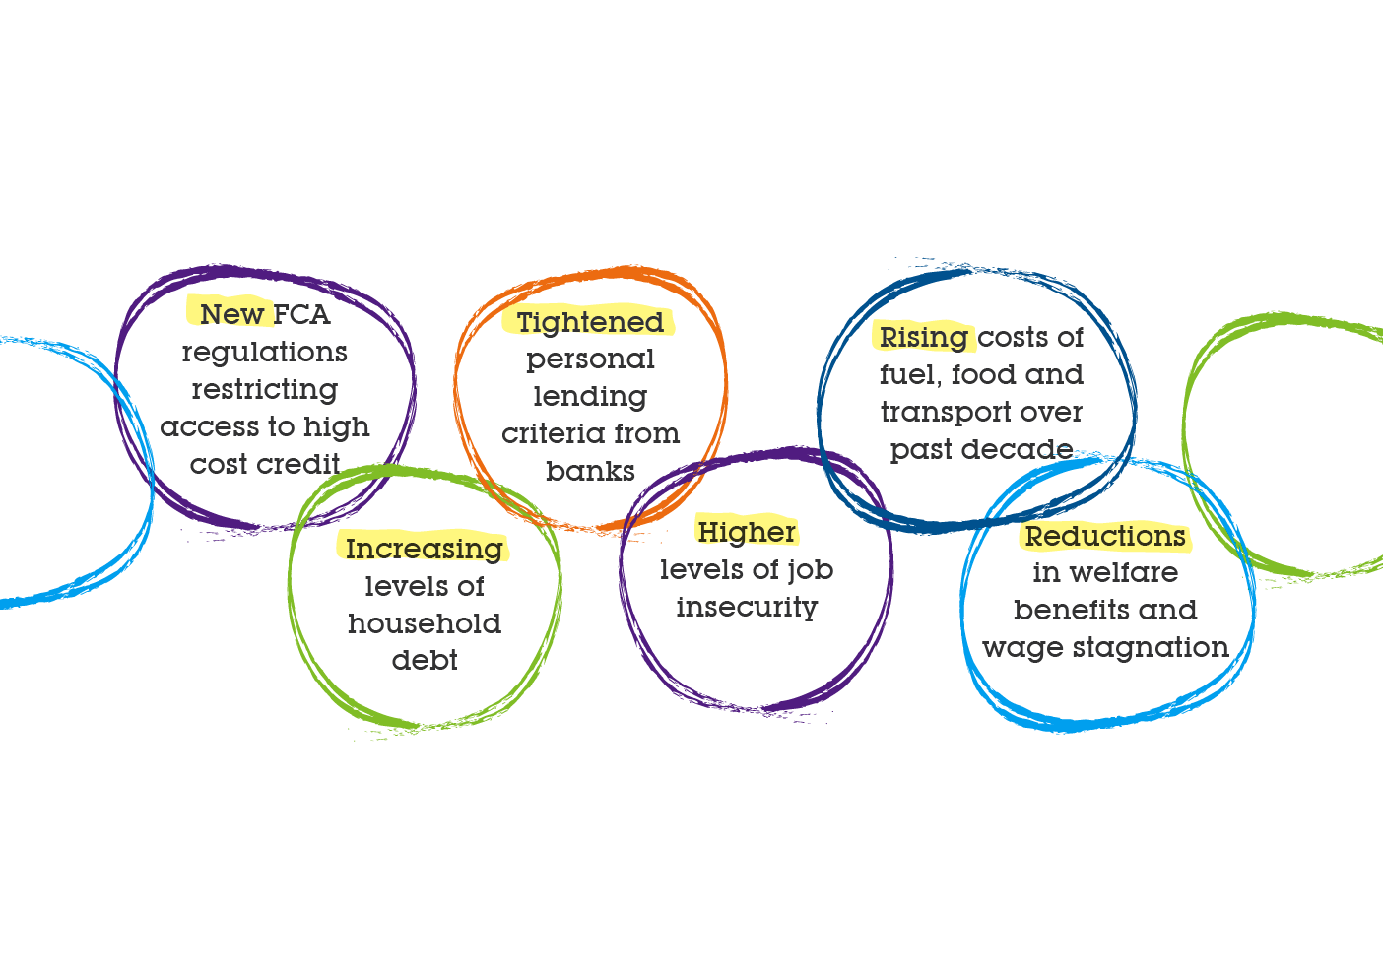
Factors increasing demand
for more affordable credit

Slide 12
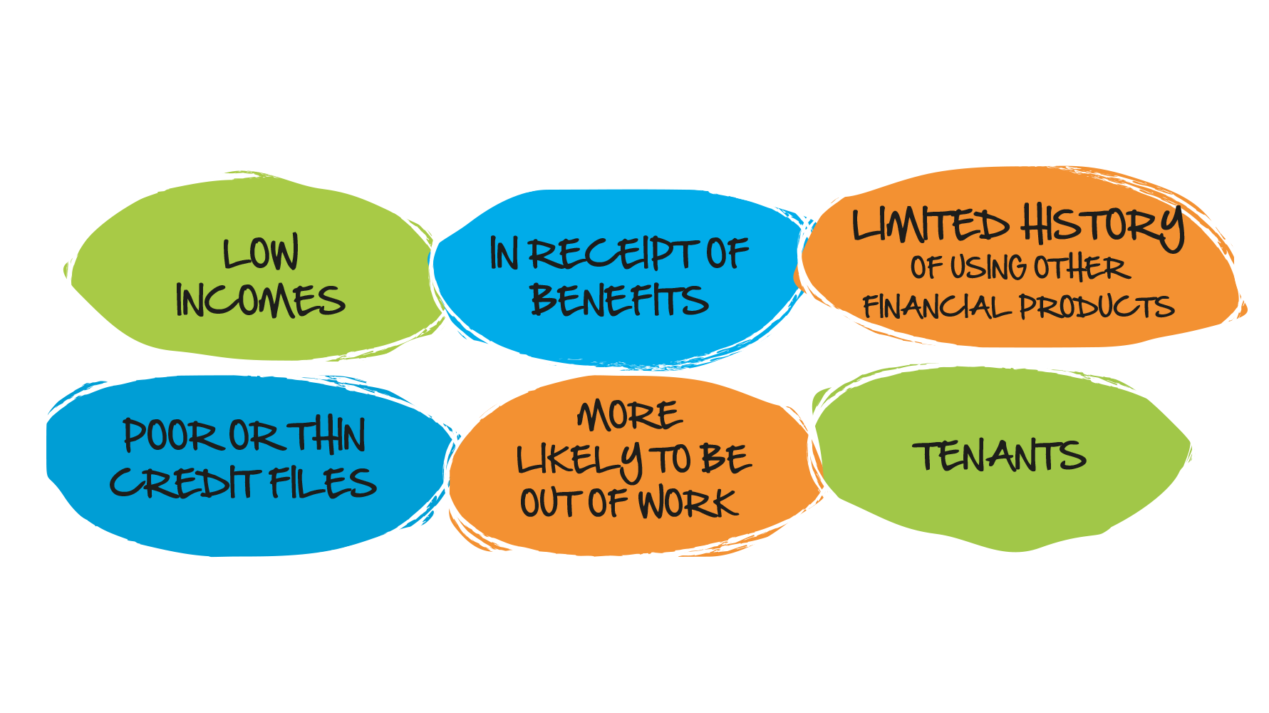
The increasingly excluded

Slide 13
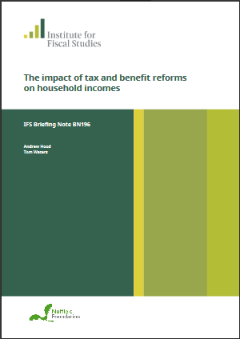
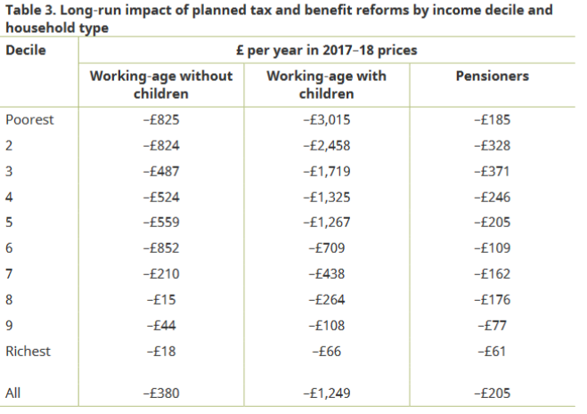
IFS say poorest with children will suffer the most

Slide 14

Illogically logical
People tell us who they
are but we ignore it,
because we want them to be
who we want them to be
Jon Hamm as Don Draper, Mad Men

Slide 15
Landscape has few alternatives
570,000 (2016)
13,600,000 (2016)

Slide 16
Landscape has few alternatives
£1.3 billion (2016)
£8.8 billion (2016)

Slide 17

It’s a big fish!
We’re gonna need a bigger boat
Roy Scheider as Chief Brody, Jaws

Slide 18
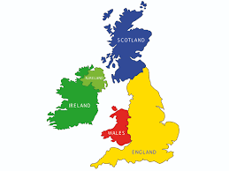
Part of the solution
Percentage adult members per nation

Slide 19
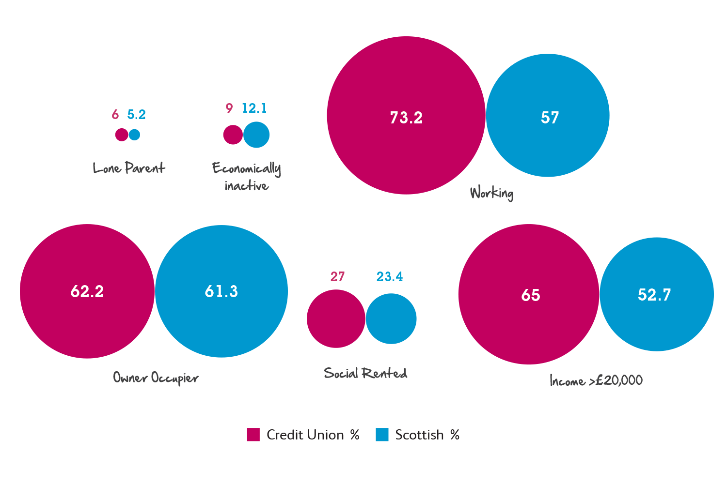
Credit Union account holders

Slide 20
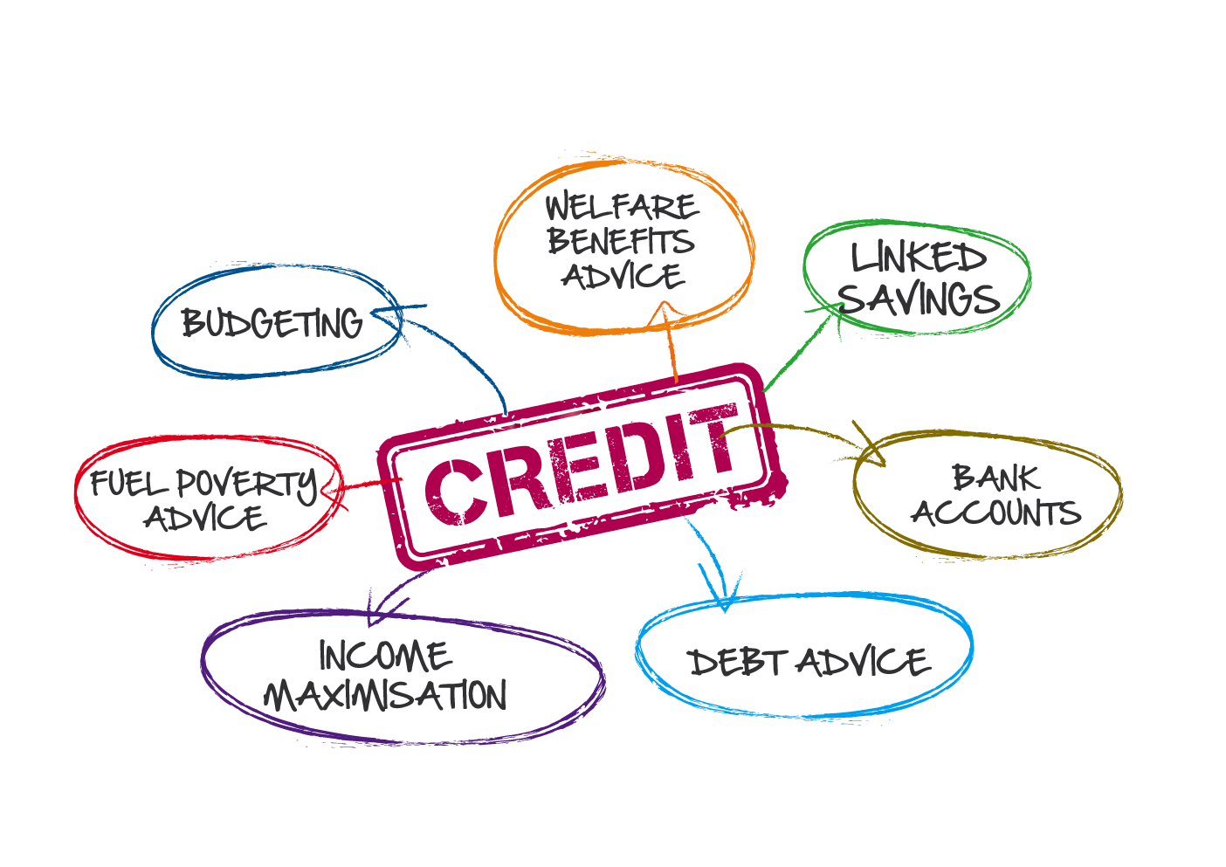
Credit as gateway to inclusion

Slide 21






Social : enterprise
No private shareholders
No paid Directors
CICs, IPS, Charity, NFP
No pressure sales
No bonus culture
Fair salary ratios
FCA regulated
No fat cats
Operational sustainability

Slide 22
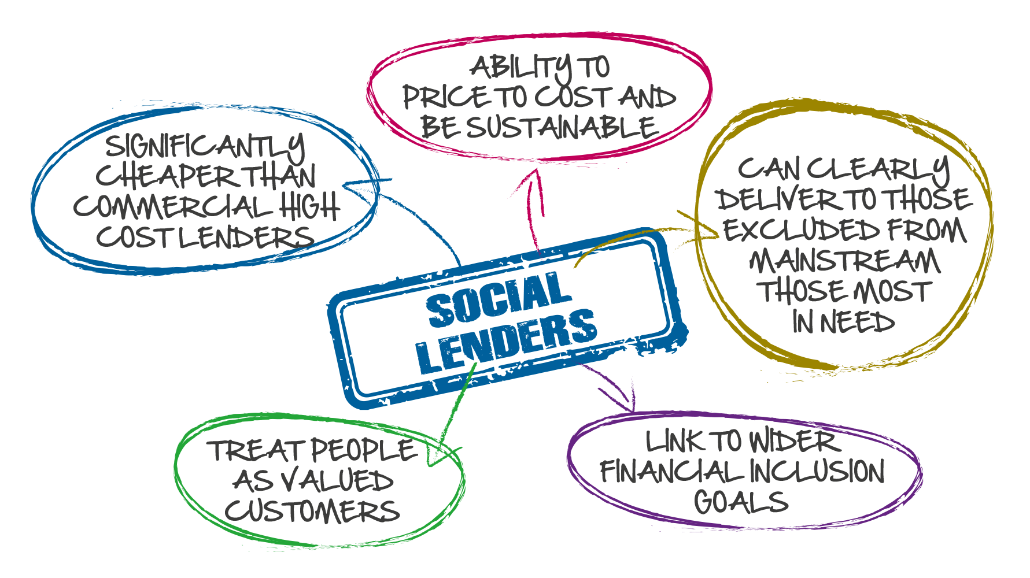

Gateway solutions

Slide 23
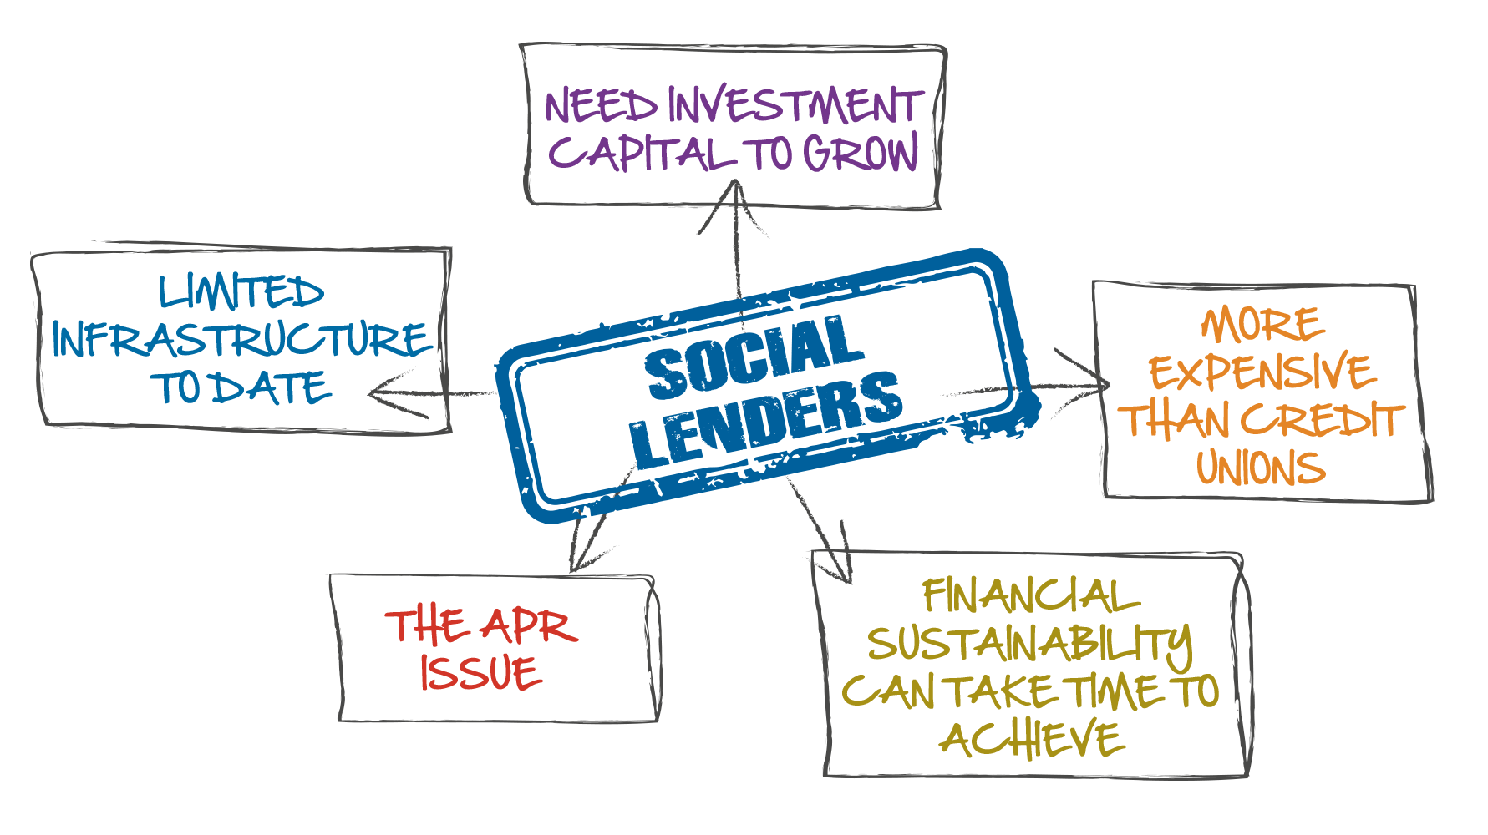
Challenges for social lenders

Slide 24

APR – much misunderstood

Slide 25
Interest on £500 over 26 weeks

Slide 26
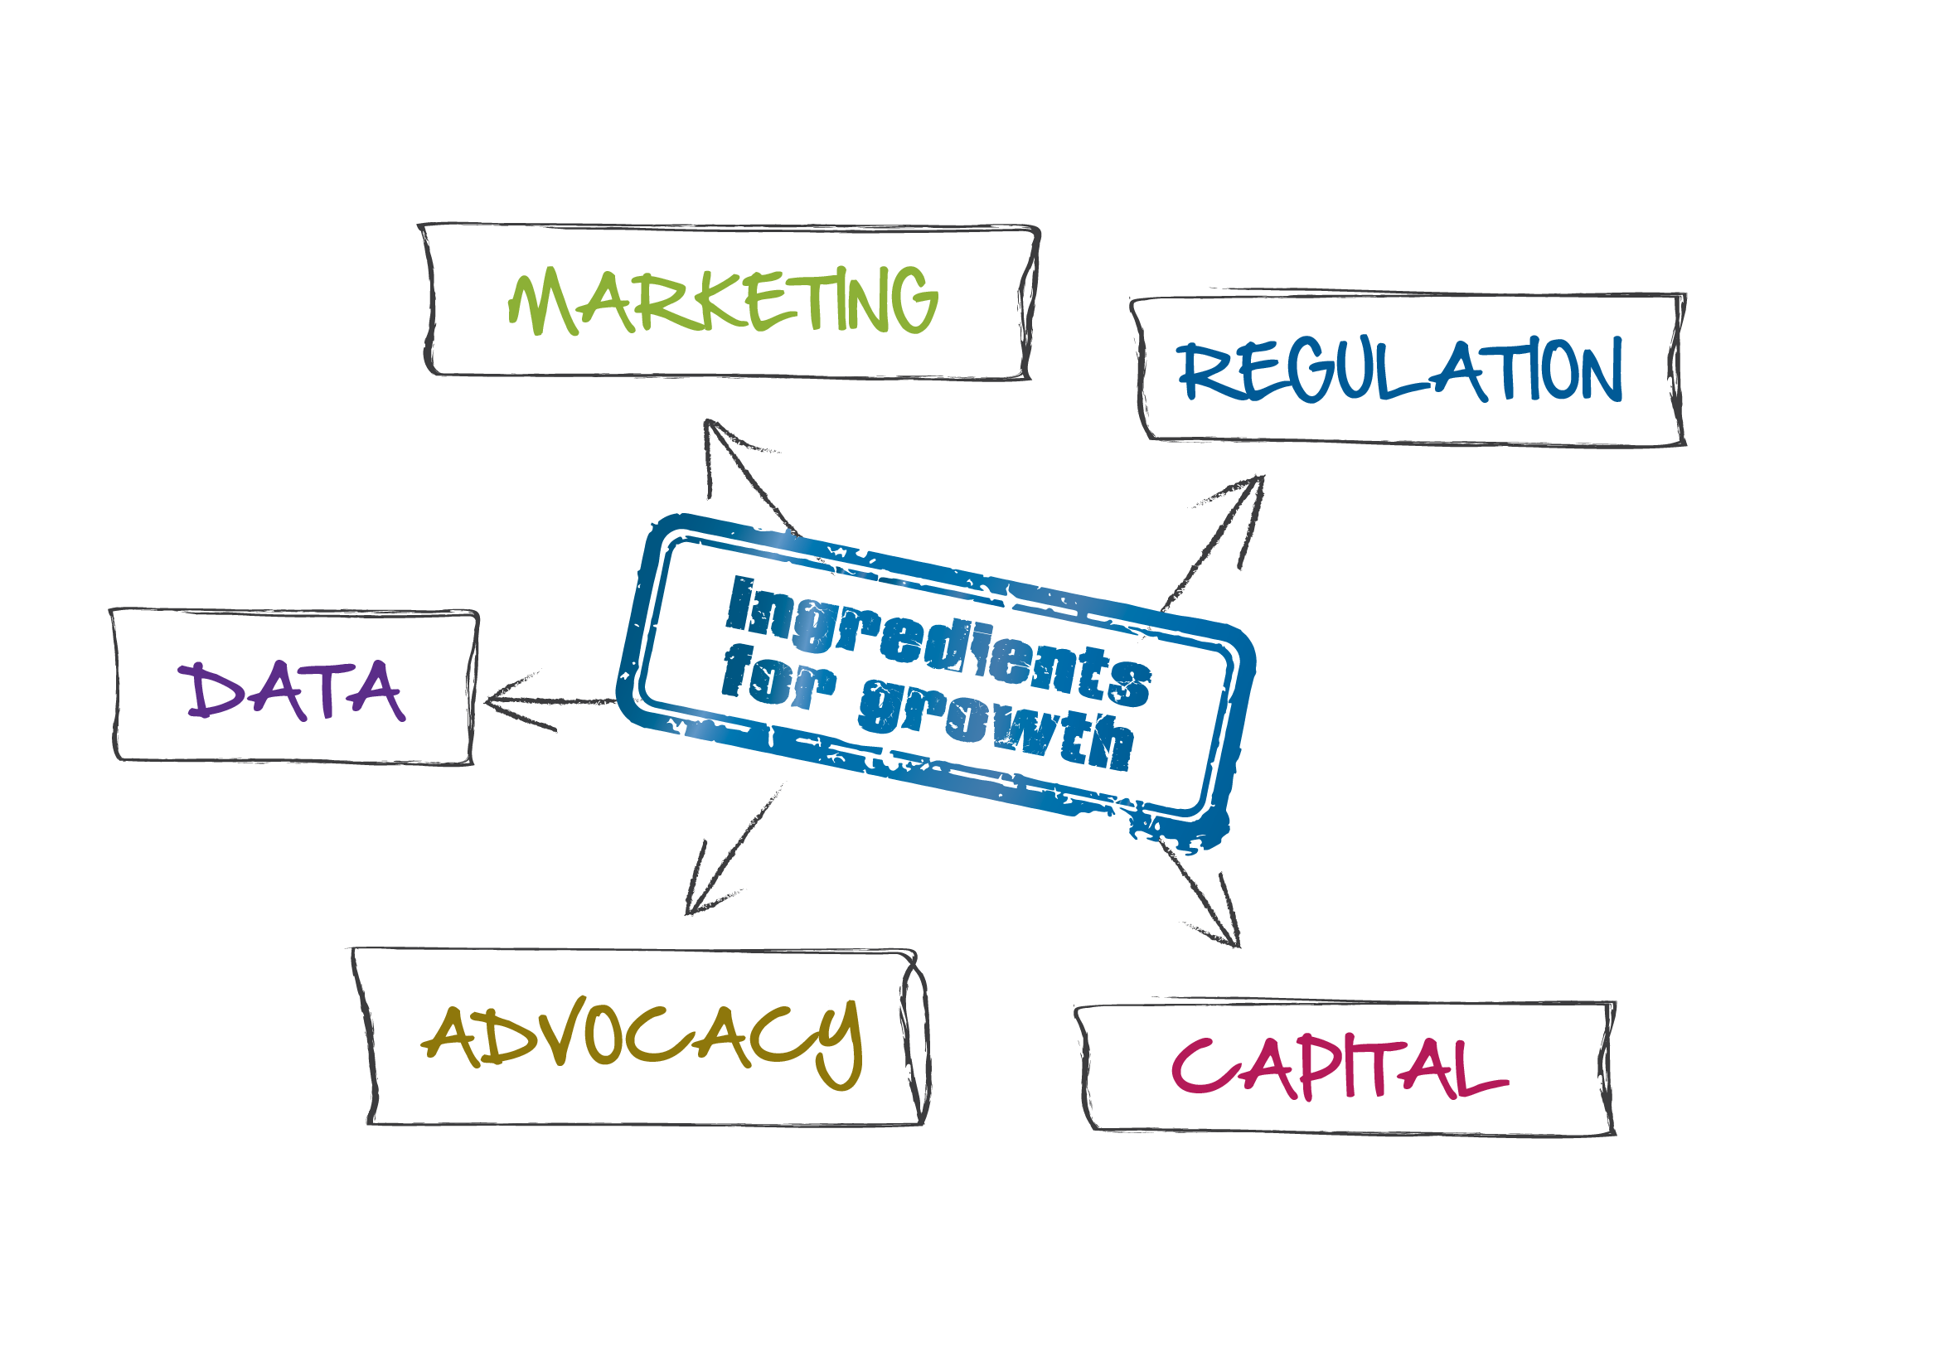
Factors affecting sustainability

Slide 27
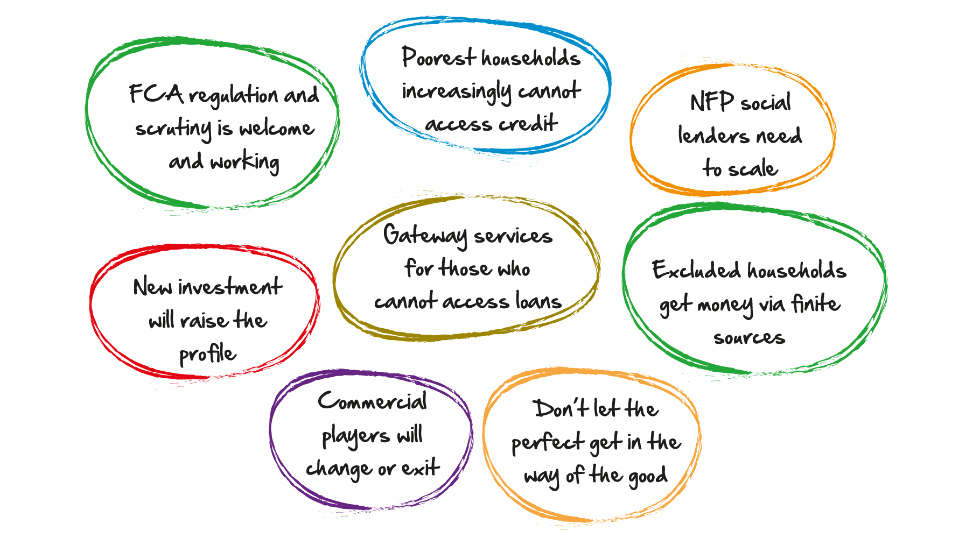
Summary

