Slide 1
Talk Money Week:
Aberdeen
Sharon Bell
Lawrie Morgan-Klein
November 2018

Slide 2
StepChange Debt Charity
The UK’s leading debt charity; we help over half a million people overcome their debt problems each year.
We are registered as a charity in Scotland, and we provide UK wide coverage with centres in Scotland, England, Wales and Northern Ireland.
We offer independent, impartial and confidential advice to people in problem debt.
Our service is free to clients; we receive funding from various sources, including donations from the financial services industry.
We work with over 900 partner organisations and deal with both secured and unsecured debt.
In total we’re managing over £4.4 billion worth of debt for our clients.

Slide 3

StepChange Debt Charity -Telephone and online
Telephone
Online
0800 138 1111
or
Warm Transfer
Debt Remedy
Information and advice

Slide 4
Our process
Telephone
Debt Remedy
Debt Advice Session
Tailored Sessions with Advocacy Team
Complete Budget
Complete Budget
Tailored Advice on Client’s Circumstances
Tailored Advice on Client’s Circumstances
Explain All Solutions Available and Recommendation
Personal Action Plan

Slide 5
Debt Solutions
Debt Management Plan
Token Payment Plan
Realise Assets
Partial Settlement
Bankruptcy
Debt Relief Orders
Individual Voluntary Arrangement (IVA)
Equity Release
Administration Order
Debt Arrangement Scheme (DAS)
Protected Trust Deed
Sequestration
Minimum Assets Process
Direct Token Payments
Debt solutions available in Scotland
Debt solutions not available in Scotland

Slide 6
Aftercare
After receiving debt advice the client will have ongoing support from us regarding any queries, concerns or changes to circumstances they may have.
For our clients;
Advice Plus team
Client support team
For our creditor & partners;
Customer Service team
Access to our portal
We complete annual budget reviews with clients and re-advise where suitable

Slide 7
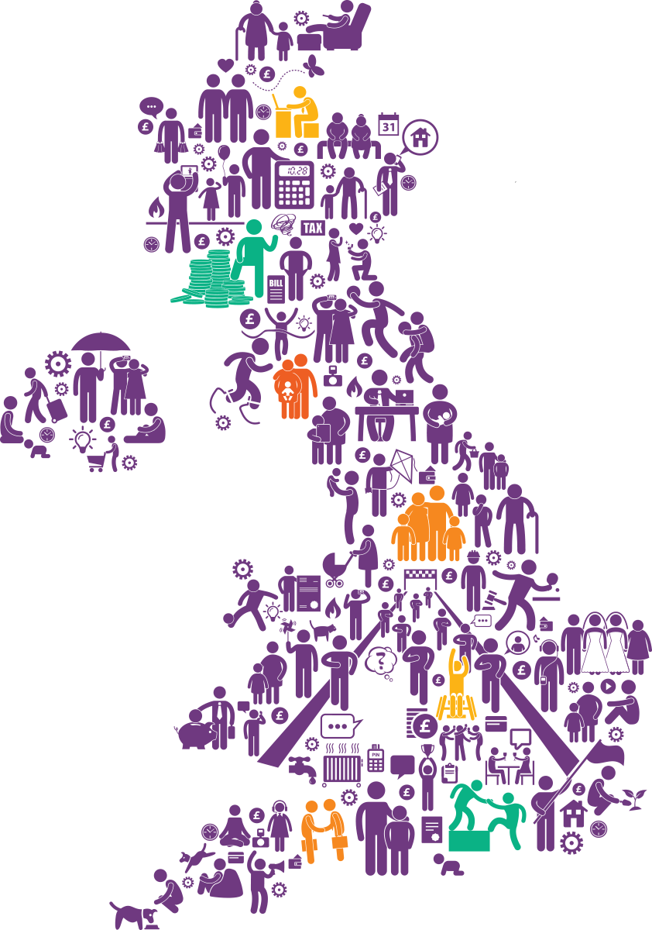
Stepping Forward
By 2022, it's estimated more than two million people will need debt advice every year.
As the UK's leading debt charity, it's vital that we step up to our social responsibility and play our part in meeting this need.
www.stepchange.org

Slide 8

Stepping Forward – Helping More People
Over the next four years, we're:
Investing in both our online and telephone services
Offering a range of solutions to clients based entirely on their needs
Introducing earlier interventions to help more people before debt pressures reach crisis point
Maximising efficiency and working with others
to deliver value and impact
Campaigning to reduce the stigma of problem debt so more people access support without fear or shame

Slide 9
The effects of problem debt
ashamed
depressed
angry
helpless
anxious
bullied
restless
embarrassed
guilt
overwhelmed
vulnerable
desperate
emotional turmoil
fear
out of control
motiveless
denial
panic
alone
victimised
lost
stressed
frustrated
threatened
worthless

Slide 10
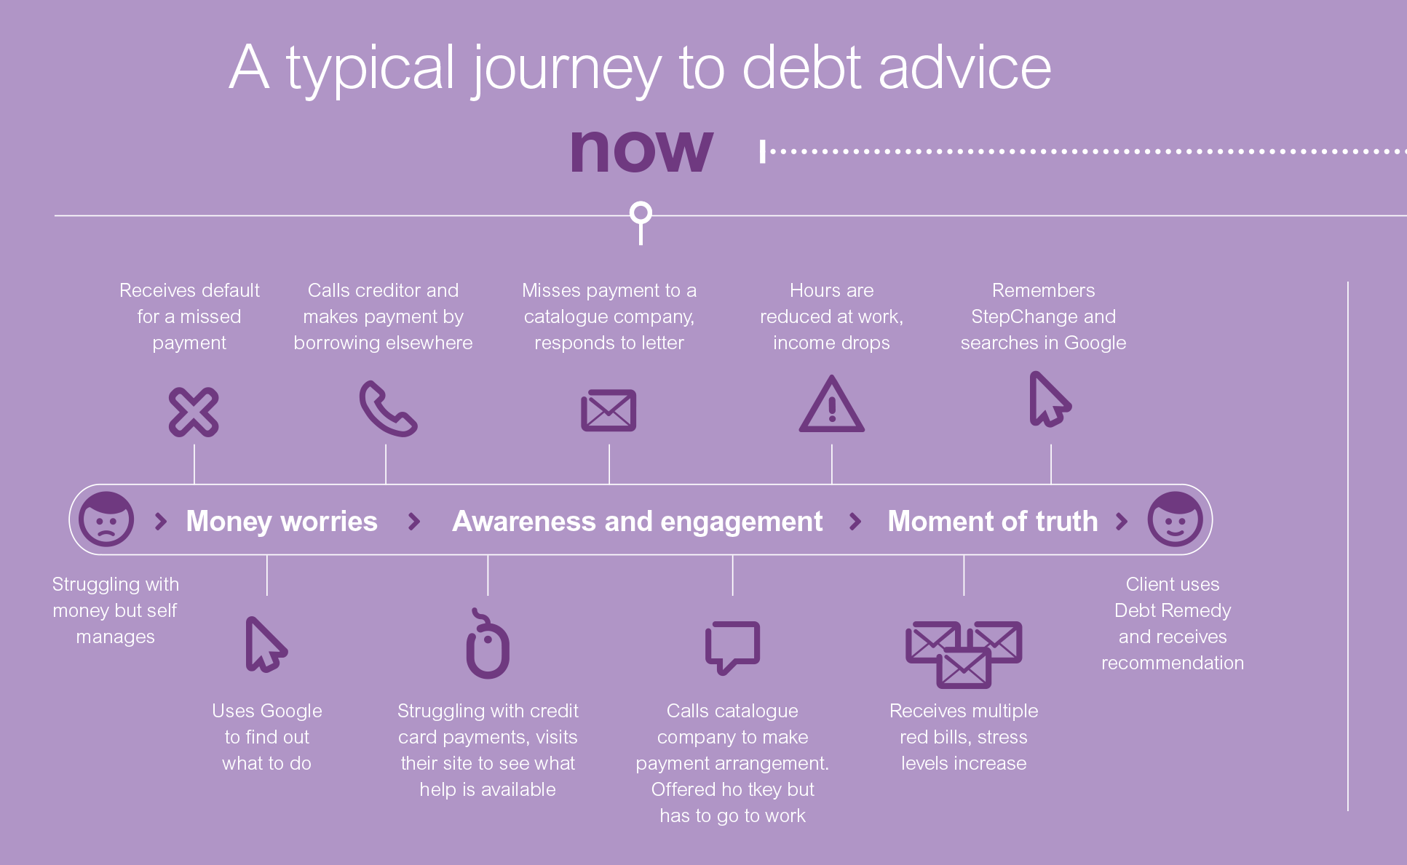

Slide 11
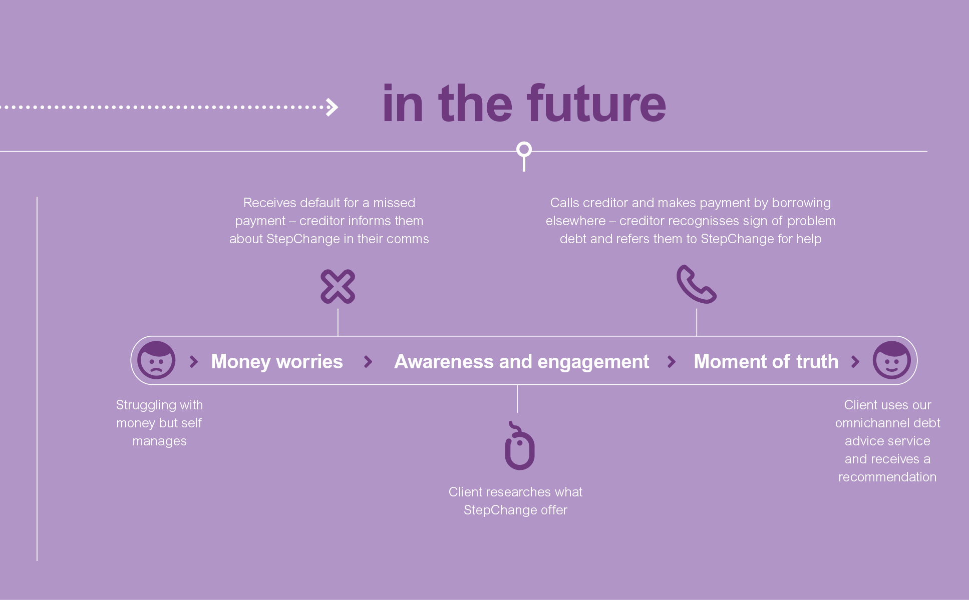

Slide 12

Our Clients in Scotland
A growing number of our Scottish clients are also choosing to seek advice online (58% compared to 42% by phone)
In Scotland we delivered full debt advice to nearly 20,000 new clients, an increase of 47% since 2013
We are the largest provider of Debt Payment Programmes (DPP) under the Debt Arrangement Scheme in Scotland

Slide 13
Reasons for Debt
Debt Reason | 2013 | 2017 | Change
Employment change/unemployment | 24% | 20% | -4%
Reduced benefit income | 21% | 18% | -3%
Illness / disability | 12% | 14% | 2%
Separation | 9% | 8% | -1%
Lack of budgeting | 14% | 13% | -1%
Bereavement | 2% | 2% | 0%
Pregnancy / childbirth | 2% | 2% | 0%
Caring for relatives | 1% | 1% | 0%
Retirement | 1% | 1% | 0%
Other | 14% | 21% | 7%
Over 60% of all clients are in problem debt due to circumstances outside of their control
Source: Scotland in the Red 2017

Slide 14
Debt, Income and Expenditure
 | 2013 | 2017 | 2013-2017 change (£) | 2013-2017 change (%)
Average unsecured debt | £13,533 | £12,488 | -£1,461 | -11%
Average monthly income (net) | £1,193 | £1,253 | £60 | 5%
Budget surplus | £24 | £15 | -£9 | -37%
% of income spent on priorities | 47% | 48% |  | 1%
Costs have risen faster than income, so incomes are down in real terms
Council tax continues to be an issue for our clients with 41% being in arrears, up from 37% in 2013
Source: Scotland in the Red 2017

Slide 15
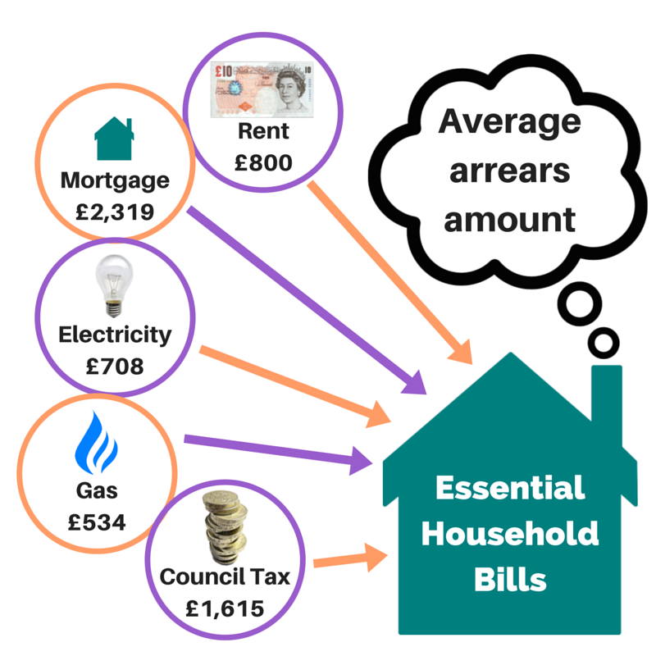
Arrears on Essential Household Bills
£740
£3,523
£745
£467
£1,983

Slide 16
Highest budget deficit by constituency
Of the 73 Scottish Parliamentary constituencies, 26 have clients who, on average, have a deficit budget
Average budget deficits are much higher in 2017 than five years ago
Constituency | Highest Deficits 2013 | Constituency | Highest Deficits 2017
Stirling | -£145 | Galloway and West Dumfries | -£206
Perthshire South and Kinrossshire | -£112 | Aberdeen South and North Kincardine | -£121
Eastwood | -£110 | Eastwood | -£115
Argyll and Bute | -£48 | Aberdeenshire West | -£108
Hamilton, Larkhall and Stonehouse | -£41 | Aberdeenshire East | -£84
Source: Scotland in the Red 2017

Slide 17
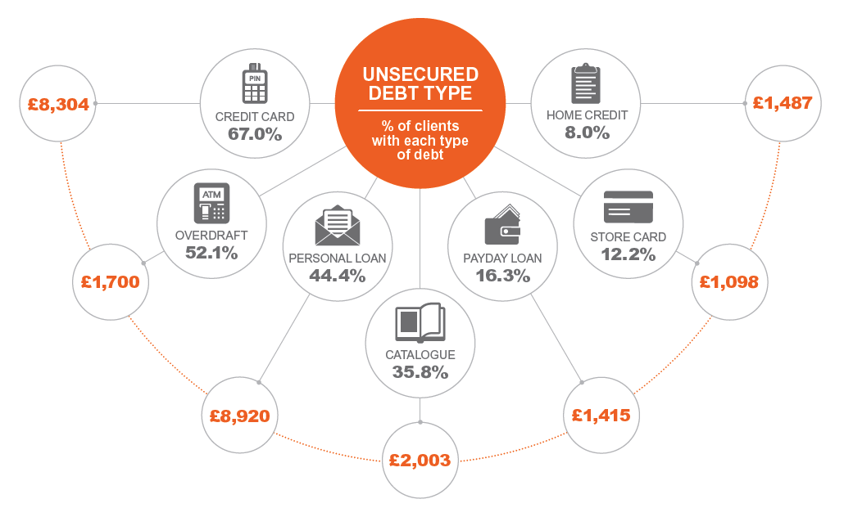
Our clients’ debts
£7,002
£1,676
64%
10%
53%
11%
£1,452
49%
9%
£1,095
39%
£7,503
£980
£1,832

Slide 18
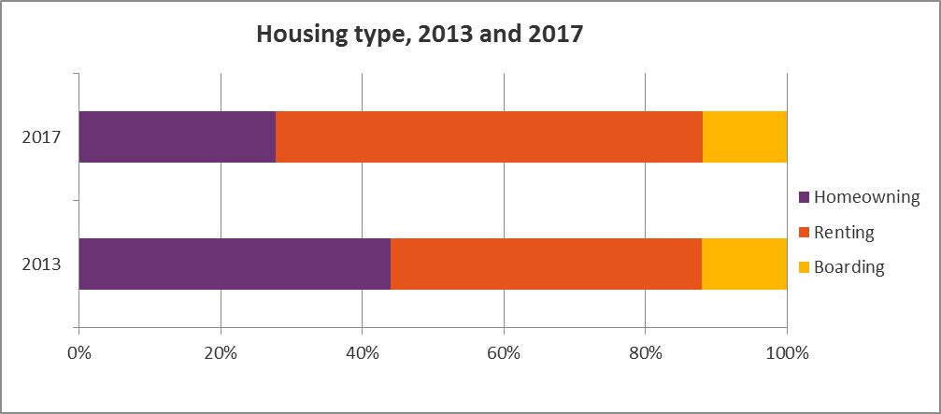
Debt and Housing
Clients in rented accommodation has increased from 44% in 2013 to 61% in 2017
Over half of all constituencies in Scotland had one in four clients in rent arrears
UC constituencies show a higher than average level of rent arrears compared to the national level
Source: Scotland in the Red 2017

Slide 19
Locked Out Report :
Our clients live in fear of eviction
Debt affects access to housing
Being in debt limits affordable housing options
Housing benefits don’t cover housing costs

Slide 20
Conclusion
Problem debt continues to be an issue in Scotland.
The free sector has a significant and increasing role to play in supporting people experiencing problem debt.
More flexible and impactful solutions are required to help provide increasingly cost effective services.
More clients can be supported through a greater blend:
  face to face support
  telephone support
  online including web chat support
StepChange aspires to support higher volumes of Scottish residents experiencing problem debt

Slide 21
Thank You

