Slide 1


Financial wellbeing
Andrew Collings

Slide 2
One of the greatest unnoticed drains on individual’s productivity is the distraction that financial stress puts on people
Dr. Stephen R Covey
    7 Habits of Highly Effective People

Slide 3
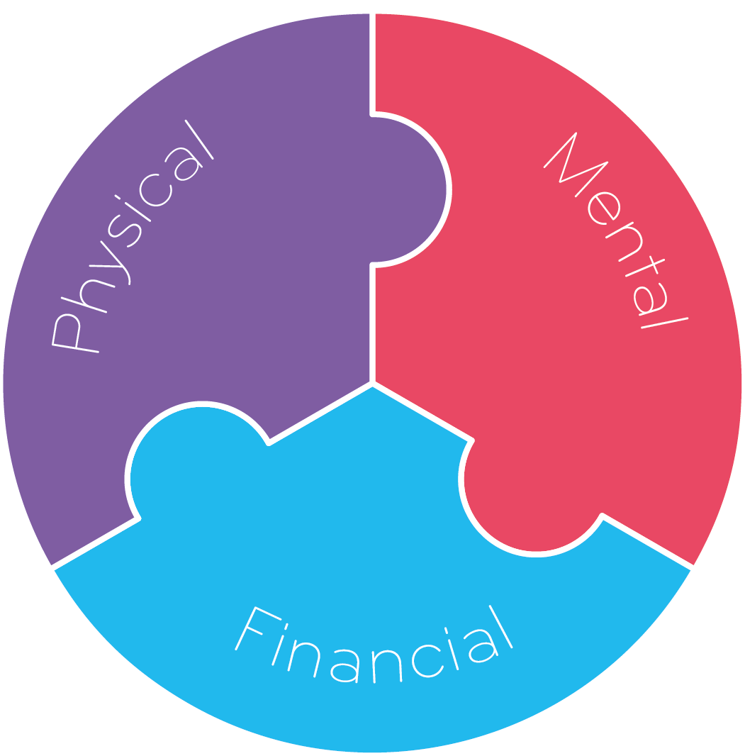

PRODUCTIVITY PUZZLE

Slide 4

Overall employee wellbeing
We asked employees what areas of their wellbeing they were unhappy with:

Slide 5







THE DNA OF FINANCIAL WELLBEING – state of the nation
35%
stressed
72%
6%
Missed work
of employees
said their mental health had made their financial situation worse
26%
Lost sleep
86%
20%
depressed
Of employees said their financial situation had made their mental health problems worse
Employees’
top concerns
No.1
Finances
1in2
No.2
£13,000+
health
Have borrowed to
meet basic needs
No.3
Average household
debt
Work/life balance
Source: The DNA of Financial Wellbeing 2018, Survey of 10,000 employees and 580 employers

Slide 6

THE DNA OF FINANCIAL WELLBEING – millennials spotlight
53%
7 in 10
JOB PERFORMANCE
81%
Of under 34s are borrowing to meet basic financial needs
58%
BEHAVIOUR
of 18-24 year olds were affected by financial worries last year
65%
Make decisions
61%
Control spending
16%
28%
of 18-24 year olds feel out of control with their finances
£14,500+
Of 18-24 year olds never check their credit score
Average household
debt for 25-44 year olds
Source: The DNA of Financial Wellbeing 2018, Survey of 10,000 employees and 580 employers

Slide 7

Future of wellbeing
  78% of millennials who say their top management are diverse
  (tolerance, inclusiveness & openness) reported greater profits – they also yearn for leaders whose decisions benefit the world
61% of millennials say
life would improve if they could manage money better
Financial rewards & workplace culture is key for millennials
Diversity & Flexibility
55% of millennials
say they would stay for 5 years based on greater flexibility
Millennials want to see a balance between business profits and “softer” outcomes
Debt consolidation

Slide 8
Methods of regular borrowing for basic needs

Slide 9

Public sector experience
Our extensive experience working with public sector clients, including a long running partnership with Police Mutual and a number of NHS Trusts and Local Authorities, has allowed us to witness first hand the issues faced and the positive impacts our products can have.
It became clear from both our own research and external data that financial worries and the subsequent stress it causes employees is causing large problems for organisations productivity and efficiency.
Affected by money worries
Anxiety
Feel out of control with day to day money
Has less than one months savings
58%
UK Average
68%
Local Authority
31%
UK Average
32%
Local Authority
11%
UK Average
14%
Local Authority
24%
UK Average
27%
Local Authority
9
Source: DNA of Financial Wellbeing 2017

Slide 10

Supporting Financial Worries
3%
Of employees would turn to either their manager
or HR team if they were having financial worries
24% Employers think employees would turn to their manager for support with financial worries & 15% would turn to HR

Slide 11
Financial Wellbeing
Do you have a financial wellbeing strategy?
11

Slide 12
Current HR priorities for the next 12 months

Slide 13
NEYBER’S SOLUTION
  A complete financial wellbeing solution at no cost
  We empower you to support your workforce’s
  financial wellbeing by giving them access to
01
Financial Wellbeing
02
Affordable Borrowing
  03
  Attractive
  Savings

Slide 14







Thank you
WINNER of “Benefits Innovation of the Year” 2017
SHORTLISTED
for “Innovation in Consumer Finance” & “Ethical Financial Services of the Year” 2017
Provider to
WINNER of
"Best Financial Wellbeing Strategy"
FINALIST for “Newcomer”
WINNER of “Benefits Innovation of the Year” 2016
SHORTLISTED for “Best Product for Making Pay Go Further”
HIGHLY COMMENDED
for “Innovation in Consumer Finance” 2016
RUNNER UP
for “People’s choice award” 2016
SHORTLISTED for
“Most Innovative Product
of the Year” & “FinTech Startup of the Year”
Copyright 2017 Neyber - All Rights reserved
Neyber Ltd is authorised and regulated by the Financial Conduct Authority. Financial Services Register number 718709; Registered address: First Floor East, Tabernacle Court, 16-28 Tabernacle St, London EC2A 4DD; Company registered number: 08806631; Data Protection Registration Number: ZA39009
Neyber intends to offer customers a range of investment options for regular, salary deducted contributions to their investments portfolio with access to a range of higher return investment/lending products including tax efficient ISAs. Such products will not be eligible for the Financial Services Compensation Scheme.
neyber.co.uk
@helloneyber
company/neyber

Slide 15
Financial Wellbeing
Questions
15

