Slide 1

Data on inequality to shape more preventative decision making and its role in the Shaping Places for Wellbeing Programme
Masterclass 3
Irene Beautyman
Place and Wellbeing Partnership Lead
Improvement Service & Public Health Scotland

Slide 2
Data on inequality to shape more preventative decision making and its role in the Shaping Places for Wellbeing Programme
✔️ Masterclass 1
✔️ The why and how of data
✔️ Impact and support

Slide 3
Data on inequality to shape more preventative decision making and its role in the Shaping Places for Wellbeing Programme
✔️ Masterclass 1
✔️ The why and how of data
✔️ Impact and support

Slide 4
Masterclass 1: Place based approaches
✔️What we mean by place and why it matters
✔️What taking a place based approach means
✔️Shaping Places for Wellbeing Programme

Slide 5
Who?
Public Health Scotland
v
v
NHS Boards
Improvement Service
Health and social Care Partnerships
Strategic decision-making impacts on a place
v
Local Authorities
Third Sector
Impacts on a place
Communities
Other statutory Authorities
Private sector
Scottish Government

Slide 6



Key parts to a place-based approach
PEOPLE
What they are experiencing
PLACE
ALL the features that have a positive impact
DECISIONS
How they impact people and place

Slide 7


Take a place based approach
PEOPLE
What they are experiencing –
inequality
Inequality data
Quantitative
Qualitative
PLACE
All the features that have a positive impact
Place and Wellbeing Outcomes
DECISIONS
How they impact people and place
Place & Wellbeing Assessments
Briefing Papers
Leadership & governance

Slide 8
Take a place based approach
PEOPLE
What they are experiencing –
Inequality
Inequality data
Quantitative
Qualitative
PLACE
All the features that have a positive impact
Place and Wellbeing Outcomes
DECISIONS
How they impact people and place
Place & Wellbeing Assessments
Briefing Papers
Leadership & governance

Slide 9
Data on inequality to shape more preventative decision making and its role in the Shaping Places for Wellbeing Programme
✔️ Masterclass 1
✔️ The why and how of data
✔️ Impact and support

Slide 10
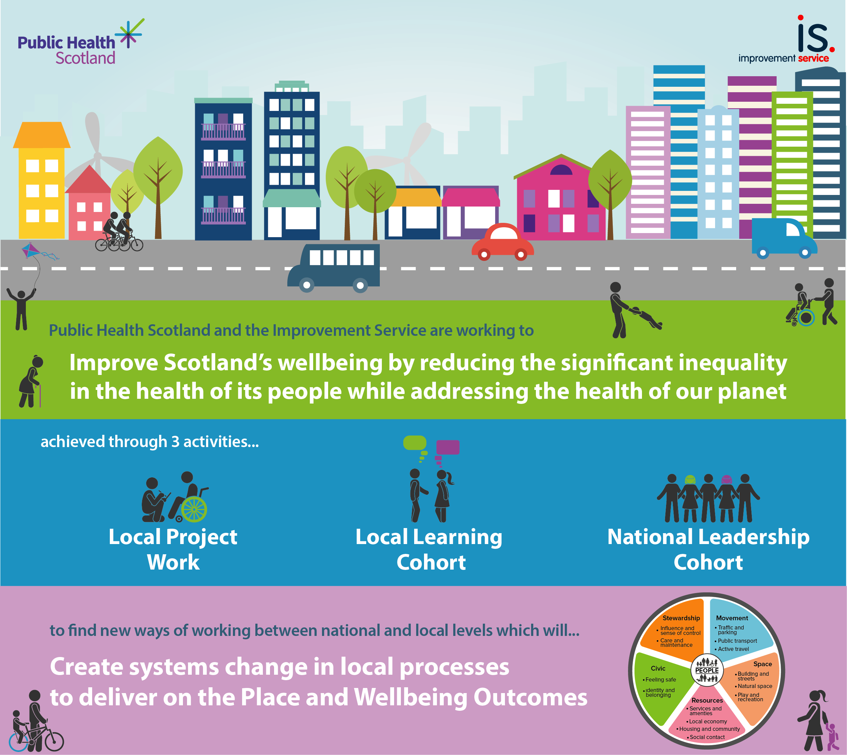
Notes:
Slide summarising the programme activity

Slide 11

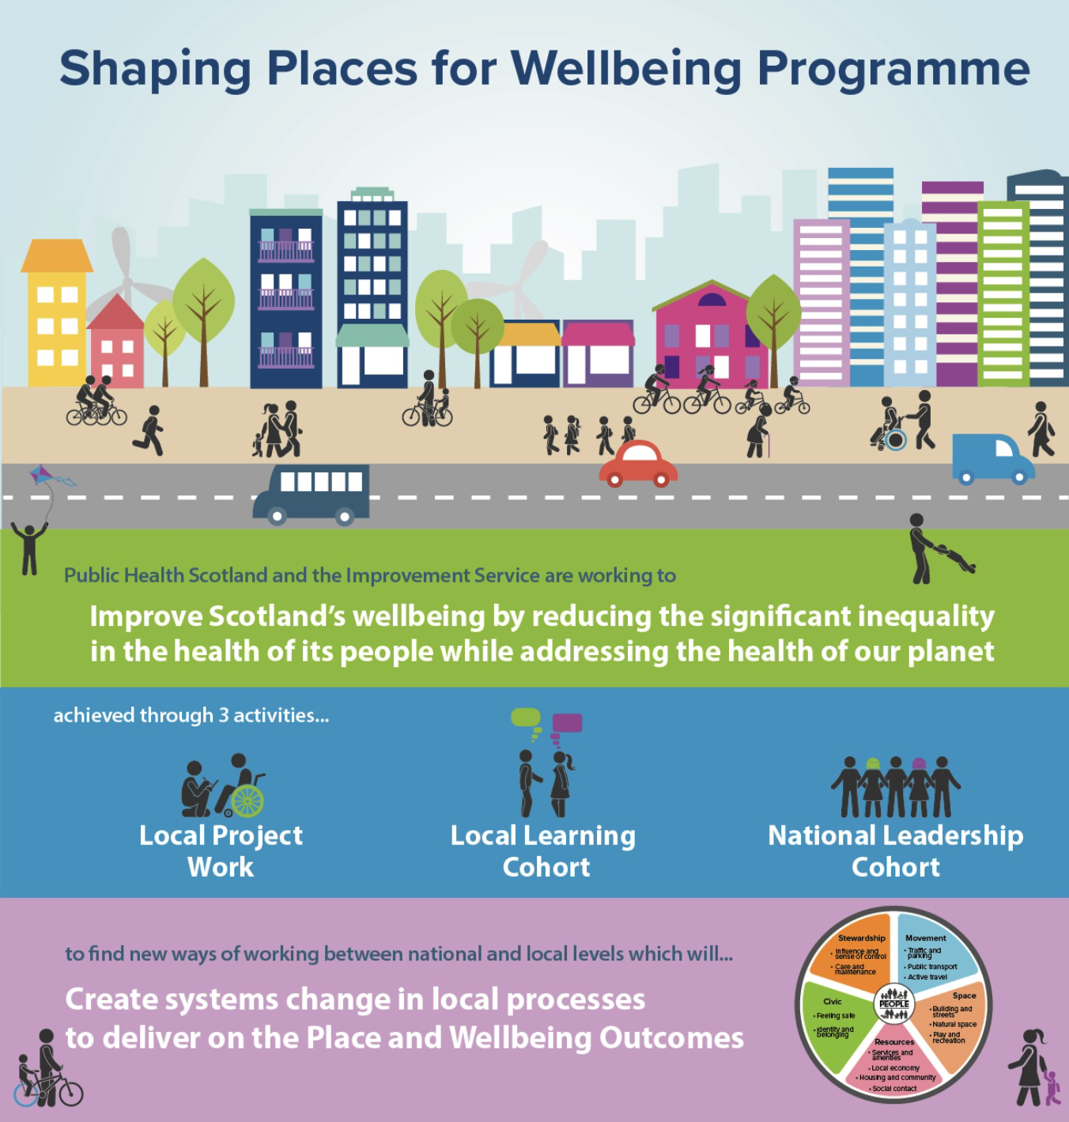
Three activities:
Council and NHS Board in Project Towns:
Alloa
Ayr
Clydebank
Dalkeith
Dunoon
Fraserburgh
Rutherglen
Replication
Reflection, learning, sharing between Project Towns
All Towns Steering Groups
“How to” Guides enable replication
Confidence
Representatives from:
Scottish Govt Directorates
All COSLA Boards
Public Health Scotland
Improvement Service
Health Foundation
Notes:
Use these slides to what suits you presentation – don't need to include them all

Slide 12
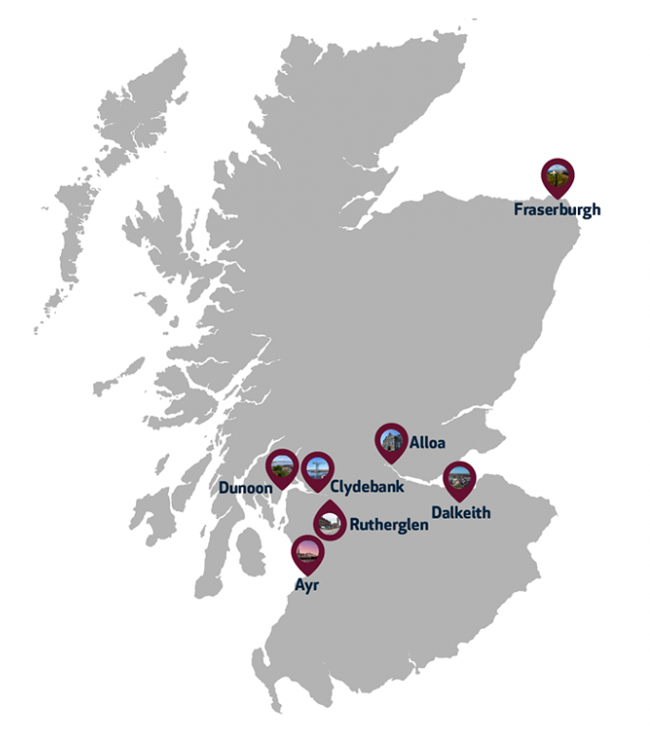
Project Towns
Population size
Notes:
The Programme is primarily being delivered through local project town work. There are seven towns in the programme for phase 1. Selected to represent different sizes of population and types of settlements – including urban, rural, costal

Slide 13
Data journey
Qualitative Report
‘Sense-checked’ key areas of inequality
What is needed from their place
Data Profile
Produced by Public Health Scotland LIST team
Key population groups experiencing inequality
Quantitative Data Infographic
Bring to life key areas of inequality in a visual
Qualitative Summary
Bring to life key community perceptions of inequality and Place & Wellbeing Outcomes
Used insight to inform data led decision making
Place and Wellbeing Assessments
Place and Wellbeing Outcome Briefing Papers

Slide 14
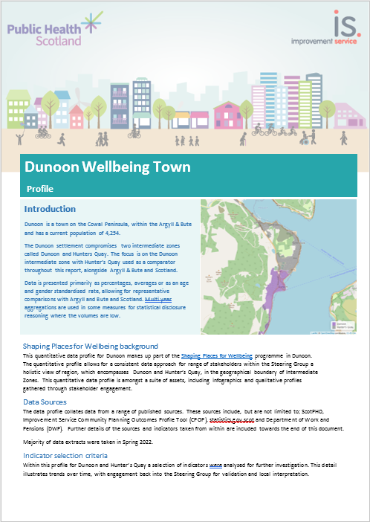
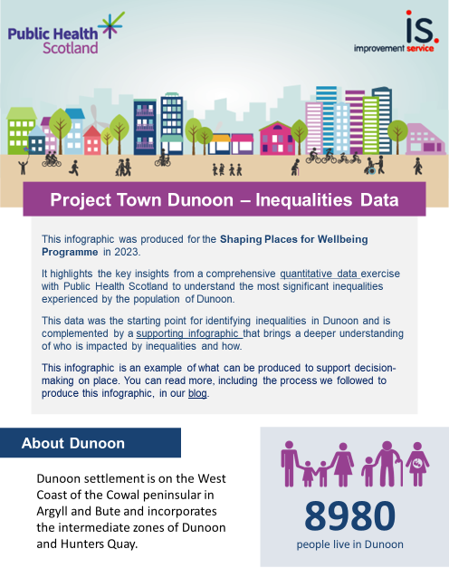
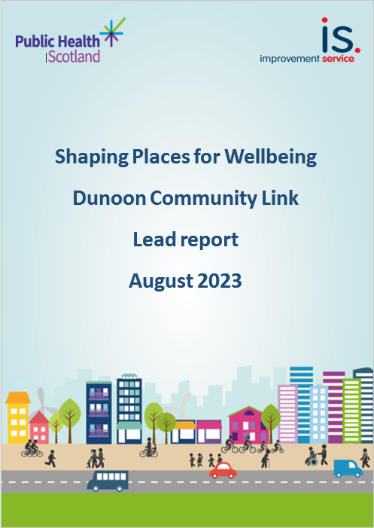
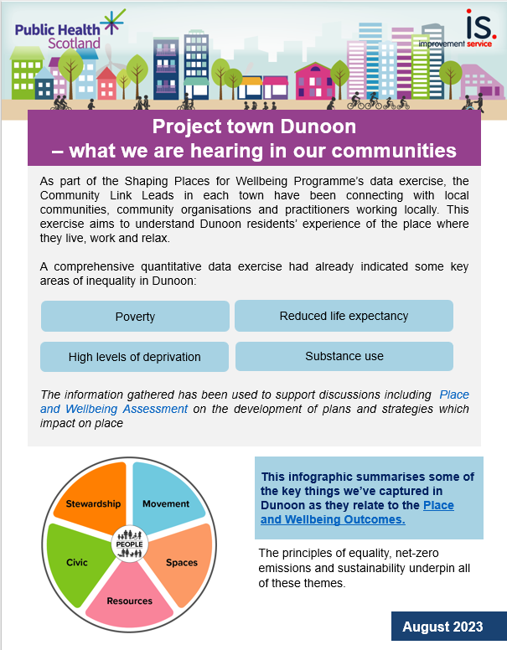
Data documents produced
PHS data profile
Quantitative data infographic
Community Link Lead report
Community Link Lead summary
Notes:
These are the outputs from each project town which are available on the programme webpages

Slide 15
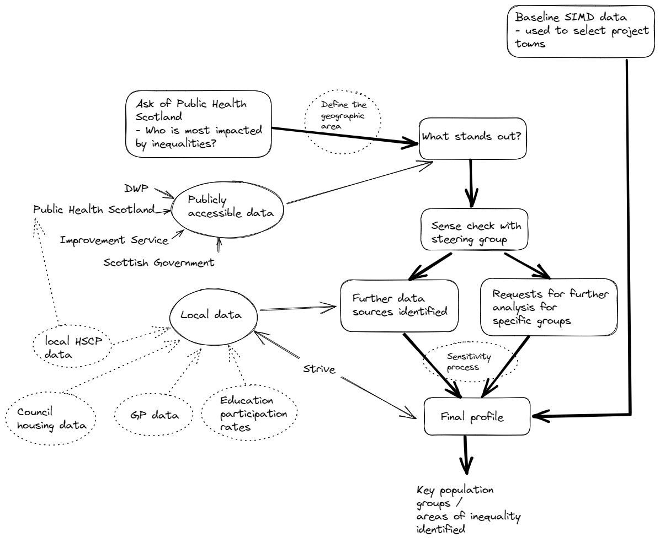
Quantitative
data collection process

Slide 16
Quantitative data on those impacted by inequality in Ayr
Geographic split of life expectancy of 14 years if living in North or South Ayr
Early deaths in those aged 15-44 living in North Ayr
People with addiction issues
People living in poverty, to include a focus on children

Slide 17
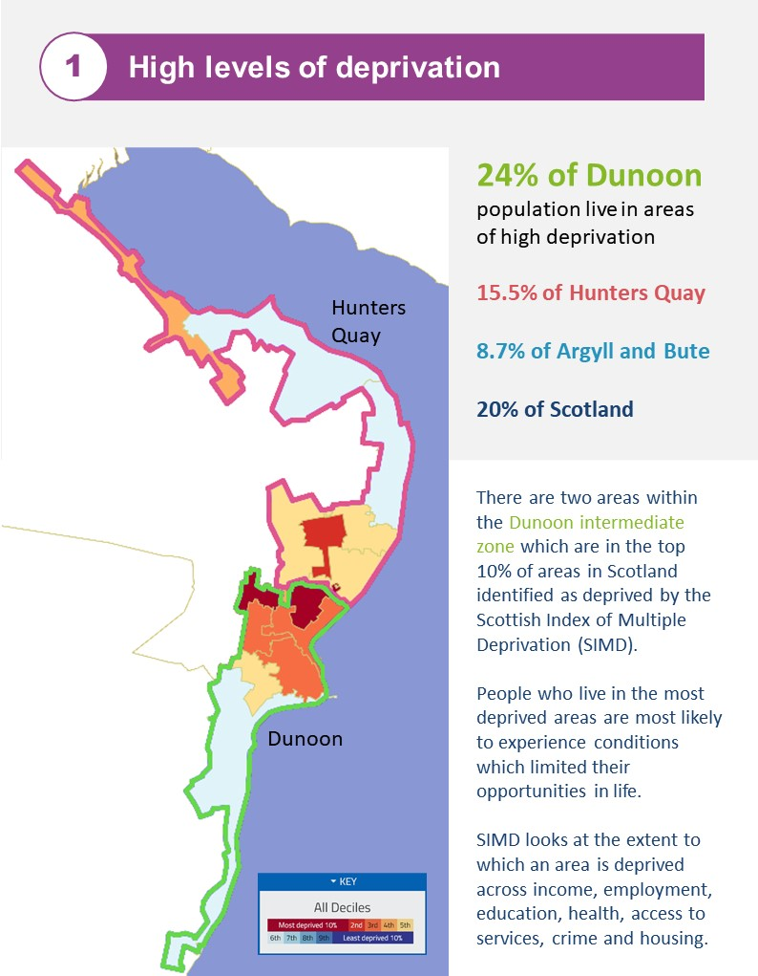
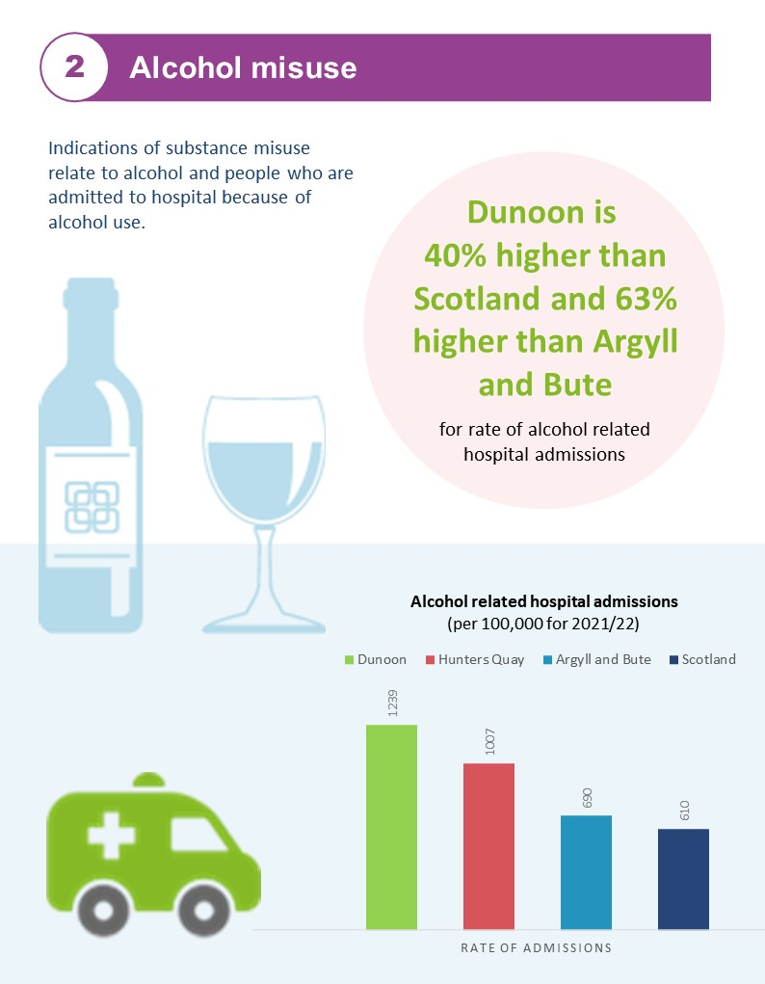
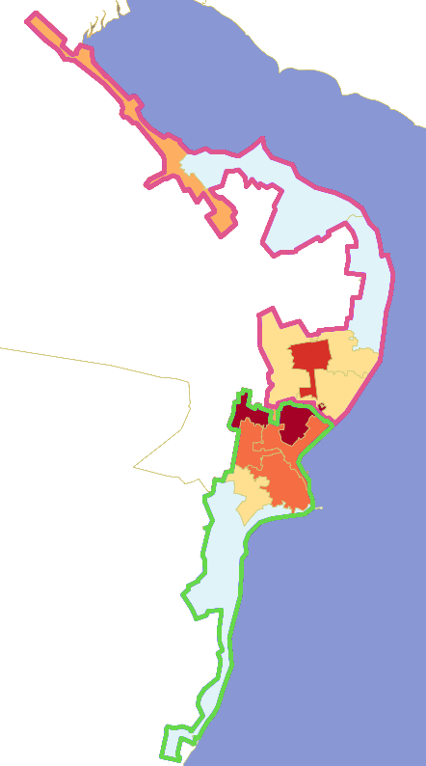


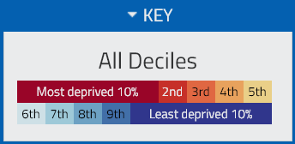
1
High levels of deprivation
2
Alcohol misuse
24% of Dunoon population live in areas of high deprivation
15.5% of Hunters Quay
8.7% of Argyll and Bute
20% of Scotland
Indications of substance misuse relate to alcohol and people who are admitted to hospital because of alcohol use.
Dunoon is
40% higher than Scotland and 63% higher than Argyll and Bute
Hunters
Quay
for rate of alcohol related hospital admissions
There are two areas within the Dunoon intermediate zone which are in the top 10% of areas in Scotland identified as deprived by the Scottish Index of Multiple Deprivation (SIMD).
People who live in the most deprived areas are most likely to experience conditions which limited their opportunities in life.
SIMD looks at the extent to which an area is deprived across income, employment, education, health, access to services, crime and housing.
Alcohol related hospital admissions
(per 100,000 for 2021/22)
Dunoon
Notes:
The key inequalities were identified through measures which stood out compared to Argyll and Bute and Scotland. In other towns there was a comparison between intermediate zones but there was not an obvious disparity in Dunoon settlement area – both data zones mixed.
Decision made to include only publicly available data so it could be easily shared with all stakeholders
Steering group and stakeholders in partner organisations helped refine key inequalities

Slide 18
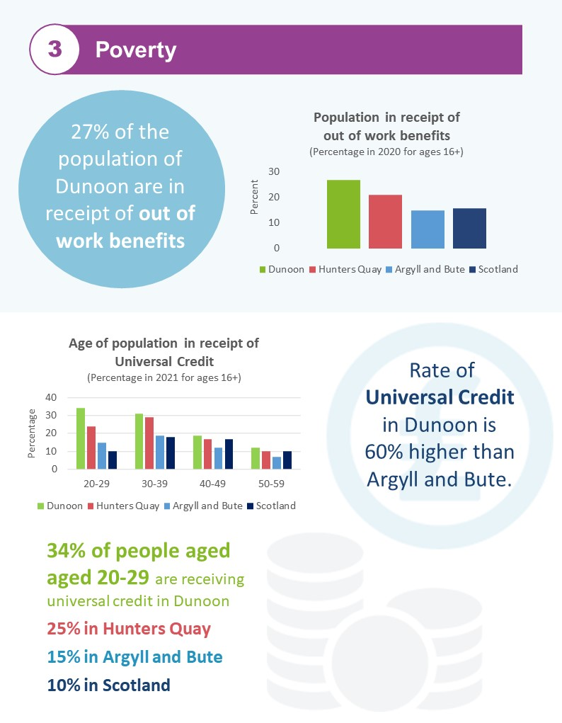



Other areas of interest
Carers allowance
3.2% of Hunters Quay population aged 16+ are in receipt of Carers Allowance within Dunoon it is 2.9%, Argyll and Bute 1.9% is and Scotland 2.2% (2021)
Personal Independence Payments
Rate of population in receipt of Personal Independence Payments (PIP) in Dunoon is almost twice the rate of Argyll and Bute.
While receipt of benefits may indicate inequality, further data is needed to draw that conclusion
Mental Health
Coronary heart disease
In Hunters Quay is higher than the averages for Argyll and Bute and Scotland
Notes:
Only able to include age/gender for DWP data
The data can be relatively easy pulled into a table for all intermediate zones – South Lan and Midlothian have asked for it

Slide 19


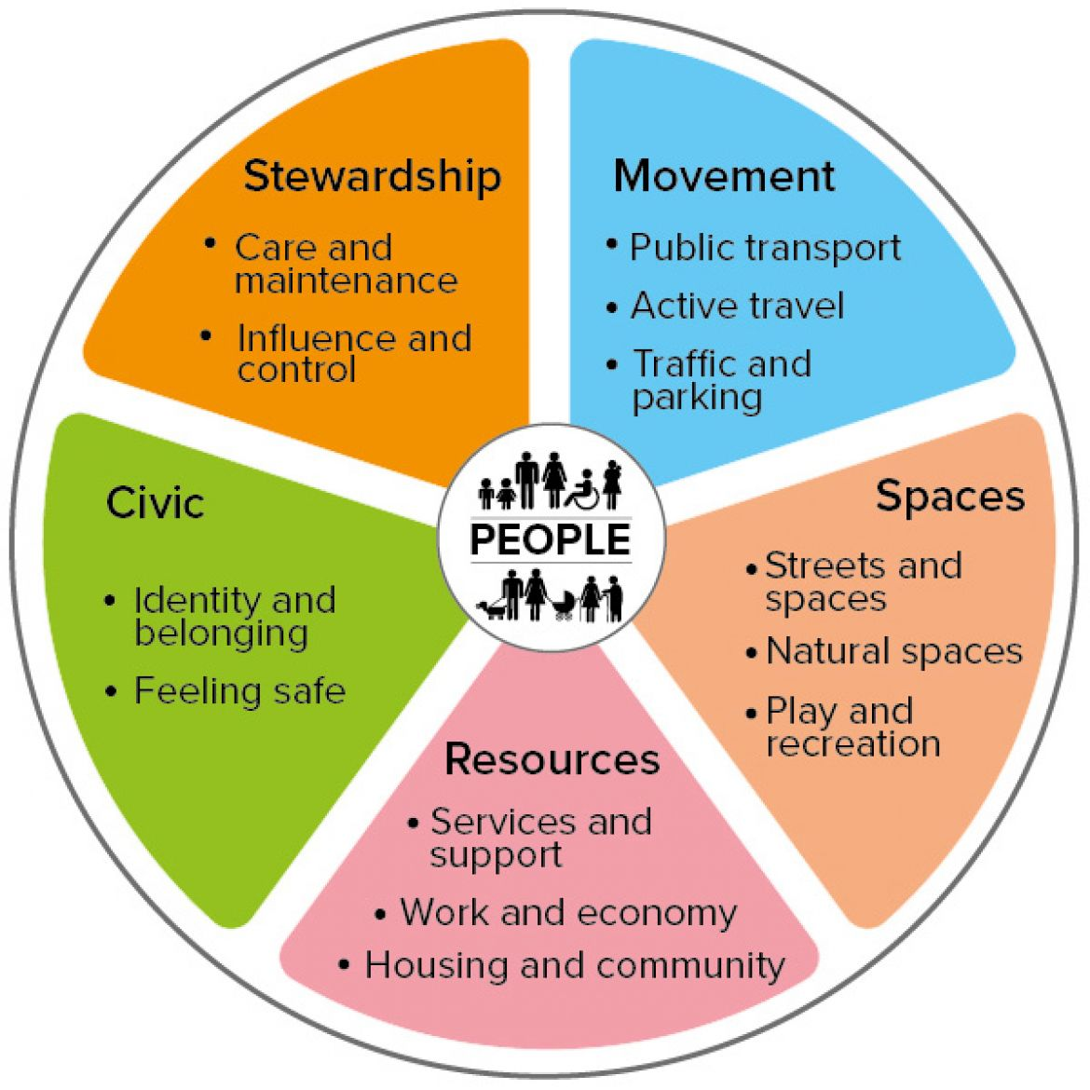


Qualitative data
Qualitative data from reports on previous engagement, consultation.
Community insight gathered through conversations with local practitioners and representatives of community groups, organisations and services.
Analysis
Map findings against the Place and Wellbeing Outcomes.
Sense check emerging findings.
Sharing findings
Feed into Place and Wellbeing Assessments
Report
Visual summary
Inform focus on inequality in future community engagement, involvement and participation activity.

Slide 20
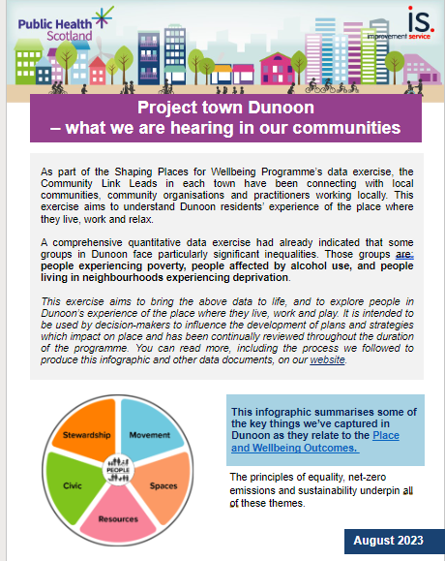
Data collection
journey
Incorporating qualitative data
Community Link Leads role to sense check and bring to life the quantitative data by connecting into the knowledge, experience and insight of community organisations in our Project Towns
People experiencing poverty
People living in neighbourhoods experiencing deprivation
People affected by alcohol use
Notes:
The Community Link Leads took areas of key inequality to further sense check and find out what people experiencing inequality needed from their place.
Dunoon example – poverty, deprivation and alcohol use

Slide 21
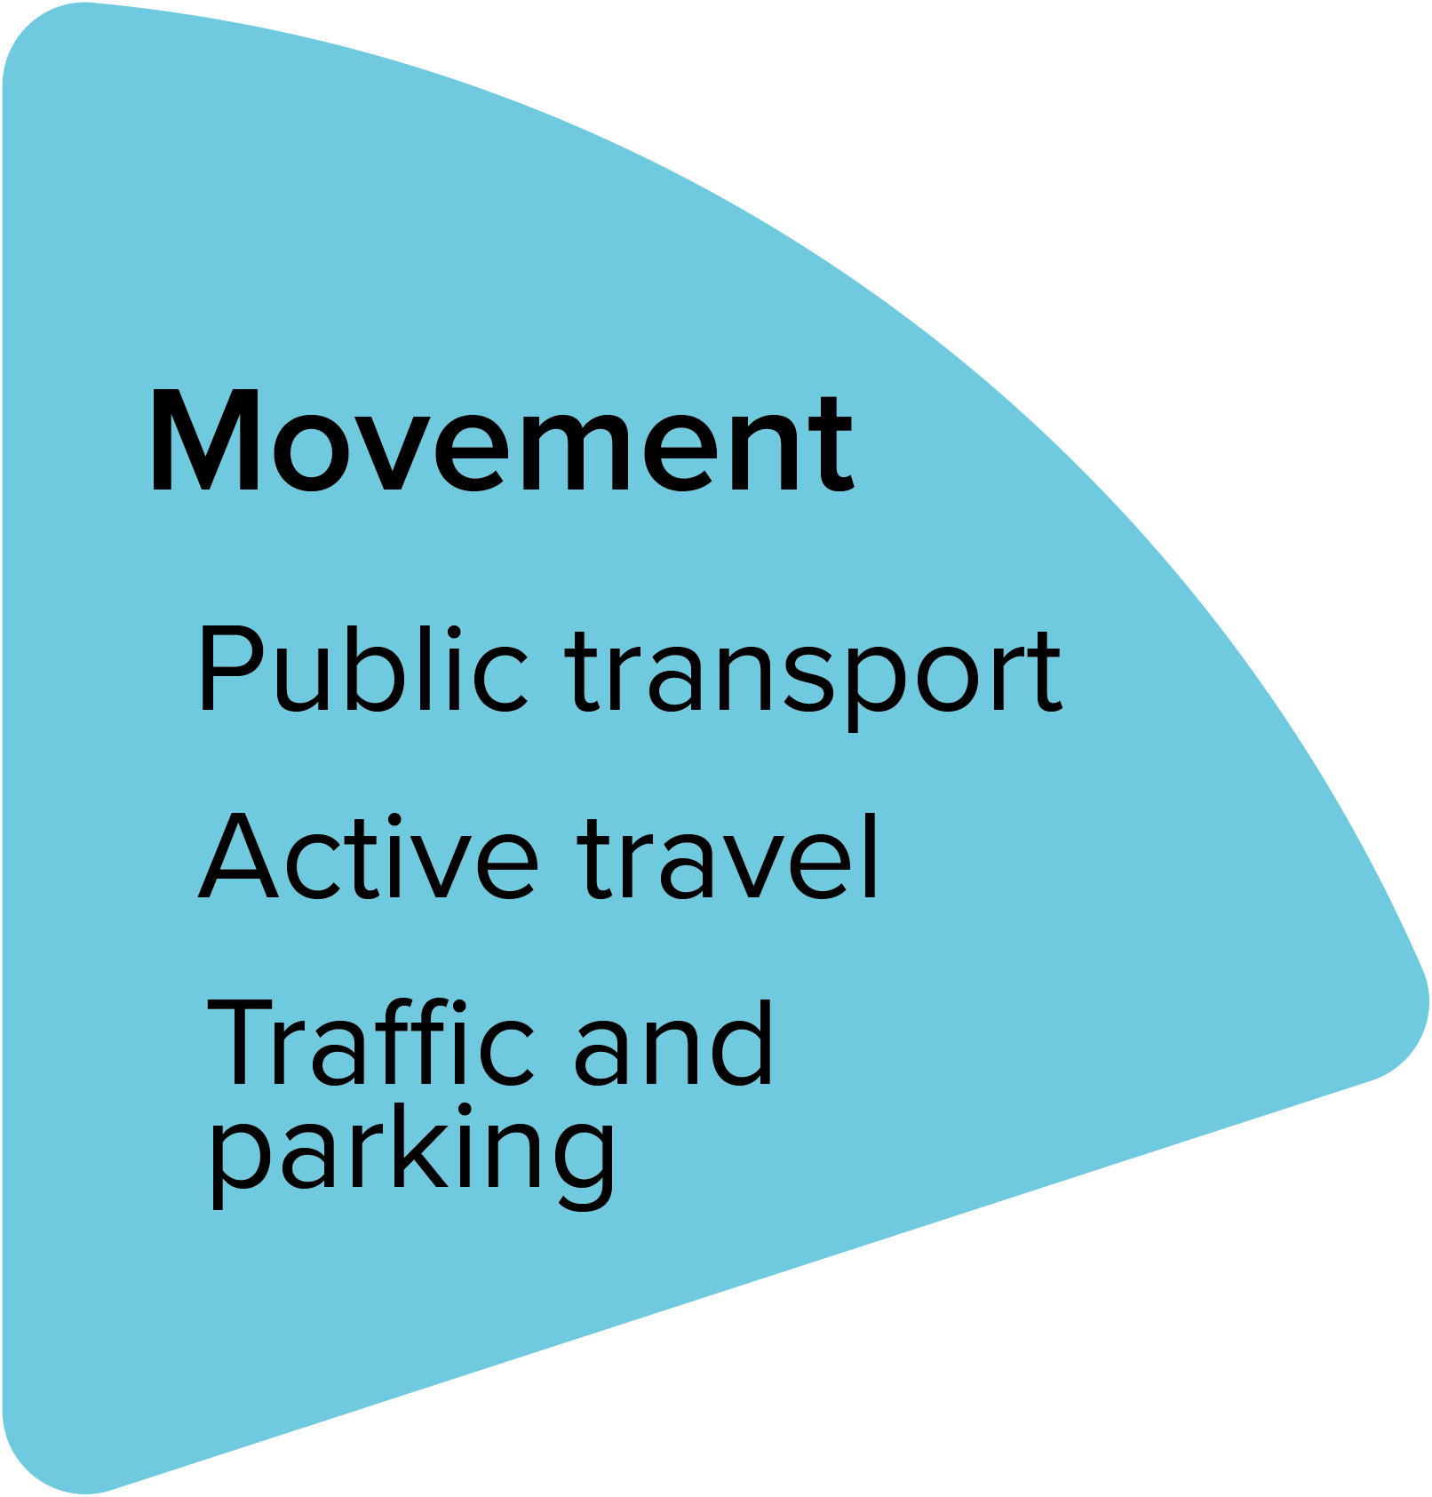
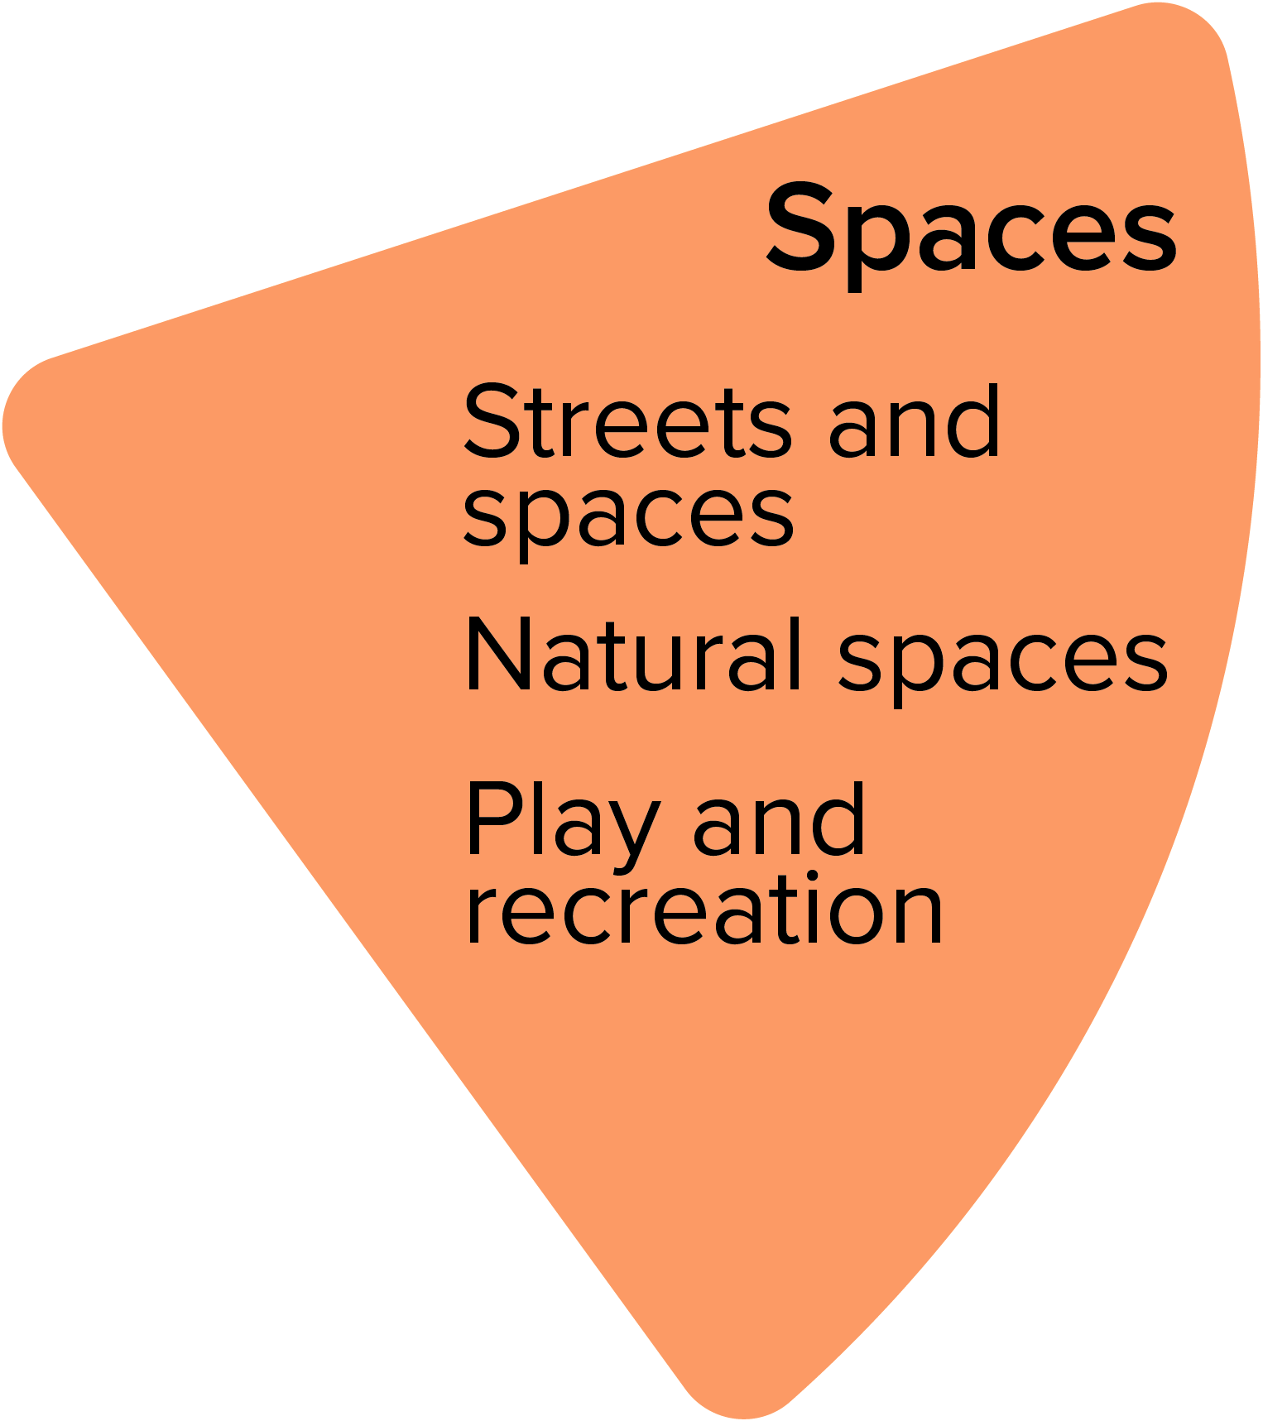
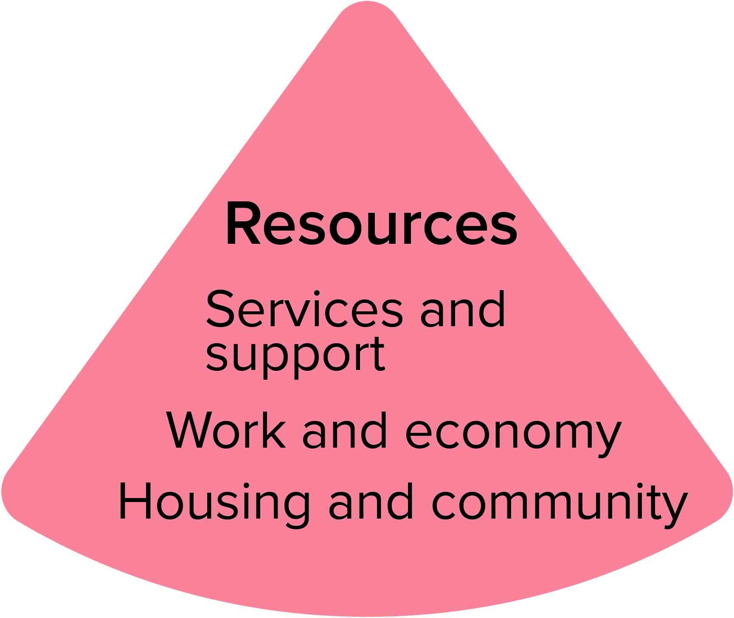

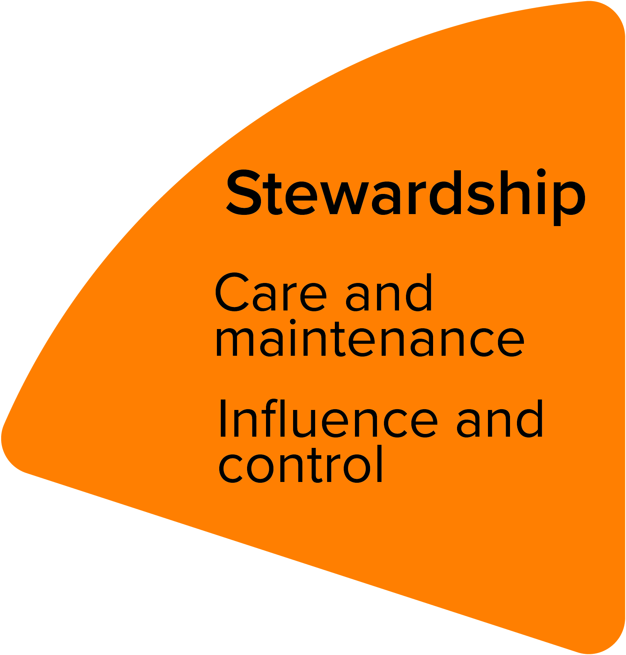
Qualitative data brings crucial community insight into our understanding of what is happening
Limited transport options affect employment opportunities and our economy, This includes access to mental health-promoting services and activities and to secondary care.
Rurality creates reliance on car use; moves to enhance local active travel are contentious.
Dunoon has good access to free, open spaces. Lack of connectivity and limited maintenance budgets means some spaces are underused.
A perceived lack of things – especially in bad weather – is thought to affect young people’s mental health and behaviour.
Mental Health is widely seen as a key local issue that’s not very visible in our quantitative data.
Connectivity – Dunoon is isolated by its geography, transport links and patchy digital connections.
Mental health and caring responsibilities underpin problems with housing, employment and income. Fuel poverty is high and exacerbates them.
Centralised services and reliance on a precarious third sector mean there are gaps in provision, and risks to sustainability of existing services.
Many services rely on a precarious third sector staffed by an ageing population.
Limited childcare and
fuel poverty are regularly cited as factors that exacerbate income deprivation.
Dunoon is a place where people generally feel safe and local connections are strong. A few datazones are considered less safe and to lack access to support services. Connectivity is also a barrier.
Recruiting and retaining workers can be challenging – sense of identity may actually be a barrier.
There is a good culture of community-led action but a precarious third sector. Lack of influence and short term funding are often raised as problems, as are volunteer fatigue, low capacity and limited communication.

Slide 22
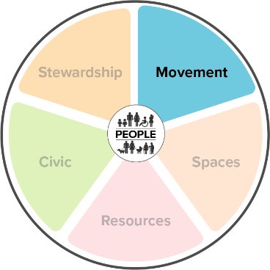
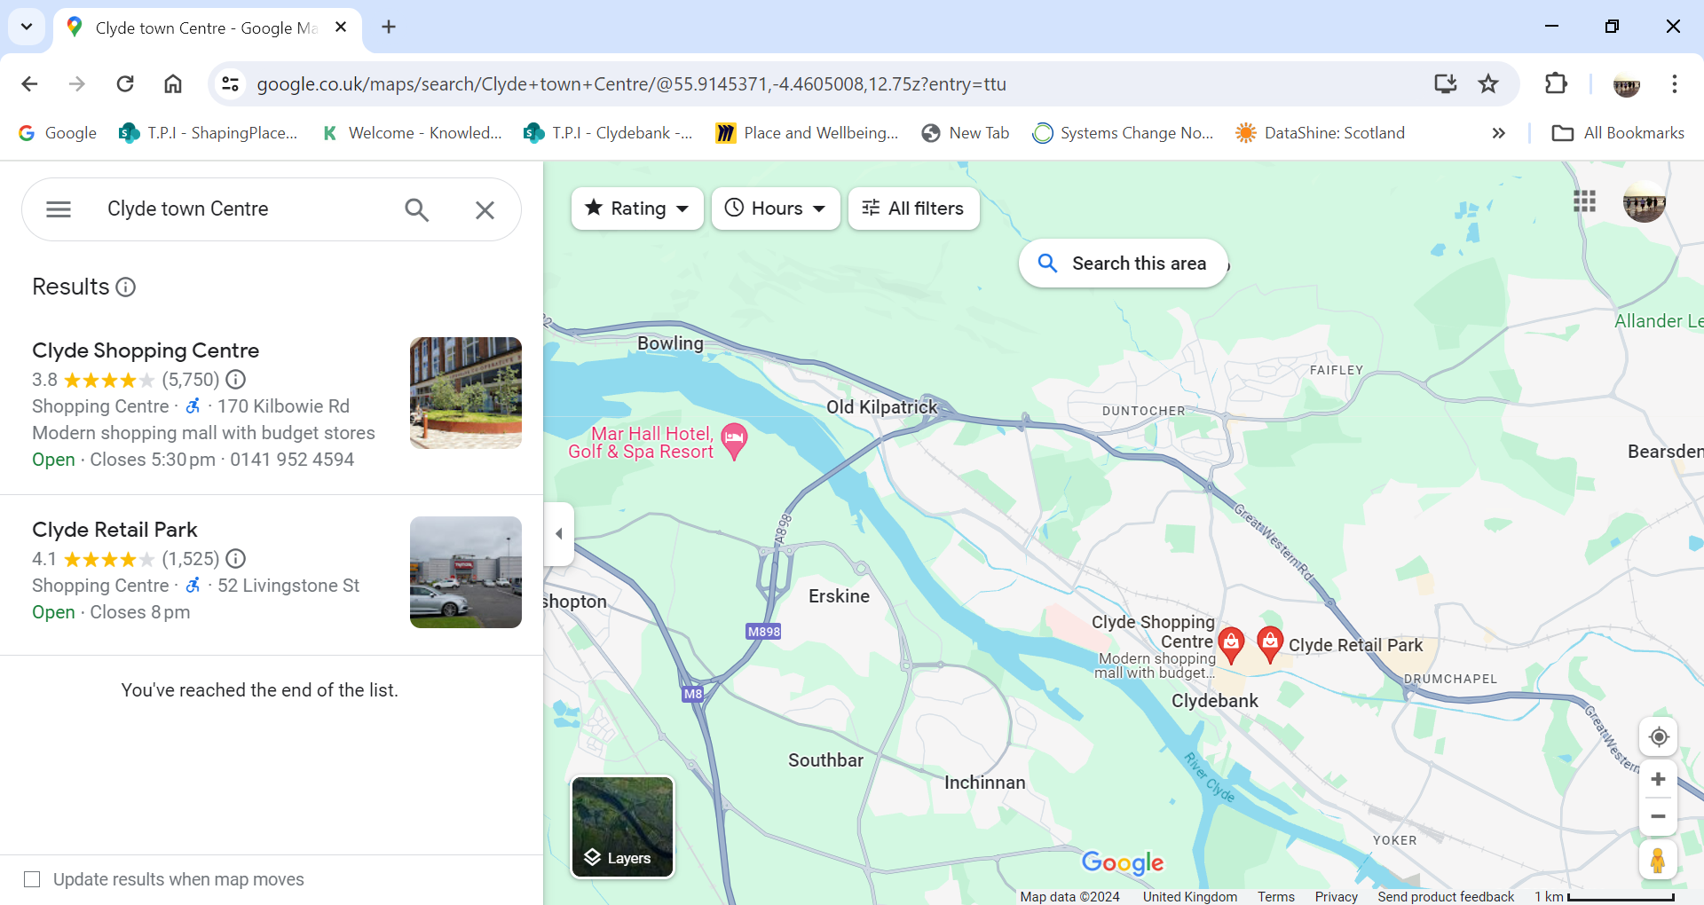
People in Clydebank: qualitative data
Emerging theme: Moving around Clydebank
  Disconnect between town centre & much of Clydebank
  High levels of poverty
  Low car ownership & dependence on public transport
  Affordability of public transport
  Access to services & employment
  Connectivity between public transport and active travel
  Barriers to active travel & public transport
  Traffic and parking safety concerns

Slide 23
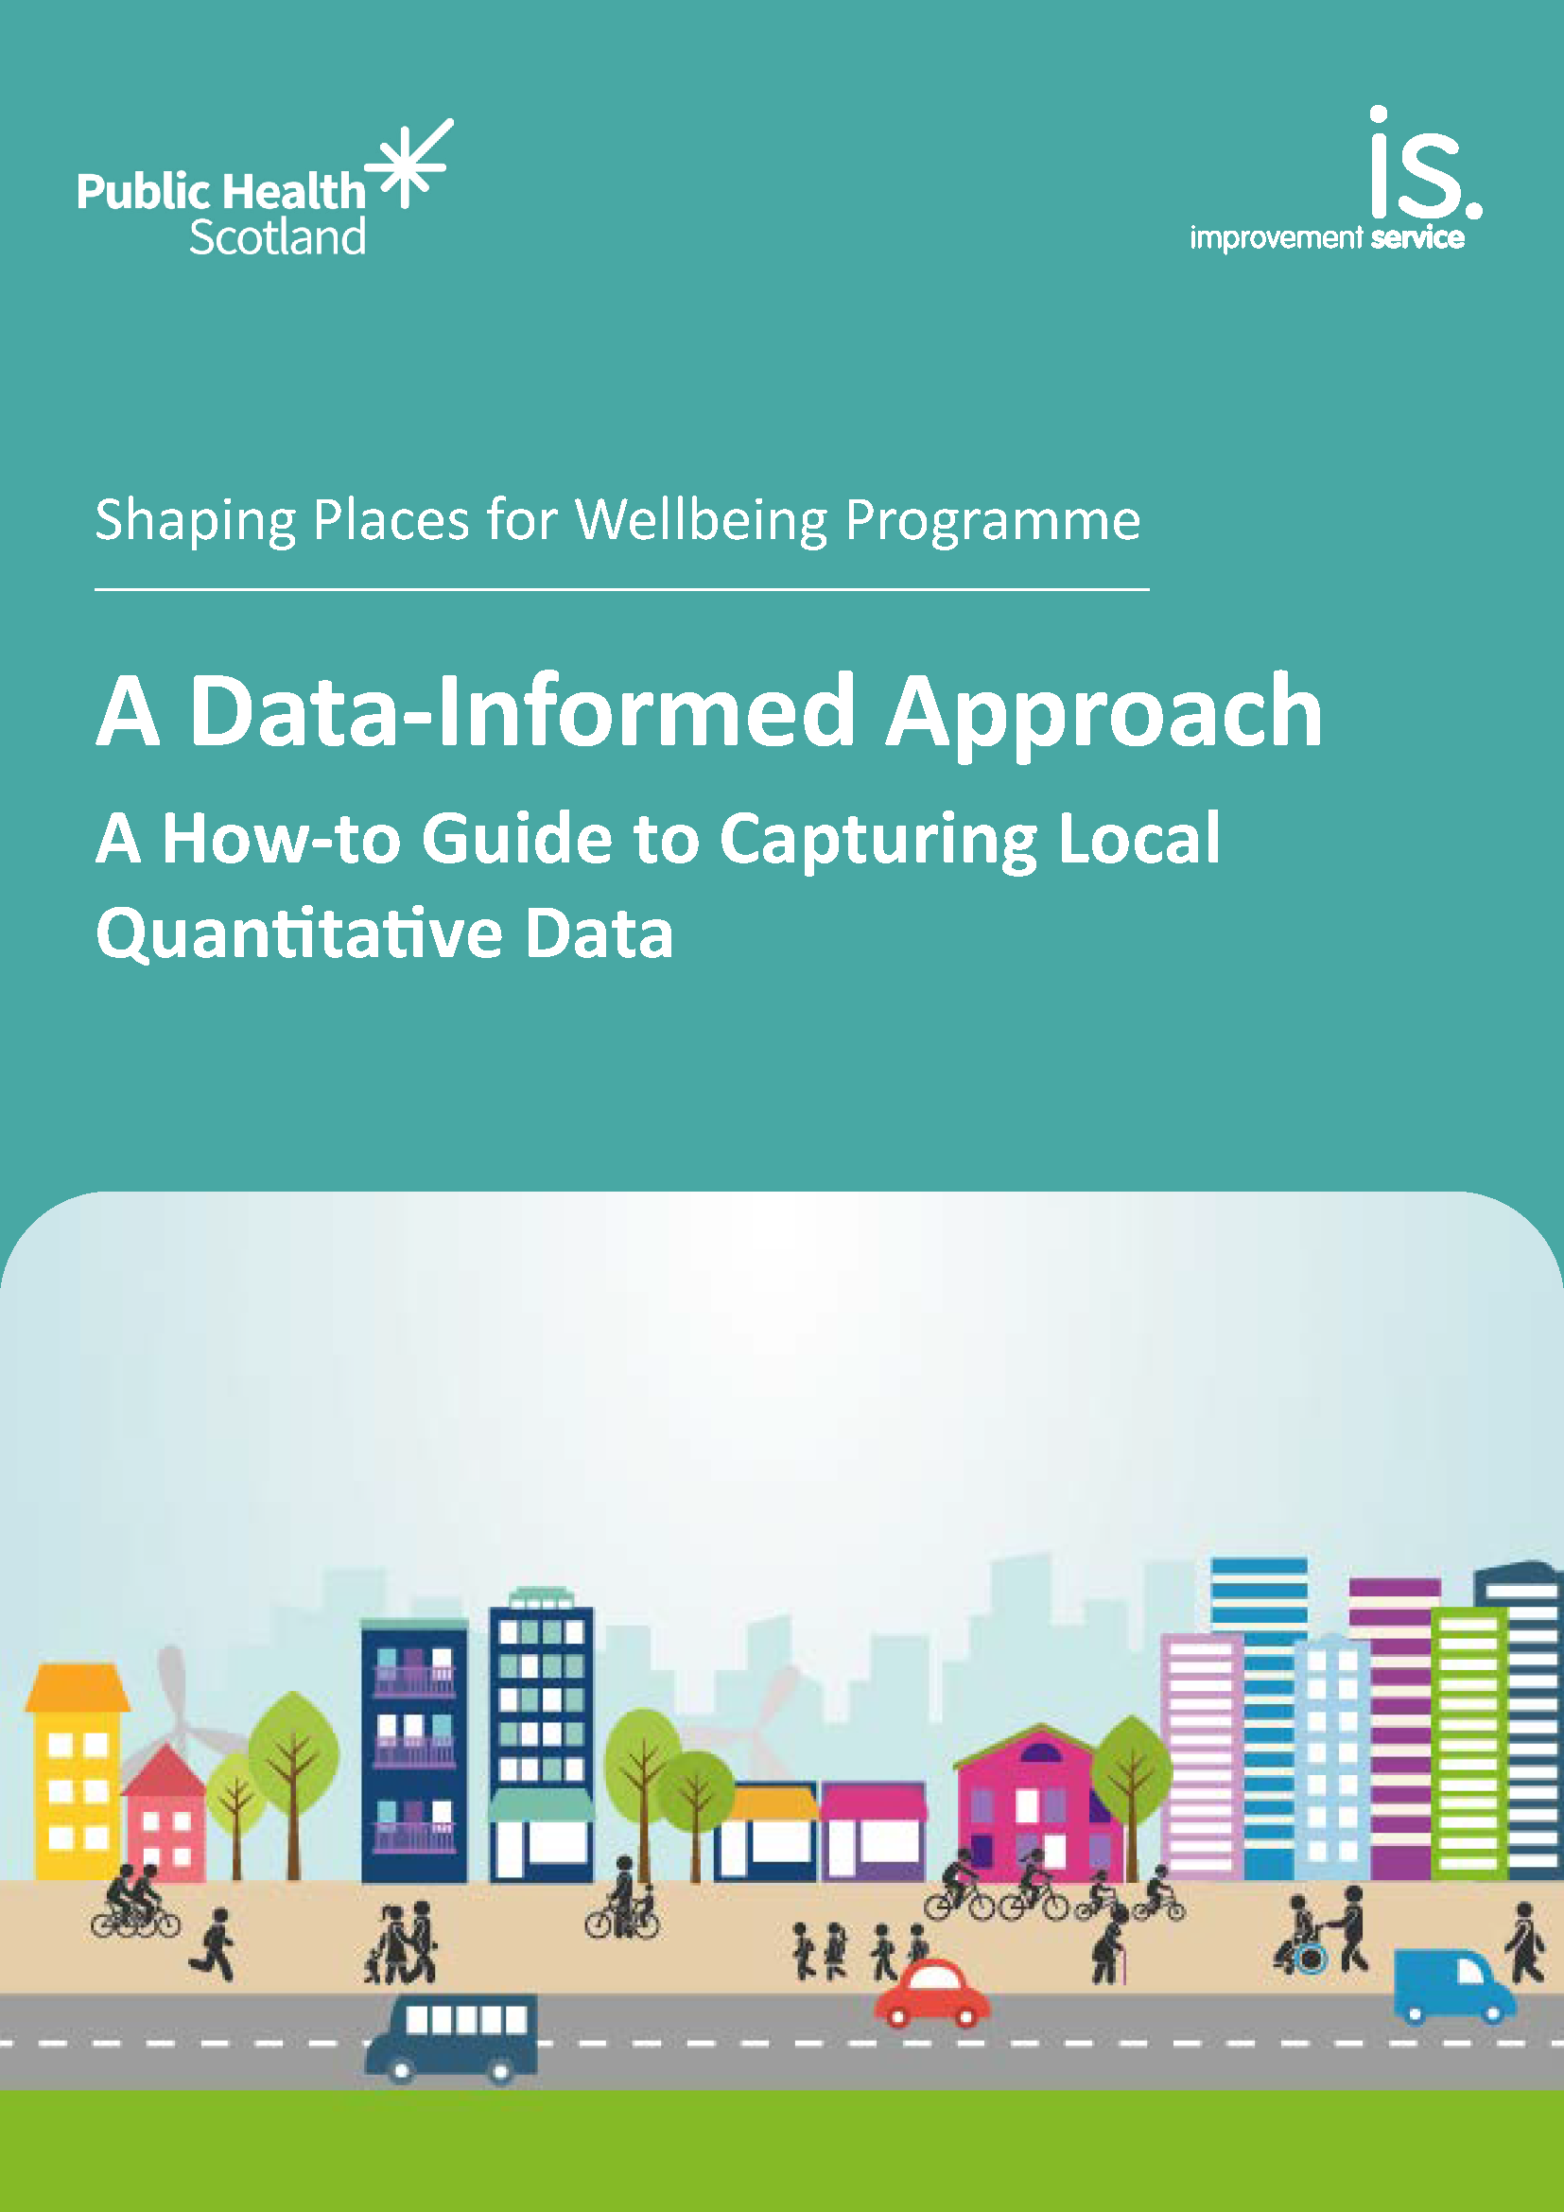
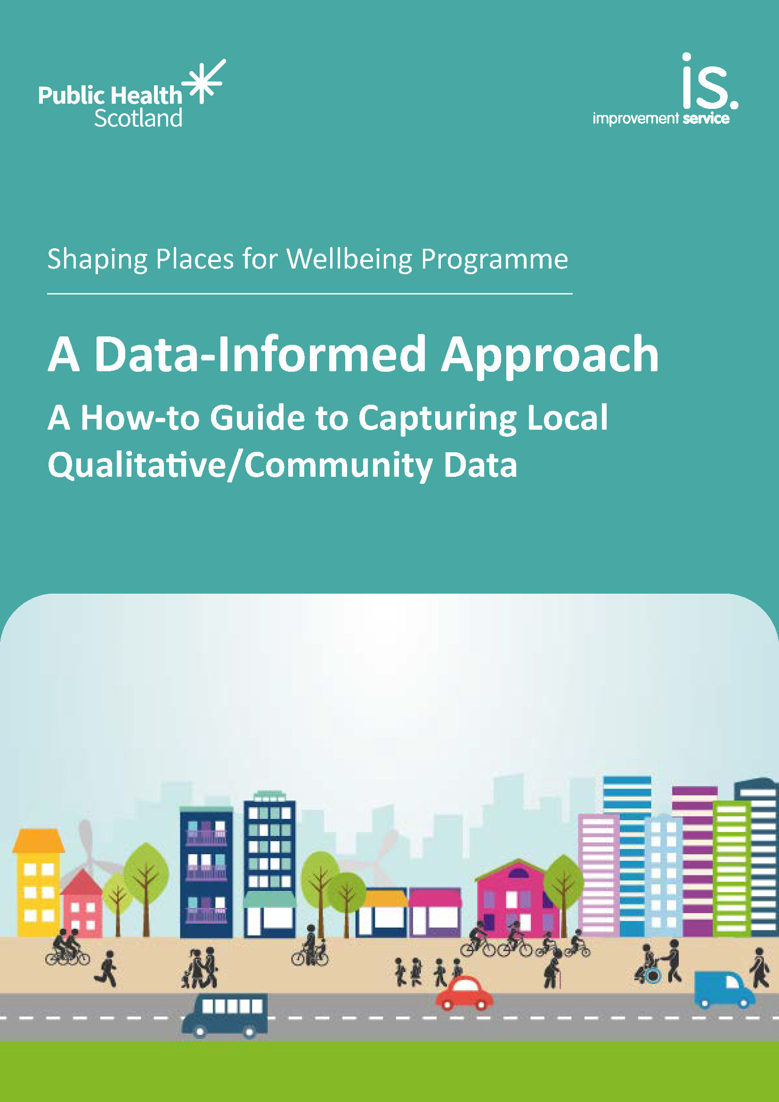
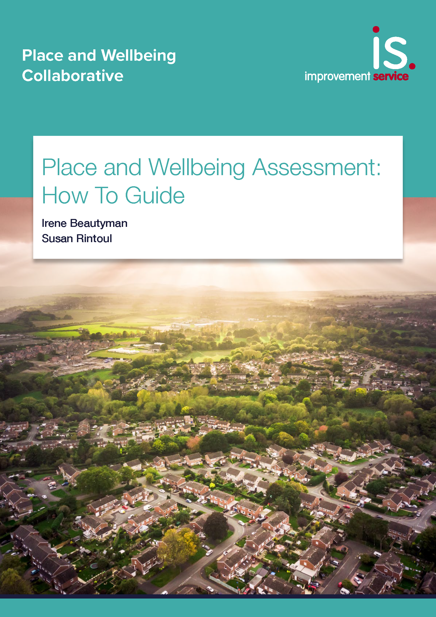
Sharing learning: output
'How to' guides
Producing quantitative data profiles
Producing qualitative data profiles
Place and Wellbeing Assessment guide

Slide 24
Data on inequality to shape more preventative decision making and its role in the Shaping Places for Wellbeing Programme
✔️ Masterclass 1
✔️ The why and how of data
✔️ Impact and support

Slide 25
“The data profile was just fantastic. It was just what we needed to allow us to make those decisions at a community planning level, to make physical changes to the geographical boundaries that we worked on and it allowed us to really have that data at our fingertips to say ‘this is why we’re making decisions to focus resources into certain areas.’ The data gave us license and the opportunity to do that in a strategic way.”.
Lesley Reid, Health Promotion Manager, NHS Ayrshire and Arran

Slide 26
Feedback on Qualitative Data
“ The report is insightful and powerful, and I think should be read (and acted upon) by anyone involved in delivering services to people in Alloa South and East in particular.
It is an excellent piece of work."
Grant Baxter, Planning & Building Standards Team Leader,
Clackmannan Council
Notes:
National plans this is fitting into – can them add another slide on the plans for your specific area

Slide 27
Decisions: Place and Wellbeing Assessments
Strategies, plans and proposals
How does the plan, policy or decision impact on each of the Place and Wellbeing Outcomes?
How does it impact on those population groups most impacted by inequalities?

Slide 28
Using the data - Place and Wellbeing Assessments
Using the data for supporting decision-making
Provides perspective on demographics who have most to gain from a reduction of inequality into the decision-making process.
Alloa Wellbeing Hub ​
location
West Dunbartonshire Health Social Care Partnership
Strategic Plan​
Argyll and Bute
Local Policing Plan
Fraserburgh Beach Front Masterplan
Dunoon Active Travel Hub plans
Ayr Local Housing Strategy ​
Argyll and Bute Economic Strategy
Clackmannanshire Local Outcome Improvement Plan
Burnhill
Neighbourhood Plan
Fraserburgh merging schools project
Clackmannanshire Interim Climate Change Strategy - 2023
Dalkeith Regeneration Development Framework
Central Dalkeith and Woodburn
Community Action Plan
Notes:
This data, evidence and insight all fed into place and wellbeing assessments
A Place and Wellbeing Assessment brings together a group of stakeholders to inform decision-making by identifying how a plan, policy or proposal will affect a place and its impact on the wellbeing of people and planet.
Range of plans at different scales and focus
Made recommendations for how organisations and services could work more closely together to deliver on the place and wellbeing outcomes and target action that benefits those impacted by inequality.

Slide 29
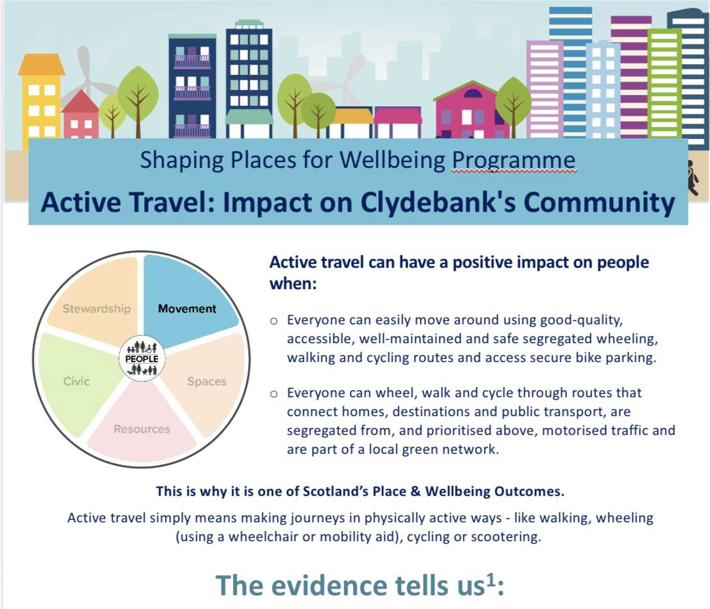
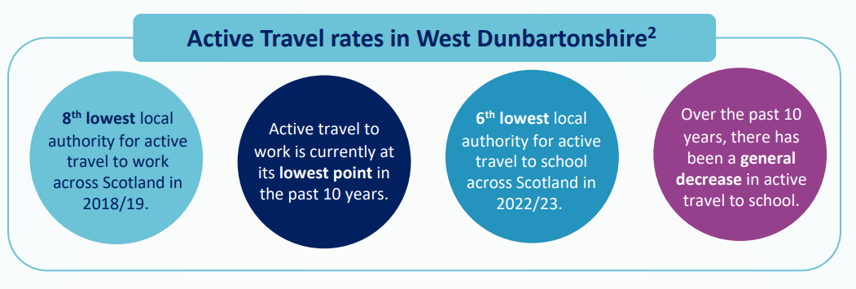
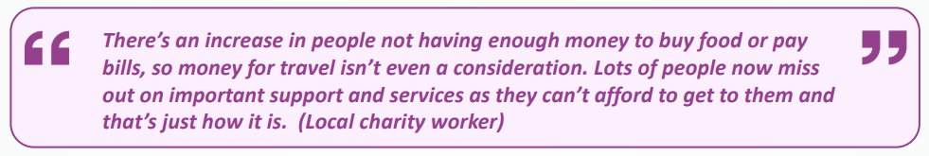
Place: what we need to get right in every place
Place and Wellbeing Outcome Briefings

Slide 30
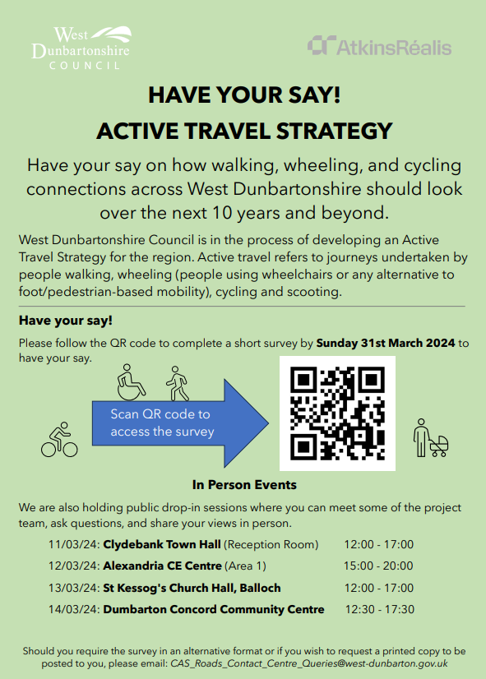
Decision making in Clydebank:
Use of Outcome Briefings
  Valuable starting point for Active Travel Discussion Group
  Contribution to West Dunbartonshire Active Travel Strategy
  Raised awareness of Movement theme, links to other outcomes and experiences of different population groups
  Funding applications, community engagement and plans
  Informing local funding priorities
  Increased understanding of link between people and place
  Briefings developed for other Project Towns

Slide 31
Shared learning

Slide 32
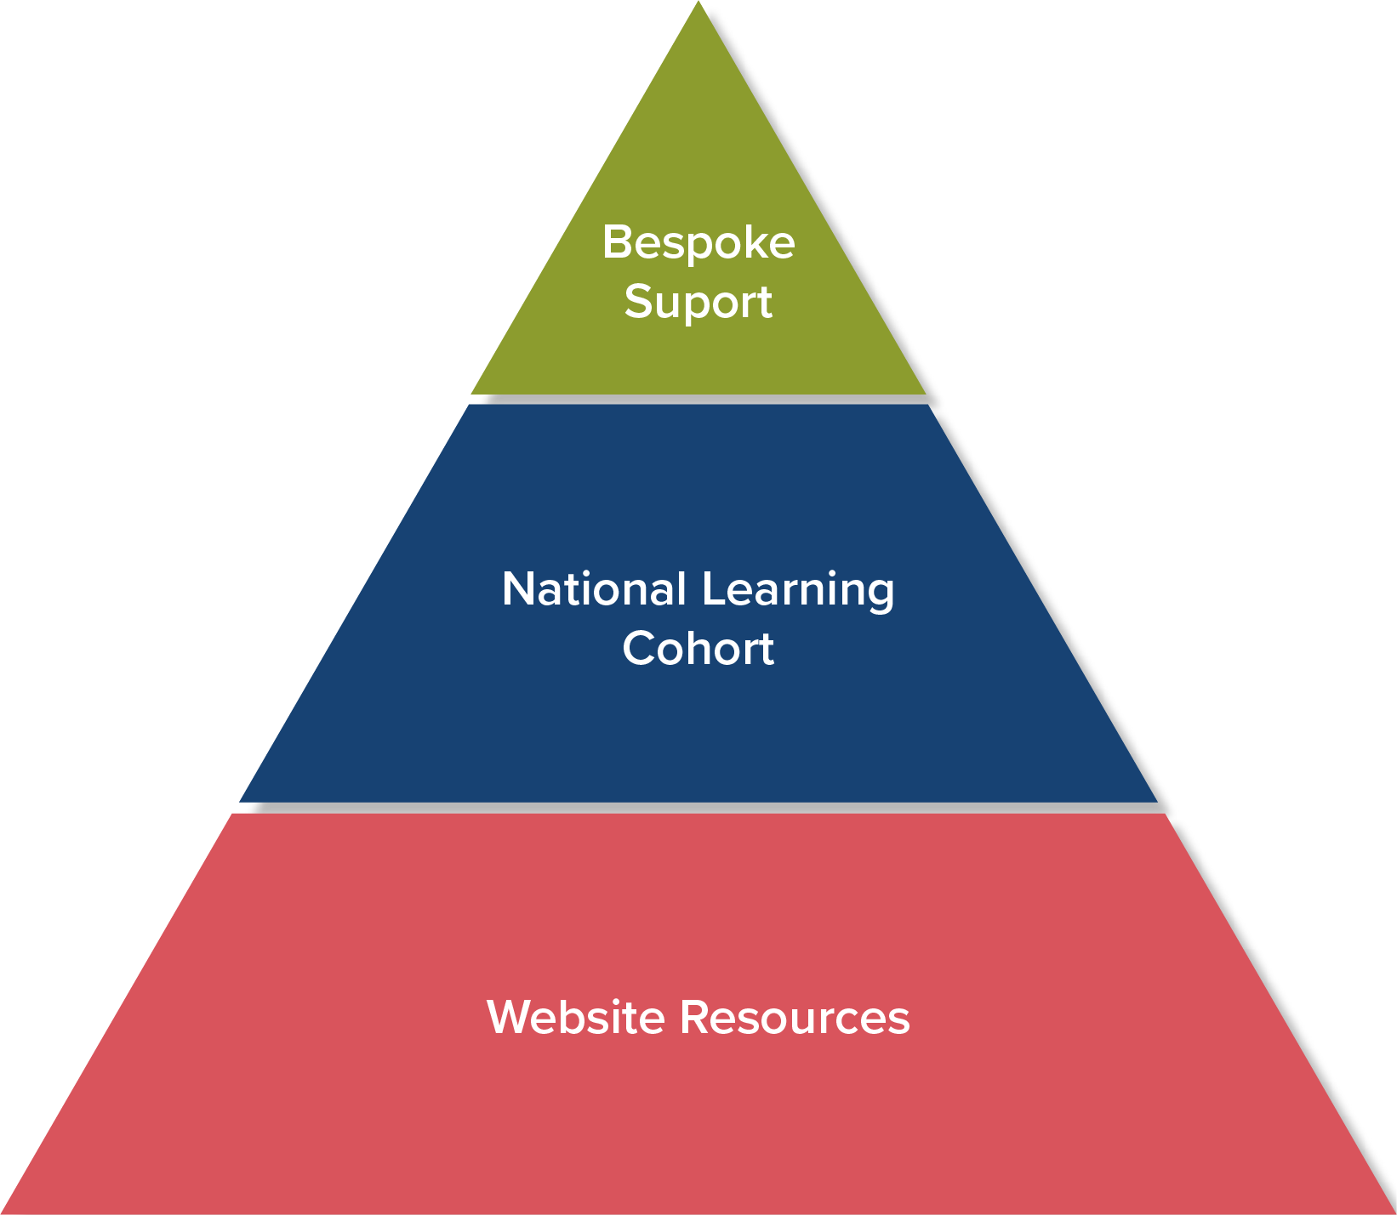
Shaping Places for Wellbeing Programme support sits at three levels

Slide 33
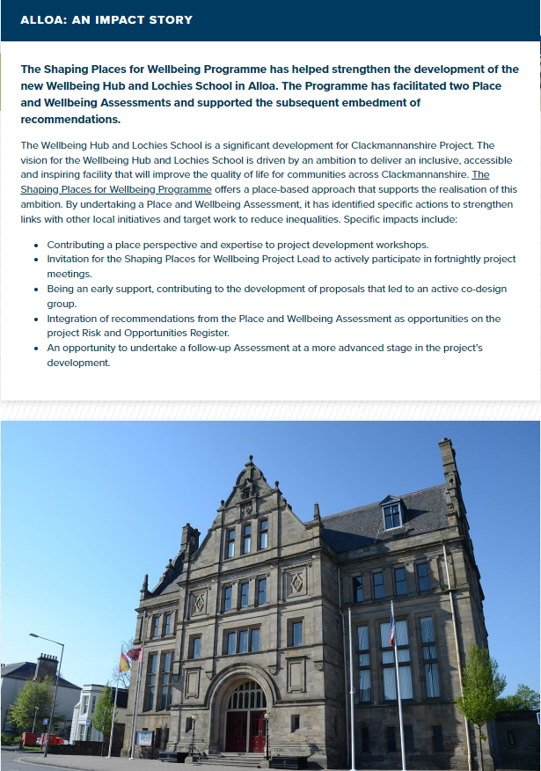
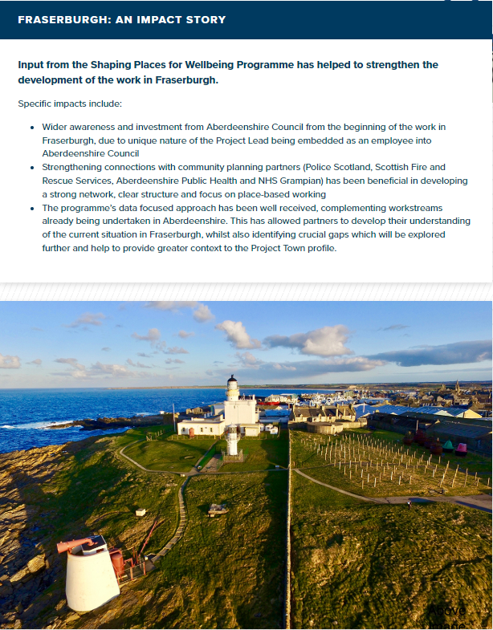
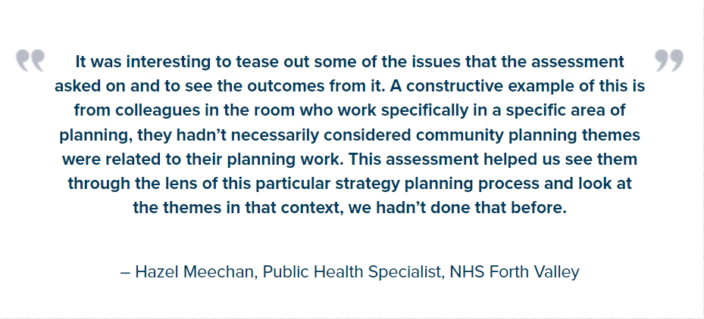
Shared Learning: Impact Stories
All the Project Town information and impact stories can be accessed here

Slide 34
Further Masterclass:
Decision making: Place and Wellbeing Assessments
Place based approaches in action

Slide 35
What next?
Expand and enhance access to quantitative data informing decisions across Scotland
Support capture of qualitative data on groups impacted by inequality with a toolkit of options
Challenges…

Slide 36
Quantitative data challenges
The limited amount of publicly available data to identify demographic detail on inequalities and on specific topics
Limitations for more sparsely populated areas
  Statistical disclosure and data sources not available below local authority level
Limited access to mental health and GP data

Slide 37
What can we all do?
Expand understanding of importance of both quantitative and qualitative data on INEQUALITY
- Share this masterclass
Embed consideration of data on inequality into strategies, plans and proposals
Use analysts – you have options
Take a place based approach to decision making

Slide 38
Find out more!
Webpage links and how to contact us
Place and Wellbeing Outcomes
Shaping Places for Wellbeing Programme
X (formerly Twitter) @Place4Wellbeing @PlaceNetworkSco @IreneBeautyman
Planning and Place Based Approaches LinkedIn
Email: placeandwellbeing@improvementservice.org.uk

Slide 39
Thank you for your time!
​

